Slide 1
CSCI 4430 - Spring 22
Tutorial 11

Slide 2
Routing
routing protocols
protocols used by routers to communicate info about the network
not the protocol inside data routed by routers
IGP | Distance vector | Link state
 | RIP, EIGRP | OSPF, ISIS
 | communicate with neighbors | broadcast in the entire network
 | collect distance and direction | build entire network topology
 | send entire routing table periodically | send triggered partial updates
 | converge faster | slower convergence
EGP | BGP

Slide 3
Q1 True/False
Link-State (LS) routing involves broadcasting its local knowledge of the network to everyone.
True; uses Dijkstra’s for computation (OSPF).
Conversely, Distance-Vector routing involves telling only neighbors about its global view.
True; uses Bellman-Ford for computation (RIP).
Both routing methods involve finding least-cost paths to all other nodes
True; allows easy metric to avoid loops.

Slide 4
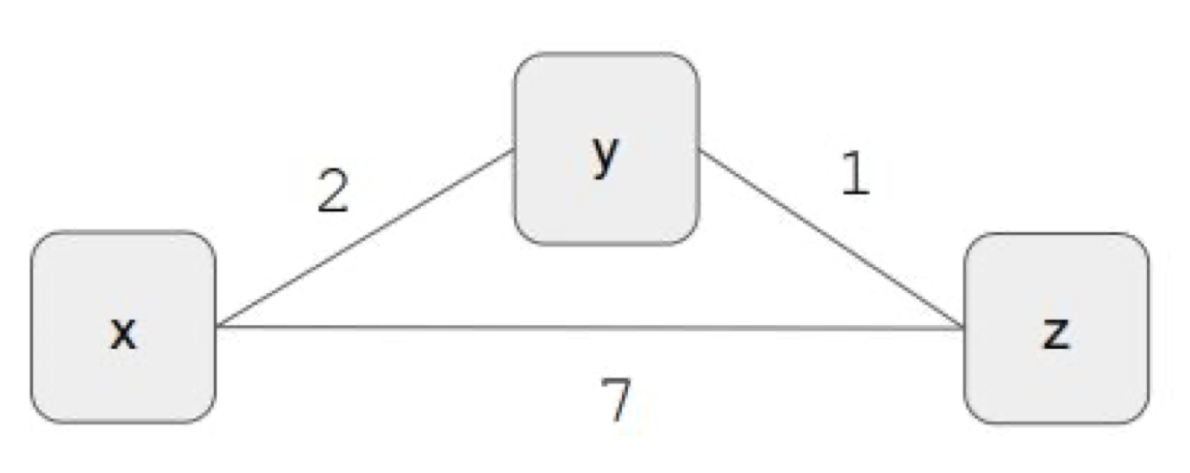
Q2 Distance-Vector Properties
True / False:
For DV routing, will the count-to-infinity problem occur if we decrease a link’s cost?
No. Loops aren’t caused by decreasing link cost
What about if we connect two previously unconnected nodes?
No. Loops potentially result from a removing a link
Count-to-infinity problem may occur when the cost of a link increases.

Slide 5
Q2 Distance-Vector Properties
To | Cost | Via
x | 2 | x
z | 1 | z
True / False:
For DV routing, will the count-to-infinity problem occur if we decrease a link’s cost?
No. Loops aren’t caused by decreasing link cost
What about if we connect two previously unconnected nodes?
No. Loops potentially result from a removing a link
Count-to-infinity problem may occur when the cost of a link increases.
cost of yz goes up to 6
6
To | Cost | Via
y | 2 | y
z | 3 | y
To | Cost | Via
x | 3 | y
y | 1 | y

Slide 6
Q2 Distance-Vector Properties
To | Cost | Via
x | 2 | x
z | ?
True / False:
For DV routing, will the count-to-infinity problem occur if we decrease a link’s cost?
No. Loops aren’t caused by decreasing link cost
What about if we connect two previously unconnected nodes?
No. Loops potentially result from a removing a link
Count-to-infinity problem may occur when the cost of a link increases.
y needs a new way to reach z, and saw x
6
To | Cost | Via
y | 2 | y
z | 3 | y
To | Cost | Via
x | 3 | y
y | 1 | y
Notes:
cost of yz changes to 6
y reconsider how to reach z
yz=6 however yxz=5 beacuse x.xz=3
z update yz=5
x saw yz updated to 5
x.xz=7 because y.yz=5
z update yz=5+2=7
y update yz=7+2=9
…

Slide 7
Q2 Distance-Vector Properties
To | Cost | Via
x | 2 | x
z | 5 | x
True / False:
For DV routing, will the count-to-infinity problem occur if we decrease a link’s cost?
No. Loops aren’t caused by decreasing link cost
What about if we connect two previously unconnected nodes?
No. Loops potentially result from a removing a link
Count-to-infinity problem may occur when the cost of a link increases.
z updated cost to z as 5, then notify x
6
To | Cost | Via
y | 2 | y
z | 3 | y
To | Cost | Via
x | 3 | y
y | 1 | y

Slide 8
Q2 Distance-Vector Properties
To | Cost | Via
x | 2 | x
z | 5 | x
True / False:
For DV routing, will the count-to-infinity problem occur if we decrease a link’s cost?
No. Loops aren’t caused by decreasing link cost
What about if we connect two previously unconnected nodes?
No. Loops potentially result from a removing a link
Count-to-infinity problem may occur when the cost of a link increases.
6
To | Cost | Via
y | 2 | y
z | 7 | y
To | Cost | Via
x | 3 | y
y | 1 | y
x update cost to z to 7, then notify y

Slide 9
Q2 Distance-Vector Properties
To | Cost | Via
x | 2 | x
z | 9 | x
True / False:
For DV routing, will the count-to-infinity problem occur if we decrease a link’s cost?
No. Loops aren’t caused by decreasing link cost
What about if we connect two previously unconnected nodes?
No. Loops potentially result from a removing a link
Count-to-infinity problem may occur when the cost of a link increases.
y update again to 9, nofity x…
problem core:
x only knows to reach z via y
6
To | Cost | Via
y | 2 | y
z | 7 | y
To | Cost | Via
x | 3 | y
y | 1 | y

Slide 10
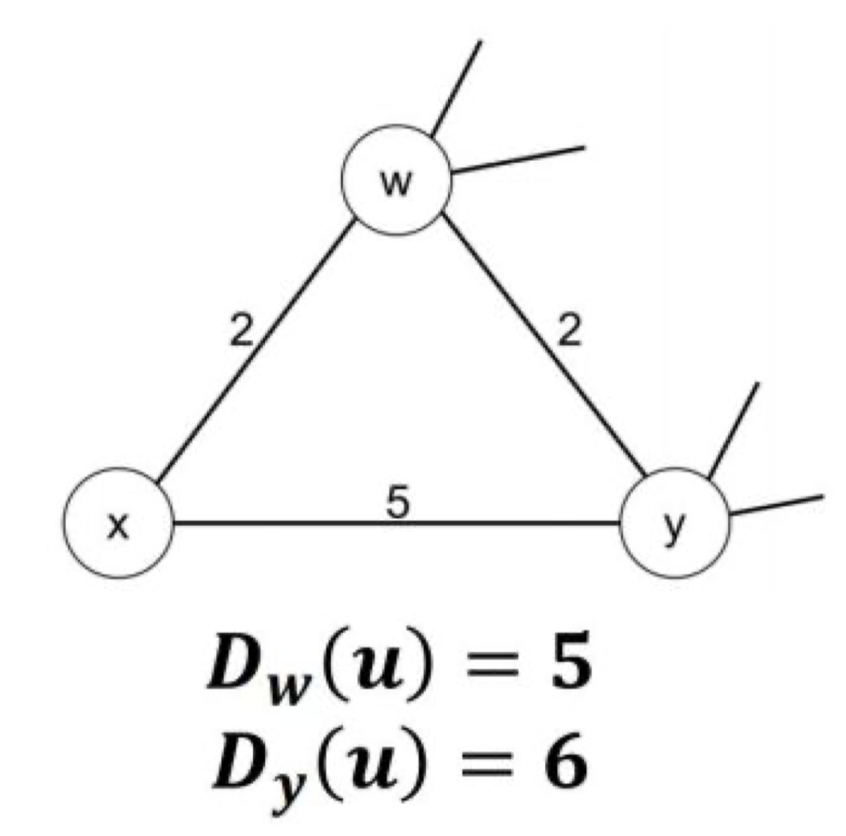
Q3 Distance-Vector Situations
Consider this network fragment:
w’s least-cost path to u (not shown) of 5
y has least cost path to u of 6
Complete paths from w and y to u not shown
All links have strictly positive costs
What is x’s distance vector for w, y, and u?
Dx(w) = 2
Dx(y) = 4 x -> w -> y
Dx(u) = 7 x -> w -> … -> u

Slide 11
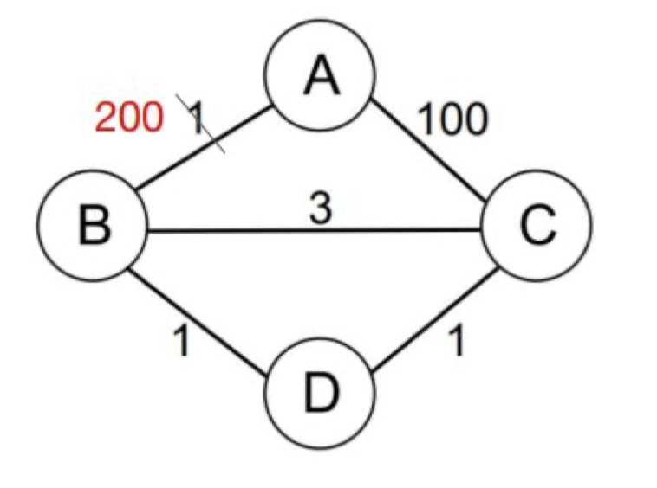
Q4 Poisoned Reverse
Consider this networkfragment Assume thefollowing events:
DV is used withpoisoned reverse
Routing state hasstabilized
c(A, B) goes from 1 to200 very suddenly
Will count to infinityoccur?
No.
In general, if x goes to z through y, then x will tell y the cost from x to z is infinity.
Reversed route is blocked here. This fixes Q2.

Slide 12
Q4 Poisoned Reverse
Initial distance vector state
 | A | B | C | D
A | 0 | 1(B) | inf | inf
B | 1(A) | 0 | 2(D) | 1(D)
C | inf | 2(D) | 0 | 1(D)
D | inf | 1(B) | 1(C) | 0
 | A | B | C | D
A | 0 | 1 | inf | 2(B)
B | 1(A) | 0 | inf | 1(D)
C | inf | inf | 0 | 1(D)
D | 2(B) | 1(B) | 1(C) | 0
B’s view
D’s view
path: ABDC

Slide 13
Q4 Poisoned Reverse
after B saw the new cost of path B->A
 | A | B | C | D
A | 0 | 1(B) | inf | inf
B | 200 | 0 | 2(D) | 1(D)
C | inf | 2(D) | 0 | 1(D)
D | inf | 1(B) | 1(C) | 0
 | A | B | C | D
A | 0 | 1 | inf | 2(B)
B | 1(A) | 0 | inf | 1(D)
C | inf | inf | 0 | 1(D)
D | 2(B) | 1(B) | 1(C) | 0
B’s view
D’s view

Slide 14
Q4 Poisoned Reverse
some moment after B saw the new cost
some momentCD saw B’s change notification to A might still ongoing
 | A | B | C | D
A | 0 | 1(B) | inf | inf
B | 200 | 0 | 2(D) | 1(D)
C | inf | 2(D) | 0 | 1(D)
D | inf | 1(B) | 1(C) | 0
 | A | B | C | D
A | 0 | 1 | inf | 2(B)
B | 200 | 0 | inf | 1(D)
C | 100 | inf | 0 | 1(D)
D | 101 | 1(B) | 1(C) | 0
B’s view
D’s view

Slide 15
Q4 Poisoned Reverse
the final image
 | A | B | C | D
A | 0 | 102 | 100 | 101
B | 102 | 0 | 2(D) | 1(D)
C | 100 | 2(D) | 0 | 1(D)
D | 101 | 1(B) | 1(C) | 0
 | A | B | C | D
A | 0 | inf | 100 | 101
B | inf | 0 | inf | 1(D)
C | 100 | inf | 0 | 1(D)
D | 101 | 1(B) | 1(C) | 0
B’s view
D’s view

Slide 16
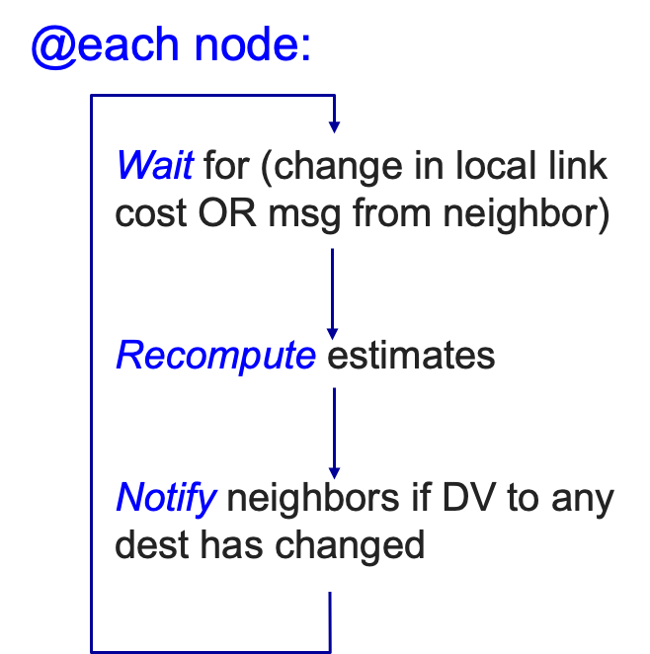
Distance-Vector routing summary
AS/Domain
a region of network under the same admistrative entity
bellman-ford equation
let d_{x}(y) := cost of least-cost path from x to y c(x, v) := cost to neighbor v
then d_{x}(y) = min_{v} {c(x, v) + d_{v}(y) } min over all neighbors v of x
posioned reverse
If y routes to z through x, y advertises to x that its cost to z is infinite
x never decides to route to z through y (reverse route is blocked here)

