Slide 1
CSCI4430 Computer Networks Lecture 16: Link Layer – Ethernet
Hong Xu, Henry
CSE@CUHK, 2023
Material with thanks to Patrick Lee, Mosharaf Chowdhury, Aditya Akella, Sugih Jamin, Philip Levis, Sylvia Ratnasamy, Peter Steenkiste, and many other colleagues.

Slide 2
Data link layer
Present everywhere
Transfers data between adjacent nodes or between nodes on the same local area network
Application
Application
Transport
Transport
Network
Network
Network
Datalink
Datalink
Datalink
Physical
Physical
Physical
End system
Switch
End system

Slide 3
Data link layer
Provides four primary services
Framing
Encapsulates network layer data
Link access
Medium access control (MAC) protocol defines when to transmit frames
Reliable delivery
Primarily for mediums with high error rates (e.g., wireless)
Error detection or correction

Slide 4
Packets are now “frames”
data
sending
node
link layer protocol
receiving
node
frame
frame
network
adaptor
network
adaptor
Frames encapsulate network layer packets
Link layer protocols are implemented in h/w
Frame formats can change based on link layer protocol

Slide 5
Point-to-point vs. broadcast medium
Point-to-point: dedicated pairwise communication
E.g., long-distance fiber link
E.g., Point-to-point link b/n Ethernet switch and host
Broadcast: shared wire or medium
Traditional Ethernet (pre ~2000)
802.11 wireless LAN

Slide 6
Multiple access algorithm
Context: a shared broadcast channel
Must avoid having multiple nodes speaking at once
Otherwise, collisions lead to garbled data
Need distributed algorithm to determine which node can transmit
Three classes of techniques
Channel partitioning: divide channel into pieces
Taking turns: scheme for deciding who transmits
Random access: allow collisions, and then recover
More in the Internet style!

Slide 7
Random access MAC protocols
When node has packets to send
Transmit at full channel data rate w/o coordination
Two or more transmitting nodes ⇒ collision
Data lost
Random access MAC protocol specifies
How to detect and recover from collisions
Examples
ALOHA and Slotted ALOHA
CSMA, CSMA/CD, CSMA/CA (wireless)

Slide 8
Ethernet
Invented as a broadcast technology
Hosts share channel
Each packet received by all attached hosts
CSMA/CD for media access control
Modern Ethernets are “switched” (later)
Point-to-point links between switches and between a host and switch
No sharing ⇒ no CSMA/CD
Uses “self learning” and “spanning tree” algorithms for routing

Slide 9
CSMA
CSMA: Carrier sense multiple access
CSMA: listen before transmit
If channel is sensed idle: transmit entire frame
If channel is sensed busy: defer transmission
Human analogy: don’t interrupt others!
Does not eliminate collisions
Why?

Slide 10
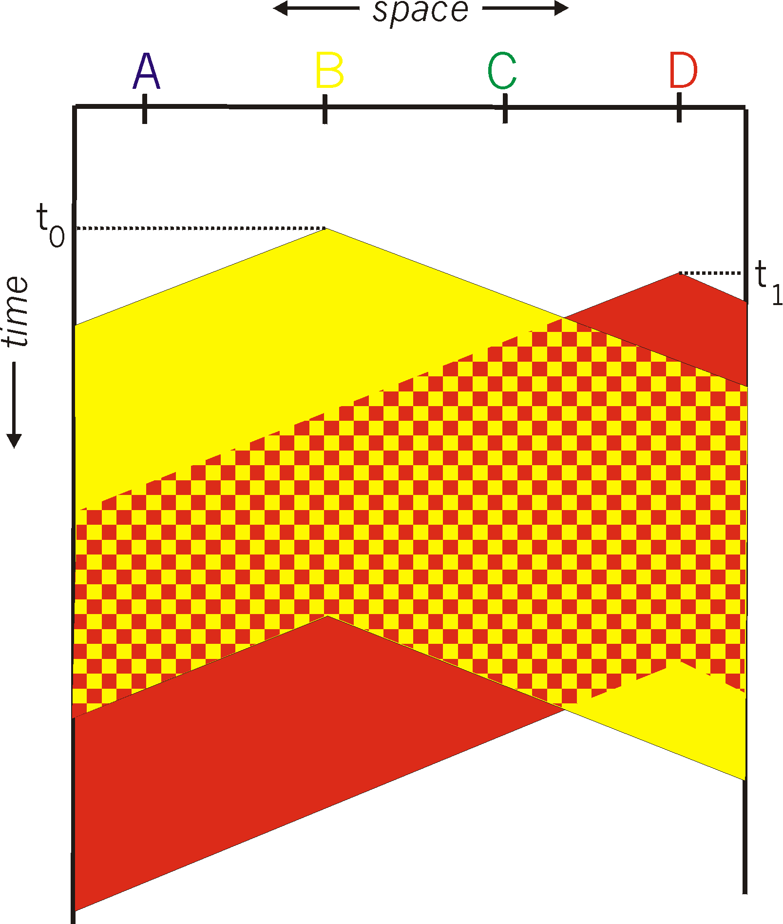

CSMA collisions
Propagation delay: two nodes may not hear each other before sending
CSMA reduces but does not eliminate collisions
Collision: entire packet transmission time wasted
Distance and propagation delay affect collision probability
Spatial layout of nodes

Slide 11
CSMA/CD (Collision Detection)
CSMA/CD: carrier sensing, deferral as in CSMA
Collisions detected within short time
Colliding transmissions aborted, reducing wastage
Collision detection easy in wired (broadcast) LANs
Compare transmitted, received signals
Collision detection difficult in wireless LANs
Notes:
wireless: because reception while tx is difficult . broadcast isn’t perfect so collisions local

Slide 12
Three key ideas of random access
Carrier sense
Listen before speaking and don’t interrupt
Checking if someone else is already sending data
… and waiting till the other node is done
Collision detection
If someone else starts talking at the same time, stop
Make sure everyone knows there was a collision!
Realizing when two nodes are transmitting at once
…by detecting that the data on the wire is garbled

Slide 13
Three key ideas of random access
Randomness
Don’t start talking again right away
Waiting for a random time before trying again

Slide 14
How long should you wait?
Should it be immediate?
Should it be a random number with a fixed distribution?

Slide 15
Ethernet: CSMA/CD Protocol
Carrier sense: wait for link to be idle
Collision detection: listen while transmitting
No collision: transmission is complete
Collision: abort transmission & send jam signal
Random access: binary exponential back-off
After collision, wait a random time before retrying
After m^{th} collision, choose K randomly from {0, …, 2^{m}-1}
Wait for K*512 bit times before trying again
If transmission occurring when ready to send, wait until end of transmission (CSMA)

Slide 16
Switched Ethernet

Slide 17
Broadcast vs. switched Ethernet
Invented as a broadcast technology
Hosts share channel
Each packet received by all attached hosts
CSMA/CD for media access control
Modern Ethernets are “switched”
Point-to-point links between switches and between a host and switch
No sharing ⇒ no CSMA/CD
Uses “self learning” and “spanning tree” algorithms for routing

Slide 18

Why switched Ethernet?
Enables concurrent communication
Host A can talk to C, while B talks to D
No collisions and no need for CSMA/CD
No constraints on link lengths, etc.
B
A
C
Ethernet switch
D

Slide 19
The evolution of Ethernet
Changed almost everything except the frame format
From 3 Mbit/s to 100 Gbit/s
From electrical signaling to optical
Lesson: the right interface can accommodate many changes
Evolve the implementation while maintaining the interface (backward compatibility)

Slide 20
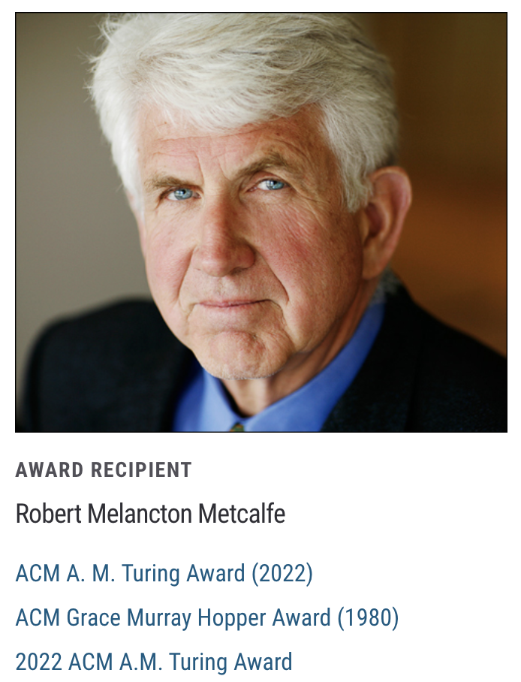
Turing Award 2022
ACM named Robert Metcalfe receipt of the 2022 Turing Award for “leading the invention, standardization, and commercialization of Ethernet local-area networking technology”
https://awards.acm.org/award-recipients/metcalfe_3968158

Slide 21
Topics
Frames and framing
Addressing
Routing
Forwarding
Discovery

Slide 22
Ethernet “Frames”
Encapsulates IP datagram
Preamble: 7 bytes for clock synchronization and 1 byte to indicate start of frame
Addresses: 6 bytes
Type: 2 bytes, higher-layer protocol (e.g., IP)
Data payload: max 1500 bytes, min 46 bytes
CRC: 4 bytes for error detection
Preamble
Dst Address
Source Address
Data
CRC
type

Slide 23
Topics
Frames and framing
Addressing
Routing
Forwarding
Discovery

Slide 24
Medium Access Control (MAC) Address
MAC address
Numerical address associated with a network adapter
Flat name space of 48 bits (e.g., 00-15-C5-49-04-A9 in HEX)
Unique, hard-coded in the adapter when it is built
Hierarchical Allocation
Blocks: assigned to vendors (e.g., Intel) by the IEEE
First 24 bits (e.g., 00-15-C5-**-**-**)
Adapter: assigned by the vendor from its block
Last 24 bits

Slide 25
MAC address vs. IP address
MAC Addresses
IP Addresses
Hard-coded when adapter is built
Flat name space of 48 bits (e.g., 00-0E-9B-6E-49-76)
Like a HK ID
Portable, and can stay the same as the host moves
Used to get packet between interfaces on same network
Configured, or learned dynamically
Hierarchical name space of 32 bits (e.g., 12.178.66.9)
Like a postal mailing address
Not portable, and depends on where the host is attached
Used to get a packet to destination IP subnet

Slide 26
Topics
Frames and framing
Addressing
Routing
Forwarding
Discovery

Slide 27
“Routing” with broadcast Ethernet
A_{MAC}
B_{MAC}
C_{MAC}
D_{MAC}
E_{MAC}
F_{MAC}
Sender transmits frame onto broadcast link
Each receiver’s link layer passes the frame to the network layer:
If destination address matches the receiver’s MAC address OR if the destination address is the broadcast MAC address (ff:ff:ff:ff:ff:ff)

Slide 28
“Routing” with broadcast Ethernet
A_{MAC}
B_{MAC}
C_{MAC}
D_{MAC}
E_{MAC}
F_{MAC}
Ethernet is “plug-n-play”
A new host plugs into the Ethernet and is good to go
No configuration by users or network operators
Broadcast as a means of bootstrapping communication

Slide 29
Why does Ethernet not use LS/DV?
Concerns over scalability
Flat MAC addresses cannot be aggregated like IP addresses
Legacy
Backward compatibility with broadcast Ethernet
Desire to maintain Ethernet’s plug-n-play behavior
How broadcast Ethernet evolved

Slide 30
Routing in extended LANs
Local-Area Network (LAN)
Bridges relay broadcasts from one LAN to the other

Slide 31
Easiest way to avoid loops
Use a topology where loops are impossible!
Take an arbitrary topology and build a spanning tree
Sub-graph that includes all vertices but contains no cycles
Links not in the spanning tree are not used to forward frames

Slide 32
Consider a graph

Slide 33
A spanning tree

Slide 34
Another spanning tree

Slide 35
Yet another spanning tree

Slide 36
Spanning tree protocol (Perlman’85)
Protocol by which bridges construct a spanning tree
Nice properties
Zero configuration (by operators or users)
Self healing
Still used today

Slide 37
Routing with switched Ethernet?
A_{MAC}
B_{MAC}
C_{MAC}
F_{MAC}
D_{MAC}
E_{MAC}

Slide 38
Flooding on spanning tree

Slide 39
Switched Ethernet
Use the same STP; flooding on the tree
Constraints (for backward compatibility)
No changes to end-hosts
Maintain plug-n-play aspect
Earlier Ethernet achieved plug-n-play by leveraging a broadcast medium
We could do the same in a switched topology
But can we do better?

Slide 40
Ethernet topics
Frames and framing
Addressing
Routing
Forwarding
Discovery

Slide 41
But isn’t flooding wasteful?
Yes, but we can use it to bootstrap more efficient forwarding
Idea: watch the packets going by, and learn from them
If node A sees a packet from node B come in on a particular port, it knows what port to use to reach B!
Works because there is only one path to B

Slide 42
Nodes can “learn” routes
Switch learns how to reach nodes by remembering where flooding packets came from
If flood packet from Node A entered switch on port 4, then switch uses port 4 to send to Node A

Slide 43
General approach
Flood first packet to node you are trying to reach
All switches learn where you are
When destination responds, some switches learn where it is…
Only some switches, because packet to you follows direct path, and is not flooded

Slide 44
Learning from flood packets
Node A can be reached
through this port
Node A can be reached
through this port
Node B
Node A
Once a node has sent a flood message, all other switches know how to reach it….

Slide 45
Node B responds
Node B can be reached
through this port
Node B can be reached
through this port
Node B can be reached
through this port
Node B can be reached
through this port
Node B
Node A
When a node responds, some of the switches learn where it is

Slide 46
Ethernet switches are “self learning”
When a packet arrives:
Inspect source MAC address, associate with incoming port
Store mapping in the switch table
Use time-to-live field to eventually forget mapping
Packet tells switch how to reach A.
B
A
C
D

Slide 47
Contrast
IP
Ethernet
Packets forwarded on all available links
Addresses can be aggregated
Routing protocol computes loop-free paths
Forwarding table computed by routing protocol
Packets forwarded on subset of links (spanning tree)
Flat addresses
“Routing” protocol computes loop-free topology
Forwarding table derived from data packets(+ spanning tree for floods)

Slide 48
Strengths of Ethernet’s approach
Plug-n-Play: zero-configuration / self-*
Simple
Cheap

Slide 49
Weaknesses of Ethernet’s approach
Much of the network bandwidth goes unused
Forwarding is only over the spanning tree
Delay in reestablishing spanning tree
Network is “down” until spanning tree rebuilt
Rebuilt spanning tree may be quite different
Slow to react to host movement
Entries must time out
Poor predictability
Location of root and traffic pattern determines forwarding efficiency

Slide 50
Link layer topics
Frames and framing
Addressing
Routing
Forwarding
Discovery and bootstrapping

Slide 51
Discovery
A host is “born” knowing only its MAC address
Must discover lots of information before it can communicate with a remote host B
What is my IP address?
What is B’s IP address? (remote)
What is B’s MAC address? (if B is local)
What is my first-hop router’s address? (if B is not local)
…

Slide 52
ARP and DHCP
Link layer discovery protocols
ARP → Address Resolution Protocol
DHCP → Dynamic Host Configuration Protocol
Confined to a single local-area network (LAN)
Rely on broadcast capability
Hosts
Router

Slide 53
ARP and DHCP
Link layer discovery protocols
Serve two functions
Discovery of local end-hosts
Bootstrap communication with remote hosts
What’s my IP address?
Who/where is my local DNS server?
Who/where is my first hop router?

Slide 54
DHCP
Dynamic Host Configuration Protocol
Defined in RFC 2131
A host uses DHCP to discover
Its own IP address
Its netmask
IP address(es) for its local DNS name server(s)
IP address(es) for its first-hop “default” router(s)

Slide 55
DHCP: Operation
One or more local DHCP servers maintain required information
IP address pool, netmask, DNS servers, etc.
Application that listens on UDP port 67

Slide 56
DHCP: Operation
One or more local DHCP servers maintain required information
Client broadcasts a DHCP discovery message
L2 broadcast, to MAC address FF:FF:FF:FF:FF:FF

Slide 57
DHCP: Operation
One or more local DHCP servers maintain required information
Client broadcasts a DHCP discovery message
One or more DHCP servers responds with a DHCP “offer” message
Proposed IP address for client, lease time
Other parameters

Slide 58
DHCP: Operation
One or more local DHCP servers maintain required information
Client broadcasts a DHCP discovery message
One or more DHCP servers responds with a DHCP “offer” message
Client broadcasts a DHCP request message
Specifies which offer it wants
Echoes accepted parameters
Other DHCP servers learn they were not chosen

Slide 59
DHCP: Operation
One or more local DHCP servers maintain required information
Client broadcasts a DHCP discovery message
One or more DHCP servers responds with a DHCP “offer” message
Client broadcasts a DHCP request message
Selected DHCP server responds with an ACK

Slide 60
DHCP: Operation
One or more local DHCP servers maintain required information
Client broadcasts a DHCP discovery message
One or more DHCP servers responds with a DHCP “offer” message
Client broadcasts a DHCP request message
Selected DHCP server responds with an ACK
DHCP “relay agents” used when the DHCP server is not on the same broadcast domain

Slide 61
DHCP uses “soft state”
Soft state: if not refreshed, state is forgotten
Hard state: allocation/revocation is deliberate
Implementation:
Address allocations have a lease period
Server sets a timer for each allocation
Client must request a refresh before lease expires
Server resets timer when a refresh arrives and ACKs
OR reclaims allocated address when timer expires
Simple, yet robust under failure

Slide 62
Are we there yet?
DHCP Server
DNS Server
Host
Host
Host
Host
What I learnt from DHCP
my IP: 1.2.3.48
netmask: 1.2.3.0/24 (255.255.255.0)
Local DNS: 1.2.3.156
router: 1.2.3.19
Router

Slide 63
Sending packets over link Layer
1.2.3.48
1.2.3.156
Host
Host
Host
Host
DNS
IP packet
90-E2-A1-09-66-1B
58-23-D7-FA-20-B0
1.2.3.53
1.2.3.156
Router
Link layer only understands MAC addresses
Translate the destination IP address to MAC address
Encapsulate the IP packet in a link-level (Ethernet) frame

Slide 64
ARP: Address Resolution Protocol
Every host maintains an ARP table
List of (IP address → MAC address) pairs
Consult the table when sending a packet
Map dest. IP address to dest. MAC address
Encapsulate (IP) data packet with MAC header; xmit
What if IP address not in the table?
Sender broadcasts: Who has IP address 1.2.3.156?
Receiver replies: MAC address 58-23-D7-FA-20-B0
Sender caches result in its ARP table

Slide 65
What if the destination is remote?
Look up the MAC address of the first hop router
1.2.3.48 uses ARP to find MAC address for first-hop router 1.2.3.19 rather than ultimate destination IP address
How does the red host know the destination is not local?
Uses netmask (discovered via DHCP)
How does the red host know about 1.2.3.19?
Also DHCP
1.2.3.0/24 (255.255.255.0)
1.2.3.48
1.2.3.156
5.6.7.0/24
host
host
...
DNS
host
host
...
host
1.2.3.19
router
router
router

Slide 66
Key ideas in both ARP and DHCP
Broadcasting: Can use broadcast to make contact
Scalable because of limited size
Caching: remember the past for a while
Store the information you learn to reduce overhead
Soft state: eventually forget the past
Associate a time-to-live field with the information
… and either refresh or discard the information
Key for robustness in the face of unpredictable change

Slide 67
ID resolution in the networking stack
Layer | Examples | Structure | Configuration | Resolution Service
App. Layer | cse.umich.edu | Organizational hierarchy | ~ manual
Network Layer | 123.45.6.78 | topological hierarchy | DHCP
Link layer | 45-CC-4E-12-F0-97 | vendor (flat) | hard-coded
DNS
ARP

Slide 68
Discovery mechanisms
We have seen two approaches
Broadcast (ARP, DHCP)
Flooding does not scale
No centralized point of failure
Zero configuration
Directory service (DNS)
No flooding = scalable
Root of the directory is vulnerable (caching is key)
Needs configuration to bootstrap (local, root servers, etc.)

Slide 69
Summary
Data link layer transfers data between adjacent nodes or nodes connected to the same switch
Ethernet evolved from a broadcast medium to switched
Spanning tree enables Ethernet to efficiently flood a network to learn routes while forwarding packets
DHCP and ARP form the discovery backplane of networking and make everything work together

Slide 70
Additional slides

Slide 71
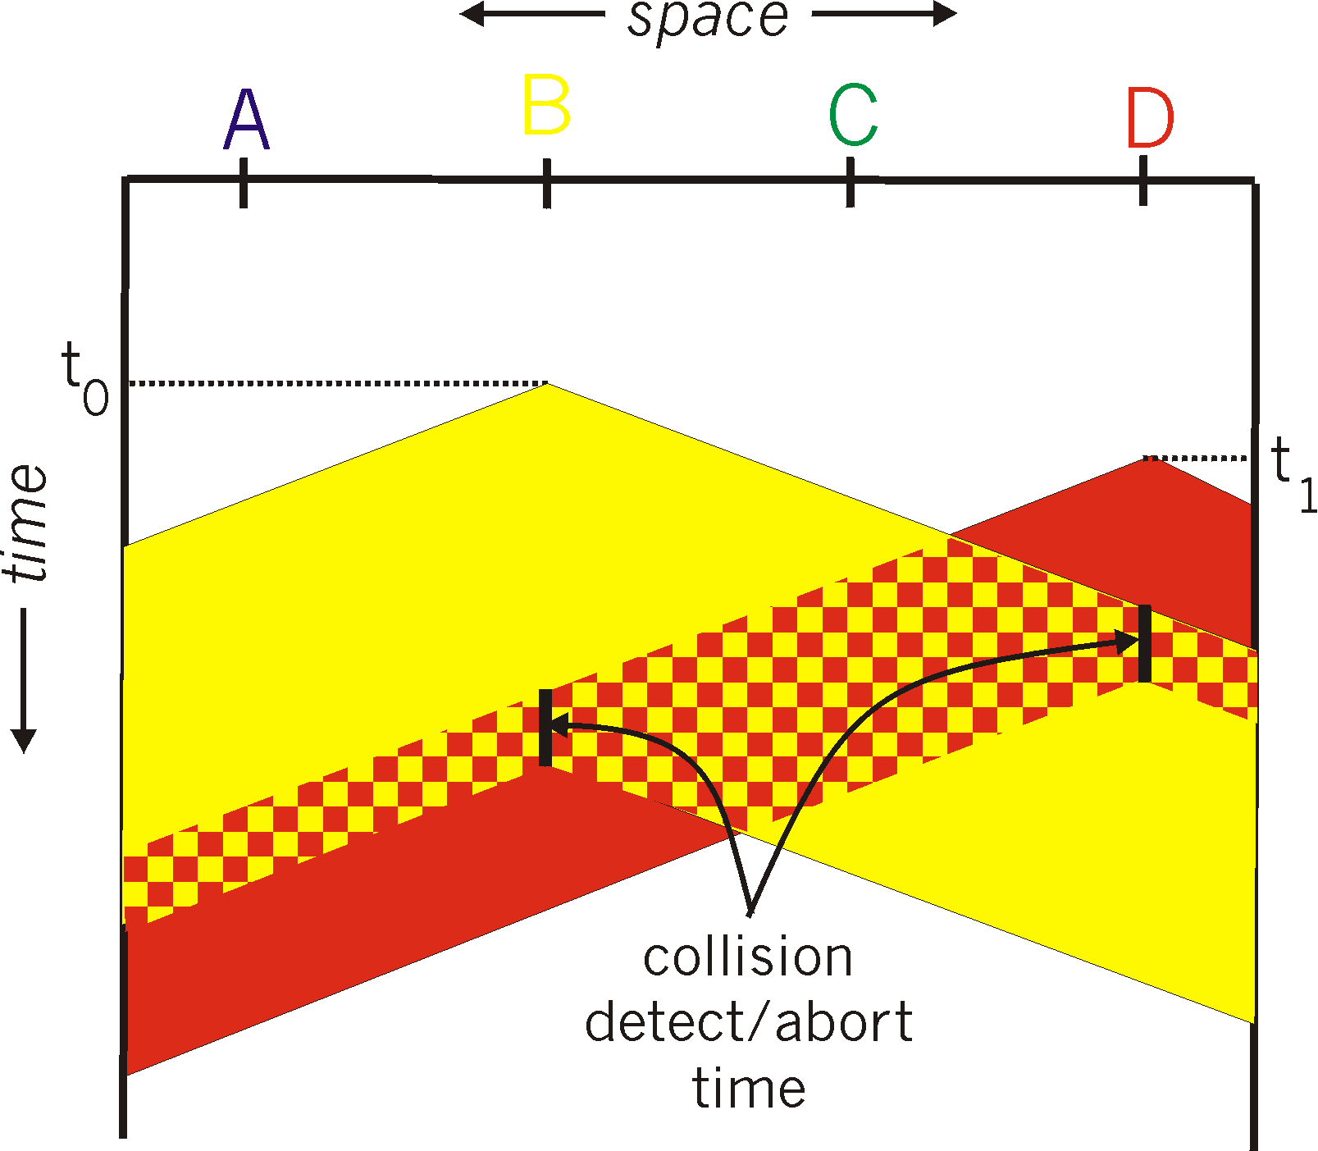
CSMA/CD (Collision Detection)
For this to work, need restrictions on minimum frame size and maximum distance
Why?
Spatial layout of nodes

Slide 72
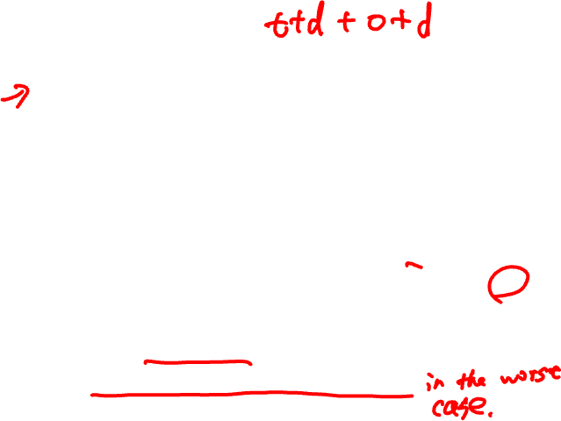
Limits on CSMA/CD network length
A
B
latency d
Latency depends on physical length of link
Time to propagate a frame from one end to other
Suppose A sends a frame at time t
And B sees an idle line at a time just before t + d
… so B happily starts transmitting a frame
B detects a collision, and sends jamming signal
But A cannot see collision until t + 2d

Slide 73
Limits on CSMA/CD network length
A
B
latency d
A needs to wait for time 2d to detect collision
So, A should keep transmitting during this period
AND keep an eye out for a possible collision
Imposes restrictions; e.g., for 10 Mbps Ethernet
Maximum length of the wire: 2,500 meters
Minimum length of a frame: 512 bits (64 bytes)

Slide 74
Framing frames
Physical layer puts bits on a link
But, two hosts connected on the same physical medium need to be able to exchange frames
Service provided by the link layer
Implemented by the network adaptor
Framing problem: how does the link layer determine where each frame begins and ends?

Slide 75
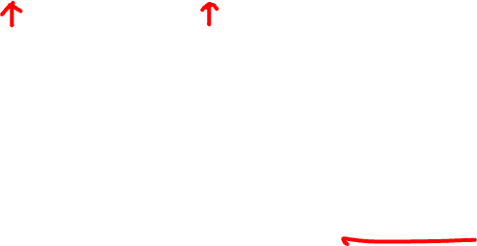
Simple approach: Count bytes
Sender includes number of bytes in header
Receiver extracts this number of bytes of body
What if the Count field is corrupted?
L2 will frame the wrong bytes → a framing error
CRC tells you to discard this frame, but what about the next one?
53
Body
80
Body
53 bytes of data
80 bytes of data
Bogus count field
61
Body
80
???
Body
61 bytes of data misdelivered
??? bytes of data misdelivered

Slide 76
Desynchronization
Once framing on a link is desynchronized, it can stay that way
Need a method to resynchronize

Slide 77

Framing with sentinel bits
Delineate frame with special “sentinel” bit pattern
e.g., 01111110 ⇒ start, 01111111 ⇒ end
What if sentinel occurs within frame?
Solution: bit stuffing
Sender always inserts a 0 after five 1s in the frame contents
Receiver always removes a 0 appearing after five 1s
01111110
Frame contents
01111111
Notes:
6 one’s → start
7 one’s → end

Slide 78
When receiver sees five 1s…
If next bit 0, remove it; begin counting again
Because this must be a stuffed bit; we can’t be at beginning/end of frame (those had six or seven 1s)
If next bit 1 (i.e., we’ve seen six 1s) then:
If following bit is 0, this is start of frame
Because the receiver has seen 01111110
If following bit is 1, this is end of frame
Because the receiver has seen 01111111
01111110
Frame content
01111111

Slide 79
Example: sentinel bits
Original data, including start/end of frame:
01111110011111101111101111100101111111
Sender rule: five 1s → insert a 0
After bit stuffing at the sender:
01111110011111010111110011111000101111111
Receiver rule: five 1s and next bit 0 → remove 0
01111110011111101111101111100101111111

Slide 80
Self learning: Handling misses
When packet arrives with unfamiliar destination
Forward packet out all other ports
Response may teach switch about that destination
B
A
C
D

