Slide 1
CSCI 4430 - Spring 22
Tutorial 2
Credits to Umich EECS 489 Discussion 2

Slide 2
Assignment 1
Due: Sat, 29 Jan. 11:59:59 p.m.
The autograder will be available soon.

Slide 3
Outline
Performance Metrics - Delay
Performance Metrics – Throughput
Performance Metrics - Q1
Performance Metrics - Q2

Slide 4
Performance Metrics - Delay
Link properties
Transmission delay
Propagation delay
Traffic mix and switch internals
Queuing delay
Processing delay (negligible)

Slide 5
Performance Metrics - Throughput
Throughput = Data transferred / Transfer time
Transfer time = transmission delay + propagation delay

Slide 6
Performance Metrics - Q1
Suppose a 100-Mbps point-to-point link is being set up between Earth and a new lunar colony.
The distance from the moon to Earth is approximately 385,000 km, and data travels over the link at the speed of light = 3∗10^8 m/s.
(a) Calculate the minimum RTT for the link.
propagation delay = 385000 km / (3 * 10^5 km/s) = 1.28333s
RTT = 2 * propagation delay = 2 * 1.28333 = 2.56666s

Slide 7
Performance Metrics - Q1
Suppose a 100-Mbps point-to-point link is being set up between Earth and a new lunar colony.
The distance from the moon to Earth is approximately 385,000 km, and data travels over the link at the speed of light = 3∗10^8 m/s.
(c) The maximum number of flying bits on the link?
# bits = propagation delay * bandwidth
= 1.28333s * 100Mbps = 1.28333 * 10^8

Slide 8
Performance Metrics - Q1
Suppose a 100-Mbps point-to-point link is being set up between Earth and a new lunar colony.
The distance from the moon to Earth is approximately 385,000 km, and data travels over the link at the speed of light = 3∗10^8 m/s.
(a) Calculate the minimum RTT for the link.
propagation delay = 385000 km / (3 * 10^5 km/s) = 1.28333s
RTT = 2 * propagation delay = 2 * 1.28333 = 2.56666s

Slide 9
Performance Metrics - Q2
Calculate the latency (from first bit sent to last bit received) for the following:
(a) A 10-Mbps link with a single store-and-forward switch in the path, and a packet size of 5,000 bits. Assume that each section of the link introduces a propagation delay of 10 microseconds, and that the switch begins retransmitting immediately after it has finished receiving the packet.
(5000 b / 10Mbps + 10us) * 2 = 1.02ms

Slide 10
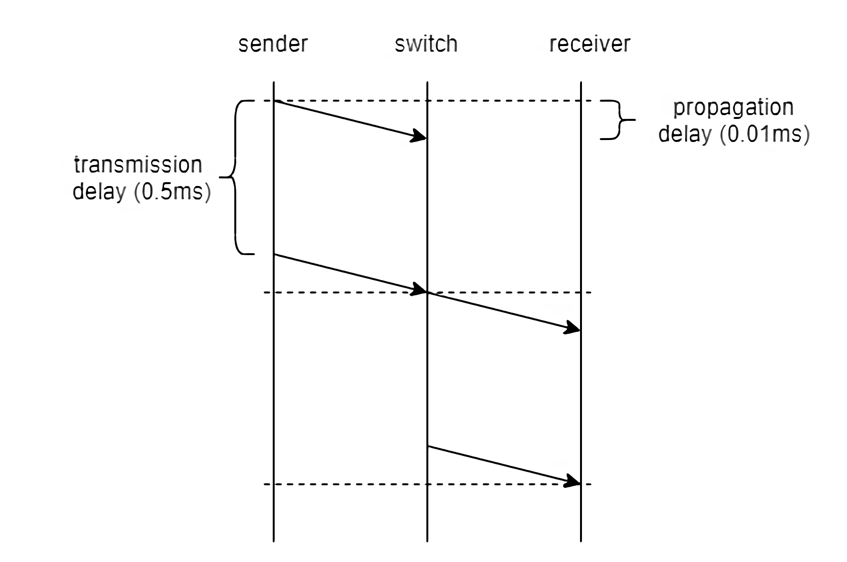
Performance Metrics - Q2
(5000 b / 10Mbps + 10us) * 2 = 1.02ms

Slide 11
Performance Metrics - Q2
Calculate the latency (from first bit sent to last bit received) for the following:
(b) A 10-Mbps link with a single cut-off switch in the path, and a packet size of 5,000 bits. Assume that each section of the link introduces a propagation delay of 10 microseconds, and that the switch begins retransmitting immediately after the first 200 bits have been received.
0.51ms + 200b / 10Mbps + 10us = 0.54ms

Slide 12
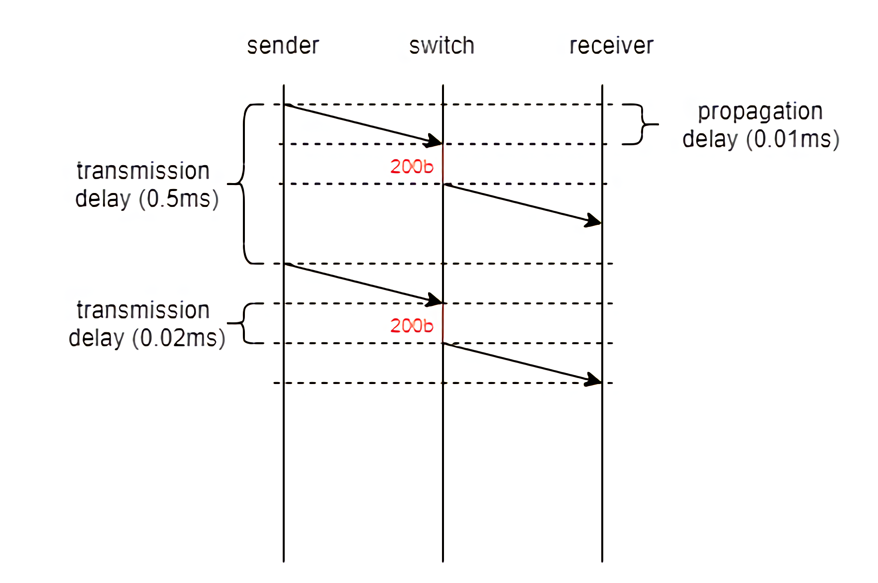
Performance Metrics - Q2
0.51ms + 200b / 10Mbps + 10us = 0.54ms

Slide 13
Thanks!

