Slide 1
CSCI4430 Computer Networks Lecture 8: Transport Layer – TCP flow control, congestion control
Hong Xu, Henry
CSE@CUHK, 2022
Material with thanks to Patrick Lee, Mosharaf Chowdhury, Aditya Akella, Sugih Jamin, Philip Levis, Sylvia Ratnasamy, Peter Steenkiste, and many other colleagues.

Slide 2
Agenda
TCP flow control
TCP congestion control

Slide 3
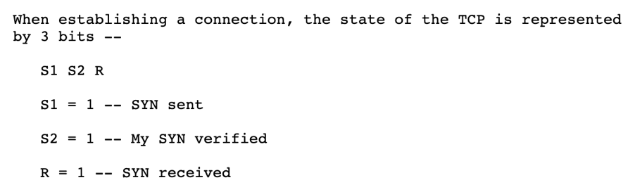
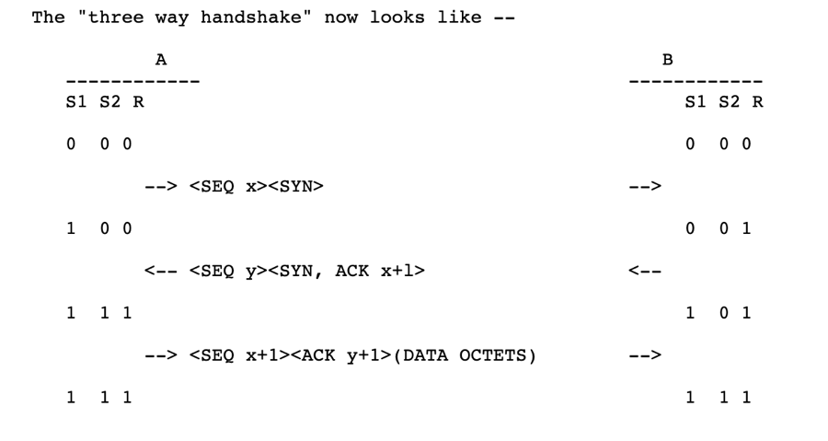
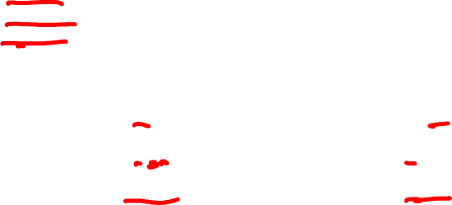
RFC 675 ($4.3.2)

Slide 4
TCP state transitions
Data, ACK exchanges are in here

Slide 5
TCP client lifecycle
CLOSED
Wait 30 sec
Send SYN
TIME_WAIT
SYN_SENT
Receive FIN
Send ACK
Receive SYN-ACK
Send ACK
FIN_WAIT_2
ESTABLISHED
Receive ACK
Send Nothing
Send FIN
FIN_WAIT_1

Slide 6
TCP server lifecycle
CLOSED
Receive ACK
Send Nothing
Create a listen socket
LAST_ACK
LISTEN
Send FIN
Receive SYN
Send SYN-ACK
CLOSE_WAIT
SYN_RCVD
Receive FIN
Send ACK
Receive ACK
Send Nothing
ESTABLISHED

Slide 7
TCP Flow Control

Slide 8
Recap: Sliding window
Both sender and receiver maintain a window
Left edge of window:
Sender: beginning of unacknowledged data
Receiver: beginning of expected data
First “gap” in received data
When sender gets ack, knows that receiver’s window has moved
Right edge: Left edge + constant
The constant is only limited by buffer size in the transport layer
Notes:
Picture on board

Slide 9

Sliding window at sender
Sending process
TCP
Buffer size
Last byte written
Previously
ACKed bytes
First unACKed byte
Last byte can send

Slide 10
Sliding window at receiver
Receiving process
Last byte read
Buffer size
Received and ACKed
Sender might overrun the receiver’s buffer
Next byte needed (1st byte not received)
Last byte received

Slide 11

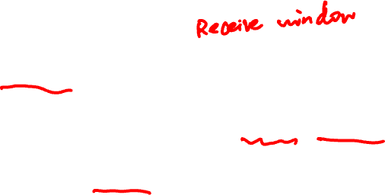
Solution: Advertised window (Flow Control)
Receiver uses an “Advertised Window” (RWND) to prevent sender from overflowing its window
Receiver indicates value of RWND in ACKs
Sender ensures that the total number of bytes in flight <= RWND

Slide 12

TCP header
Source port
Destination port
Sequence number
Acknowledgment
HdrLen
0
Flags
Advertised window
Checksum
Urgent pointer
Data

Slide 13
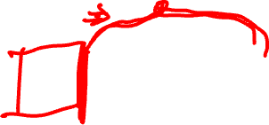
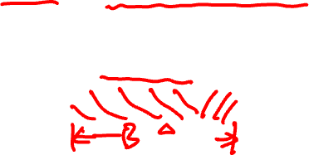
Sliding window at receiver
RWND = B - (LastByteReceived - LastByteRead)
Receiving process
Last byte read
Buffer size (B)
Next byte needed (1st byte not received)
Last byte received

Slide 14
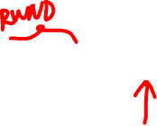
Sliding window at sender
Sending process
TCP
RWND
Last byte written
First unACKed byte
Last byte can send

Slide 15
Sliding window with flow control
Sender: window advances when new data ACK’d
Receiver: window advances as receiving process consumes data
Receiver advertises to the sender where the receiver window currently ends (“righthand edge”)
Sender agrees not to exceed this amount
UDP does not have flow control
Data can be lost due to buffer overflow

Slide 16
Advertised window limits rate
Sender can send no faster than RWND/RTT bytes/sec
Receiver only advertises more space when it has consumed old arriving data
What happens when RWND=0?
Sender keeps probing with one data bytes
In original TCP design, that was the sole protocol mechanism controlling sender’s rate
What’s missing?

Slide 17
TCP Congestion Control

Slide 18

What is congestion?
If two packets arrive at a router at the same time
Router will transmit one and buffer/drop the other
Internet traffic is bursty
Many packets can arrive close in time
Causes packet delays and drops
Root cause: statistical multiplexing

Slide 19
Congestion collapse in 1980s
Sending rate only limited by flow control
Dropped packets → senders (repeatedly!) retransmit
Led to “congestion collapse” in Oct. 1986
Throughput on the NSF network dropped from 32Kbits/s to 40bits/sec
“Fixed” by Van Jacobson’s development of TCP’s congestion control (CC) algorithms

Slide 20
Jacobson’s fix to TCP
Extend TCP’s existing window-based protocol but adapt the window size in response to congestion
A pragmatic and effective solution
Required no upgrades to routers or applications!
Patch of a few lines of code to TCP implementations
Extensively researched and improved upon
Especially now with datacenters and cloud services

Slide 21
Key design considerations
How do we know the network is congested?
Implicit and/or explicit signals from the network
Who takes care of congestion?
End hosts (may receive some help from the network)
How do we handle congestion?
Continuous adaptation

Slide 22
Three issues to consider
Discovering the available (bottleneck) bandwidth
Adjusting to variations in bandwidth
Sharing bandwidth between flows

Slide 23
Abstract view
Ignore internal structure of router and model it as a single queue for a particular input-output pair
A
B
Sending Host
Buffer in Router
Receiving Host

Slide 24
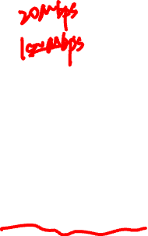
Discovering available bandwidth
Pick sending rate to match bottleneck bandwidth
Without any a priori knowledge
Could be gigabit link, could be a modem
A
100 Mbps
B
Sending Host
Buffer in Router
Receiving Host

Slide 25
Adjusting to variations in bandwidth
Adjust rate to match instantaneous bandwidth
Assuming you have a rough idea of bandwidth
BW(t)
A
B

Slide 26
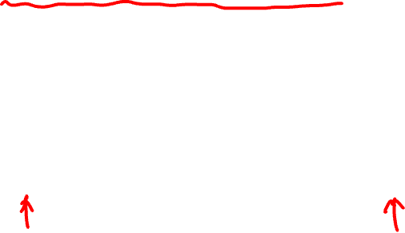
Multiple flows and sharing bandwidth
Two Issues:
Adjust total sending rate to match bandwidth
Allocation of bandwidth between flows
A1
B1
A2
BW(t)
B2
A3
B3

Slide 27
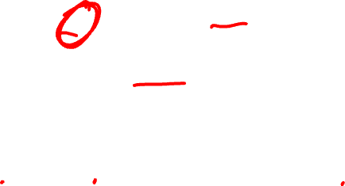
Reality
1Gbps
1Gbps
600Mbps
Congestion control is a resource allocation problem involving many flows, many links, and complicated global dynamics

Slide 28
Possible approaches
(0) Send without care
Many packet drops

Slide 29
Possible approaches
(0) Send without care
(1) Reservations
Pre-arrange bandwidth allocations
Requires negotiation before sending packets
Low utilization

Slide 30
Possible approaches
(0) Send without care
(1) Reservations
(2) Pricing
Don’t drop packets for the high-bidders
Requires payment model

Slide 31
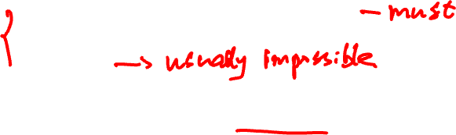
Possible approaches
(0) Send without care
(1) Reservations
(2) Pricing
(3) Dynamic Adjustment
Hosts infer level of congestion; adjust
Network reports congestion level to hosts; hosts adjust
Combinations of the above
Simple to implement but suboptimal, messy dynamics

Slide 32
Possible approaches
(0) Send without care
(1) Reservations
(2) Pricing
(3) Dynamic Adjustment
Generality of dynamic adjustment has proven to be very powerful
Doesn’t presume business model, traffic characteristics, application requirements
But does assume good citizenship!

Slide 33
TCP’s approach in a nutshell
Each TCP connection has a window
Controls number of packets in flight
Sending rate ~Window/RTT
Vary window size to control sending rate

Slide 34
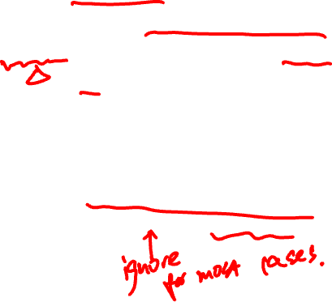
Windows to keep in mind
Congestion Window: CWND
Bytes that can be sent without overflowing routers
Computed by sender using congestion control algo.
Flow control window: RWND
Bytes that can be sent without overflowing receiver
Determined by the receiver and reported to the sender
Sender-side window = min {CWND, RWND}
Assume for this lecture that RWND >> CWND

Slide 35
Note
This lecture talks about CWND in units of MSS
MSS (Maximum Segment Size): the amount of payload data in a TCP packet
This is only for the simplicity of presentation
Real implementations maintain CWND in bytes

Slide 36
Two basic questions
How does the sender detect congestion?
How does the sender adjust its sending rate?
To address three issues
Finding available bottleneck bandwidth
Adjusting to bandwidth variations
Sharing bandwidth

Slide 37

Detecting congestion
Packet delays
Tricky: noisy signal (delay often varies considerably)
Routers tell end hosts when they’re congested
Packet loss
Fail-safe signal that TCP already has to detect
Complication: non-congestive loss (e.g., checksum errors)

Slide 38
Not all losses are the same
Duplicate ACKs: isolated loss
Still getting ACKs
Timeout: much more serious
Not enough dupacks
Must have suffered several losses
Will adjust rate differently for each case

Slide 39
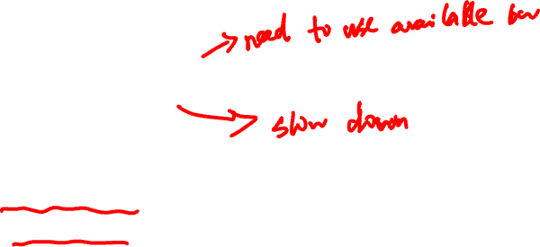
Rate adjustment
Basic structure
Upon receipt of ACK (of new data): increase rate
Upon detection of loss: decrease rate
How we increase/decrease the rate depends on the phase of congestion control we’re in:
Discovering available bottleneck bandwidth vs.
Adjusting to bandwidth variations

Slide 40
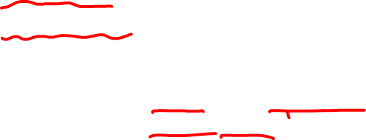
Bandwidth discovery with “Slow Start”
Goal: estimate available bandwidth
Start slow (for safety)
Ramp up quickly (for efficiency)
Consider
RTT = 100ms, MSS=1000bytes
Window size to fill 1Mbps of BW = 12.5 packets
Window size to fill 1Gbps = 12,500 packets
Either is possible!

Slide 41

Slow Start phase
Sender starts at a slow rate, but increases exponentially until first loss
Start with a small congestion window
Initially, CWND = 1
So, initial sending rate is MSS/RTT
Double the CWND for each RTT with no loss
Notes:
MSS vs MTU??

Slide 42
Slow Start in action
For each RTT: double CWND
i.e., for each ACK, CWND += 1
Linear increase per ACK(CWND+1) ➔ exponential increase per RTT (2*CWND)

Slide 43
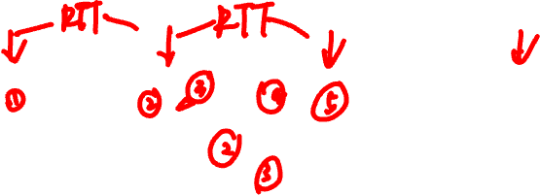
Slow Start in action
For each RTT: double CWND
i.e., for each ACK, CWND += 1
1
2
3
4
8
Src
D
A
D
D
A
A
D
D
D
D
A
A
A
A
Dest

Slide 44
When does Slow Start stop?
Slow Start gives an estimate of available bandwidth
At some point, there will be loss
Introduce a “slow start threshold” (ssthresh)
Initialized to a large value
If CWND > ssthresh, stop Slow Start

Slide 45
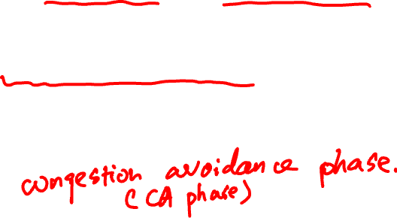
Adjusting to varying bandwidth
CWND > ssthresh
Stop rapid growth and focus on maintenance
Now, want to track variations in this available bandwidth, oscillating around its current value
Repeated probing (rate increase) and backoff (decrease)
TCP uses: “Additive Increase Multiplicative Decrease” (AIMD)

Slide 46
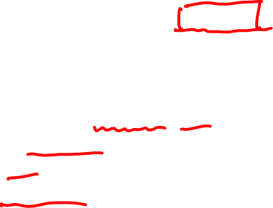
AIMD
Additive increase
For each ACK, CWND = CWND+ 1/CWND
CWND is increased by one only if all segments in a CWND have been acknowledged
Multiplicative decrease
On packet loss, divide ssthresh in half and slow start
ssthresh = CWND/2
CWND = 1
Initiate Slow Start
Note that we’re ignoring the “dupAck” fix for now

Slide 47
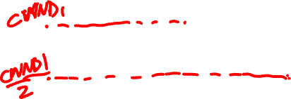
AIMD leads to TCP sawtooth
Window
Loss
Additive Increase
Multiplicative Decrease
Exponential “slow start”
t

Slide 48
Why AIMD?
Recall the three issues
Finding available bottleneck bandwidth
Adjusting to bandwidth variations
Sharing bandwidth
Two goals for bandwidth sharing
Efficiency: High utilization of link bandwidth
Fairness: Each flow gets equal share

Slide 49

Why AIMD?
Every RTT, we can do
Multiplicative increase or decrease: CWND→ a*CWND
Additive increase or decrease: CWND→ CWND + b
Four alternatives:
AIAD: gentle increase, gentle decrease
AIMD: gentle increase, drastic decrease
MIAD: drastic increase, gentle decrease
MIMD: drastic increase and decrease

Slide 50
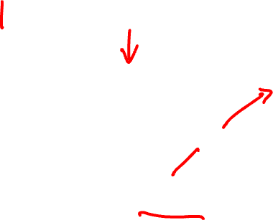
Simple model of congestion control
1
Efficiency line (x₁+x₂ = 1)
Fairness line (x₁ =x₂)
Two users
rates x1 and x2
Congestion when x1+x2 > 1
Unused capacity when x1+x2 < 1
Fair when x1 =x2
User 2’s rate (x₂)
congested →
← inefficient
User 1’s rate (x₁)
1

Slide 51
Example
1
Fairness
line
Efficient: x₁+x₂=1
Fair
Congested: x₁+x₂=1.2
User 2: x₂
(0.2, 0.5)
(0.7, 0.5)
(0.5, 0.5)
(0.7, 0.3)
Inefficient: x₁+x₂=0.7
congested →
Efficient: x₁+x₂=1
Not fair
← inefficient
Efficiency
line
User 1: x₁
1

Slide 52
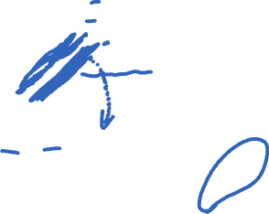
AIAD
(x₁-a_{D}+a_{I}), x₂-a_{D}+a_{I}))
Fairness
line
Increase: x + a_{I}
Decrease: x - a_{D}
Does not converge to fairness
(x₁,x₂)
User 2: x₂
(x₁-a_{D},x₂-a_{D})
congested →
← inefficient
Efficiency
line
User 1: x₁

Slide 53

AIAD Sharing Dynamics
x₁
A
B
x₂
D
E

Slide 54
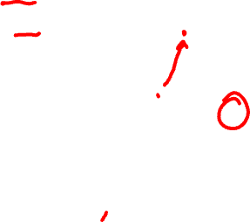
MIMD
Fairness
line
Increase: x*b_{I}
Decrease: x*b_{D}
Does not converge to fairness
(x₁,x₂)
(b_{I}b_{D}x₁, b_{I}b_{D}x₂)
User 2: x₂
(b_{d}x₁,b_{d}x₂)
congested →
← inefficient
Efficiency
line
User 1: x₁

Slide 55
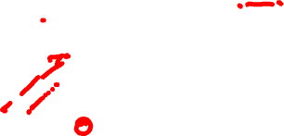
AIMD
Fairness
line
Increase: x+a_{I}
Decrease: x*b_{D}
Converges to fairness
(x₁,x₂)
(b_{D}x₁+a_{I}, b_{D}x₂+a_{I})
User 2: x₂
(b_{D}x₁,b_{D}x₂)
congested →
← inefficient
Efficiency
line
User 1: x₁

Slide 56
AIMD Sharing Dynamics
x₁
A
B
x₂
50 packets/sec
D
E
Rates equalize → fair share

Slide 57

MIAD
Fairness
line
Increase: x*b_{I}
Decrease: x - a_{D}
Does not converge to fairness
Does not converge to efficiency
“Analysis of the Increase and Decrease Algorithms for Congestion Avoidance in Computer Networks”
-- Chiu and Jain
(b_{I}(x_{1h}-a_{D}), b_{I}(x_{2h}-a_{D}))
(x_{1h},x_{2h})
User 2: x₂
(x_{1h}-a_{D},x_{2h}-a_{D})
Efficiency
line
User 1: x₁

Slide 58
Summary
Flow control ensures that the sender does not overflow the receiver
Congestion control ensures that the sender does not overflow the network
Discover bandwidth
Adjust to conditions
Share bandwidth with others

