Slide 1
CSCI4430 Computer Networks Lecture11: Network Layer – IP routers
Hong Xu, Henry
CSE@CUHK, 2022
Material with thanks to Patrick Lee, Mosharaf Chowdhury, Aditya Akella, Sugih Jamin, Philip Levis, Sylvia Ratnasamy, Peter Steenkiste, and many other colleagues.

Slide 2
Agenda
IP routers
Router-assisted congestion control

Slide 3
IP routers
Core building block of the Internet infrastructure
$120B+ industry
Vendors: Cisco, Huawei, Juniper, Alcatel-Lucent (account for >90%)

Slide 4
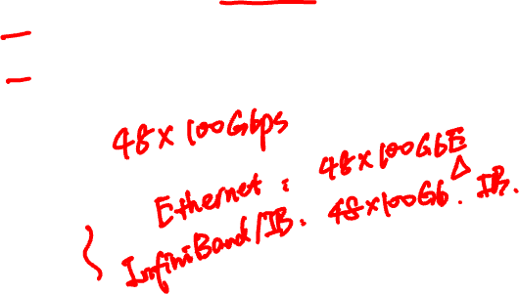
Router definitions
Router capacity = N x R
N = Number of external router “ports”
R = Speed (“line rate”) of a port

Slide 5

Networks and routers
UMICH
edge (enterprise)
BBN
AT&T
home, small business
core
edge (ISP)
NYU
core
Notes:
Bunch of different kinds of routers: small for homes, routers that connect different ISPs or ISPs to enterprises (edge)

Slide 6
Many types of routers
Core
R = 10/40/100 Gbps
NR = O(100) Tbps (Aggregated)
Edge
R = 1/10/40
NR = O(100) Gbps
Small business
R = 10/100/1000 Mbps
NR < 10 Gbps

Slide 7

What’s inside a router?
Control Plane
Route/Control Processor
Data Plane
Linecards (input)
Linecards (output)
1
1
2
2
Interconnect (Switching)
Fabric
N
N

Slide 8
What’s inside a router?
Linecards
Input linecards process packets on their way in
Output linecards process packets on way out
Input and output for the same port are on the same physical linecard
Interconnect/switching fabric
Transfers packets from input to output ports

Slide 9
Input linecards
Tasks
Receive incoming packets (physical layer stuff)
Update the IP header
TTL, Checksum, Options and Fragment (maybe)
Lookup the output port for the destination IP address
Queue the packet at the switch fabric
Challenge: speed!
100B packets @ 40Gbps → new packet every 20 nano secs!
Typically implemented with specialized ASICs (network processors)
Notes:
Next: one particular part of the functionality: how to determine the output port for the destination IP address

Slide 10

Looking up the output port
One entry for each address → 4 billion entries!
For scalability, addresses are aggregated
Notes:
How does a router determine which output port for the packet!

Slide 11
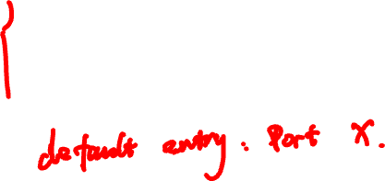
Example
Router with 4 ports
Destination address range mapping
11 00 00 00 to 11 00 00 11: Port 1
11 00 01 00 to 11 00 01 11: Port 2
11 00 10 00 to 11 00 11 11: Port 3
11 01 00 00 to 11 01 11 11: Port 4

Slide 12
Example
Router with 4 ports
Destination address range mapping
11 00 00 00 to 11 00 00 11: Port 1
11 00 01 00 to 11 00 01 11: Port 2
11 00 10 00 to 11 00 11 11: Port 3
11 01 00 00 to 11 01 11 11: Port 4

Slide 13
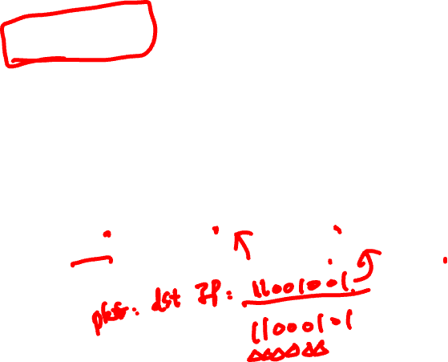
Longest prefix matching
Port 1
ISP Router
Port 4
Port 2
Port 3
110000**
110001**
1100****
1101****

Slide 14
Finding match efficiently
Testing each entry to find a match scales poorly
On average: O(number of entries)
Leverage tree structure of binary strings
Set up tree-like data structure

Slide 15
Longest prefix matching
Port 1
ISP Router
Port 4
Port 2
Port 3
110000**
110001**
1100****
1101****

Slide 16

Tree structure
000 ➔ Port 1
001 ➔ Port 2
0** ➔ Port 3
1** ➔ Port 4
***
0
1
0**
1**
0
1
0
1
00*
01*
10*
11*
0
1
0
1
0
1
0
1
000
001
010
011
100
101
110
111
Notes:
Idea: build tree to help with match. When a new packet comes in, walk the tree to determine the correct port.
Each level in the tree: one bit. Root: all wild cards

Slide 17

Tree structure
000 ➔ Port 1
001 ➔ Port 2
0** ➔ Port 3
1** ➔ Port 4
***
0
1
0**
1**
0
1
0
1
00*
01*
10*
11*
0
1
0
1
0
1
0
1
000
001
010
011
100
101
110
111
Record port associated with latest match, and only override when it matches another prefix during walk down tree
Notes:
Idea: build tree to help with match. When a new packet comes in, walk the tree to determine the correct port.
Each level in the tree: one bit. Root: all wild cards

Slide 18
Input linecards
Main challenge is processing speeds
Tasks involved:
Update packet header (easy)
LPM lookup on destination address (harder)
Mostly implemented with specialized hardware

Slide 19
Output linecards
Packet classification: map packets to flows
Buffer management: decide when and which packet to drop
Scheduler: decide when and which packet to transmit
flow 1
Classifier
flow 2
Scheduler
flow n
Buffer management

Slide 20

Simplest: FIFO router
No classification
Drop-tail buffer management: when buffer is full drop the incoming packet
First-In-First-Out (FIFO) Scheduling: schedule packets in the same order they arrive
Buffer
Scheduler

Slide 21
Packet classification
Classify an IP packet based on a number of fields in the packet header, e.g.,
Source/destination IP address (32 bits)
Source/destination TCP port number (16 bits)
Type of service (TOS) byte (8 bits)
Type of protocol (8 bits)
In general fields are specified by range
Classification requires a multi-dimensional range search!

Slide 22
Scheduler
One queue per “flow”
Scheduler decides when and from which queue to send a packet
Goals of a scheduling algorithm
Fast!
Depends on the policy being implemented (fairness, priority, etc.)

Slide 23
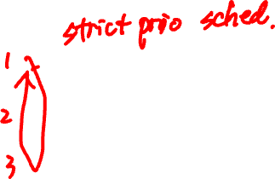
Priority scheduler
Priority scheduler: packets in the highest priority queue are always served before the packets in lower priority queues
High priority
Medium priority
Priority
Scheduler
Low priority

Slide 24
Round-robin scheduler
Round robin: packets are served from each queue in turn
Fair queuing (FQ): round-robin for packets of different size
Weighted fair queueing (WFQ): serve proportional to weight
FQ gives equal weight to each flow

Slide 25
Connecting inputs to outputs: Switching fabric
Mini-network
Three primary ways to switch
Switching via shared memory
Switching via a bus
Switching via an inter-connection network
For example, cross-bar

Slide 26

Crossbar fabric
2N buses intersecting with each other:
N input
N output
Non-blocking
Input ports
Output ports
Notes:
Non-blocking: Packets being forwarded to different output ports does not block each other.

Slide 27
Router-assisted Congestion control

Slide 28
Recap: TCP problems
Routers tell endpoints if they’re congested
Misled by non-congestion losses
Fills up queues leading to high delays
Short flows complete before discovering available capacity
AIMD impractical for high speed links
Saw tooth discovery too choppy for some apps
Unfair under heterogeneous RTTs
Tight coupling with reliability mechanisms
End hosts can cheat
Routers tell endpoints what rate to send at
Routers enforce fair sharing
Could fix many of these with some help from routers!
Notes:
Congestion losses: switch queue is filled up
Non-congestion losses: packet reordering & channel errors / link noise & packet corruption
Short flows may never leave slow start when finish
CC and reliability intertwined; sometimes don’t want both
Endhosts: increase CWND at a faster rate; open parallel connections

Slide 29
Router-assisted congestion control
Three tasks for congestion control
Isolation/fairness
Adjustment
Detecting congestion

Slide 30
Fairness: General approach
Routers classify packets into “flows”
Let’s assume flows are TCP connections
Each flow has its own FIFO queue in router
Router services flows in a fair fashion
When line becomes free, take packet from next flow in a fair order
What does “fair” mean exactly?

Slide 31
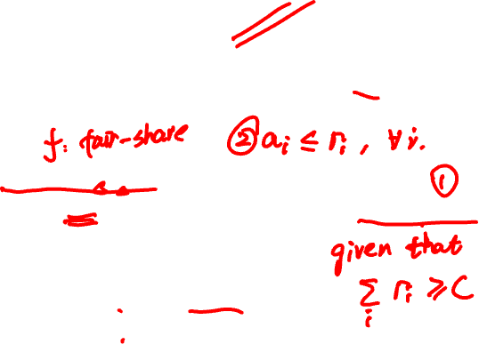
Max-Min fairness
Given set of bandwidth demands r_{i} and total bandwidth C, max-min bandwidth allocations are:
a_{i} = min(f, r_{i})
where f is the unique value such that Sum(a_{i}) = C
r₁
?
r₂
C bits/s
?
r₃
?
Notes:
If you don’t get full demand, no one gets more than you.

Slide 32
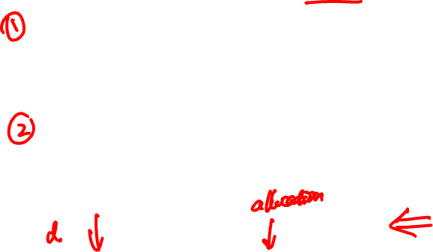
Example
C = 10; r₁ = 8, r₂ = 6, r₃ = 2; N = 3
C/3 = 3.33 →
r₃ needs only 2
Can service all of r₃
Remove r₃ from the accounting: C = C – r₃ = 8; N = 2
C/2 = 4 →
Can’t service all of r₁ or r₂
So hold them to the remaining fair share: f = 4
8
f = 4:
min(8, 4) = 4
min(6, 4) = 4
min(2, 4) = 2
10
4
6
4
2
2

Slide 33

Max-Min fairness
Given set of bandwidth demands r_{i} and total bandwidth C, max-min bandwidth allocations are:
a_{i} = min(f, r_{i})
where f is the unique value such that Sum(a_{i}) = C
If you don’t get full demand, no one gets more than you
This is what round-robin service gives if all packets are the same size

Slide 34
How do we deal with packets of different sizes?
Mental model: Bit-by-bit round robin (“fluid flow”)
Can you do this in practice?
No, packets cannot be preempted
But we can approximate it
This is what “fair queuing” routers do

Slide 35
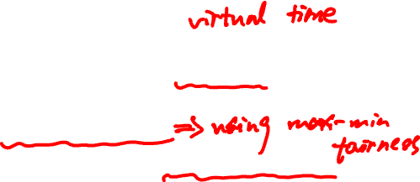
Fair Queuing (FQ)
For each packet, compute the time at which the last bit of a packet would have left the router if flows are served bit-by-bit
Then serve packets in the increasing order of their deadlines

Slide 36
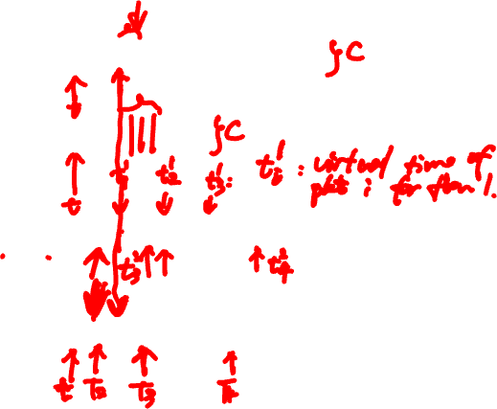
Example
Flow 1
(arrival traffic)
1
2
3
4
5
6
time
Flow 2
(arrival traffic)
1
2
3
4
5
time
Service
in fluid flow
system
1
2
1
2
3
4
5
6
3
4
5
time
FQ Packet
system
1
2
1
3
2
3
4
4
5
5
6
time

Slide 37
Fair Queuing (FQ)
Implementation of round-robin generalized to the case where not all packets are equal sized
Weighted fair queuing (WFQ): assign different flows different shares
Today, some form of WFQ implemented in almost all routers
Not the case in the 1980-90s, when CC was being developed
Mostly used to isolate traffic at larger granularities (e.g., per-prefix)

Slide 38
FQ vs. FIFO
FQ advantages:
Isolation: cheating flows don’t benefit
Bandwidth share does not depend on RTT
Flows can pick any rate adjustment scheme they want
Disadvantages:
More complex than FIFO: per flow queue/state, additional per-packet book-keeping

Slide 39
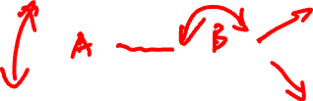
FQ in the big picture
FQ does not eliminate congestion → it just manages the congestion
5Gbps
100Mbps
1Gbps
1Gbps
Will drop an additional 400Mbps from the green flow
1Gbps
Blue and Green get 0.5Gbps; any excess will be dropped
If the green flow doesn’t drop its sending rate to 100Mbps, we’re wasting 400Mbps that could be usefully given to the blue flow

Slide 40
FQ in the big picture
FQ does not eliminate congestion → it just manages the congestion
Robust to cheating, variations in RTT, details of delay, reordering, retransmission, etc.
But congestion (and packet drops) still occurs
We still want end-hosts to discover/adapt to their fair share!
What would the end-to-end argument say w.r.t. congestion control?

Slide 41
Fairness is a controversial goal
What if you have 8 flows, and I have 4?
Why should you get twice the bandwidth?
What if your flow goes over 4 congested hops, and mine only goes over 1?
Why shouldn’t you be penalized for using more scarce bandwidth?
What is a flow anyway?
TCP connection
Source-Destination pair?
Source?

Slide 42
Router-Assisted Congestion Control
CC has three different tasks:
Isolation/fairness
Rate adjustment
Detecting congestion

Slide 43
Why not let routers tell what rate end hosts should use?
Packets carry “rate field”
Routers insert “fair share” f in packet header
End-hosts set sending rate (or window size) to f
Hopefully (still need some policing of end hosts!)
This is the basic idea behind the “Rate Control Protocol” (RCP) from Dukkipati et al. ’07
Flows react faster

Slide 44
Router-Assisted Congestion Control
CC has three different tasks:
Isolation/fairness
Rate adjustment
Detecting congestion

Slide 45

Explicit Congestion Notification (ECN)
Single bit in packet header; set by congested routers
If data packet has bit set, then ACK has ECN bit set
Many options for when routers set the bit
Tradeoff between (link) utilization and (packet) delay
Congestion semantics can be exactly like that of drop
i.e., end-host reacts as though it saw a drop

Slide 46
ECN
Advantages:
Don’t confuse corruption with congestion; recovery w/ rate adjustment
Can serve as an early indicator of congestion to avoid delays
Easy (easier) to incrementally deploy
Today: defined in RFC 3168 using ToS/DSCP bits in the IP header
Common in datacenters

Slide 47
Summary
IP routers form the backbone of the Internet
Aims for speed while providing fairness
Routers can assist in addressing/mitigating many of TCP’s shortcomings

