Slide 1

AccrediChain
Web3.0 Accreditation System
Anson Heung, Owen Lee, Rachel Chui
Notes:
https://pastebin.com/0Fza8BXh

Slide 2



Our Team
Heung Kai Him (Anson)
Lee Ho Wan (Owen)
Chui On Lam (Rachel)

Slide 3
04
Table of Contents
01
03
02
Go-to-market
Launching strategies
Situation Analysis
Implementation
Analysis of conventional certification
Features and system architecture
Solution
A decentralized accreditation platform

Slide 4
01
Situation Analysis
Analysis of conventional certification system

Slide 5
Market Size
168B
309B
80% U.S. organizations rely on centralized certification systems
84% HR think certification is important
In 2020
By 2028
Global Certification Market Size
All prices mentioned in this presentation are in USD, unless otherwise specified.
The above statistics are given by Grand View Research and HR Certification Institute 2020 Survey
Notes:
However, according to a report by Grand View Research, the global certification market size was valued at USD 167.78 billion in 2020 and is expected to reach USD 308.98 billion by 2028, growing at a compound annual growth rate (CAGR) of 7.8% from 2021 to 2028. The report attributes the growth to the increasing demand for skilled professionals and the need for compliance with industry standards and regulations across various sectors such as healthcare, IT, education, and manufacturing.
According to a survey conducted by HR Certification Institute in 2020, about 80% of the organizations in the United States rely on centralized certification systems to assess the skills and qualifications of their employees or job candidates. Additionally, the same survey found that 84% of HR professionals believe that certification is an important criterion for evaluating candidates during the hiring process.

Slide 6
Customer Journey
Ask for Mary’s consent to disclose her record
Call to verify Mary’s internship
Verify Mary’s internship
Previous Employer
Give permission
Outsource background check
Mary
Third-party Background Check
Deloitte
Send background check result
Send previous employment certificates

Slide 7
Pain Points
Previous Employer
New Employer
Applicant
Time-consuming
Privacy concerns
Time-consuming
Costly
Limited information about verification process
Delay in hiring process

Slide 8
Traditional Certificates
Lack Transparency
Limited Accessibility
Limited Portability
Limited Security
Issued by centralized authorities
Expensive and time-consuming to obtain
Specific to industries and regions
Susceptible to fraud and counterfeiting

Slide 9
Solution
02
A solution to tackle the mentioned challenges

Slide 10

Web 3.0 Accreditation
Revolutionizing credential verification with blockchain technology with a decentralized Accreditation platform

Slide 11
Decentralization
Certificate as an NFT (ERC721)
Shared database
Multiple writers
Absence of trust
Disintermediation
Transaction interaction
Notes:
Shared database
Yes, need database to store data
Multiple writers
Yes, multiple entities generating and modifying data
Absence of trust
Yes, certifications cannot be trusted unless they are verifiable
Disintermediation
Yes, should not trust any central third party
Transaction interaction
Yes, the minting and data generation and modification may result in different output if handled independently (TODO)

Slide 12
Workflow
Certificate Issuer
Certificate Applicant
Launch accreditation and issue certificates
View and verify his/her certificates
Others
Verify ownership and issuance of certificates
Certificates are instances of an Accreditation.

Slide 13
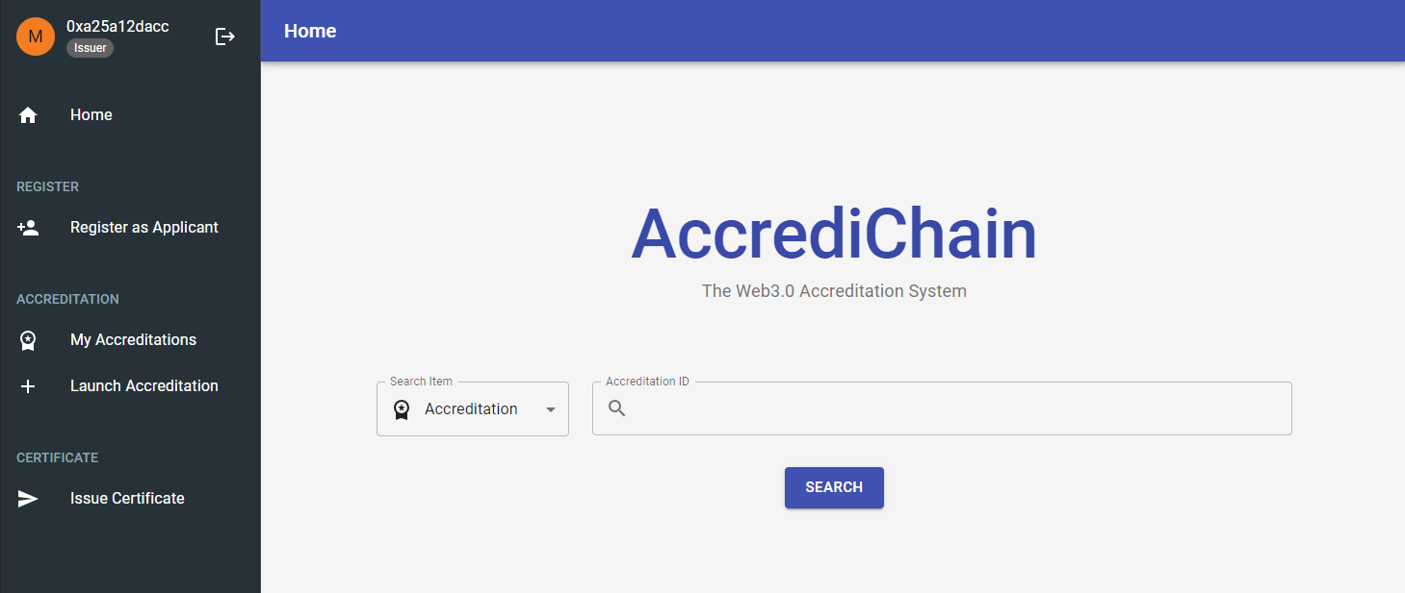
Front-end Web App

Slide 14
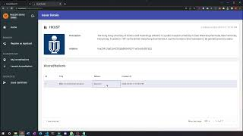

Slide 15
Live Demo
Searching in Guest View
https://isom3000h-project-6ijv-274ayojj3-isom3000.vercel.app/
Notes:
https://isom3000h-project-6ijv-274ayojj3-isom3000.vercel.app/certificate/1

Slide 16
Business Model
Issuance fee
Ads fee
Certificate Issuer
Verification fee
Ads
Verifier
Certificates are instances of an Accreditation.

Slide 17
Benefits
Decentralized Verification
Increased Portability
Increased Accessibility
Easier to obtain and verify credentials
Improved Security
Ensure immutability and tamper-proof of records
Notes:
Decentralized verification: The Web3 Accreditation System uses a decentralized network of nodes to verify credentials, eliminating the need for centralized authorities.
Increased accessibility: The Web3 Accreditation System is more accessible and affordable, making it easier for individuals and organizations to obtain and verify their credentials.
Increased portability: The Web3 Accreditation System is not limited to specific industries or regions, making it easier for individuals to use their credentials in different contexts.
Improved security: The Web3 Accreditation System uses blockchain technology to ensure the immutability and tamper-proof of the records, making it more difficult for credentials to be fraudulently or falsely represented.

Slide 18
03
Implementation
Features and system architecture

Slide 19
Architecture
Backend –
Smart Contracts
Frontend
production
4 × Storage Contracts
2 × NFT Contracts
4 × Endpoints Contracts
ETD Debug Chain
Deployed with hardhat
NextJS styled with MUI
Deployed with Vercel
testnet
Mumbai Testnet
local
In Solidity
Ganache
Notes:
To be formatted

Slide 20
Contracts
Endpoints
NFT (ERC721)
Storage
Issuers
Issuers
Applicants
Applicants
Client
Accreditations
Accreditations
Accreditations
Certificates
Certificates
Certificates
Notes:
To be formatted

Slide 21
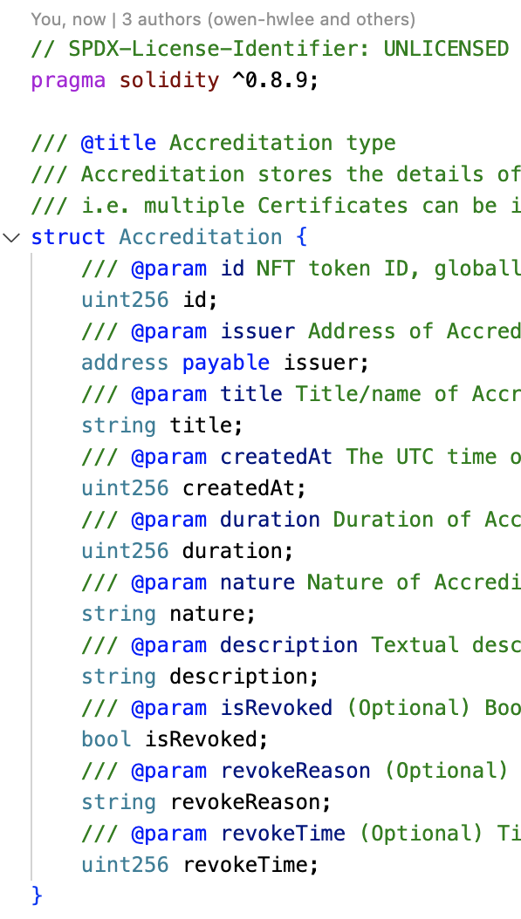
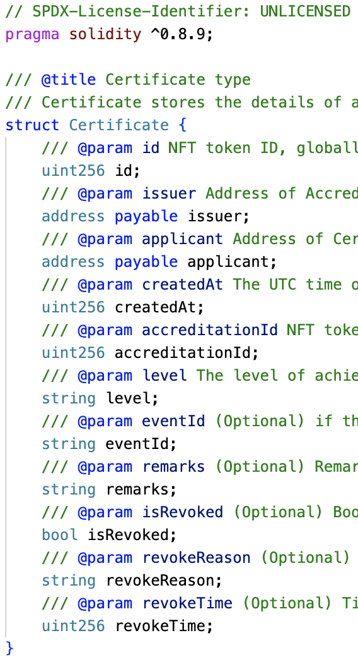
Data Structure
Accreditation
Certificate
A collection of certificates created by issuer (e.g. HKDSE)
A child of an accreditation created by issuer and owned by applicant (e.g. HKDSE certificate of Mary)
Notes:
To be formatted

Slide 22
Contracts Interactions
Creating a user
Applicant Endpoint
Applicant Storage
Certificate Applicant
registerApplicant
createApplicant
Notes:
To be formatted

Slide 23
Contracts Interactions
Creating a certificate
Accreditation Endpoint
Accreditation NFT
Accreditation Storage
launchAccreditation
launchAccreditation
createAccreditation
Certificate Endpoint
Certificate NFT
Certificate Storage
Certificate Issuer
launchCertificate
launchCertificate
createCertificate
Notes:
To be formatted

Slide 24
Contracts Interactions
Verifying a certificate
Certificate Endpoint
Certificate Storage
Other Companies
getCertificateById
getCertificateById
Notes:
To be formatted

Slide 25
Thank you!

