Slide 1
CAPSTONE PROJECT – NORTHWIND TRADERS
By
Ansuman Bhattacharjee

Slide 2
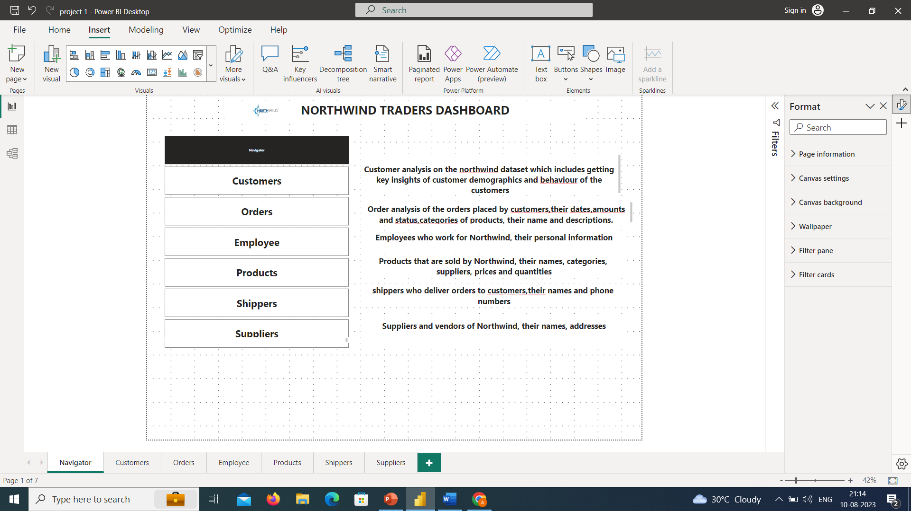

Slide 3

North Wind Analysis
The northwind analysis is A data analysis project that uses the northwind dataset, A sample database that contains data about A fictitious company that sells specialty foods around the world.
The northwind traders dataset offers comprehensive insights into various aspects of the business, focusing on customer analysis, order analysis, employee analysis, product analysis, supplier analysis, and shipper analysis

Slide 4
North wind Exploration
What are the most profitable products and regions for Northwind, and how can they increase their sales and margins?
How do the customers of Northwind differ in their preferences, behavior, and loyalty, and how can they segment and target them effectively?
How can Northwind optimize their order cycle, inventory management, and delivery quality, and how can they forecast their demand and supply?

Slide 5
Approach
Import and Explore the Northwind Database Using Power Bi
Create and Test Hypotheses Using SQL Queries
Visualize and Interpret the Results Using Excel
Discuss the Implications and Recommendations for Northwind

Slide 6
The project will involve the following tasks
Conducting a thorough analysis of the customer behavior, preferences, and loyalty of Northwind products using SQL and Power BI.
Drawing meaningful conclusions and recommendations for enhancing customer satisfaction and retention of Northwind products using various metrics and calculations.
Presenting analysis results, conclusions, and recommendations for stakeholders using a dashboard that highlights the key findings and insights.
The success of the project will be measured by the following metrics:
The accuracy of the analysis
The usefulness of the insights
The effectiveness of the recommendations
This project is significant because it has the potential to improve the customer relationship and competitiveness of Northwind, a fictitious specialty foods export/import company. By understanding the factors that influence customer behavior, preferences, and loyalty of Northwind products, the company can better position itself to succeed in the global marketplace.

Slide 7
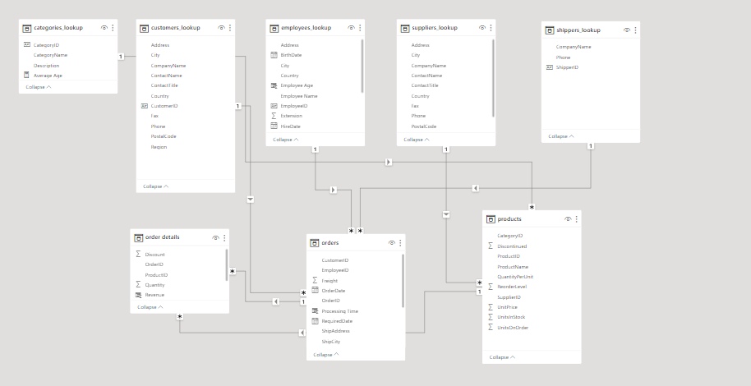
ER DIAGRAM

Slide 8

Power Bi Report

Slide 9
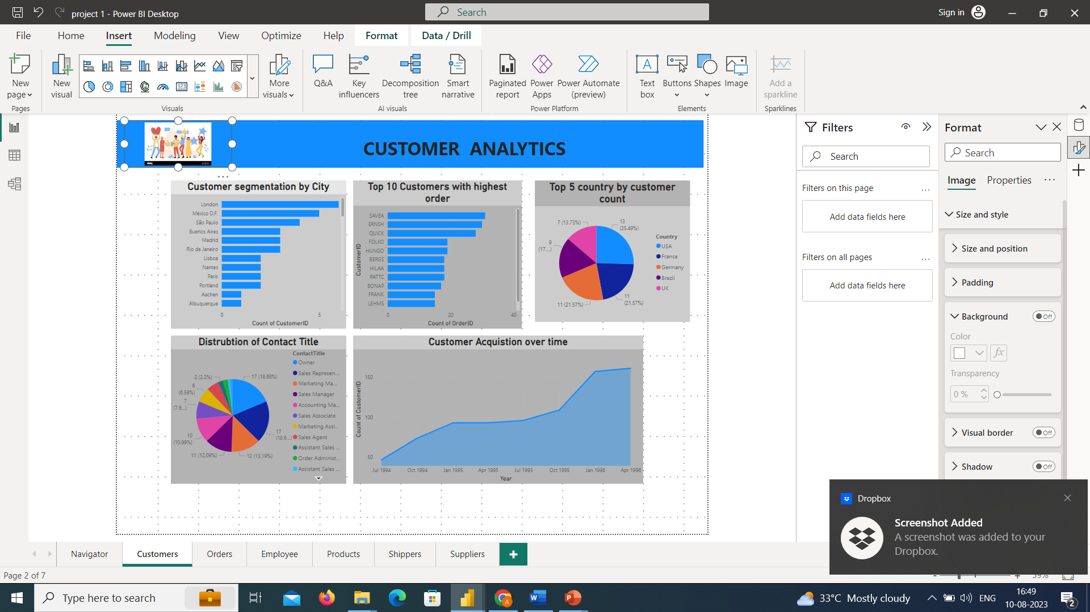

Slide 10
This dashboard primarily focuses on customer demographics and their behavioral Analysis.
First bar chart focuses on the customer segmentation by cities which gives us an insight to the different cities around the world which helps us to focus more on expansion of business over the world
Second chart focuses on the behavioral analysis which is the process of examining and interpreting the actions, interactions, and patterns exhibited by customers when they interact with a product, service, website, app, or any other touchpoint associated with a business. Here we can see the Top 10 customers with highest number of order counts which clearly indicates the customers with a higher retention rate that indicates customer are happy with our products.
Similar to first chart 3rd chart which is a pie chart which focuses on the customer demographics this time with top 5 countries which helps the business to focus more the countries and explore new opportunities in the countries in a view to expanding the business to more new cities.
4th chart is a pie chart which gives the distribution of customer by their Contact Title i.e., job role of different customers.
5th chart is a Area Chart which focuses on customer acquisition over time(i.e. month,year,quarter) which refers to the process of attracting and converting individuals into new customers for a business's products or services.

Slide 11
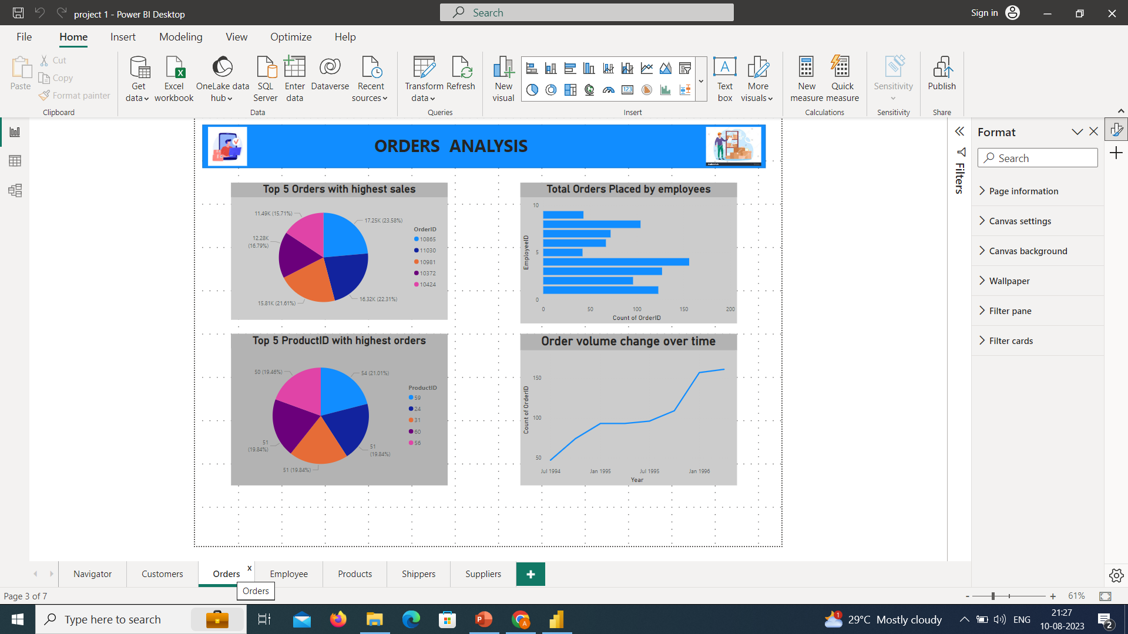

Slide 12
This Dashboard Primarliy focuses on orders made by customers , revenue generated by the orders ,order volume change ,Order placed,different types of products placed.
1st chart gives us a insight to the order values i.e. sales revenue generated by the orders.Here we can see that this pie chart gives the top 5 orders with highest revenue which is a kpi for this business.
2nd pie chart gives us a insight of top 5 product placed with highest orders which signifies the demand of products amongst the customers .
3rd bar chart gives us a insight of Order placed by different employees over their period of service
4th Line chart gives us a insight of order volume change that is orders placed in each year.Here we can see that in each year order count are rising which is a good sign for the business.

Slide 13
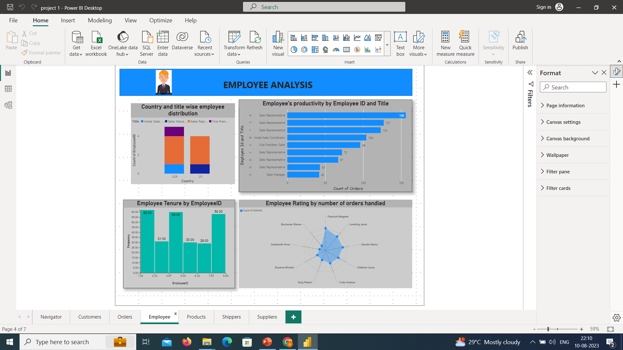

Slide 14
This dashboard focuses on employee demographics ,their work tenure and also their ratings
1st Stacked bar chart describe the employee demographics which includes country and title wise employee distribution
Second bar chart describes the employee productivity by employeeid and title which basically is their productivity count
Third chart which is a histogram describes the employee tenure which shows their loyalty towards their company
Fourth chart which is a spider web tells about the employee rating given by different customers which is a key performance indicator in employee section.

Slide 15
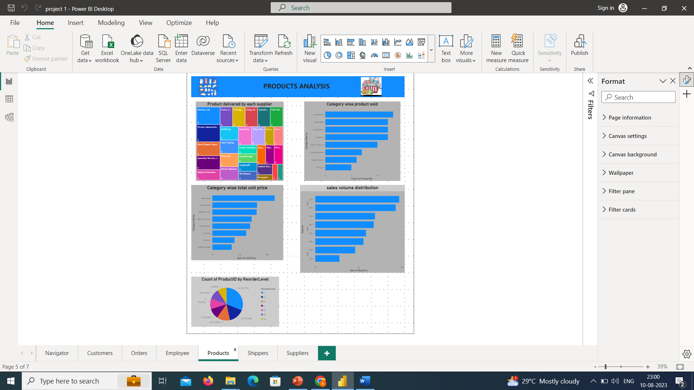

Slide 16
This dashboard comprises of Product analysis of different products sold across different categories
1st chart gives insight distribution of products sold by each supplier in a hierarchical manner
2nd chart gives a insight of category wise product sold across different categories
3rd chart gives a insight of total unit price category wise
4th and 5th chart gives a insight of sales volume that is order quantity over the years and product wise reorder level.

Slide 17
EDA Report

Slide 18
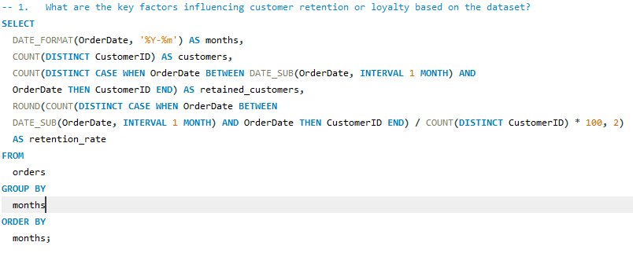
Problem: What are the key factors influencing customer retention or loyalty based on the dataset?
Statement: By the below image there is MySQL query for the above Problem by this I retrieved the data and below there I have uploaded the screenshots of query and the output result.

Slide 19
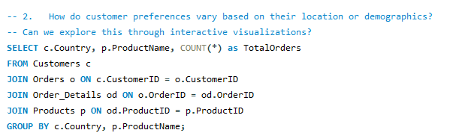
Problem :How do customer preferences vary based on their location or demographics? Can we explore this through interactive visualizations?
Statement: By the below image there is MySQL query for the above Problem by this I retrieve the data uploaded the data on excel and I done the visualization part for this query

Slide 20
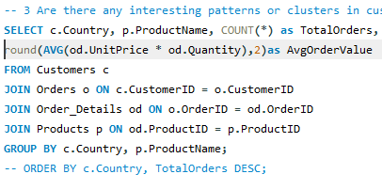
Problem :Are there any interesting patterns or clusters in customer behavior that can be visualized to identify potential market segments?
Statement: By the below image there is MySQL query for the above Problem by this I retrieve the data uploaded the data on excel and I done the visualization part for this query

Slide 21
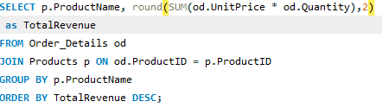
Problem :Are there any specific product categories or SKUs that contribute significantly to order revenue? Can we identify them through visualizations?
Statement: By the below image there is MySQL query for the above Problem by this I retrieve the data uploaded the data on excel and I done the visualization part for this query

Slide 22
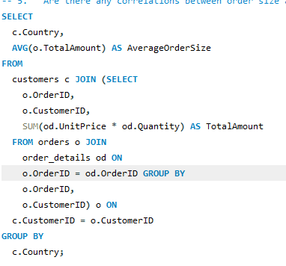
Problem :Are there any correlations between order size and customer demographics or product categories? Can we explore this visually using scatter plots or heatmaps?
Statement: By the below image there is MySQL query for the above Problem by this I retrieve the data uploaded the data on excel and I done the visualization part for this query

Slide 23
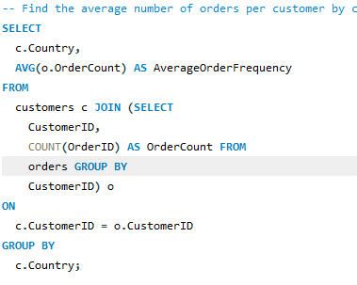
Problem :How does order frequency vary across different customer segments? Can we visualize this using bar charts or treemaps?
Statement: By the below image there is MySQL query for the above Problem by this I retrieve the data uploaded the data on excel and I done the visualization part for this query

Slide 24
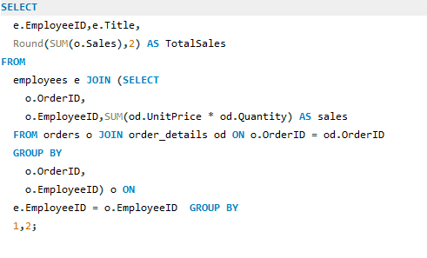
Problem :Are there any correlations between employee satisfaction levels and key performance indicators? Can we explore this visually through scatter plots or line charts?
Statement: By the below image there is MySQL query for the above Problem by this I retrieve the data uploaded the data on excel and I done the visualization part for this query

Slide 25
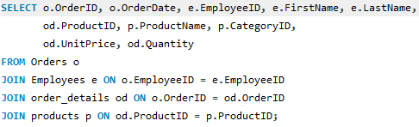
Problem :How does employee turnover vary across different departments or job roles? Can we visualize this using bar charts or heatmaps? Statement: By the below image there is MySQL query for the above Problem by this I retrieve the data uploaded the data on excel and I done the visualization part for this query

Slide 26
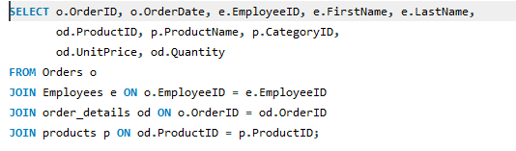
Problem :Are there any correlations between product attributes (e.g., size, color, features) and sales performance? Can we explore this visually using scatter plots or heatmaps?
Note : There is no size ,color on my data filed so I did my own analysis to check the correlations between the products of unit price and quantity
Statement: By the below image there is MySQL query for the above Problem by this I retrieve the data uploaded the data on excel and I done the visualization part for this query

Slide 27
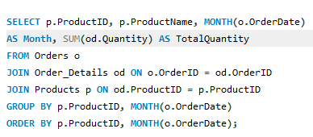
Problem :How does product demand fluctuate over different seasons or months? Can we visualize this through line charts or area charts?
Statement: By the below image there is MySQL query for the above Problem by this I retrieve the data uploaded the data on excel and I done the visualization part for this query

Slide 28
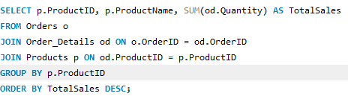
Problem :Can we identify any outliers or anomalies in product performance or sales using visualizations? How can this information be used for product optimization?
Statement: By the below image there is MySQL query for the above Problem by this I retrieve the data uploaded the data on excel and I done the visualization part for this query

Slide 29
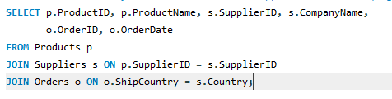
Problem :Are there any correlations between supplier attributes (e.g., location, size, industry) and performance metrics (e.g., on-time delivery, product quality)? Can we explore this visually through scatter plots or heatmaps?
Statement: By the below image there is MySQL query for the above Problem by this I retrieve the data uploaded the data on excel and I done the visualization part for this query

Slide 30
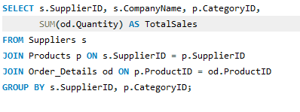
Problem :How does supplier performance vary across different product categories or departments? Can we visualize this using stacked bar charts or grouped column charts?
Statement: By the below image there is MySQL query for the above Problem by this I retrieve the data uploaded the data on excel and I done the visualization part for this query

Slide 31
Understand the sales performance of different products, categories, regions, and customers. By using various metrics such as total sales, average sales, profit margin, and growth rate, we can identify the best-selling and the least-selling products, categories, regions, and customers. We can also compare the sales performance across different dimensions and time periods to discover trends and patterns.
Understand the customer behavior and preferences of different segments. By using various techniques such as clustering, segmentation, and association rules, we can group customers based on their characteristics and purchase history. We can also find out what products are frequently bought together by different customers. This can help us tailor our marketing and promotion strategies to target different customer segments and increase customer loyalty and retention.
Understand the supply chain and inventory management of different products and suppliers. By using various methods such as forecasting, optimization, and simulation, we can predict the demand and supply of different products and suppliers. We can also find out the optimal order quantity, reorder point, and safety stock level for each product and supplier. This can help us reduce costs, improve efficiency, and avoid stockouts or overstocking.
Understand the employee performance and satisfaction of different roles and regions. By using various measures such as sales quota, commission rate, bonus amount, and employee survey results, we can evaluate the performance and satisfaction of different employees. We can also compare the employee performance and satisfaction across different roles and regions to identify gaps and opportunities for improvement.

