Slide 1

ALUMNILINK Alumni-student connection portal
TEAM MEMBERS:
ANSU KURIAN
DEVIKA SAJI
ANGEL SEBASTIAN
SUNISHA K.S

Slide 2
MOTIVATION
Create a centralized platform to connect alumni , students and the college.
Enhance learning and professional opportunities through collaboration.
Promote alumni engagement via events , meetups and department level interactions.

Slide 3
APPLICATIONS
Students: Gain mentorship, explore internship and career opportunities from alumi and collaborate on projects.
Alumni: Contribute through mentorship, job refferals and events.
Institution: Strengthen alumni relationships and improve placement support.

Slide 4
PROBLEM STATEMENT
To develop a website for alumni-student collaboration, career guidance and resource management.

Slide 5
GAP ANALYSIS OF EXISTING PRODUCTS
General platforms like LinkedIn are not tailored for specific institutions.
Lack of college-specific features such as mentorship requests and project collaboration tools.
Minimal alumni involvement in campus activities

Slide 6
WEAKNESSES OF EXISTING SYSTEM
Existing platforms lack a direct focus on college-specific needs.
Limited support for collaboration between students and alumni.

Slide 7
USE CASE
Explore Internships: Students can explore and apply for internships posted by alumni or organizations.
Manage Funds: Alumni incharge can access information or requests related to fund allocation, typically for projects or events and manage the datas of these funds.
Manage Refferals: Students can request referrals for internship opportunities or higher studies from alumni. Alumni can process and provide these referrals.
Collaborate Project: Students can post community-focused project ideas and alumni or their companies who are ready to collaborate to support and implement these ideas can.

Slide 8
USE CASE
Support Placement: Students receive guidance for placements via alumni and resources provided.
Organize Events: Alumni can initiate or participate in organizing events like alumni meets, workshops, or networking sessions.
Post Internship: Alumni can post internship opportunities for students, enhancing job readiness which are offered by their companies or any other.
Generate Reports: The alumni incharge oversees data management, tracking the system’s activities, and generating reports for analysis.

Slide 9
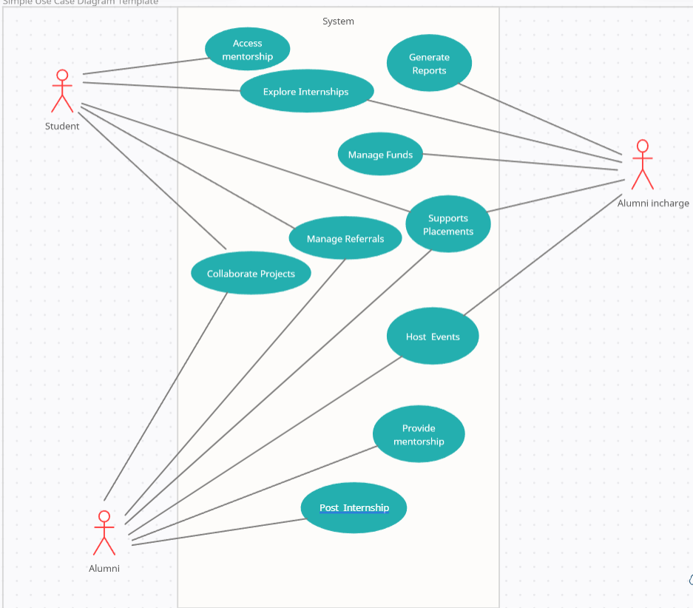

Slide 10
THANK YOU

