Slide 1

MODULE 2 FUNDAMENTALS OF COUNTING THEORY
ANSU KURIAN

Slide 2
The Rule of Sum
If a first task can be performed in m ways, while a second task can be performed in n ways, and the two tasks cannot be performed simultaneously, then performing either task can be accomplished in any one of m+n ways.
Ex. A college library has 40 textbooks on Sociology and 50 textbooks dealing with Anthropology. By the rule of sum, a student at this college can select among 40+50 = 90 textbooks in order to learn more about one or the other of these two subjects.

Slide 3
Extension of Sum Rule
Extension of Sum Rule: If tasks T1, T2,……, Tm can be done in n1, n2, n3, ……, nm ways respectively and no two of these tasks can be performed at the same time , then the number of ways to do one of these tasks is n1 + n2+…+nm.
Ex. If a student can choose a project either 20 from Mathematics or 35 from Computer Science or 15 from Engineering, then the student can choose a project in
20 + 35+15= 75 ways.

Slide 4
The Rule of Product
If a procedure can be broken down into first and second stages, and if there are m possible outcomes for the first stage and if, for each of these outcomes, there are n possible outcomes for the second stage, then the total procedure can be carried out, in the designated order, in mn ways.
Ex. The drama club of central University isis holding tryouts for a spring play. With 6 men and 8 women auditioning for the leading male and female roles. By the rule of product, the director can cast his leading couple in 6* 8= 48 ways

Slide 5
Extension of Product Rule
Extension of Product Rule: Suppose a procedure consists of performing tasks T1, T2,……, Tm in that order. Suppose task Ti can be performed in ni ways after the tasks T1, T2,……, Ti-1 are performed, then the number of ways the procedure can be executed in the designated order is n1, n2,……, nm.
Ex.Charmas brand shirt available in 12 colors, has a male and female version. It comes in four sizes for each sex, comes in three makes of economy, standard and luxury. Then the number of different types of shirts produced are 12*2*4*3=288 ways

Slide 6

PERMUTATIONS

Slide 7
PERMUTATIONS
Def: Given a collection of n distinct objects, any (linear) arrangement of these objects is called a permutation of the collection. If there are n distinct objects and r is an integer, with 1≤r≤n, then by the rule of product, the number of permutations of size r for the n objects are
P(n, r) = n×(n-1)×(n-2)×……..×(n-r+1)= n!/ (n-r)!

Slide 8

Ex. How many arrangements are there of all the letters in COMPUTER be arranged?
Sol: 8!
Ex. How many arrangements are there of all the letters in DATABASES be arranged?
Sol: 9!/ (2! 3!) = 30, 240.
Ex.(a) In how many ways can seven people be arranged about a circular table?
(7-1)!
(b) If two of the people insist on sitting next to each other, how many arrangements are possible?
H &W+5=6 members= (6- 1)!*2!=5! 2!

Slide 9

COMBINATIONS

Slide 10
COMBINATIONS
If we start with n distinct objects, each selection, or combination, of r of these objects, with no reference of order, corresponds to r! permutations of size r from the n objects. Thus the number of combinations of size r from a collection of size n is C(n, r) = P(n, r)/ r!= n!/ [r! (n-r)!]; 0≤r≤n.
Ex. A student taking a history examination is directed to answer any seven of 10 essay questions. Student can answer the examination in C(10, 7)= 120 ways

Slide 11
.
Ex.A student taking a history examination is directed to answer three questions from the first five and four questions from the last five.
Student can complete the examination in C(5, 3) * C(5, 4)= 50 ways.
Ex. A student taking a history examination is directed to answer 7 of the ten questions where atleast three are selected from the first five.
Then there are three cases (i) The student answers three of the first five questions and four of the last five questions, C(5,3) C(5,4)= 50 ways. (ii) C(5, 4) C(5,3)= 50 ways (iii) C(5,5) C(5, 2)= 10 ways Hence student can complete the examinations in 50+50+10 ways= 110 ways.

Slide 12
.
Ex. How many arrangements of the letters in MISSISSIPPI have no consecutive S’s Sol.
Number of arrangements of the letters is 11!/(4!4!2! 1!)
When we disregard the S’s, there are 7!/(4!2! 1!)=105 ways to arrange the remaining letters.
One of the arrangements as follows I I M I P I P and eight possible locations for the four S’s.
Four of these locations can be selected in C(8, 4)= 70 ways and because this is also possible for all other 104 arrangements.
Hence by rule of product there are 105×70=7,350 arrangements of the letters in MISSISSIPPI with no consecutive S’s.

Slide 13
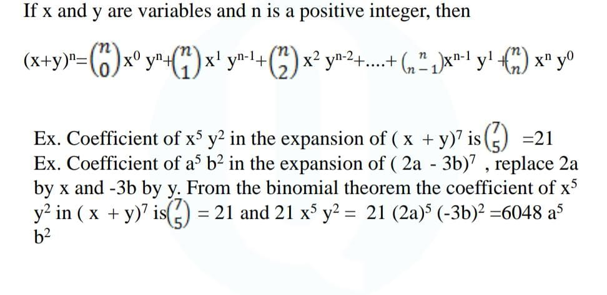
BINOMIAL THEOREM

Slide 14

PIGEON HOLE PRINCIPLE

Slide 15
THE PIGEON HOLE PRINCIPLE
The Pigeonhole principle-If n pigeons are assigned to m
pigeonholes, and m<n, then atleast one pigeonhole contains
two or more pigeons.
Ex. An office employs 13 file clerks, so atleast two of them
must have birthdays during the same month.
Sol. Here we have 13 pigeons and 12 pigeonholes ( the month
of the year). By pigeonhole principle atleaast two of them must
have birthdays during the same month

Slide 16
EXAMPLE
Ex. Show that if any five numbers from 1 to 8 are chosen, then two of them will add up to 9.
Sol. Construct four different sets, A1= {1, 8}, A2= {2, 7}, A3= {3, 6}, A4= {4, 5}. Each of the five numbers chosen must belong to one of these sets. Since there are only four sets, by pigeonhole principle, two of the chosen numbers belong to the same set. These numbers add up to 9.

Slide 17
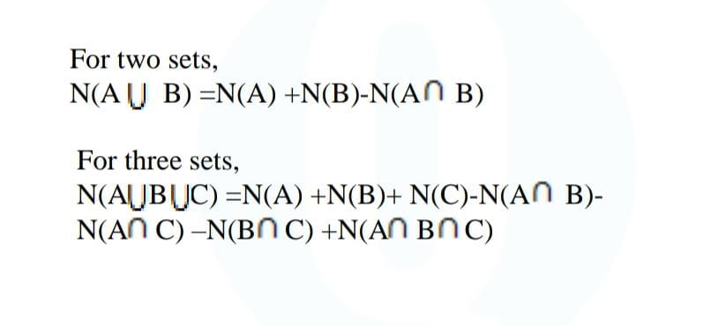
PRINCIPLE OF INCLUSION AND EXCLUSION THEOREM

Slide 18
EXAMPLE
Ex. Let S represent the set of 100 students enrolled in the freshman engineering program at Central College. Then |S| =100. Now let c1, c2 denote the following conditions satisfied by some of the elements of S:
c1 : A student at Central college is among the 100 students in the freshman engineering program and is enrolled in freshman competition.
c2 : A student at Central college is among the 100 students in the freshman engineering program and is enrolled in Introduction to Economics. Suppose that 35 of these 100 students are enrolled in Freshman Competition and that 30 of them are enrolled in Introduction to economics. If nine of these 100 students are enrolled in both Freshman Composition and Introduction to Economics. Find the number of students not taking both the course.
Ans.44

Slide 19
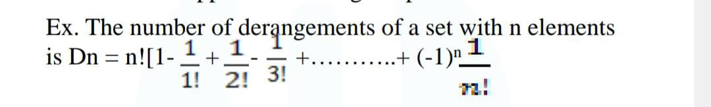
DERANGEMENTS
Derangement is a permutation of the elements of a set, such that no element appears in its original position.

Slide 20
EXAMPLE
Ex. A postman can put 12 letters into their respective envelopes such that exactly 5 will go into the right envelope. Find the number of ways of doing this work
Sol. The number of ways in which the 5 correct envelopes can be selected = 12C5 = 864 Derangement of the remaining 7 envelopes & letters = 1864 (derangement value for 7 is 1864) Total No of ways of arrangement = 1864 * 864 = 1610496.

Slide 21
THANK YOU

