Slide 1
Greenways (Small things make a big difference)
Ansuman Das
Inzemam Baig
Kunal Samantaray

Slide 2
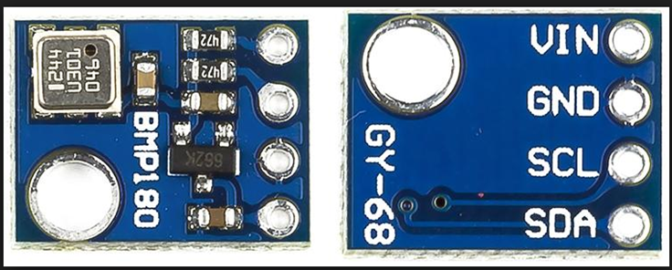
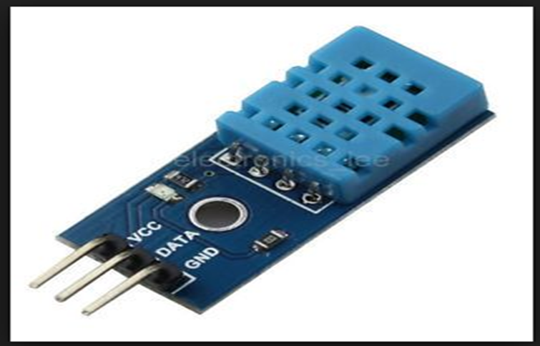
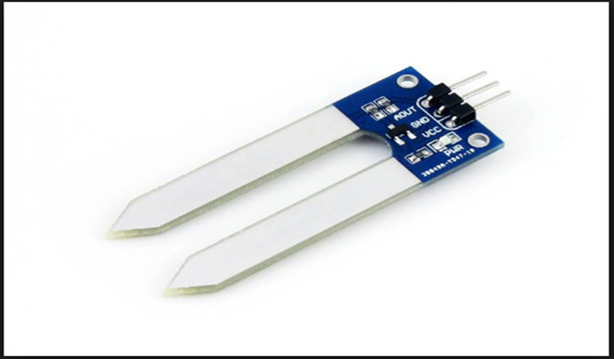
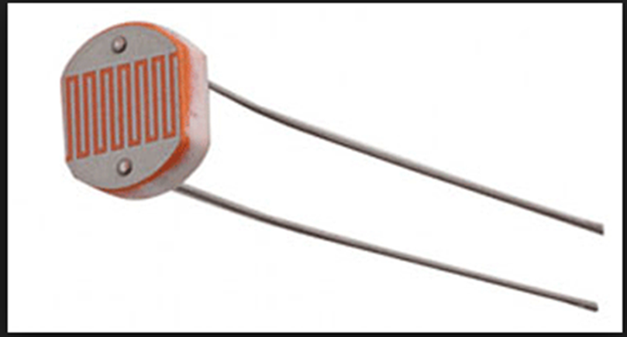
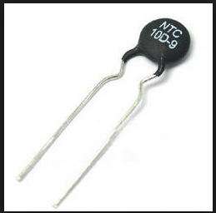
-> Height sensor
Humidity sensor <-
->Moisture sensor
Light sensor <-
->Temperature sensor
Gas sensor<-

Slide 3
These sensors are like artificial sensing organs for a monitoring system. These sensors acts like a bridge between the natural environment and computer system. Our idea is to combine all these small components and get all relevant data to a distant monitoring system.
Through this we can collect the precise data for a long period of time and analyze the difficulties and harsh challenges of a particular area and then for the next time we can use that data and overcome that situation in advance.
With passing of time the systems gets smarter by itself.
By using AI we can also make a automatic recommendation system.

Slide 4
Our Technology can serve in Horizontal Gardening
We have developed a novel combination of bamboo palm, snake plant and aloe vera to reduce volatiles and particulate matter in city air.
Horizontal Gardening will create a aesthetic value to any home.

Slide 5
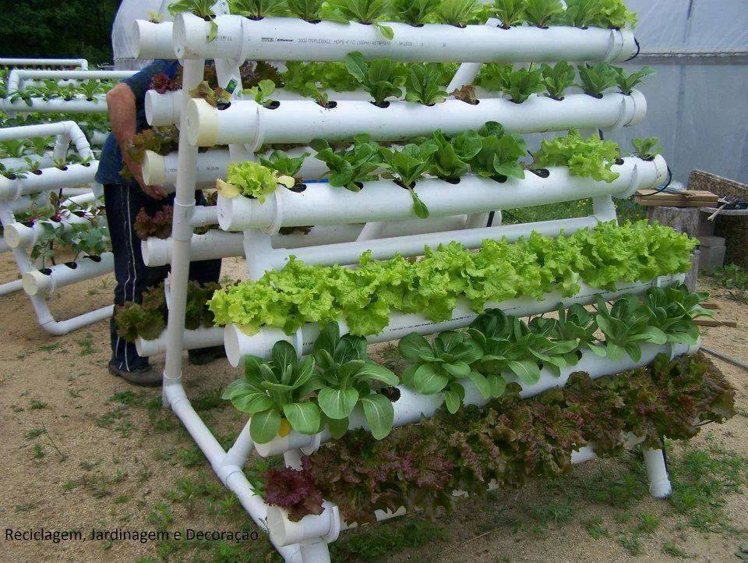
Horizontal Gardening

Slide 6
Eliminates nitrogen and formaldehyde. It performs C4 cycle of carbon fixation and utilizes CO2 to give out oxygen even at night. Therefore, it can be kept in sleeping areas.
Eliminates carbon monoxide, xylene, benzene and formaldehyde.
Eliminates benzene and formaldehyde. It also has medicinal value.
We have Combination of indigenous mosses (belonging to genus Sphagnum, Taxiphyllum and Vesicularia), which rejuvenates air in closed spaces by removing particulate matter and reducing carbon dioxide and nitrogen oxides.
Snake Plant
Bamboo Palm
Aloe Vera
Moss

Slide 7
Moss
Advantage:-
Mosses used are native to our country and would not be an invasive species. The complement of mosses can be tuned for region and state to best match naturally available species.
Disadvantage:-
Mosses release spores.

Slide 8
Spores control mechanism
We have used BMP180 sensor to monitor the growth of mosses, at a particular stage where mosses generate spores the sensor will give feedback to motor unit to cut the sporulant part.

Slide 9
Our technology can serve in agriculture sector by:
rationalising water use
providing agriculturally important data points from multiple sensors covering the whole field (moisture, temperature, air quality, humidity of air, intensity of sunlight)
improving fertilizer/ manure use by tracking plant growth (IR sensor, BM180) and timing agricultural strategies for maximum yield.
This sensor can also track weed growth and help use weedicides judiciously.

Slide 10
Home-suitable plants and herbs inside small spaces of modern homes (and apartments).
Moisture sensors and water drip controllers to optimize water usage per plant and make home garden cultivation less laborious.
Our smart home gardens also entail a set of plants proven to facilitate better air quality by removing particulate matter and reactive oxide species (Nitrogen oxides).

Slide 11
Moisture sensor will be giving analog value which can be read through Arduino, So value is low moisture sensor will detect the scarcity of water in soil and motor pump will be started and analog value is high the water pump will be stopped.
Mq135 is a gas sensor used for detecting the presence of NH3, NOx, Alcohol, benzene, smoke, CO2 etc. We interfaced this sensor with our greenways app.
BMP180 sensor we have used to detect the overall growth of plants while checking attributes like height, humidity in air, temperature etc. We interfaced this sensor with our greenways app.
Soil Moisture Sensor
Mq135 Gas Sensor
BMP180 Sensor

Slide 12
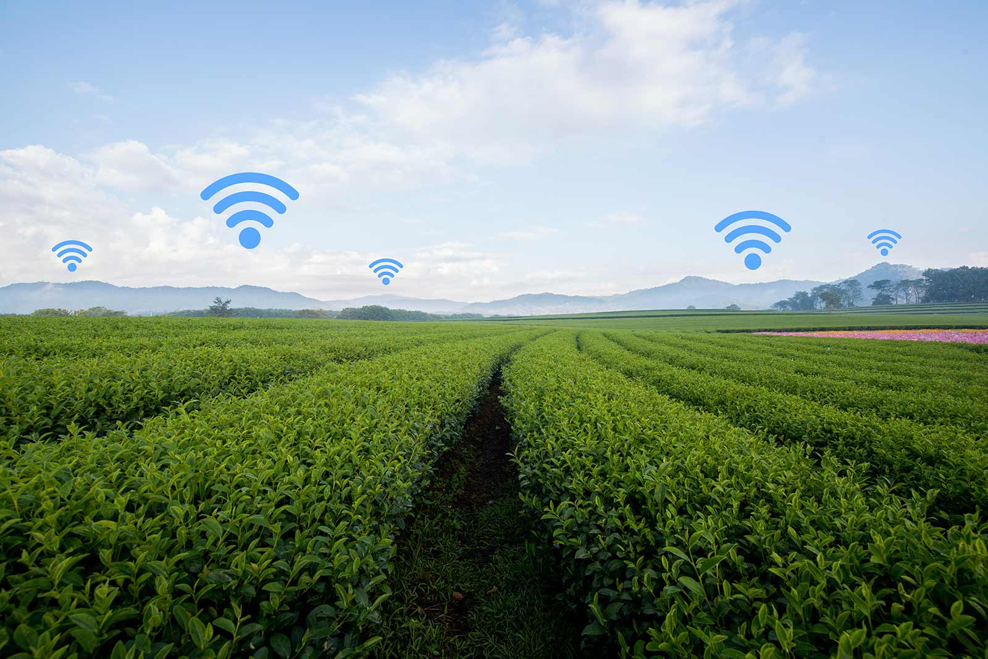
Smart Agriculture

Slide 13
Growth of the plant, Temperature, Humidity of air can also be monitored through integrated sensors.
We have use IR and BMP180 sensors that would track the growth of plants as well as weed.
This would enable judicious weedicide application.

Slide 14
Current drip irrigation systems, while better than traditional systems, are not integrated to sensors. This results in uniform soil irrigation and, often, use of more water than required. Moisture sensors we have used can be widely distributed across the agricultural field area.
All these data collected through our device are utilized to improve the yield of crop.
Majority of population depends on agriculture products hence productivity and yield of the crop are major parameters, which our device helps to fulfil.

