Slide 1
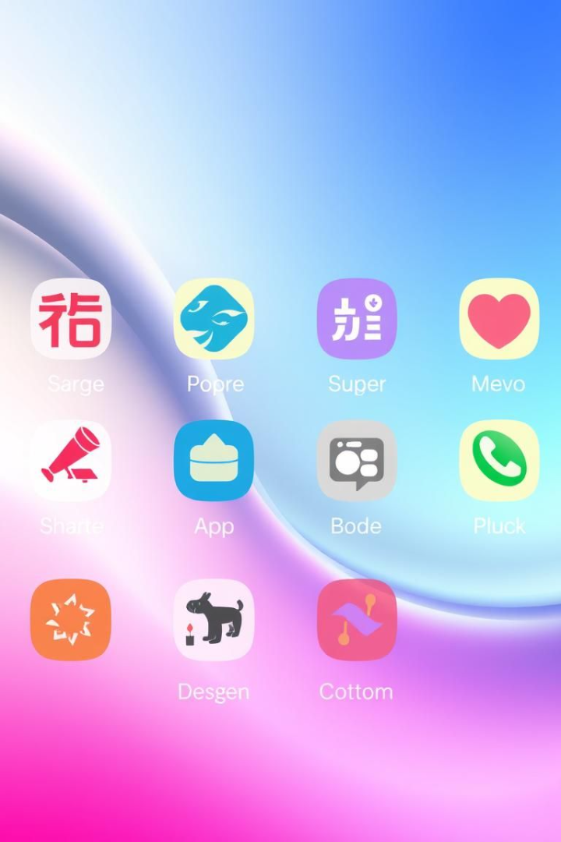
Real-Time Language Translator with Python & Tkinter
Introducing a dynamic, voice-activated language translator built with Python and Tkinter. It features real-time translation, a user-friendly interface, voice input, and personalization. This is made using Python, Tkinter, and the Google Translate API, and the SpeechRecognition library. Aimed at language learners, travelers, and communication enthusiasts.
Designed By :
Ansuman Mahapatra
Biswajeet Patra
Tapan Ku. Sahoo

Slide 2
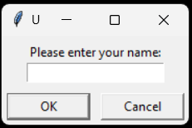




Real-Time Translation Engine
The core logic leverages libraries like googletrans or translatepy for real-time translation. Manage API keys, rate limits, and errors. Supports languages such as English, Spanish, French, and Mandarin. Speed is measured in milliseconds, and accuracy is measured with a BLEU score.
API Selection
Choose translation API
Text Input
Receive text
Translation
Translate with selected API
Display
Show translated text

Slide 3
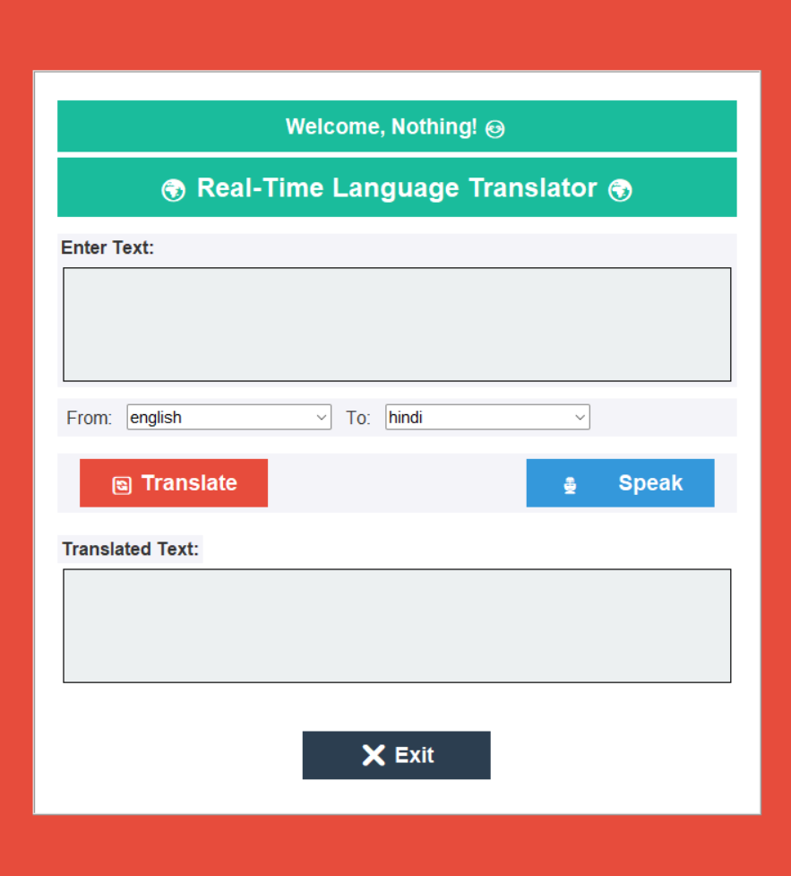



Tkinter UI Implementation
The UI includes input and output text areas and language selection dropdowns. Key Tkinter widgets include Text, Entry, OptionMenu, Button, and Label. Event handling binds functions to UI events like button clicks and dropdown changes. For instance, translate\_button = Button(root, text="Translate", command=translate\_text). Other GUI libraries are Tkinter, PyQt, and Kivy.
Text Area
Dropdown Menu
Button

Slide 4




Architecture and Implementation
Input
The user provides text or voice input.
Processing
The input is processed and cleaned.
Translation
Text is translated via API in a separate thread.
Output
The translated text is displayed to the user.

Slide 5



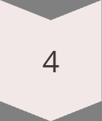
Enhanced User Interface
Elevate the user experience by implementing dynamic background color transitions using Tkinter's after() method, creating a visually engaging environment. Personalize the interface by using simpledialog.askstring() to capture the user's name and display a welcoming message like "Welcome, [User Name]!" within the UI. Refine the visual aesthetics with thoughtfully chosen color schemes, modern fonts, and consistent styling using ttk.Style for a polished look.
Prompt User
Display Name
Color Change
Style Elements

Slide 6
Voice Input Integration
Use the speech\_recognition library for voice input. Handle microphone access and device selection. Implement voice-to-text conversion, such as r.recognize\_google(audio). Address noise, accents, and recognition failures. This will allow the user to give voice command to be translated.
1
Access Microphone
2
Convert Voice to Text
3
Address Errors

Slide 7
Architecture and Implementation
Use modular design to break the project into reusable functions and classes. Structure the code for input processing, translation, output display, and voice capture. Perform translation in a separate thread to prevent UI freezing, such as using threading.Thread(target=translate\_text).start().
Input
Translate
Output
Process input
Translate text
Display translation

Slide 8



Demo and Example
Showcase real-time translation, voice input, and UI features. Highlight key code segments like the translation function and voice capture. Demonstrate practical applications of the translator. Seeing a functional demonstration is an important step in verifying the program.
Translation
1
Real-time translate
Voice Input
2
Capture voice
Interface
3
Display features

Slide 9

Conclusion
Key features and technologies are reviewed. There is room for improvements such as adding more languages and improving accuracy. There is also a potential for adding offline mode. Users are encouraged to try the translator and provide feedback. Links to libraries, APIs, and documentation are provided.
Future Scope
User Feedback
Add Languages
Provide feedback
Resources
Links to APIs

