Slide 1

SCHOOL OF ENGINEERING AND TECHNOLOGY
DEPARTMENT OF COMPUTER SCIENCE AND ENGINEERING
MINOR/LEARNING PROJECT
PRESENTATION ON LANGUAGE
TRANSLATOR
Presented By:
Ansuman Mahapatra(23UG010605)
Biswajeet Patra(23UG010614)
Tapan Kumar Sahoo(23UG010632)
Under the Guidance of Mr.Himansu Barik Sir
Mr. Himansu Barik
Assistant Professor
Dept. Of CSE,
GIET University , Gunupur

Slide 2
OUTLINES
S.NO. | CONTENTS | PAGE NO.
1 | PROBLEM STATEMENT | 3
2 | INTRODUCTION | 4
3 | TECHNOLOGIES USED | 5
4 | NECESSARY DIAGRAMS | 6
5 | FEATURES | 7
6 | CHALLENGES | 8
7 | LIMITATIONS | 9
8 | SCREENSHOTS | 11
9 | CONCLUSION | 16
10 | FUTURE ENHANCEMENT | 17
11 | REFERENCES | 18

Slide 3
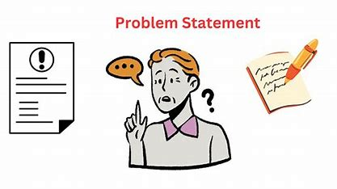
PROBLEM STATEMENT
In a world of increasing globalization, language barriers continue to hinder effective communication across cultures. Whether in education, healthcare, tourism, or daily conversations, real-time multilingual communication remains a challenge for individuals without fluency in other languages. Existing translation tools are often not beginner-friendly, lack real-time speech capabilities, or require constant internet connectivity.
This project addresses the need for an intuitive, real-time language translator application that supports both text and speech input, instantly translates between multiple languages, and securely tracks user sessions using a database. It aims to bridge language gaps and enhance cross-lingual communication for users in everyday scenarios.

Slide 4
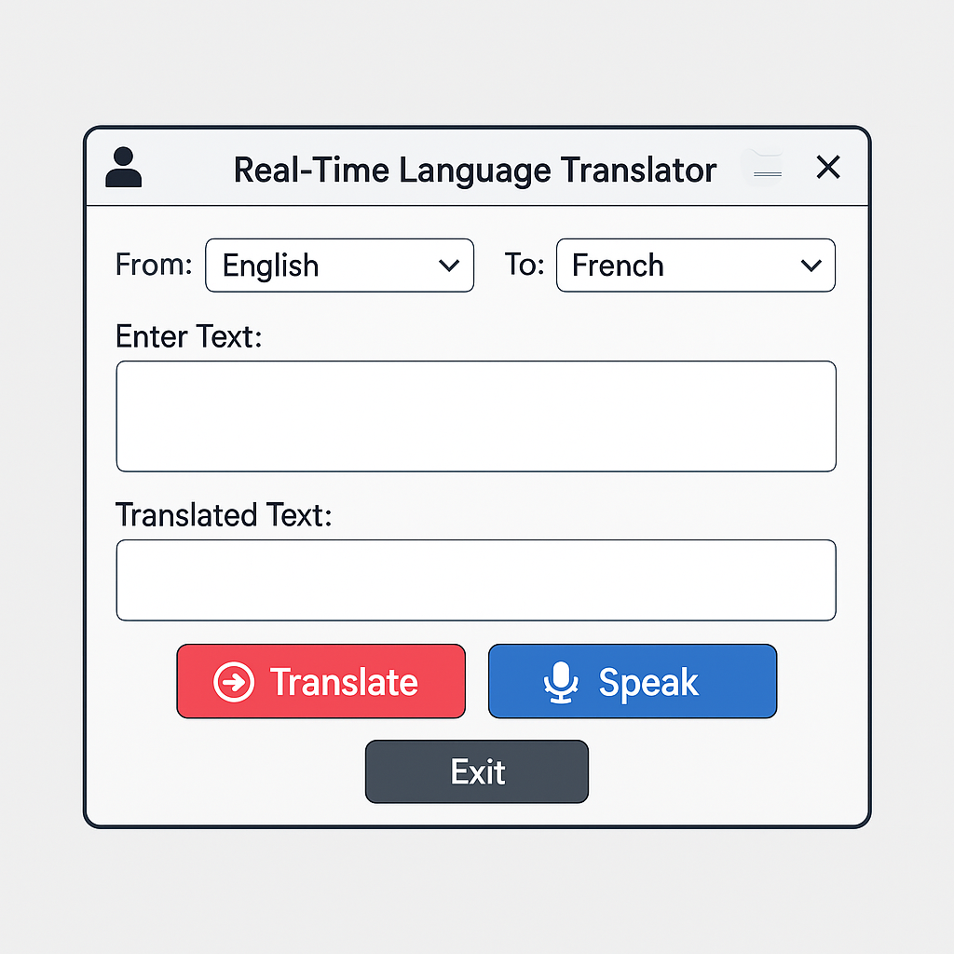
INTRODUCTION
Language differences often create barriers in communication, especially in global settings. This project introduces a Real-Time Language Translator App that:
Translate both text and speech immediately
Supports multiple languages
Uses a simple and interactive GUI
Logs user login with admin level access

Slide 5
TECHNOLOGIES USED
Frontend / GUI
Tkinter – Python's built-in library for creating desktop GUI applications
Pillow (PIL) – For displaying animated splash GIFs
Translation & Speech
deep_translator (GoogleTranslator) – To perform multilingual text translation
speech_recognition – For converting voice input into text
Backend / Database
MySQL – To store and manage user login details securely
mysql-connector-python – For connecting Python with MySQL database
Other Tools / Libraries
Threading – To handle voice recognition without freezing the GUI
Datetime – To store login timestamps
Random – For UI color and style animations

Slide 6
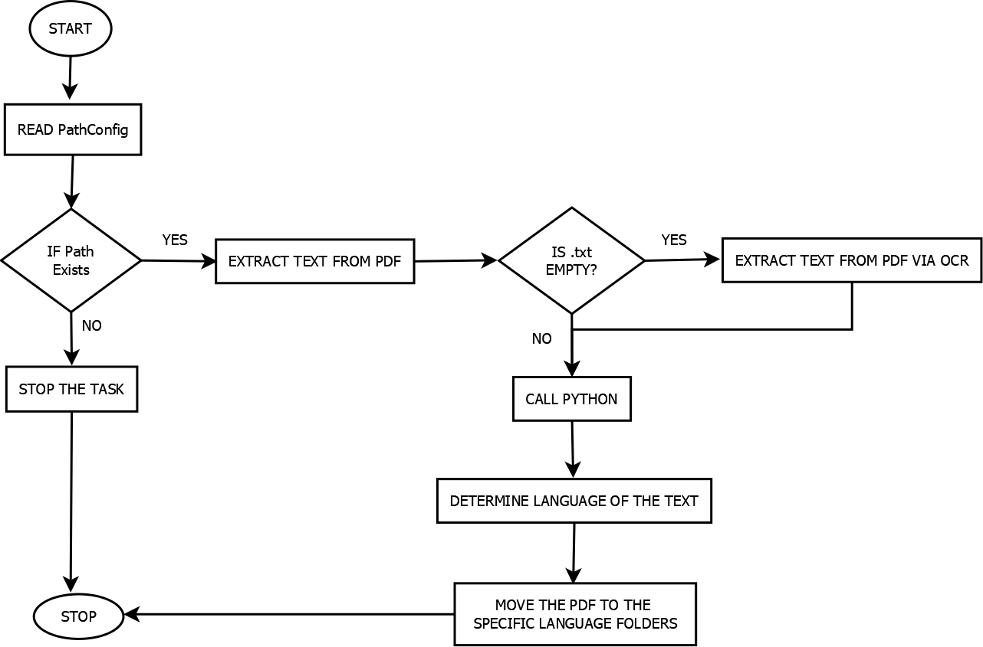
ER - Diagram

Slide 7
Key Features
Real-Time Text Translation Translates typed text between multiple languages instantly.
Speech-to-Text Translation Converts spoken words to text and translates them in real time.
Multi-Language Support Supports a wide range of languages using Google Translator API.
Admin Login System Admins can log in securely and view user login activity from the database.
User Login Logging Automatically logs each user’s name and login time in MySQL database.
Animated Splash Screen Engages users with a visually appealing startup animation.
Dynamic UI Styling Background and footer styles change dynamically for a modern feel.
Easy-to-Use Interface Intuitive GUI design for all users, no technical skills needed.

Slide 8
Challenges Faced
Language Detection & Mismatch Ensuring correct source and target language combinations without manual errors.
Database Connectivity Issues Handling connection errors and exceptions while logging user data in MySQL.
Thread Handling in GUI Preventing the app from freezing during voice recognition by using threading properly.
Dependency Conflicts Managing Python package versions (like deep_translator and speech_recognition ) during development .
Speech Recognition Accuracy Dealing with background noise and different accents affected voice-to-text conversion.

Slide 9
Limitations of the Application
Internet Dependency
The translator (GoogleTranslator) and speech recognition (recognize_google)
both require an active internet connection.
Without it, translations and voice input will fail.
No Language Detection
Users must manually select source and target languages.
There's no automatic detection of input language.
Speech Input is Time-Limited
Listens for a fixed duration (5 seconds) only.
Doesn't support continuous or long speech-to-text conversion.
Limited Admin Security
Admin credentials are checked directly from the database without hashing.
There's no session timeout or attempt logging.

Slide 10
Limitations of the Application
No Offline Mode
Entire functionality breaks without online services (no offline fallback).
No Error Logging System
Errors are only displayed to users; there's no logging to file or database for debugging.
No Translation History
Translated results are not saved or retrievable later.
UI Responsiveness
The app is built with Tkinter, which isn’t ideal for advanced responsive or mobile-friendly UI.

Slide 11
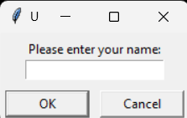
SCREENSHOTS
USER LOGIN PAGE : -

Slide 12

SCREENSHOTS
WELCOME PAGE : -

Slide 13
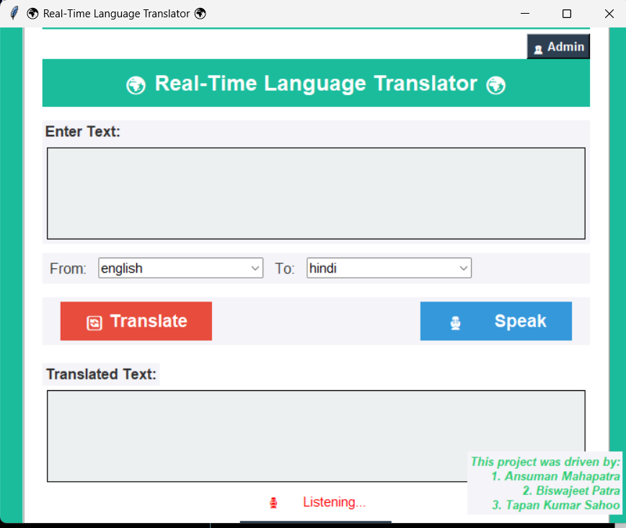
SCREENSHOTS
TRANSLATOR PAGE (MAIN PAGE) : -

Slide 14
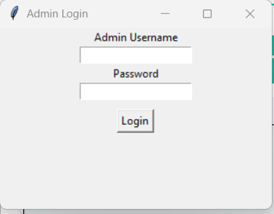
SCREENSHOTS
ADMIN LOGIN PAGE : -

Slide 15
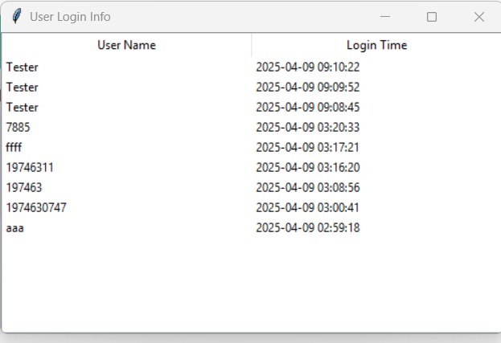
SCREENSHOTS
ADMIN PAGE THAT SHOWS USER LOGINS : -

Slide 16
CONCLUSION
This Real-Time Language Translator bridges the communication gap by offering instant text and speech-based translations using Google Translate API and speech recognition.
It ensures a user-friendly interface with vibrant visuals, splash screen, and admin monitoring features.
The application also logs user login history securely using MySQL, adding an extra layer of management and analysis.
Though it has some limitations (like internet dependence and basic admin security), the project successfully demonstrates the integration of GUI, databases, speech tech, and real-time translation in a single application.
With future improvements like offline support, history tracking, and advanced voice handling, it has the potential to evolve into a full-fledged productivity tool.

Slide 17
Future Enhancements
Offline Translation Support
Integrate offline language packs to allow translation without internet access.
Smart Language Detection
Automatically detect the source language instead of requiring manual selection.
Translation History & Export
Save past translations and allow users to export or review them later.

Slide 18
References
Google Translate API
https://pypi.org/project/deep-translator/
Speech Recognition Library (Python)
https://pypi.org/project/SpeechRecognition/
Tkinter Documentation (GUI Library)
https://docs.python.org/3/library/tkinter.html
Pillow (Image Handling)
https://pypi.org/project/Pillow/
MySQL Connector for Python
https://pypi.org/project/mysql-connector-python/

Slide 19
Q&A
Thank you all for your attention! Any questions?

