Slide 1
WP 3&4 Workshop @Paris Alstom 25.03.2015 – User Stories
Baseliyos Jacob, DB Netz AG

Slide 2
Construct User Story
Defined by:
OPERATOR (WP 1 and WP 4)
User Story
BREAKDOWN
OPERATORand EUG
Use Cases
Use Cases
Use Cases
Use Cases
MATRIX
Industry (Alstom and Siemens)
ETCS Onboard
Functions
ETCS Onboard
Functions
ETCS Onboard
Functions
SIMULATION
Simulation

Slide 3
Documentation Situation
User Stories: defined by the Operator
Functional Scenarios List: defined by the Operator and EUG
ETCS Onboard Unit Function List: defined by the Industry
(Siemens and Alstom in Charleroi Workshop 11/2013)
ETCS Onboard Decomposition and Data Dictionary:
delievered by Alstom in 10/2013.

Slide 4
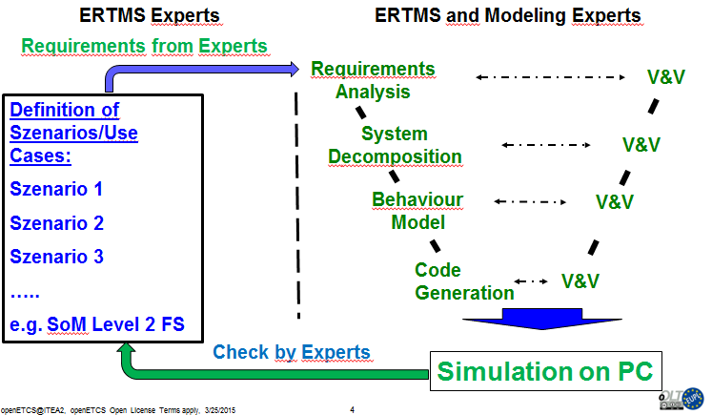
Workflow

Slide 5
Proof of concept Utrecht – Amsterdam ETCS Level 2 - Milestones
M 1: Architecture
and process
M 2: First Demonstration
of choosen scenarios
01.12.2014
27.03.2015
M 4: Final proof on
Amsterdam - Utrecht
M 3: First proof on
Amsterdam - Utrecht
Shift2Rail
30.06.2015
30.10.2015

Slide 6
User Stories Utrecht – Amsterdam Roadmap
Roadmap
US 1: Start of Mission – Awakness of Train
US 2: Start of Mission – Start running in Level 2 Mode FS
US 3: Brake Intervention
US 4: Reading and sending of track information
Starting in Utrecht CS -> Amsterdam CS
US 5: Start of Mission – Start in STM in Level 2
US 5: Change from Shunting to FS Level 2
US 6: Sending the Position Report
US 7: Establishement and Maintenance the RBC Session
US 8: Receving of MA on the track for „free section“
US 9: End of Mission
Scenarios in Operation on Track
US 10: Train stops before Signal Maker Board after revoked Movement Authority (MA)
US 11: Mode Change and communication with the RBC
US 12: Behavior of the OBU after a TRIP
US 13: Route is cancelled from the end of route signal
………………… → Further User Stories
M 2: First
Demonstration
of selected
scenarios
Today
M 3: First proof
on Amsterdam
- Utrecht
30.06
M-Iteration: proof
on Amsterdam
- Utrecht
30.07

Slide 7
Example
User Story 5: Start of Mission – Start STM in Level 2
BREAKDOWN
Functional Scenarios:
→ 1.1 Onboard stored level is 2/3 and is „valid“
→ 37.2. Entry into a shunting area commanded by RBC for the current location, train at speed below permitted shunting speed, RBC giving list of balises the train is allowed to overpass
MATRIX
ETCS Onboard Unit Functions:
→ 2.6.3 Manage Procedures
→ 2.6.3.1 Capture data for Mission

Slide 8
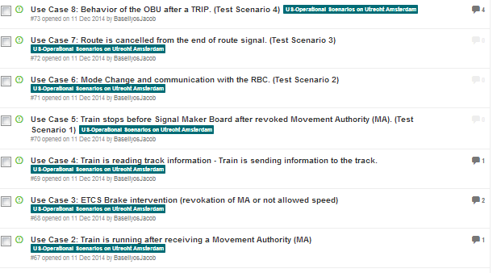
User Stories
See Git Hub:

Slide 9
Matrix
Excel Document

