Slide 1
Open-ETCS
Meeting and Report
24-25 June 2014
Munich

Slide 2
Open-ETCS
DB Netz : Völckerstraße 5 Schwabing
Ibis : DachauerStrasse 21 Munchen

Slide 3
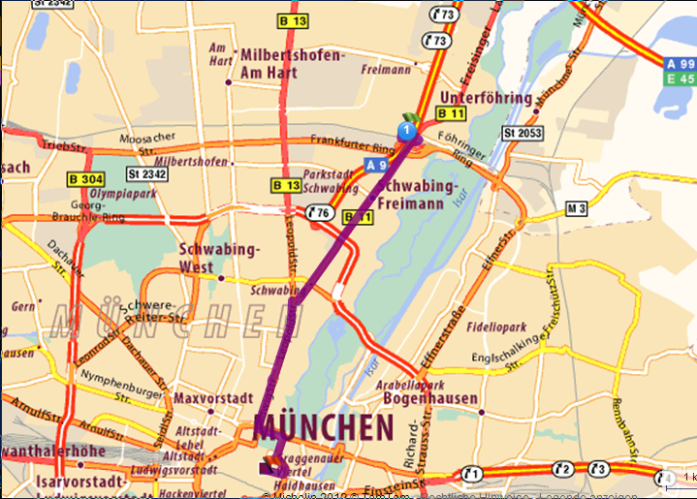
OpenETCS

Slide 4
OpenETCS
First day on 24th :
Starting at 10 AM
Train Positioning and API of MMU and BTM, up to 12.30 AM
Break up to 1 PM
Overall Structure / Internal Data Structure (24th AM), up to 4PM
Short break from 4 PM
WP4 coordination up to 6.30 PM

Slide 5
OpenETCS
Second day on 25th:
Starting at 8.30 AM
Review of WP3 OpenETCS Database version V8, up to 11 AM
Feedback of On-going Actions (and/or new actions if needed), up to 12.30 AM
Break up to 1 PM
Planning of vacation up to 4 PM

Slide 6
OpenETCS
Balise track layout
Linking normal track 1
Linking normal track 1
01
03
05
Linking reverse track 1
Linking normal track 2
Linking normal track 2
Linking reverse track 2
02

Slide 7
OpenETCS
Comments on track layout :
A track of double direction is equipped with beacons all oriented in same way
Beacons describing track in one direction are linked together
There is no need to link all beacons in both direction
It is always possible to invert both beacons and running direction

Slide 8
OpenETCS
The MMU provides at the beginning of each real time cycle :
Coordinate : 3 absolute counters of distance :
C_estimate : nominal estimated value, so-called “Cn”,
C_doubt-over : maximal value, so-called “Cmax”,
C_doubt-under : minimal value. so-called ”Cmin”.
Speed : vital speed so-called “Vn”,
Acceleration : not vital (?) so-callled ”Acc”,
Motion_State : vital boolean so-called “Motion”,
Motion_Direction : vital boolean so-called “Q_DIRTRAIN”,
Time_Stamp : Timer value “Tn” when evaluating MMU Data
( Cn, Vn, Tn).

Slide 9
OpenETCS
Comments:
Coordinate is 3 absolute and unsigned counters of distance
Unsigned means value is : 0..2exp(n)-1
Or value is Modulo 2exp(n) with n = number of bit = 32 tbc
In computation, any result is Modulo 2exp(n)
Time is also one unsigned counter modulo 2exp(n)
Any event can be “time_stamped”
Any delay between 2 events can be evaluated by difference of time stamps
Any distance between 2 events can be evaluated by integration of speed

Slide 10
OpenETCS
MMU / BTM Timing Diagram
Distance
MMU (odometry) gives Coordinate values with speed and time-stamp at beginning of each real time cycle
Cycle_n
Cn, Vn
Tn
Cycle_n+1
Cn+1, Vn+1
Tn+1
Cycle_n+2
Cn+2, Vn+2
Tn+2
Time
BTM (balise reader) gives Telegrams and time stamp when balise axle and antenna axle are alined
B-1
Tel-1
T1
C1 ?
B-2
Tel-2
T2
C2 ?
B-3
Tel-3
T3
C3 ?
B-4
Tel-4
T4
C4 ?

Slide 11
OpenETCS 24/25 june 2014
Cycle “n” : LRBG is positionned by C0,
MMU provides Cn, Vn, Tn,
BTM has provided Tel-1, T1,
Balise B1 position is : C1 = Cn – Vn * (Tn – T1),
Compute C1 with Doubt-Over and Doubt-Under.
Cycle “n+1” : LRBG is still positionned by C0,
MMU provides Cn+1, Vn+1, Tn+1,
BTM has provided Tel-2, T2,
Balise B2 position is : C2 = Cn+1 – Vn+1 * (Tn+1 – T2),
Compute C2 with Doubt-Over and Doubt-Under.
Cycle”n+2” : BG becomes LRBG
B3 and B4 position are computed (same way)
C4 becomes C0

Slide 12
EVC
Fixed Values
To Store System Data
Additional Data (changeable on-board)
To Manage DMI
Train Data
A6
A1
DMI Data
System Data
Orders / Display
National Values
Balise Content
To check and Store Balise Content
To Store Track Description in Database
A2
Packets
A4
Linking and
re-positionning
Database
Radio Message
To check and Store Radio Message
To Achieve Processes
Messages
A3
TIU Data
A5
To Manage TIU
Synchro Odo / Balise
Train Position & Speed
Command / Control
A7
To Position Train
Odometry
A8

Slide 13
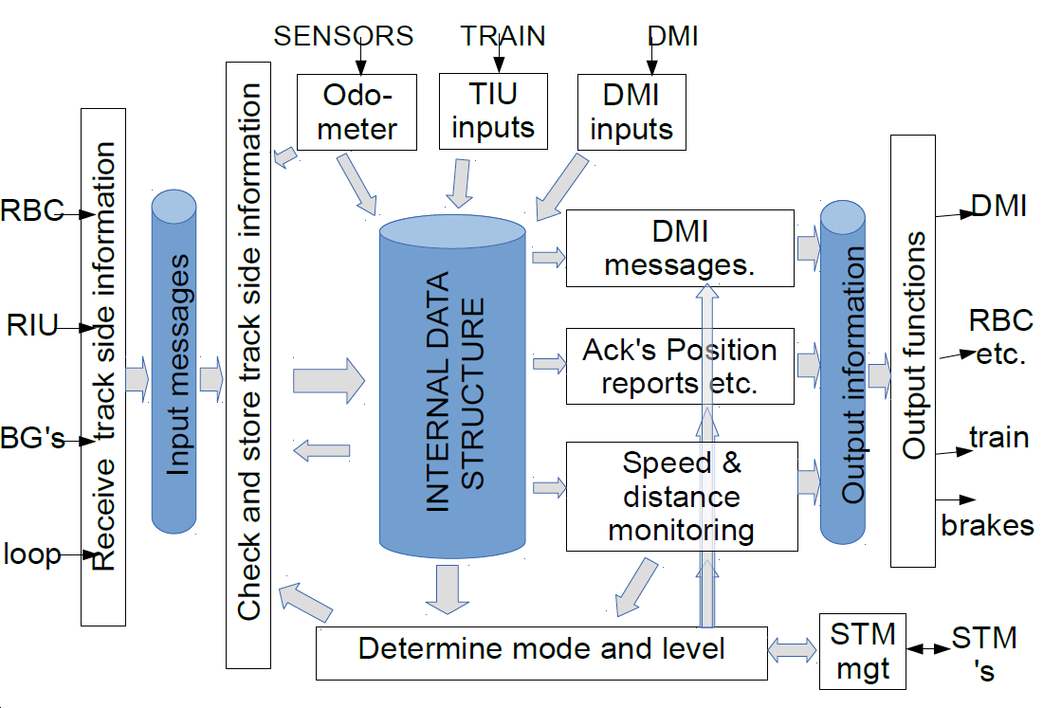
OpenETCS 24/25 june 2014
SysML IBD Diagram is a formalisation of un-formal diagram extracted from SRS analysis/
Boxes A2 and A4 need to be specified by I/O and function. Matrix structure has to be defined more. Boxe A5 is split into 2 parts.

Slide 15
To Achieve Processes A.5
Asafe
Computation
Asafe (x, v )
SRS-026 3-13-3
System Data
Classify DataBase
& MRSP Computation
MRSP (x)
SRS-026 3-13-7
Database
SRS-026 3-13-8
Orders / Display
Train Position
& Speed
Target and Curves Computation
Curves & Target
SRS-026 3-13-9 & 3-13-10
Supervision Limits Computation
Orders / Display
A5.1
SvL
& over speed
& overide
SRS-026 3-13-14-2
Protection
A5.2
Mode request
& EB request
SRS-026 3-12-4 & SRS-026 4
Mode and Level
Messages
A5.3
Mode & Level
SRS-026 3-13-14-1
Command / Control
Brake Handling
A5.4
SRS-026 3-12 & 3-15
Special & Radio
Functions
A5.5 & 6
SRS-026 3-13-17
Version Management
A5.7
Defaut

Slide 16
OpenETCS 24/25 june 2014
Asafe
Computation
Asafe (x, v )
SRS-026 3-13-3
System Data
Classify DataBase
& MRSP Computation
MRSP (x)
SRS-026 3-13-7
Database
SRS-026 3-13-8
Orders / Display
Train Position
& Speed
Target and Curves Computation
Curves & Target
SRS-026 3-13-9 & 3-13-10
Supervision Limits Computation
Orders / Display
A5.1
SvL
& over speed
& overide

Slide 17
OpenETCS 24/25 june 2014
Actions on-going :
SysML Diagram rework (3) :
Christian G & Jaime & All4tec (sep 1st)
Overal Architecture (boxes empty & evident)
Subset inaccuracy (1) :
Ian Walverts (sept 1st)
Positioning inaccuracy, Eb deceleration
Mock-up of Train Position & Balise Content (1) :
‘Uwe (1st Aug)
1st step as defined
Vector & Matrix in SCADE (4) :
Bernd (next meeting)
Use vector and matrix in Scade
Classification of element

Slide 18
OpenETCS 24/25 june 2014
Actions on-going :
SysML Diagram rework (3) :
Progress-on-going :
Boxes A2 and A4 to be refined
Subset inaccuracy (1) :
Ian Walverts (sept 1st)
Positioning inaccuracy, Eb deceleration
Mock-up of Train Position & Balise Content (1) :
‘Uwe (1st Aug) on Going
1st step as defined
Vector & Matrix in SCADE (4) :
Bernd (next meeting)
Use vector and matrix in Scade : to be examinated
Classification of element : to be examinated

Slide 19
OpenETCS 24/25 june 2014
New Actions :
To fix and close API : Alstom
To fix all positioning variables, and
To address re-positioning : All4Tec
To fix Data Architecture : Lloyds
To examine SCADE with Table : Alstom to be trained…
and Papyrus

