Slide 1
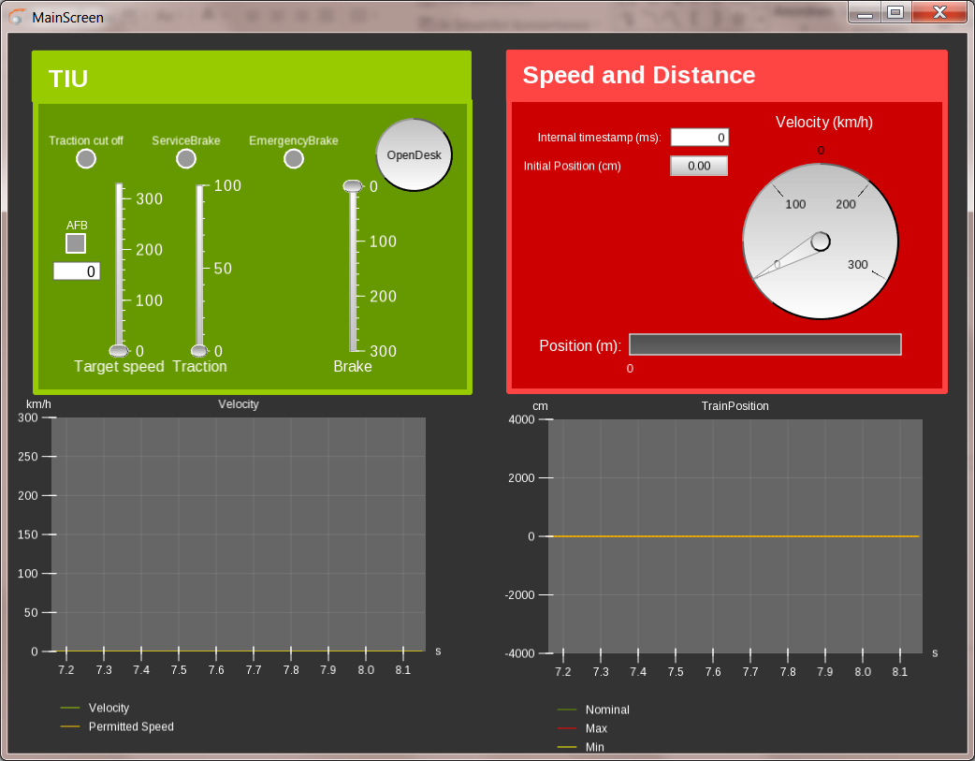
Brake indicators
Open the cabin
Automatic speed control
Brake control
Position and speed display
Traction control
Velocity graph
Location inaccuracies

