Slide 1

陶思雨：51194506034

Slide 2
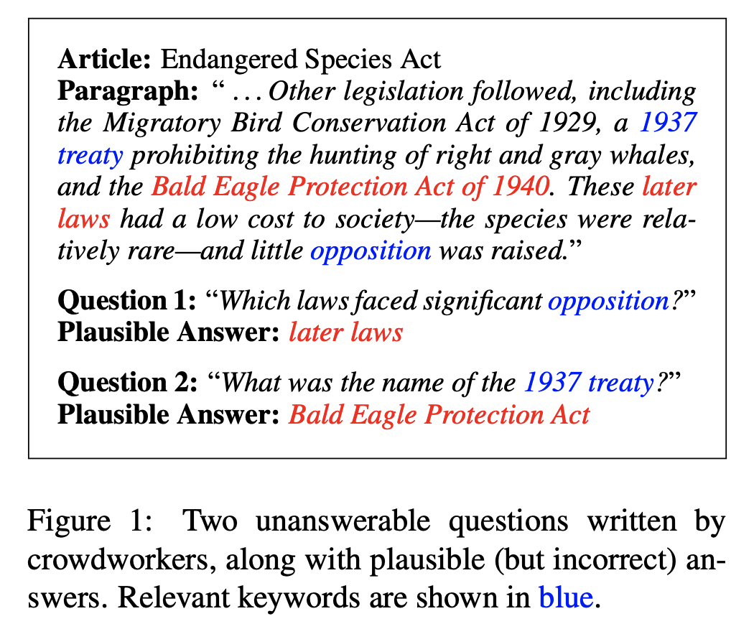
a sample from sQuAD 2.0 dataset

Slide 3

Training Data Construction
use (plausible) answer spans in paragraphs as pivots to align pairs of answerable questions and unanswerable questions
sort the pairs by edit distance and keep the pair with the minimum distance

Slide 4
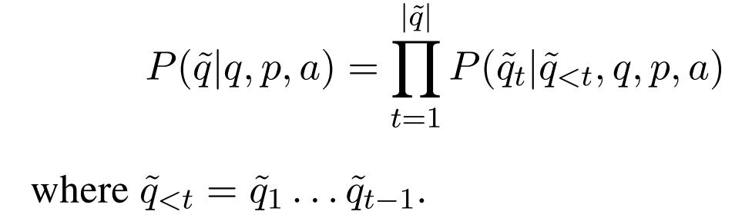
Problem Formulation
Given an answerable question q and its corre- sponding paragraph p that contains the answer a, we aim to generate unanswerable questions.
1.it cannot be answered by paragraph p.
2.it must be relevant to both answerable question q and paragraph p, which refrains from producing irrelevant questions.
3.it should ask for something of the same type as answer.

Slide 5
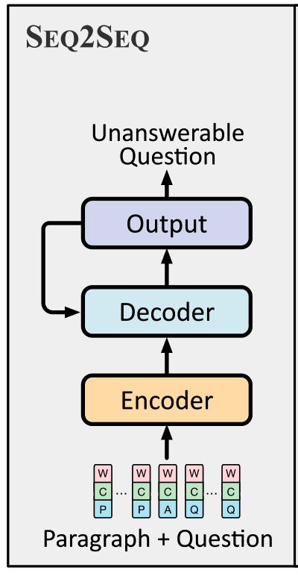
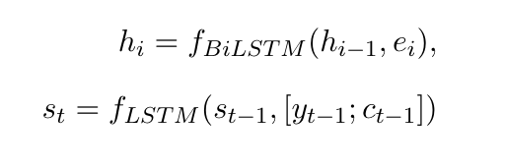
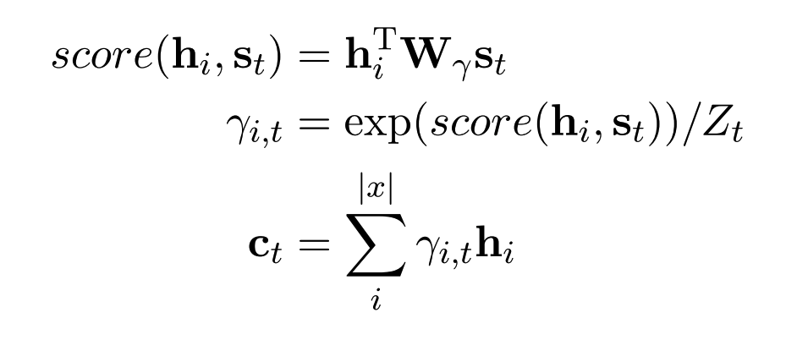

Sequence-to-Sequence Model

Slide 6


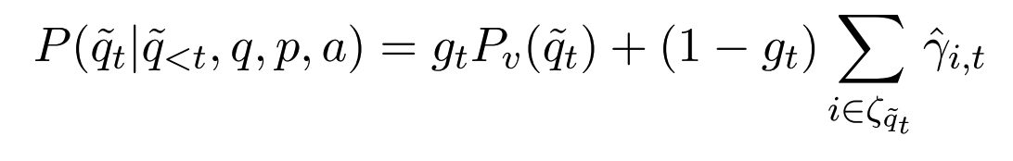
Sequence-to-Sequence Model
Copy mechanism:

Slide 7
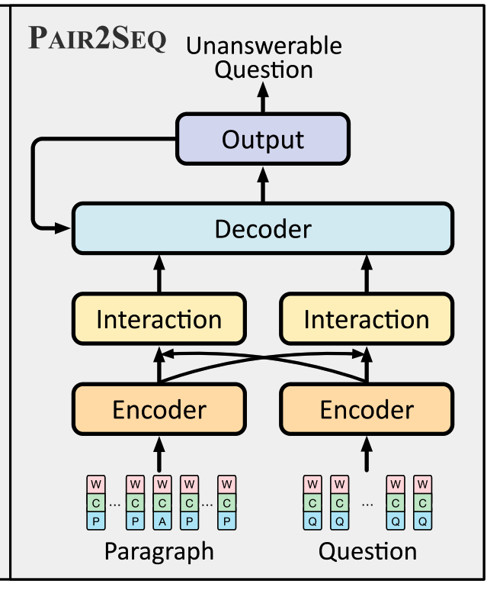
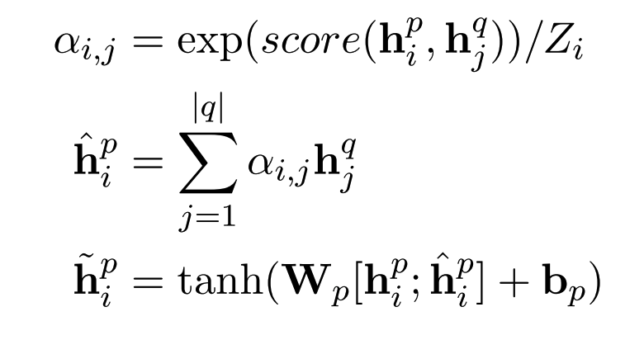

Pair-to-Sequence Model
question-aware paragraph representations

Slide 8
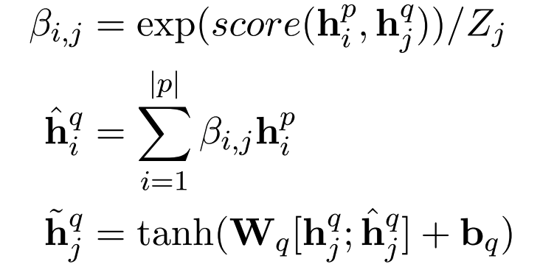

Pair-to-Sequence Model
paragraph-aware question representations

Slide 9
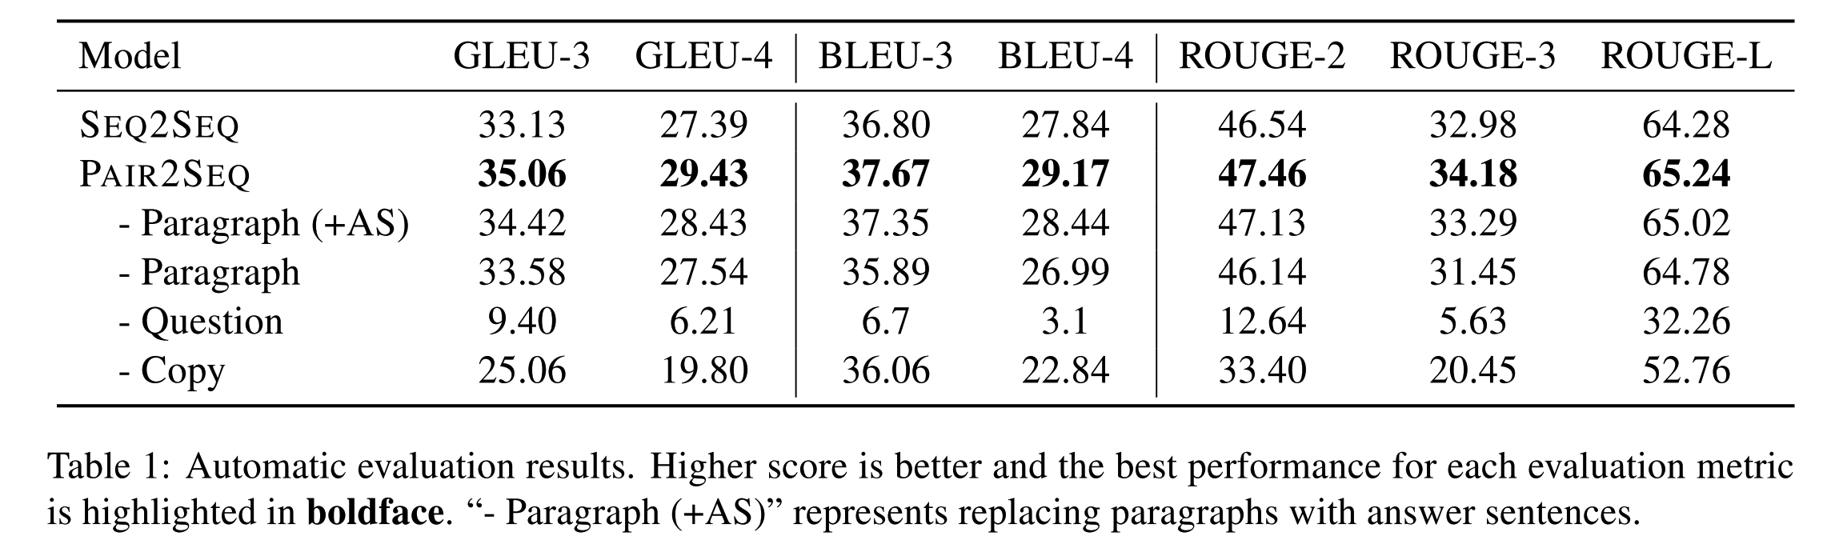
Experiments

Slide 10
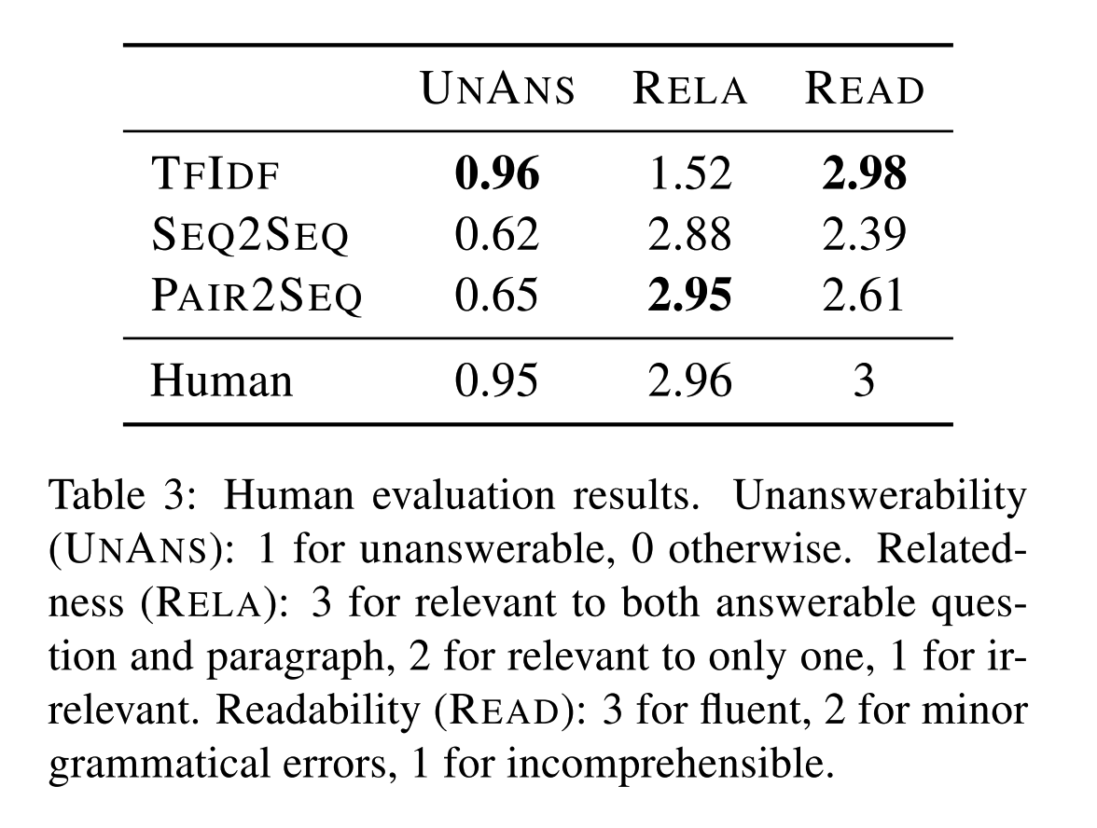
Experiments
TFIDF: baseline method
uses the input answerable question to retrieve similar questions towards other articles as outputs

Slide 11
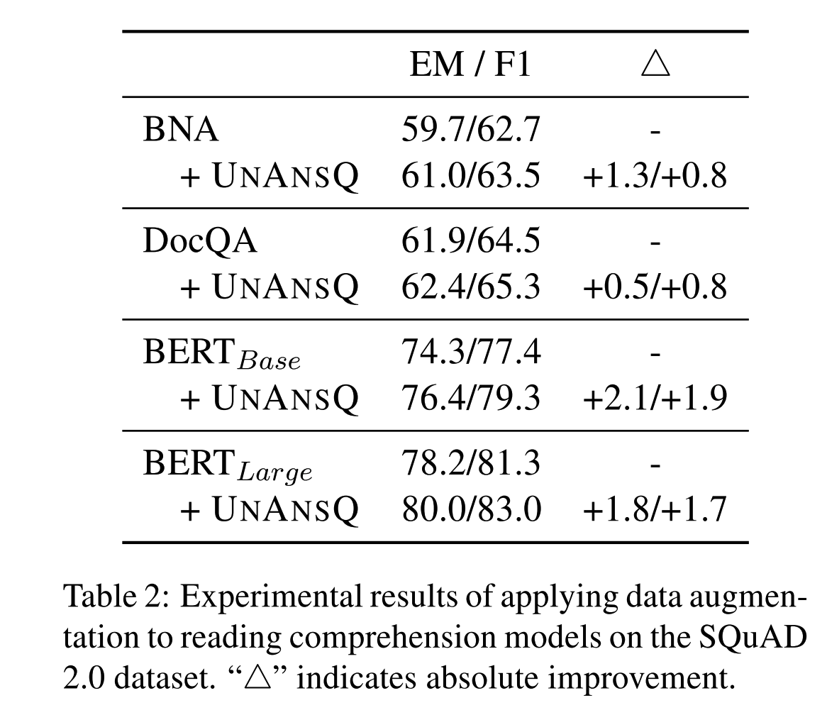
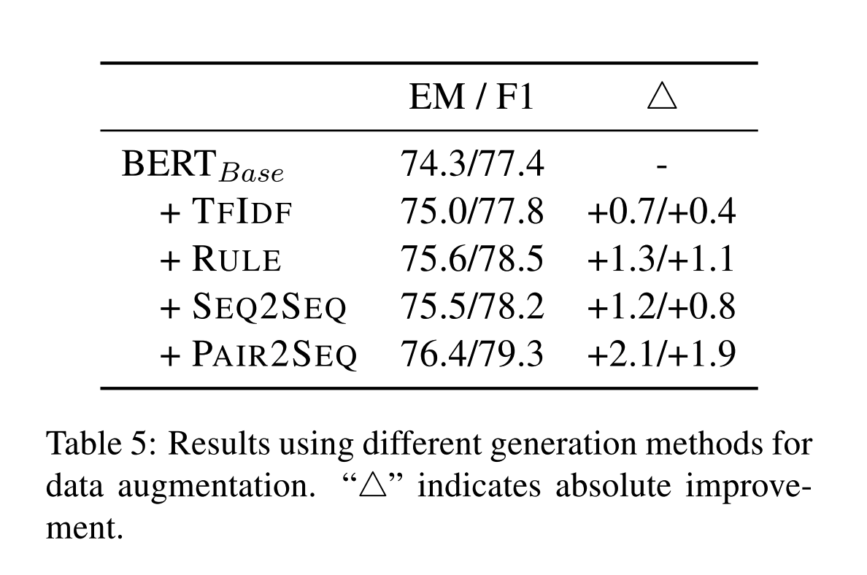
Experiments

Slide 12
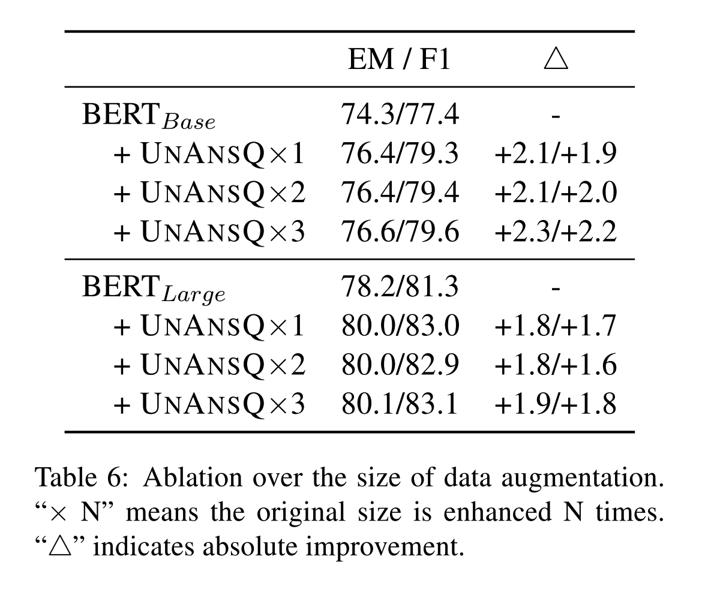
Experiments

