Slide 1
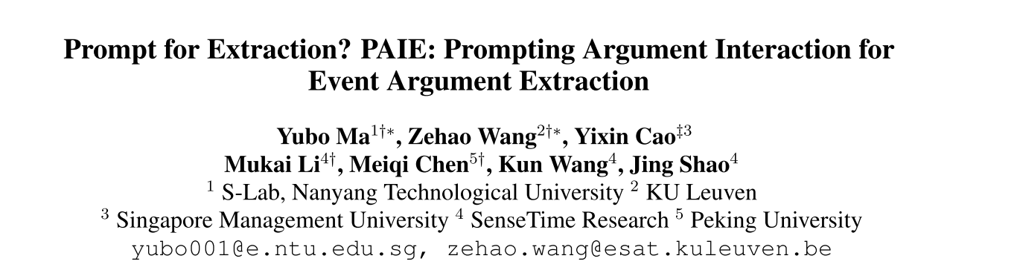
ACL2022
刘燕婷

Slide 2
Event Extraction
Formulate it as a semantic role labeling problem
error propagation
Sovle EAE by Question Answering and Text Generation
QA-based models can effectively recognize the boundaries of arguments with role-specific questions, while the prediction has to be one by one.
Generation-based methods are efficient for generating all arguments, but sequential predictions degrade the performance on long-distance and more arguments.

Slide 3



PAIE
Prompt Creation : given context X and a series of queries $Q=\{q_{1}, q_{2},… q_{K}\}$
$$P_{t}= f_{prompt}(Q)$$
Prompted Selector Decoding: given a PLM $ℒ$ ,context X and prompt $P_{t}$
$$θ_{qk}= h_{ℒ}(q_{k}; P_{t}, X)$$
Prompted Span Selection
$$\left(s, e\right) _{q_{k}}=Span−search[g_{ℒ}(X;θ_{qk})]$$

Slide 4
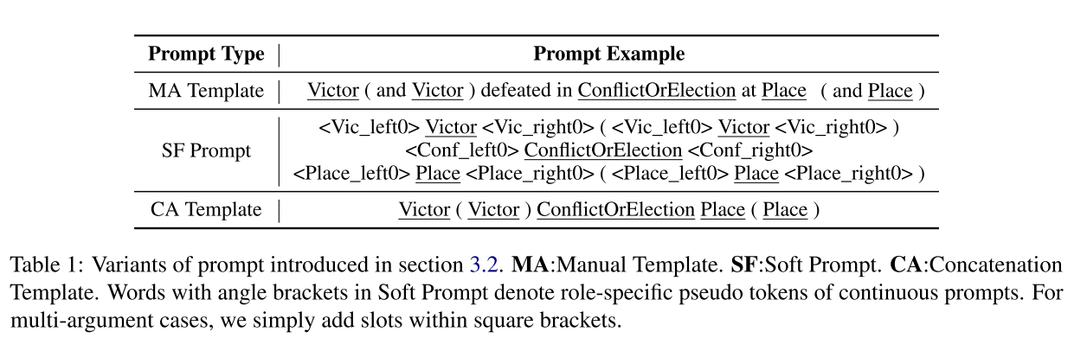

Prompt Creation for EAE
Each prompt contains all roles $r ∈ R(e$)
$$R\left(negotiate\right)=\{Participant, Topic, Place\}$$
Participant communicated with Participant about Topic at Place
slot
Three different prompt creators $f_{prompt}$: Manual Template、Soft Prompt、Concatenation Template

Slide 5
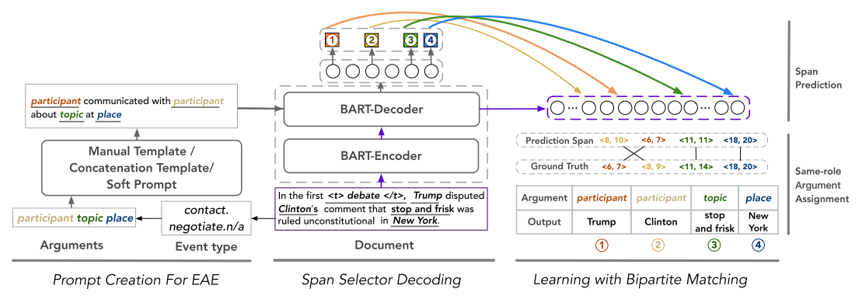
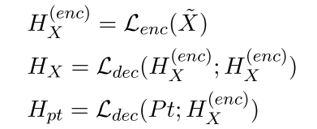
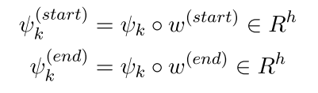
Role-specific Selector Generation
Given context $X$ and prompt $Pt$, this module generates the role-specific span selector $θk$, for each slot $k$ of the prompt.

Slide 6
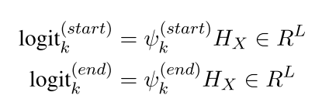
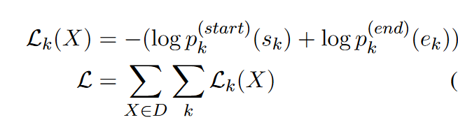
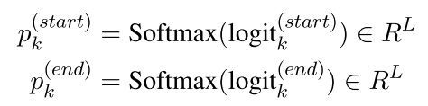
Learning with Prompted Span Selector
Calculate the distribution of each token being selected as the start/end of the argument for each role feature
Then we calculate probabilities where the start/end positions locate

Slide 7
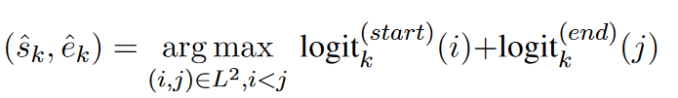
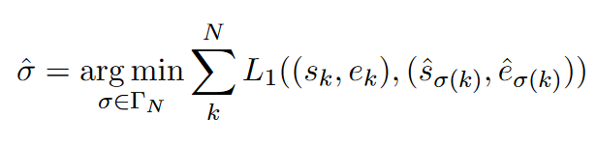
Learning with Prompted Span Selector
Bipartite Matching：
Loss：

Slide 8


Inference
Define the set of candidate spans for event arguments as $C = \{(i, j)|(i, j) ∈ L^{2}, 0 < j − i ≤ l\} ∪ \{(0, 0)\}$
enumerate and score all candidate spans
the predicted span of slot k

Slide 9
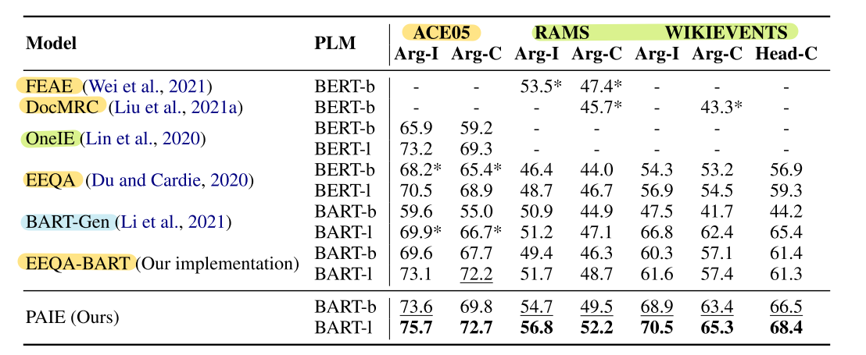
offset, event type,role type
add a window centering on the trigger words and only encode the words within the window
Experiments
offset, event type
sentence-level
Document-level
a good generalization ability on dealing with varying lengths of context.

Slide 10
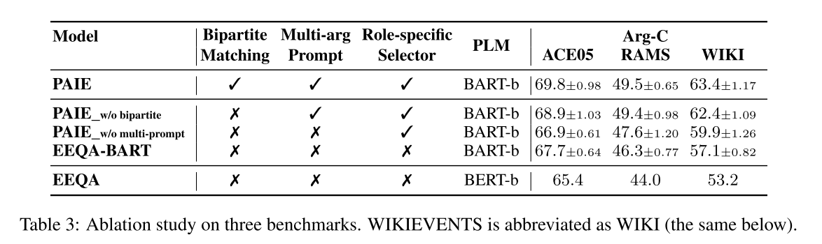
Ablation Study
role-specific selector plays a critical role when identifying and disambiguating roles with complicated ontology structures in long documents.
joint prompt has the potential to capture implicit interaction among arguments.

Slide 11
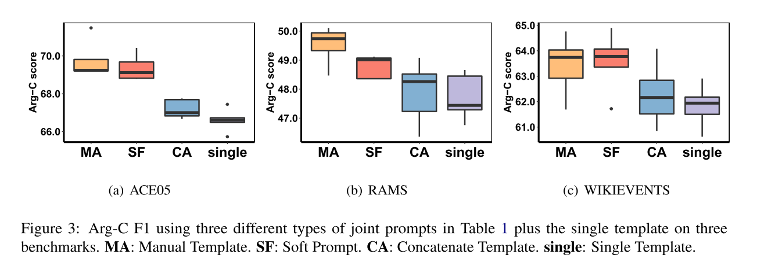
Prompt Variants
Soft prompt achieves comparable result with a manual template
Concatenation template performs worst among joint prompts

Slide 12
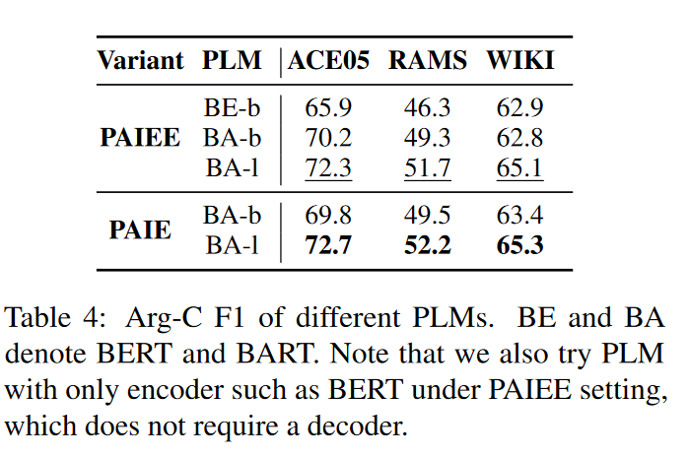
Architecture Variants
the over-interaction between context and prompt is not of benefit
squeezes the limited input length of the encoder

Slide 13
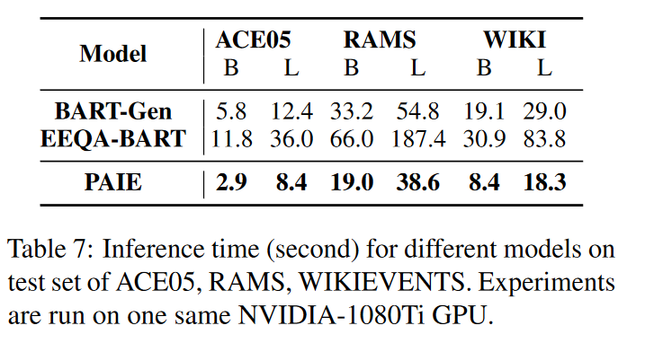
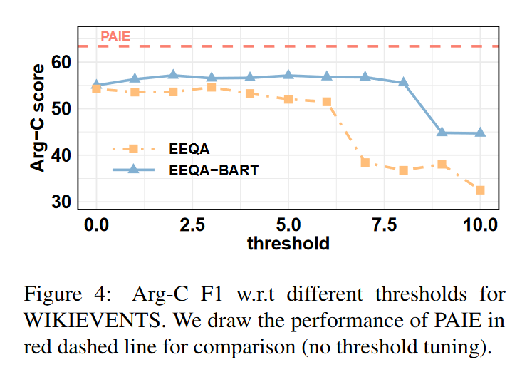
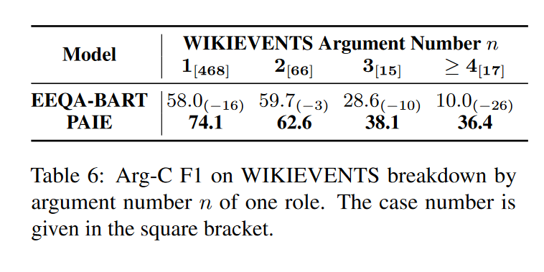
Efficiency & Effectiveness
consumes lots of time and computational resources for finding a good threshold and usually ends with sub-optimal results
capability of PAIE and EEQA-BART in predicting multiple arguments with the same role
The choice of threshold highly affects the performance of the model

Slide 14
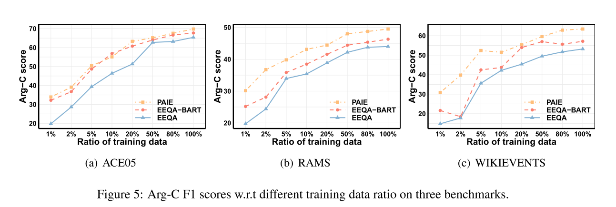
Few-shot Setting
All observations above indicate that PAIE can better utilize PLMs for few-shot settings.

Slide 15
Thanks

