Slide 1
Relation Extraction using Explicit Context Conditioning
Gaurav Singh∗
University College London
g.singh@cs.ucl.ac.uk
Parminder Bhatia
Amazon
parmib@amazon.com
51194501042 郭嘉

Slide 2
Overview
Motivation
First-Order Relations Model
Second-Order Relations Model
Efficient Implementation Method
Experimentation
Conclusion and Future Work

Slide 3
Motivation
Relation Extraction (RE) aims to label relations between groups of marked entities in raw text.
Most current RE models learn context-aware representations of the target entities that are then used to establish relation between them.
This works well for intra-sentence RE and we call them first-order relations. However , this methodology can sometimes fail to capture complex and long dependencies.
To address this, we hypothesize that at times two target entities can be explicitly connected via a context token. We refer to such indirect relations as second-order relations and describe an efficient implementation for computing them.
At the end, we combine these second-order scores with first-order scores derived from a traditional RE model and achieve state-of-the-art performance over two biomedical datasets.
Notes:
尽管语病，不通顺，语义不变

Slide 4
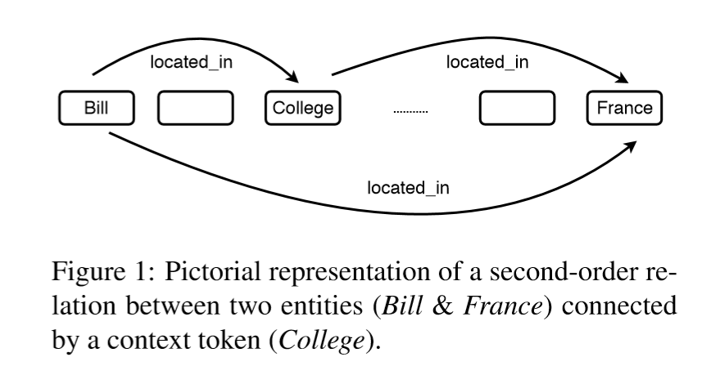
We propose a model based on the hypothesis that two target entities, whether intra-sentence or cross-sentence, could also be explicitly connected via a third context token (Figure 1).
More specifically, we find a token in the text that is most related to both target entities and compute the score for relation between the two target entities as the summation of their relation scores with this token. We refer to these relations as second-order relations.

Slide 5
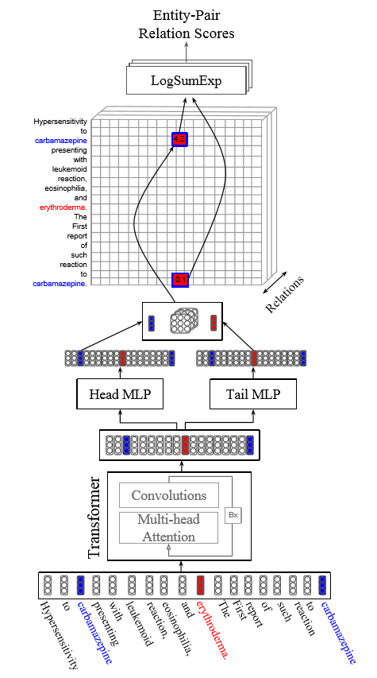
First-Order Relations Model
A recent RE method called BRAN (Verga et al., 2018) proposed to use encoder of Transformer (Vaswani et al., 2017) for obtaining token representations and then used these representations for RE. It does not work well, especially when the two target entities were connected by a string of logic spanning over multiple sentences.
Verga P, Strubell E, Mccallum A, et al. SIMULTANEOUSLY SELF-ATTENDING TO ALL MENTIONS FOR FULL-ABSTRACT BIOLOGICAL RELATION EXTRACTION[C]. north american chapter of the association for computational linguistics, 2018: 872-884.

Slide 6
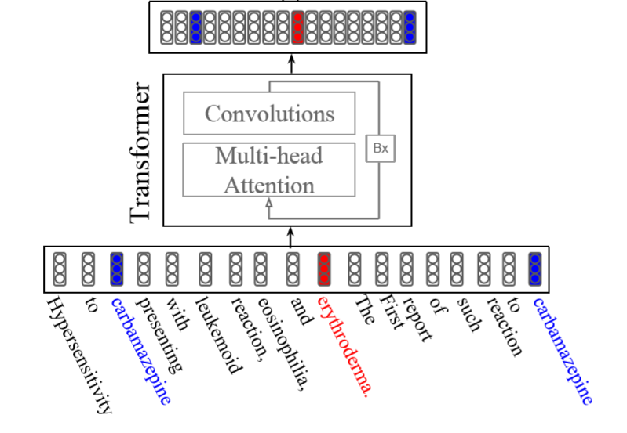


Input:
Transformer:
Notes:
这里的i是第i个词的表示，bik，是第k个transformer block（最后一个）的第i个词的encodder

Slide 7
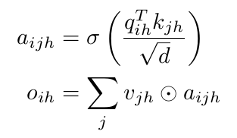
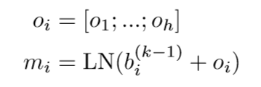
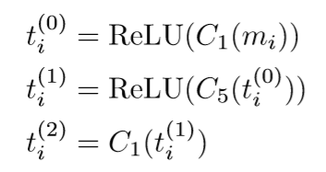
attention:
Convolutions:
Notes:
相似度计算，scaled dot-product attention
这里用三层convolution（实际上是一个n-gram model，第二个卷积层是大小为5的卷积核，即n=5）的目的是减轻关注局部特征时的负担。

Slide 8
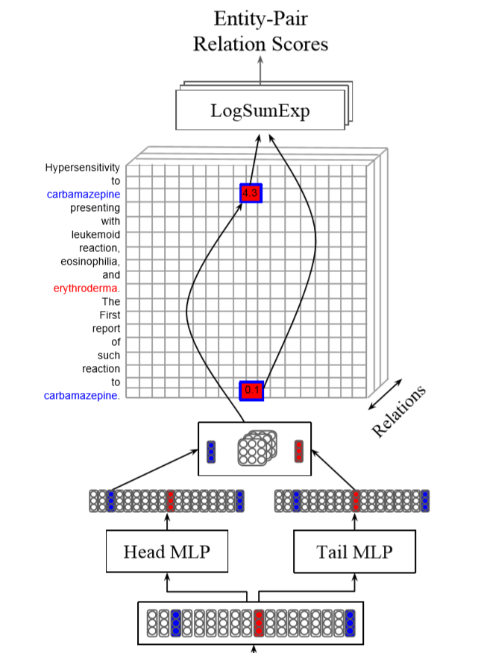
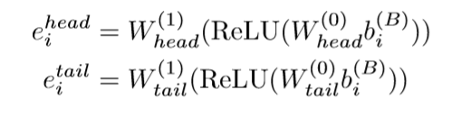

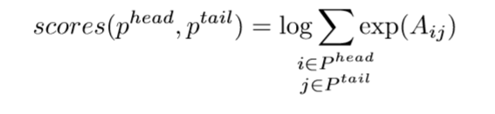
MLPs generate head/tail representation:
（1）
（2）
bi-affine transformation :
（3）
LogSumExp aggregation(First-order relation scores) :
（4）
entity-pair：(head，tail)
entity-pair：(carbamazepine，erythroderma)
Notes:
eihead，是把第i个词作为头，即作为实体对中的第一个实体表示。
计算score，i属于Phead，表示所有提及的phead词（图中的两个蓝色词）

Slide 9
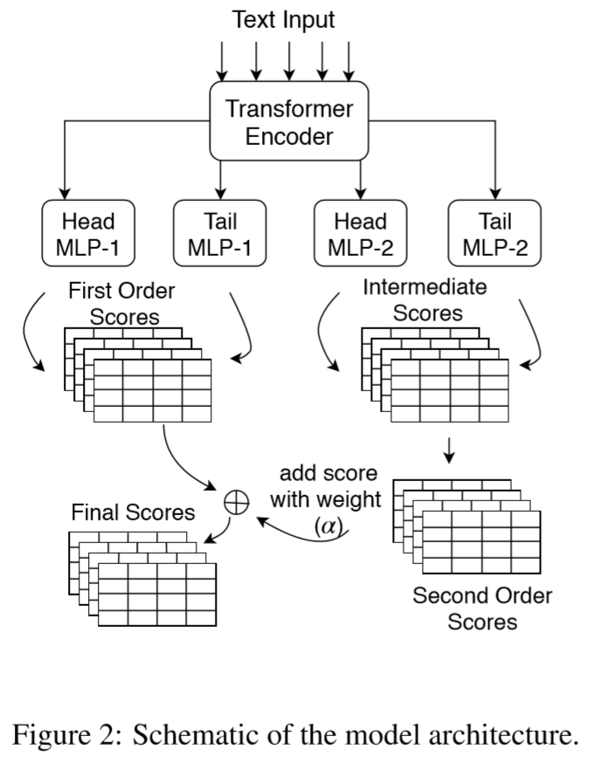


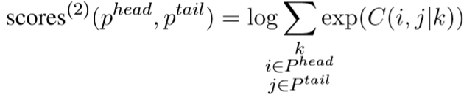
Second-Order Relations Model
bi-affine transformation(intermediate pairwise scores) :
（5）
sum(context-conditioned scores ) :
（6）
LogSumExp aggregation(Second-order relation scores ) :
（7）

Slide 10
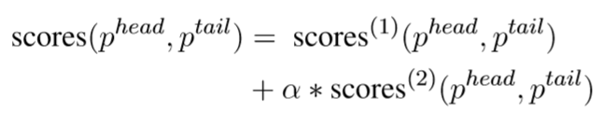
weighted sum(the final score ) :
（8）

Slide 11
Efficient Implementation Method
C(i,j|k), require space of the order O(N3)
describe a space-time efficient method to compute final second-order relation scores.
B are a tensor of dimension b × N × R × N comprising of pairwise scores for b batches.

Slide 12
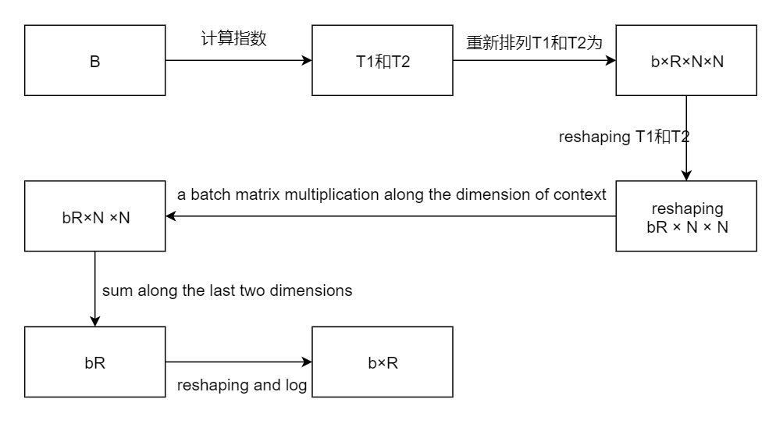
b × N × R × N
代替公式3的求exp
代替公式2的相加和公式3的下标k的Σ求和
代替公式3下标i和j的Σ求和
（1）
代替公式3的求log
（2）
（3）

Slide 13
Experimentation
three datasets
i2b2 2010 challenge. It consists of documents describing relations between different diseases and treatments. There are 3244/409 relations in train/test set and 6 predefined relations types including one negative relation e.g. TrCP (Treatment Causes Problem), TrIP(TrImprovesPr),TrWP(TrWorsensPr).
de-identified clinical notes (DCN). It contains approximately 170K relations There are 7 predefined relation types including one negative relation type. These are mostly between medication name and other entities e.g. “paracetamol everyday”, “aspirin with dosage 100mg”.
achemical-disease relations dataset known as BioCreative V (CDR). There are only two relation types between any two target entities i.e. positive/negative. There are 5038 relations in train sets.
Notes:
关系对，和关系类型

Slide 14
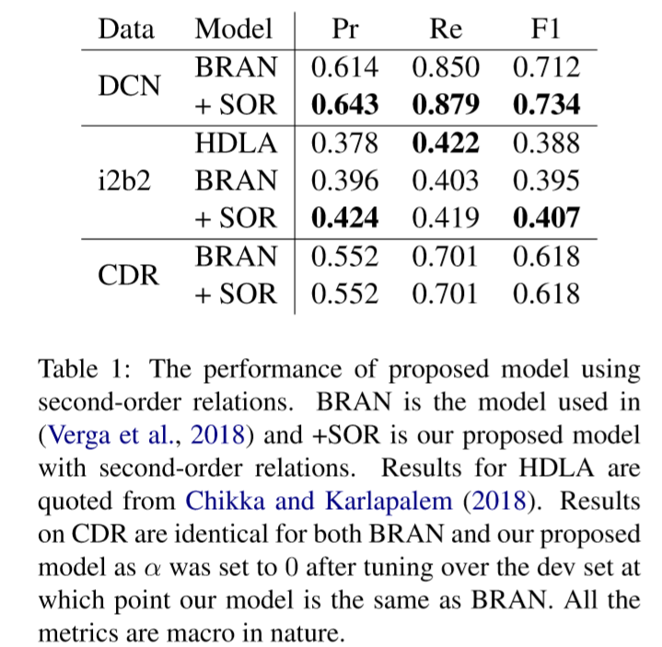
HDLA used syntactic parsers for feature extraction
the weight of second-order relations denoted by α = 0.0 for CDR dataset.
proposed model converged to BRAN

Slide 15
Conclusion and Future Work
Contribution
propose using second-order relation scores to capture long dependencies for improved RE.
describe an efficient algorithm to obtain second-order relation scores.
Future Work
the proposed method can be generalized to third and fourth order relations.
we only considered one relation type between each entity and bridge token but it is possible, and very likely that two different relation types may lead to a third relation type.

