Slide 1
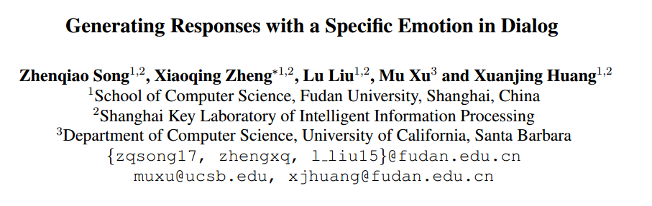
张骏 51194506048
ACL 2019

Slide 2
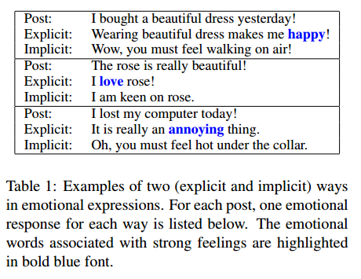

Problem Define
Express emotion in both explicit and implicit ways
Given a post
and an emotion category e, the objective is to generate a response that is not only meaningful with the content, but also in accordance with the desired emotion

Slide 3
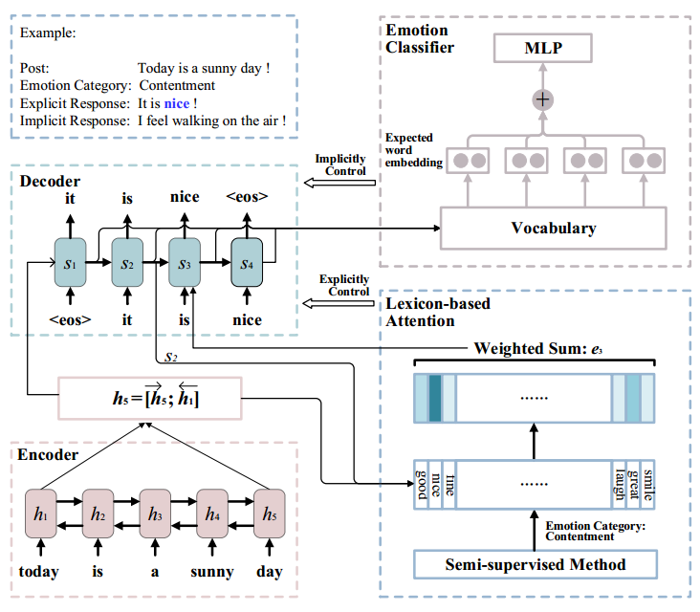
Model Overview

Slide 4



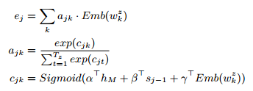
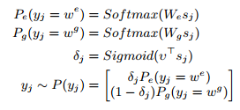

Dialogue System with Lexicon-based Attention Mechanism
Encoder
Decoder

Slide 5
Emotion Lexicon Construction
semi-supervised
today
is
a
sunny
day
(p_{w1}, n_{w1})
(p_{w2}, n_{w2})
(p_{w3}, n_{w3})
(p_{w4}, n_{w4})
(p_{w5}, n_{w5})
Emotion
happy
句子级别情感
Loss =

Slide 6
Emotion Classification

Slide 7





Emotion Classification
Straightforward method
Proposed method

Slide 8
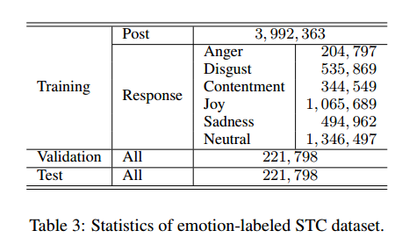
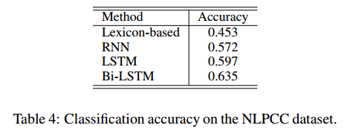
Experiments
Datasets
NLPCC2013 NLPCC2014 for Emotion Annotation
Short Text Conversation (STC) for training dialog systems

Slide 9
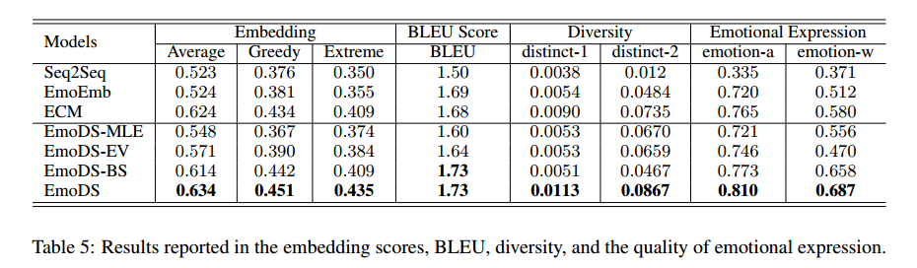
Experiments

Slide 10
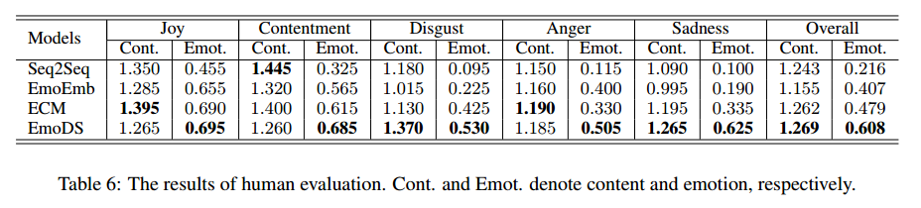
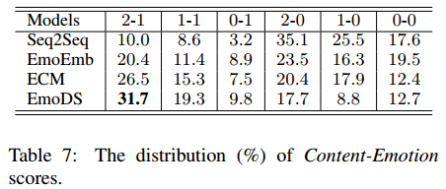
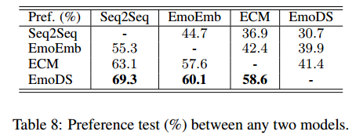
Experiments

