Slide 1
Denosing Relation Extraction
from Document-level Distant Supervision
刘申 20210420

Slide 2
1.问题
01.Document-level Relation extraction
2.难点
01.远监督数据存在大量噪声
02.直接将DS迁移到 Document-level 不可行
3.Contributions
01.使用pre-denosing ，处理DS data
02.使用设计的三个预训练方法，处理模型

Slide 3
1.问题
Document-level Relation extraction
1.1 特点
intra-sentence and inter-sentence

Slide 4
2.难点
01.远监督数据存在大量噪声
02.直接将远监督扩展到 Document-level 的不可行
the inherent noise in DS may be even multiplied in document level and significantly harm the performance of RE
challenges:
Each entity contains multiple mentions, and mentions without relational context bring noise to entity representations
The inherent noise of DS will be even mulitplied at the document level.
It’s challenging to capture useful relational semantics from long documents,since most contents in the documents may be irrelevant to the given entities and relations.

Slide 5
3. Contributions
the three pre-training tasks include:
(1)Mention-Entity Matching
aim to capture useful information from multiple mentions to produce informative representations for entities
(2)Relation Detection
focuses on denoising “Not-A-Relation(NA)” and incorrectly labeled instances by detecting the entity pairs with relations, i.e., positive instances.
(3)Relation Fact Alignment
requires the model to produce similar representations for the same entity pair from diverse expressions.

Slide 6
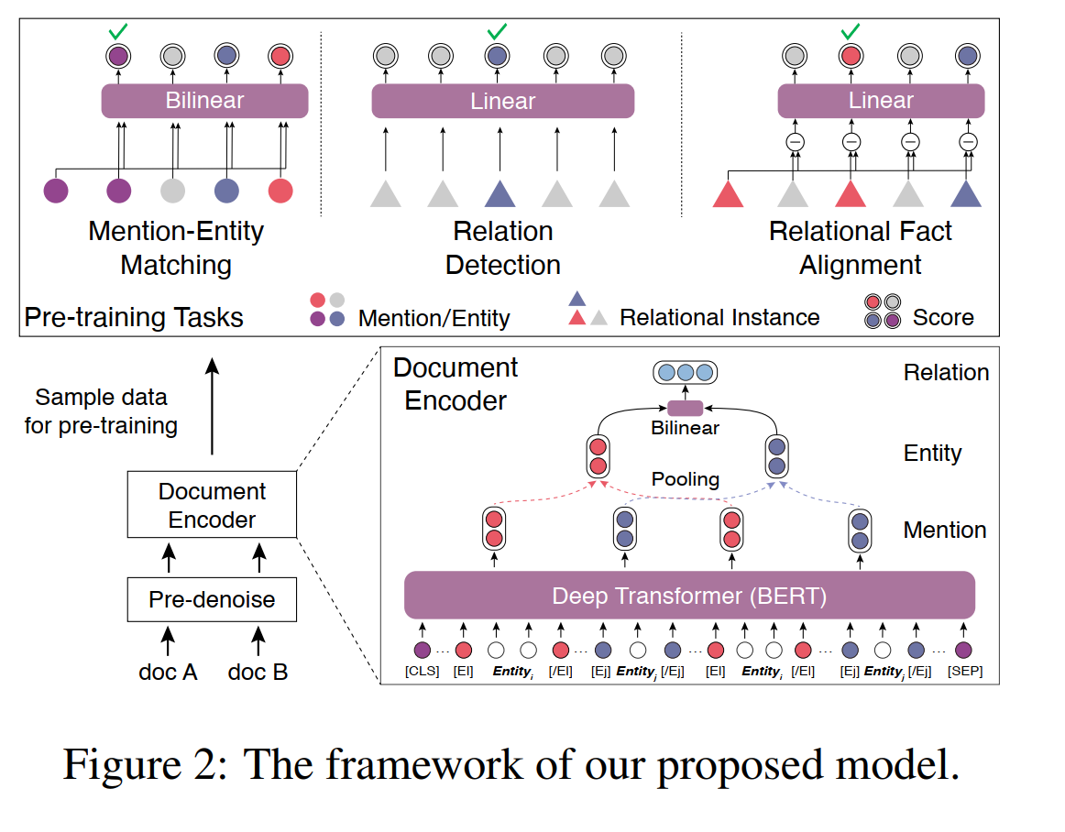
4.模型结构
First apply the pre-denoising module to screen out some NA instances from all documents.
Then we pre-train the document encoder with three pre-training tasks on the document-level distantly supervised dataset.
Finally, we fine-tune the model on the human-annotated dataset.

Slide 7

5.具体实现
5.0 Basic encoder
adopt BERT as the document encoder to encode documents into representations of entity mentions, entities and relational instances.
5.1 Mention-Entity Matching
一个entity可能会以多种不同形式的mention 出现，所以让模型抓住其形象的表示。这个任务包括intra-document 和 inter-document两个子任务。
intra-document sub-task :让模型理解共指信息。
使用的方法就是mask。mask 一个entity mention(m^{q})，要求模型预测这是doc 中的哪一个实体
inter-document sub-task: 将不同doc的同一个entity 链接起来，方法与上面这个类似。

Slide 8

5.2 Relation Detection
背景：The NA relation is dominating in DocRE
要求：denoise NA instances and to identify the true positive instances from NA noise.
做法：requires the model to distinguish positive entity pairs from NA instances.
分成intra- and inter- document sub-tasks.

Slide 9
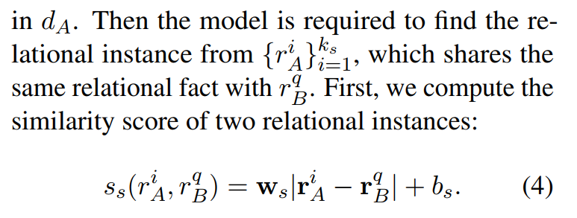
5.3 Relational Fact Alignment
目的：
grasp useful information from the long documents and denoise irrelevant content
requires the representations of the same entity pairs in different documents to be similar
方法：

Slide 10
5.4 Pre-denoising Module
问题：document-level DS will generate more noise.
方法：
screen out entity pairs with low relational probability from all documents with a rank model.
We train the rank model with the Relation Detection task on the human-annotated training set.

