Slide 1
基于检索的语言模型 Retrival-based LM
Liu Yanting

Slide 2
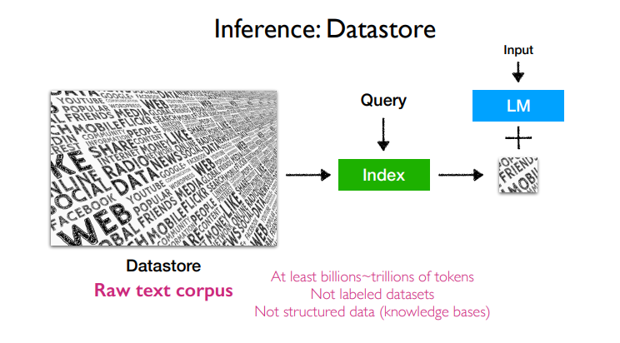

Slide 3
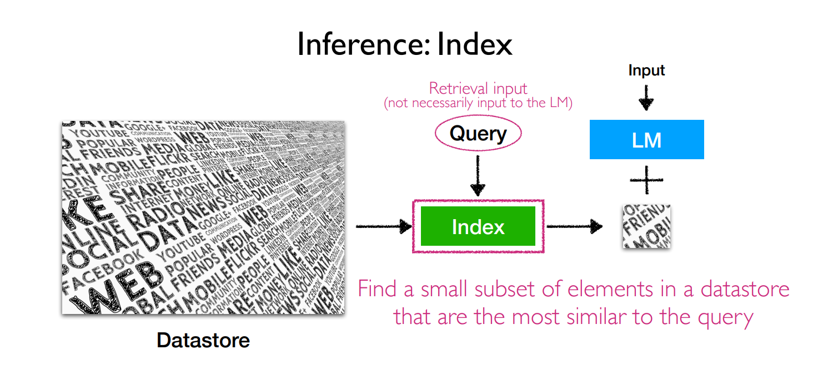
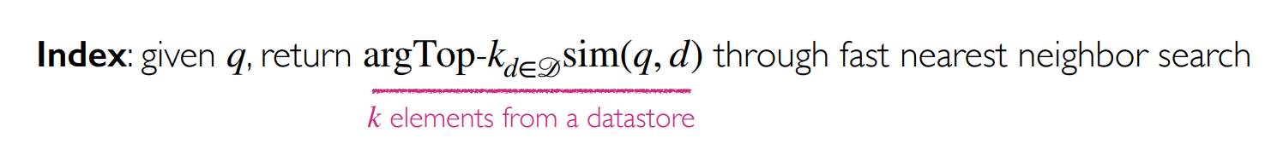

Slide 4
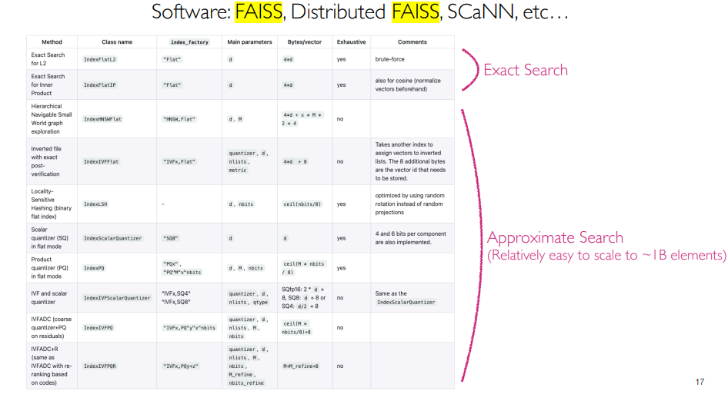
Notes:
faiss的核心就是索引（index）概念， 针对高维空间中的海量数据，提供了高效且可靠的检索方法。

Slide 5
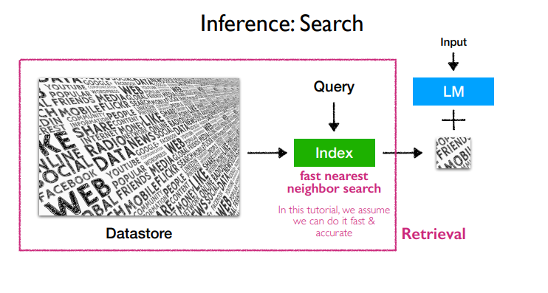

Slide 6
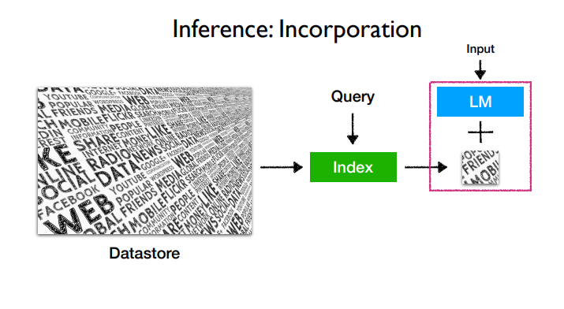

Slide 7
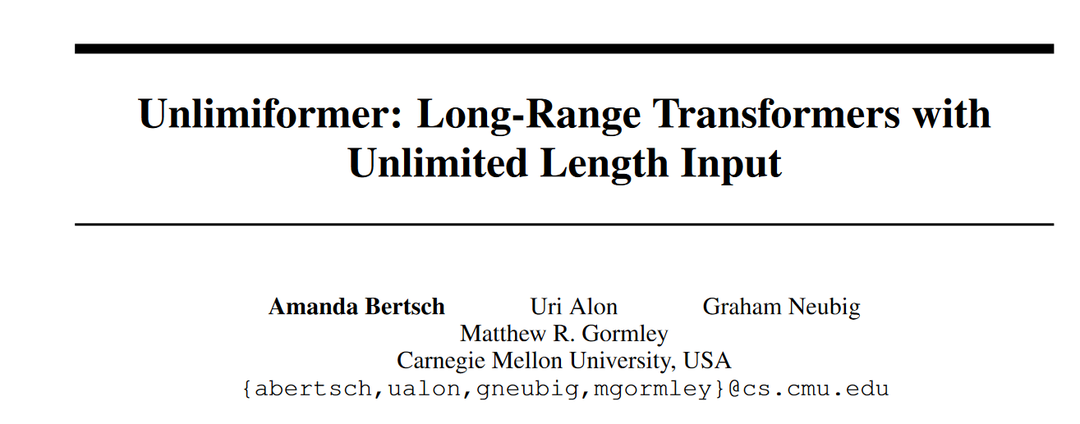

Slide 8
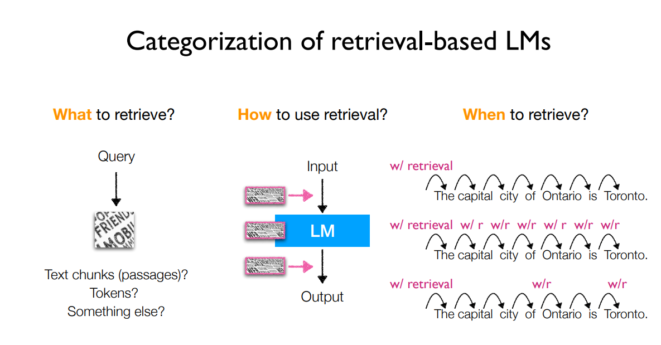

Slide 9
Introduction
Unlimiformer: Long-Range Transformers with Unlimited Length Input
What to retrieval
Chunk
Tokens
Others
How to use retrieval
Input layer
Intermediate layers
Output layer
When to retrieval
Once
Every n tokens(n>1)
Every token

Slide 10
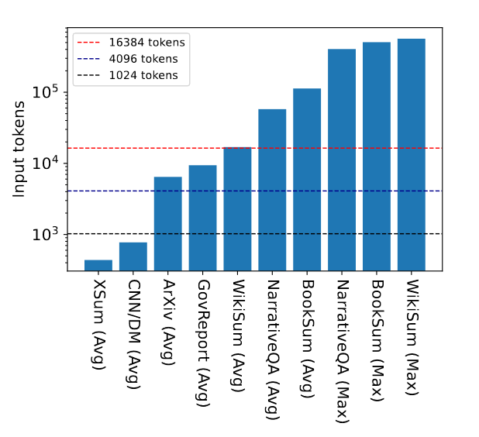
Motivation
Unlimiformer: Long-Range Transformers with Unlimited Length Input
Transformer models have been limited to bounded input lengths, because of their need to attend to every token in the input.
Long-input transformers usually modify the base architecture, and thus necessitate re-pre-training the model from scratch, which requires significant computational resources. Other architectures such as Longformer-Encoder-Decoder can leverage pretrained models, but they still need to further train new position embeddings or global attention weights, which is computationally and environmentally costly.
Notes:
Long-range transformers can avoid input truncation in some datasets; however, there are datasets with inputs many times longer than these models’ maximum input length. The dotted lines represent three common maximum input lengths for models; the bars are the average or maximum input length in each dataset, as indicated.

Slide 11

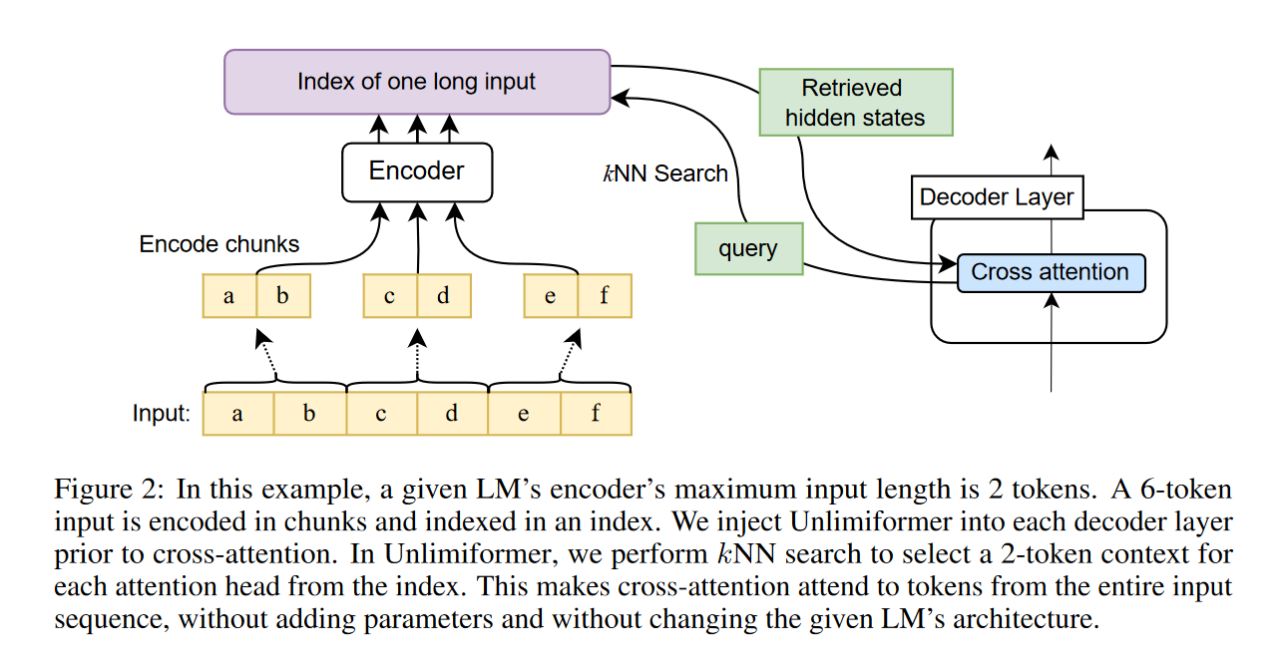
Unlimiformer

Slide 12
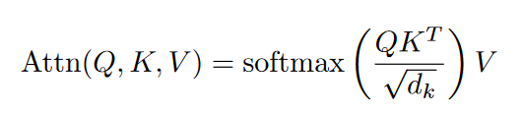
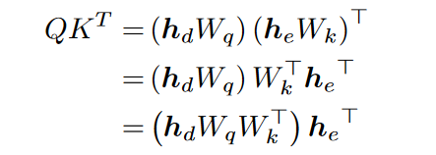
Attention reformulation
2 × L × H indexes
$W_{q}$, $W_{k}$, and $W_{v}$ are layer-specific and head-specific
store a single index across all attention heads and all decoder layers, without changing the mathematical definition of the transformer’s standard dot-product attention

Slide 13
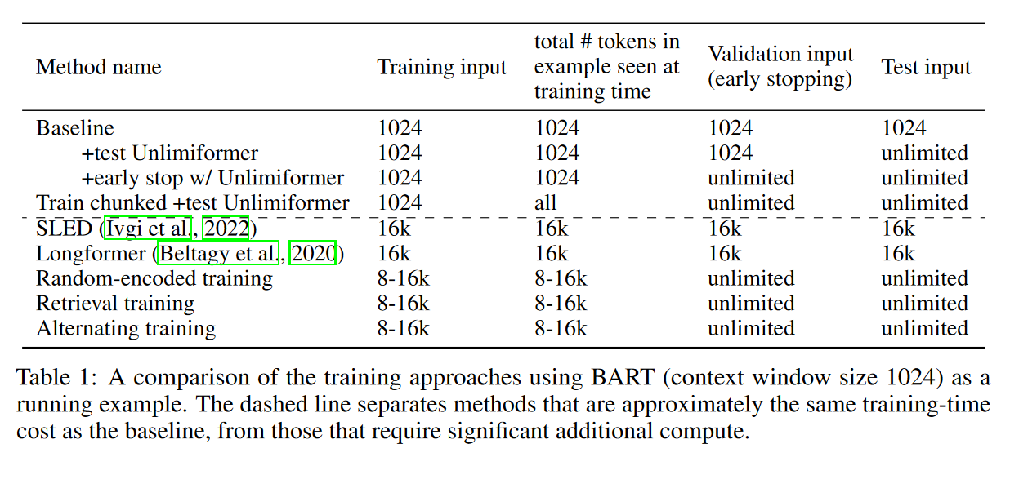
Training Unlimiformer
Notes:
Unlimiformer can be used, at test time, with an already-trained model, and lead to gains without further training, as we show later in Table 3. Next, we turn our focus to training approaches to further improve the performance of Unlimiformer. Table 1 summarizes and contrasts the training approaches described below

Slide 14
Baselines
BART (base): maximum input sequence length is 1024 tokens
PRIMERA: a Longformer-Encoder-Decoder with maximum input length of 4096 tokens
SLED: a training approach that extends encoder-decoder models for longer contexts by applying fusion in-decoder
Memorizing Transformers : a training approach that extends a transformer with a trainable attention gate that moderates between the standard cross-attention and attention over retrieved keys from a datastore

Slide 15
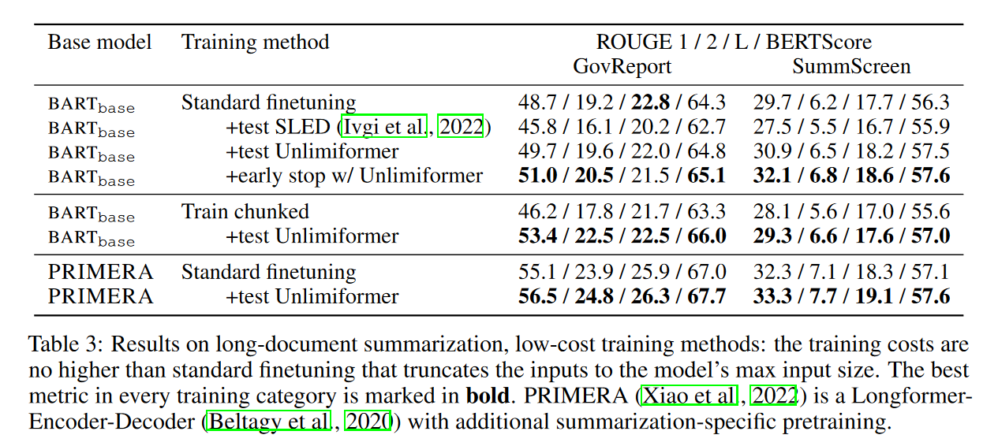
RESULTS
Applying Unlimiformer on an existing checkpoint without any training (+test Unlimiformer) does make improvement.
Unlimiformer is the only model that can provide benefits without further training.

Slide 16
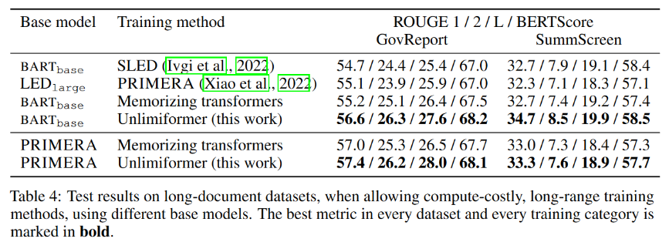
Long-range training
Unlimiformer outperforms the SLED and Memorizing Transformers baselines when using the same base model.
Unlimiformer can also be applied on top of existing long-range transformers and further improve them

Slide 17
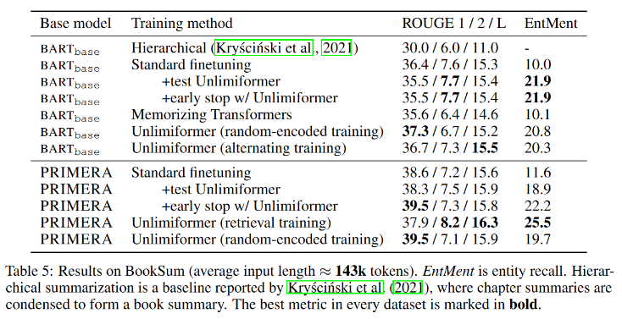
Book Summarization
Unlimiformer improves both base models BARTbase and PRIMERA, in both low-cost training approaches and long-range training approaches.

