Slide 1
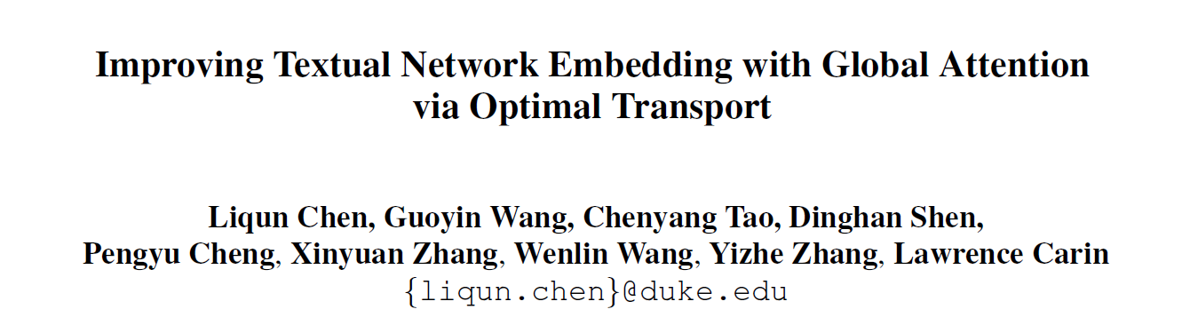
ACL 2019
51194501166
宋子涵

Slide 2
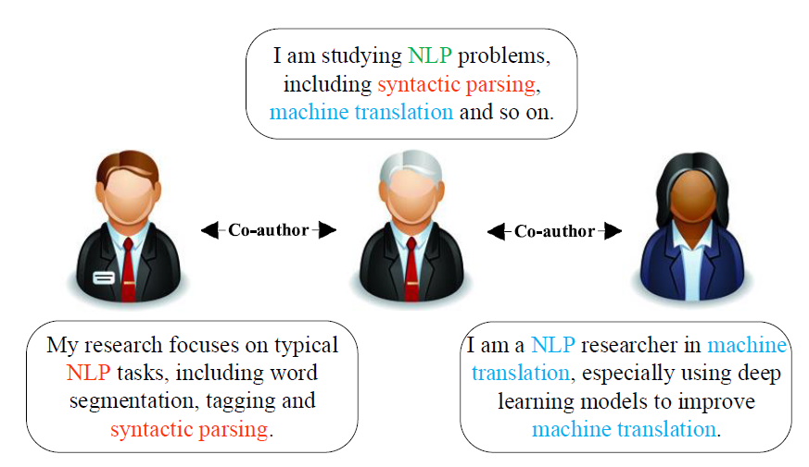
Background
Network Embedding
Map vertices of a network into a low-dimensional space according to their structural roles in the networks
Textual Network Embedding

Slide 3

Background
Context-free embedding & Context-aware embedding (CANE)
Take a vertex $u$ and its neighbor $v$ for example, the context-free embedding of $u$ remains unchanged when interacting with different neighbors.
The context-aware of $u$ is dynamic when confronting different neighbors
CANE: Context-Aware Network Embedding for Relation Modeling: https://www.aclweb.org/anthology/P17-1158.pdf

Slide 4
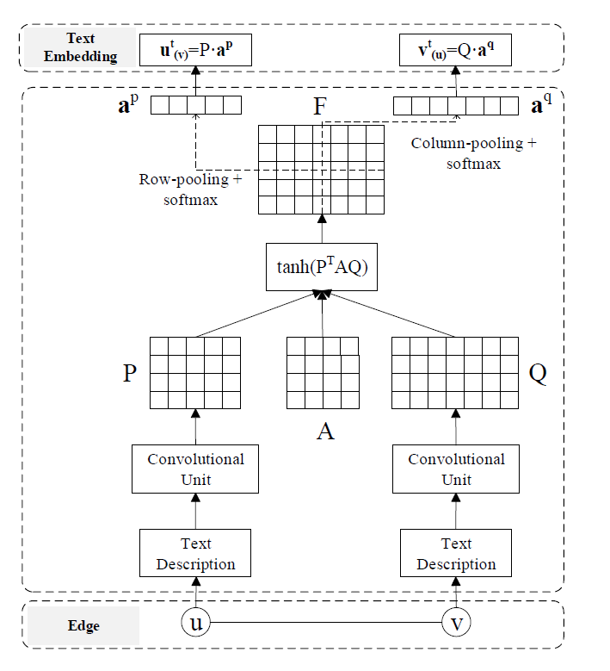




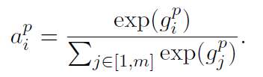
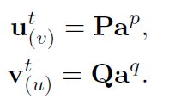
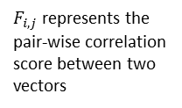
Related work
CANE
embedding dynamically depends on the context
introduce a simple mutual attention weighting mechanism
$F_{i,j}$ represents the pair-wise correlation score between two vectors

Slide 5
Motivation
Limitations
mutual attentions are computed from pairwise similarities between local text embeddings (Optimal transport)
low-level affinity scores are directly used as mutual attention without considering any high-level parsing (Attention-parsing)
yield dense attention matrix (Optimal transport)

Slide 6
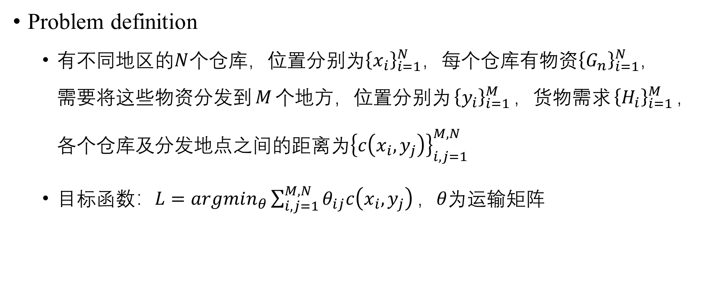
Optimal transport (OT)
Problem definition
有不同地区的$N$个仓库，位置分别为${\left\{x_{i}\right\}}_{i=1}^{N}$，每个仓库有物资${\left\{G_{n}\right\}}_{i=1}^{N}$，需要将这些物资分发到$M$个地方，位置分别为${\left\{y_{i}\right\}}_{i=1}^{M}$，货物需求${\left\{H_{i}\right\}}_{i=1}^{M}$，各个仓库及分发地点之间的距离为${\left\{c\left(x_{i},y_{j}\right)\right\}}_{i,j=1}^{M,N}$
目标函数：$L=argmin_{θ}{\sum_{i,j=1}^{M,N}{θ_{ij}c\left(x_{i},y_{j}\right)}}，θ为$运输矩阵

Slide 7
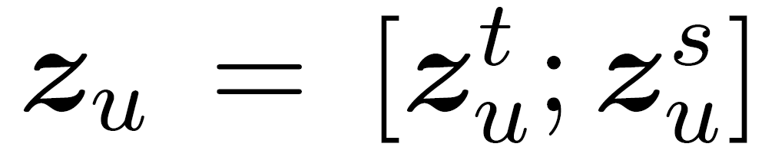
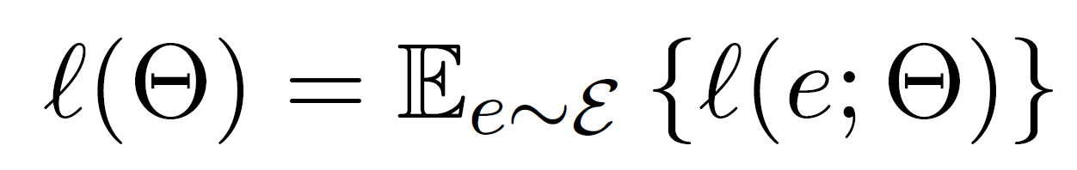
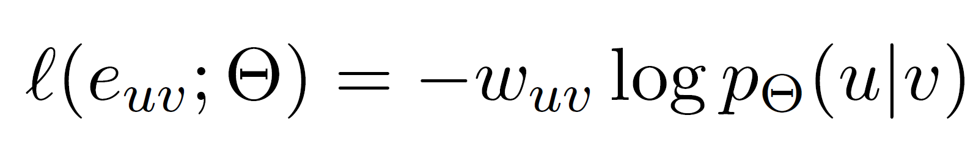
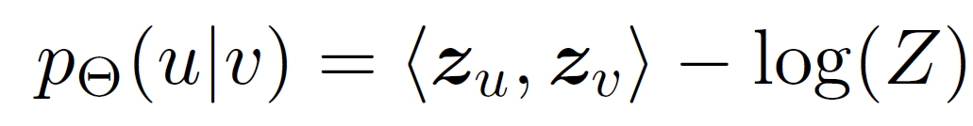
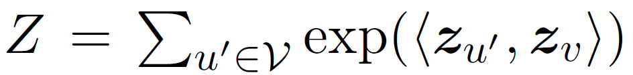
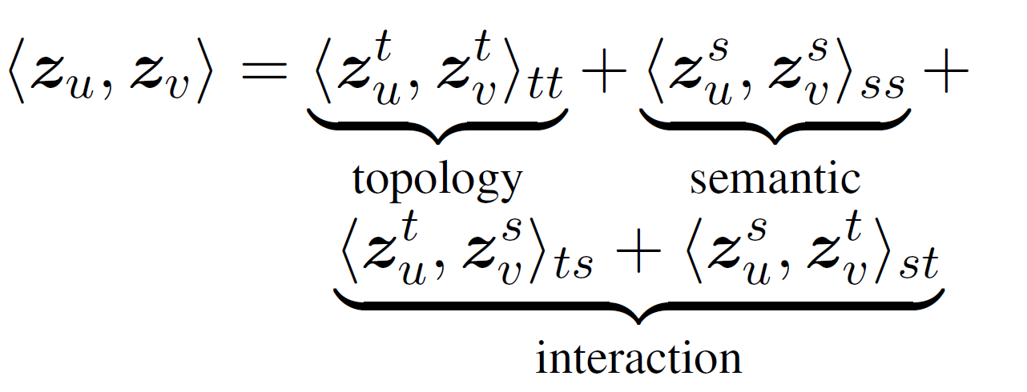
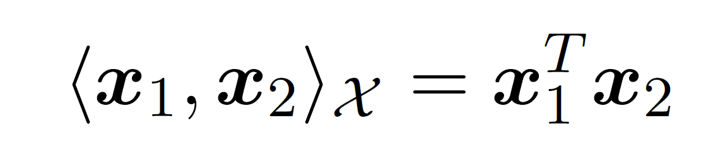
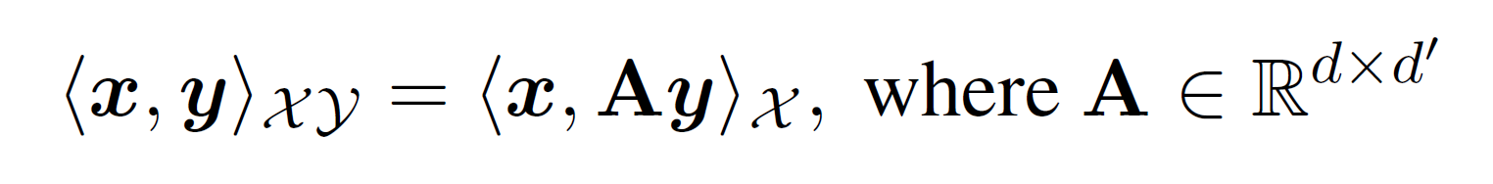
Model framework overview

Slide 8
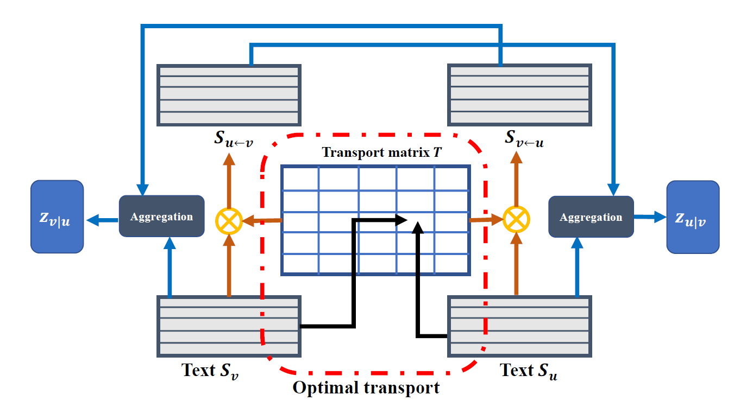
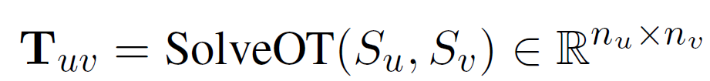
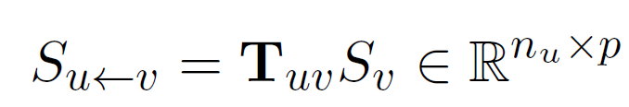

Optimal-transport-based matching
Sparsity: when solved exactly, is a sparse matrix with at most (2m-1) non-zero elements, where m is the number of contents
Self-normalized: row-sum and column-sum equal the respective marginal distributions.

Slide 9

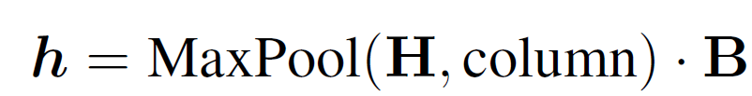
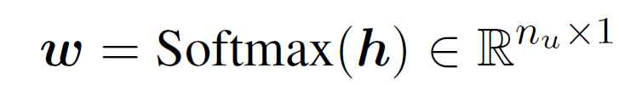

Attention parsing
low-level attention scores can be noisy (i.e., spurious matchings)
similarity-matching does not allow relational inference.

Slide 10
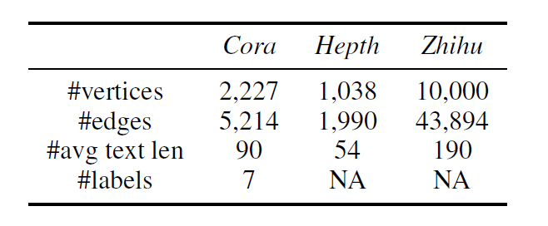
Experiment
Dataset
Task
Link prediction & Multi-label node classification
Evaluation metrics
AUC

Slide 11
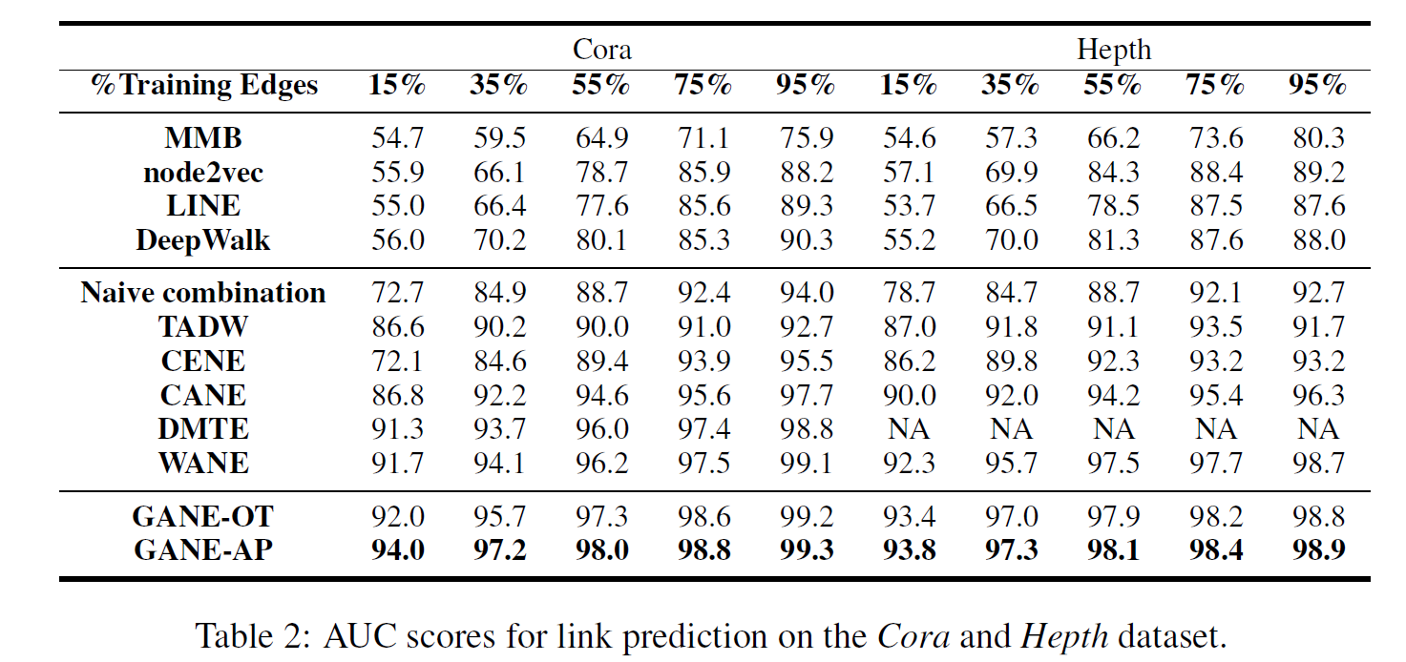
Link prediction

Slide 12
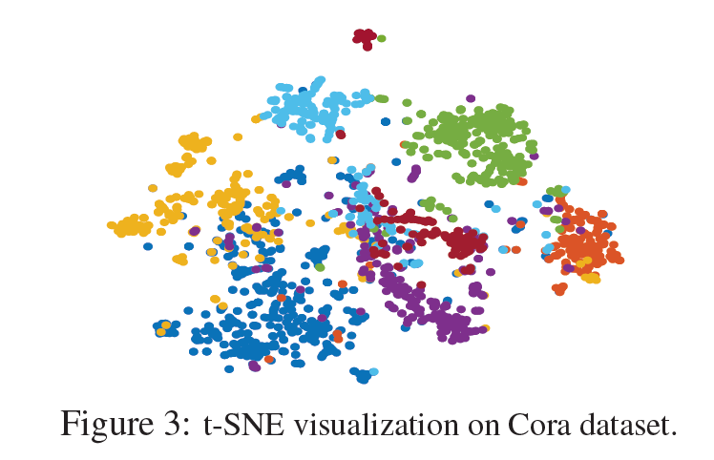
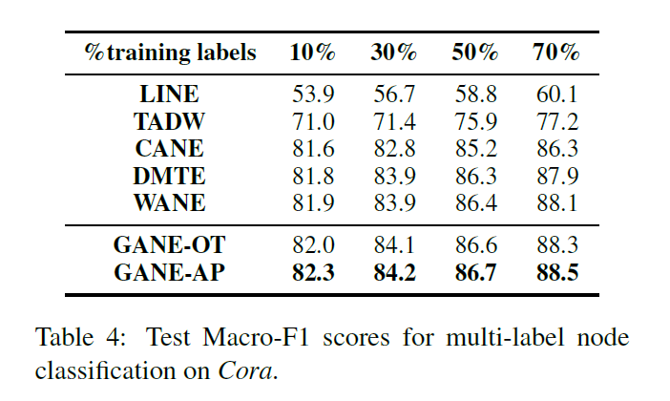
Multi-label node classification

Slide 13
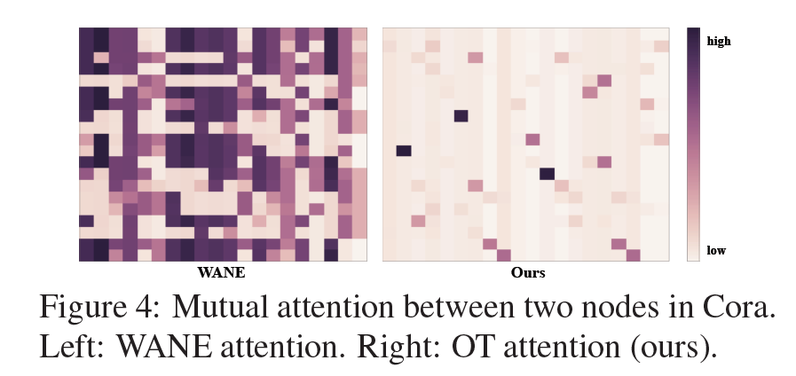
Attention matrix comparison

Slide 14
Conclusion
Propose a novel and principled mutual-attention framework based on optimal transport
Sparse
Global sequence matching scheme
Capture long-term interactions
Propose attention parsing mechanism
Improve the low-level mutual attention matrix

Slide 15
Thank you!

