Slide 1
Emotional Chatting Machine: Emotional Conversation Generation with Internal
and External Memory
AAAI-2018
Hao Zhou, Minlie Huang, Tianyang Zhang, Xiaoyan Zhu, Bing Liu
Tsinghua University
Notes:
使用一个多重位置的句子表达的深度模型去做语义匹配

Slide 2
Background
Conversation systems(single-turn)
  A: What are you doing?
  B: I’m talking to you.
Open domains
Content: diversity and uncertainty
for example: chatbot
Notes:
对于一个文本对进行语义上的匹配评估

Slide 3
Background
Two main methods
A: Retrieval-based
search preestablished database for candidate responses by query retrieval
B: Generation-based
generate a new, tailored utterance given the userissued query

Slide 4
Background
Factors affecting the quality of responses
1. Responses should be fluent
2. Semantic or topic relevant
Emotion Factor
Diversity of response
…

Slide 5
Motivation
Open domains:
Perception and expression of emotion are key factors to the
success of dialogue systems or conversational agents. However, this problem has not been studied in large-scale conversation generation so far.

Slide 6
For this paper:
1. Conversation system(single-turn)
2. Open domain
3. Generation-based methods (seq2seq)
4. Focus on emotion factor

Slide 7
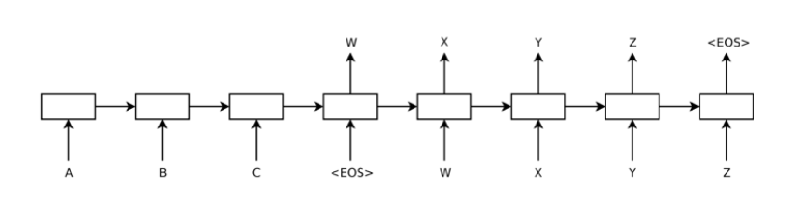
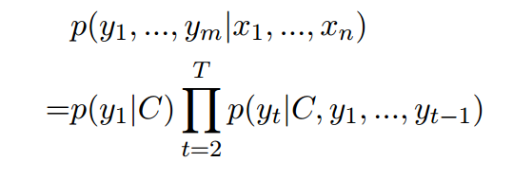
Related work
Standard seq2seq
Notes:
首先看第一个联盟，也就是各自联盟，1用户有动机去加入2联盟，这样就可以把花费从33降到30，因此联盟一不稳定。再看第二个联盟，用户2有动机加入1联盟，也可以把花费从33降到30。第三个联盟没有用户有动机跳到另一个联盟，因此是这个博弈的纳什均衡。第四个联盟中用户3有动机从联盟脱离，这样可以把花费从81降到80，因此即使这样联盟总花费最少，也不是纳什均衡。

Slide 8
Task Definition and Overview
Input: post and a user specified emotion category
Output: response that is coherent with the emotion category
Notes:
首先看第一个联盟，也就是各自联盟，1用户有动机去加入2联盟，这样就可以把花费从33降到30，因此联盟一不稳定。再看第二个联盟，用户2有动机加入1联盟，也可以把花费从33降到30。第三个联盟没有用户有动机跳到另一个联盟，因此是这个博弈的纳什均衡。第四个联盟中用户3有动机从联盟脱离，这样可以把花费从81降到80，因此即使这样联盟总花费最少，也不是纳什均衡。

Slide 9
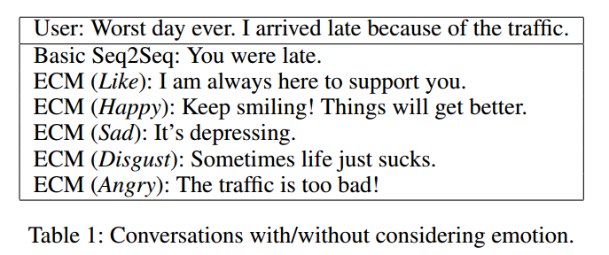
Examples
Notes:
A1-A2: 哪个关键词起到的作用更大，得到的结果可能不同
A2-A3：同一个关键词在不同的语境中也有不同意思

Slide 10
Contributions
It is the first work to address the emotion factor in large-scale conversation generation.
It proposes an end-to-end framework (called ECM) to incorporate the emotion influence in large-scale conversation generation.
It shows that ECM can generate responses with higher content and emotion scores than the traditional seq2seq model.
Notes:
A1-A2: 哪个关键词起到的作用更大，得到的结果可能不同
A2-A3：同一个关键词在不同的语境中也有不同意思

Slide 11
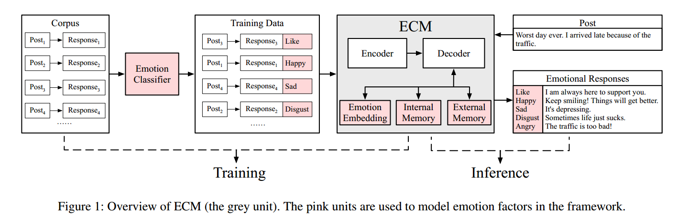
Overview

Slide 12
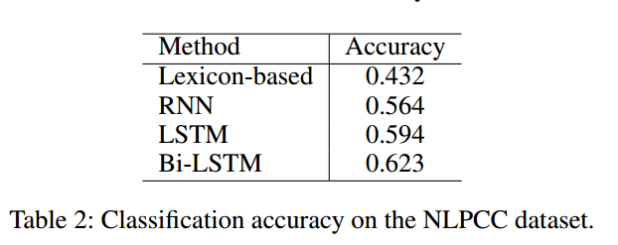
Dataset
Building an Emotion Classifier:
This dataset was used in challenging tasks of emotion classification in NLPCC2013 and NLPCC2014, consisting of 23,105 sentences collected
from Weibo.
The dataset consist of 6 emotion categories:
Angry, Disgust, Happy, Like, Sad and Other

Slide 13
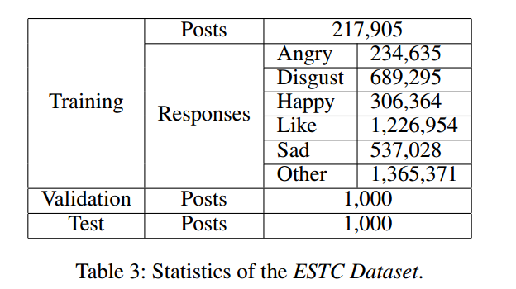
Dataset
2 . Annotating STC with Emotion:
We applied the best classifier, Bi-LSTM, to annotate the STC Dataset with the six emotion categories.

Slide 14

Model
Emotion Category Embedding
1. we randomly initialize the vector of an emotion category Ve, and then learn the vectors of the emotion category through training.
2. The emotion category embedding Ve, along with word embedding e(yt-1),and the context vector Ct, are fed into the decoder to update the decoder’s state St:

Slide 15
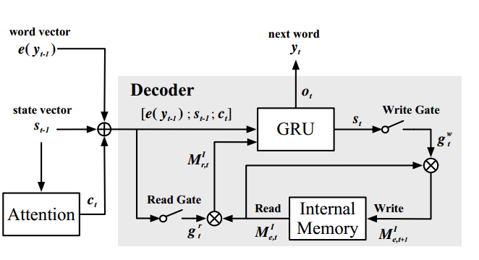
Model
Internal Memory
capture the emotion dynamics during decoding.

Slide 16
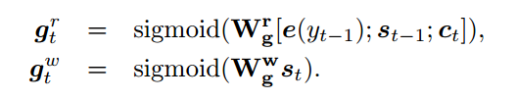
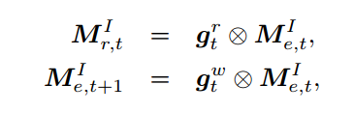

Model
Internal Memory
at each step the emotion state decays by a certain amount; once the decoding process is completed, the emotion state should decay to zero indicating the emotion is completely expressed.

Slide 17
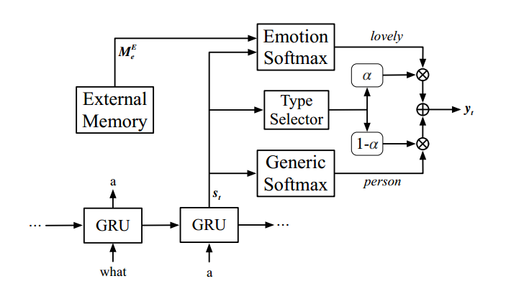
Model
External Memory
model emotion expressions explicitly by assigning different generation probabilities to emotion words and generic words.

Slide 18
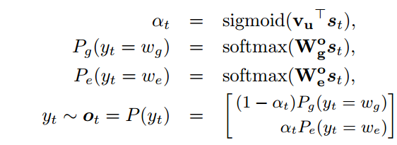
Model
External Memory
Pg/Pe is the distribution over generic/emotion words respectively, and P (yt) is the final word decoding distribution.

Slide 19

Model
Loss Function
we apply two additional regularization terms:
one on the internal memory, enforcing that
the internal emotion state should decay to zero at the end
of decoding the other on the external memory, constraining the selection of an emotional or generic word.

Slide 20
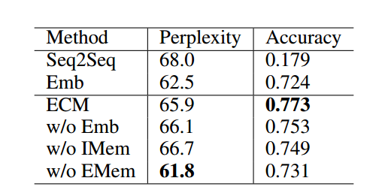
Experiments
Automatic Evaluation
1 . Perplexity
2. Accuracy

Slide 21
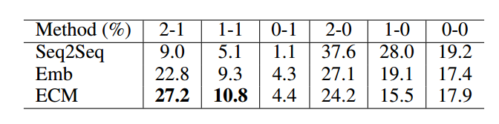
Experiments
Manual Evaluation
Content (rating scale is 0,1,2) and Emotion (rating scale is 0,1)
randomly sampled 200 posts
from the test set.

Slide 22
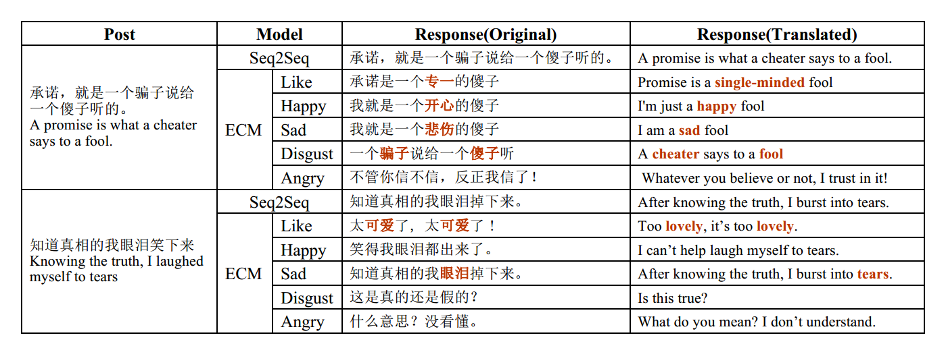
Experiments
Sample responses

Slide 23
Conclusion and Future Work
1 . We explore an Emotional Chatting Machine
(ECM) to model the emotion influence in large-scale conversation generation.
2 . In the future, we may explore emotion interactions
with ECM: instead of specifying an emotion class, the model
should decide the most appropriate emotion category for the
response.

Slide 24
Thank you !

