Slide 1

GPTEVAL: NLG Evaluation using GPT-4 with Better Human Alignment[微软]
陈可迪 51255901050

Slide 2
Motivations
Natural Language Generation (NLG)生成的结果很难被评价，BLEU和ROUGE之类的评价指标本质是计算重叠率，和人工评判结果往往相差甚远。
2022年底有工作开始将LLMs用作评价器的想法，但是有效性和可靠性依然是个问题。
GPTEVAL: NLG Evaluation using GPT-4 with Better Human Alignment

Slide 3
Tasks
本文设计的evaluator被称作GPTEVAL主要用于text summarization和dialogue generation两个任务
GPTEVAL: NLG Evaluation using GPT-4 with Better Human Alignment

Slide 4
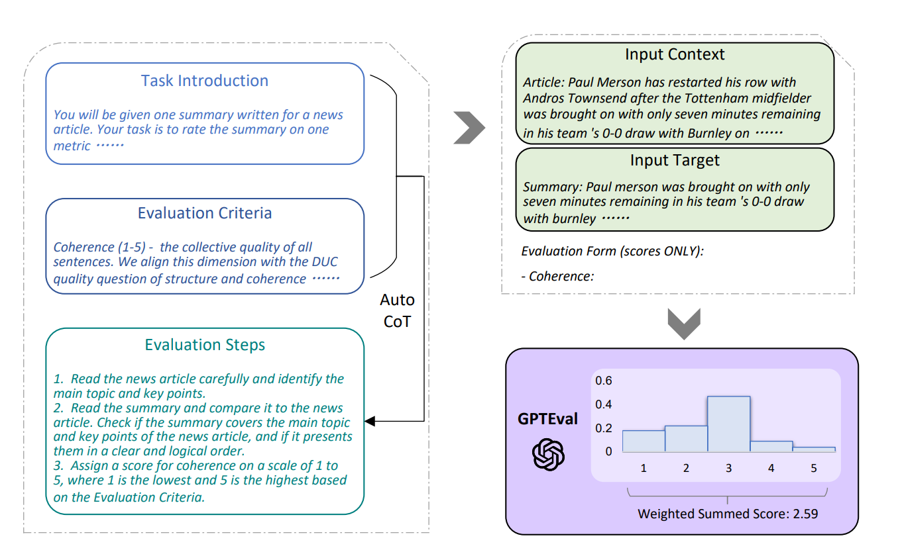
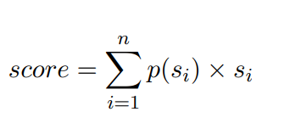
Framework
GPTEVAL: NLG Evaluation using GPT-4 with Better Human Alignment

Slide 5
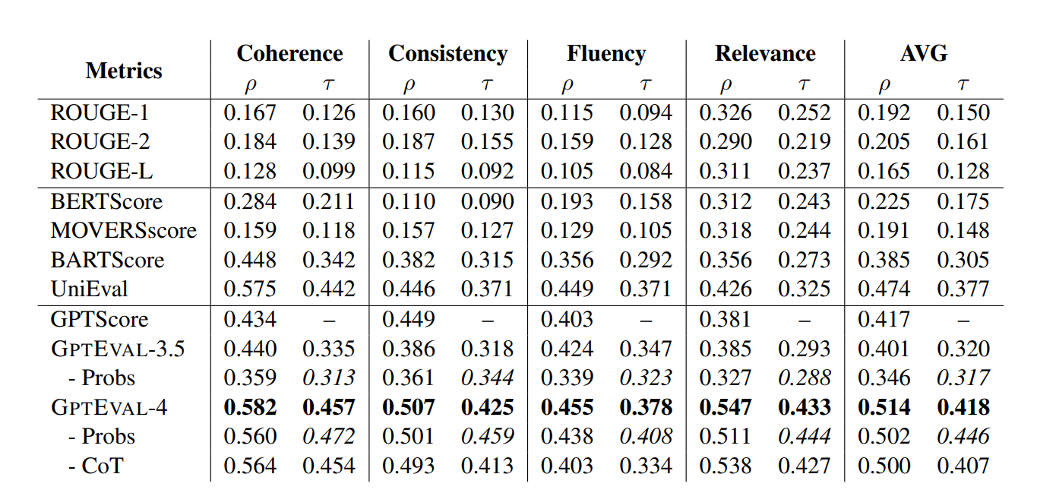
Result of text summarization
不同的评价维度
评价指标
人工评测的分数: [0.5, 0.7 ,0.5]
Metrics的打分: [0.3,0.6,0.4]
计算出这两个list之间的Spearman (ρ) and Kendall-Tau(τ )
GPTEVAL: NLG Evaluation using GPT-4 with Better Human Alignment

Slide 6
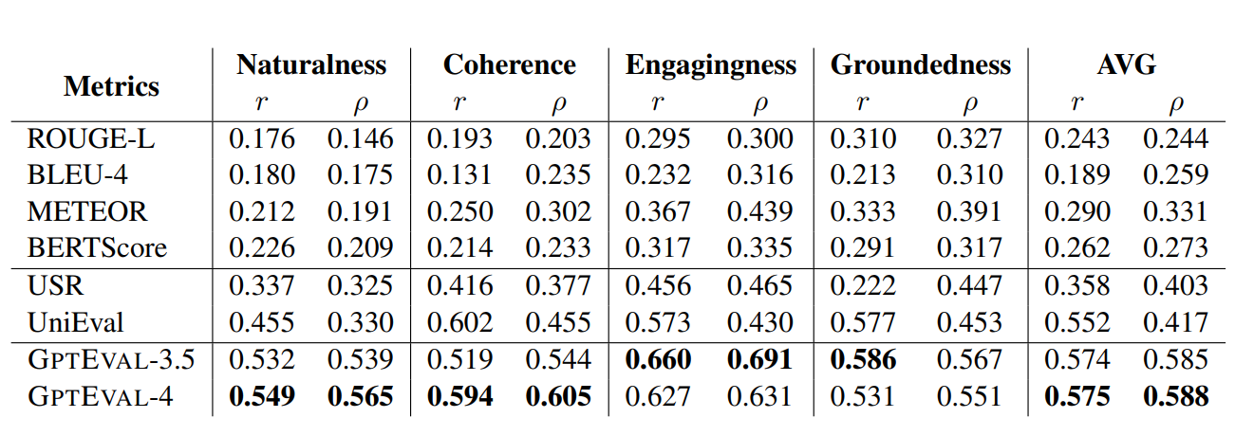
Result of dialogue generation
GPTEVAL: NLG Evaluation using GPT-4 with Better Human Alignment

Slide 7
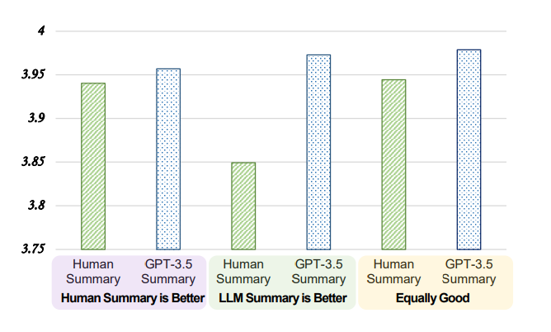
Analysis
Will GPTEVAL prefer LLM-based outputs?
LLM-based evaluators to reduce its inherent bias towards LLM generated text.
GPTEVAL: NLG Evaluation using GPT-4 with Better Human Alignment

Slide 8
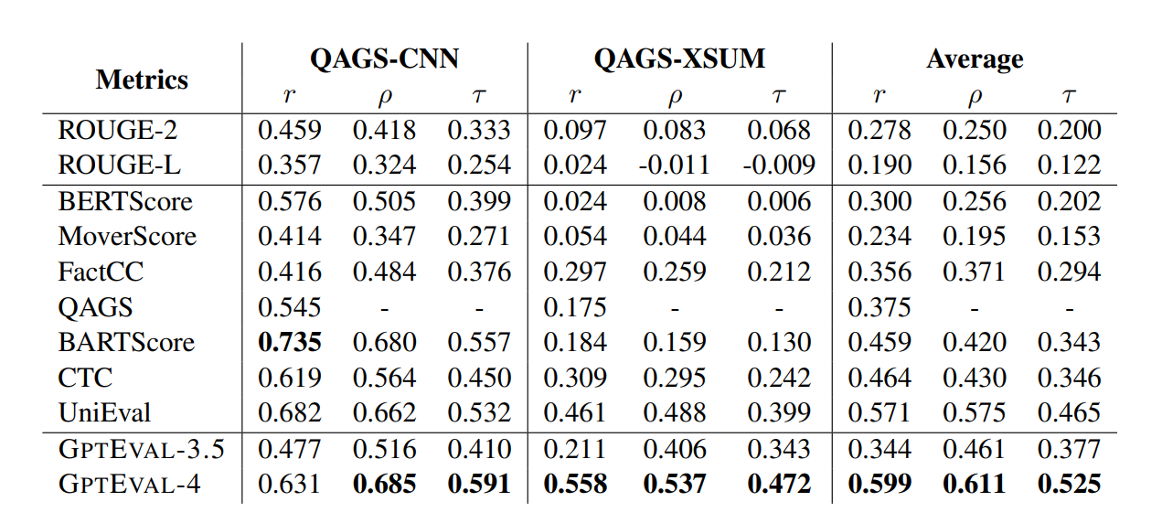
Analysis
The Effect of Model Size
QAGS:QA事实一致性评估模型
GPTEVAL: NLG Evaluation using GPT-4 with Better Human Alignment

Slide 9
Conclusion
本文提出了 GPTEVAL，这是一个使用 LLM 和 CoT来评估生成文本质量的框架。
本文对两个 NLG 任务（文本摘要和对话生成）进行了广泛的实验，并表明 GPTEVAL 可以胜过最先进的评估器并实现更高的人类对应关系。
我们还提出了对基于 LLM 的评估者行为的初步分析，并强调了基于 LLM 的评估者对 LLM 生成的文本有偏见的潜在问题。
1.本文只探讨了对于生成和对话任务的评测，是否可以扩展到别的传统NLP任务？
2.LLMs的bias在不同任务中具体表现形式。
3.生成的CoT能否提升准确性？
GPTEVAL: NLG Evaluation using GPT-4 with Better Human Alignment

Slide 10
Enlighten
可否利用LLM为各个AI任务设计更加合理的评价指标？
比如实体抽取，gt的标注有人为的偏差性
 | GT | 抽取结果 | 判断结果
span | apple | the apple | False
LLMs | apple | the apple | True
语义上相同+语法上合规
GPTEVAL: NLG Evaluation using GPT-4 with Better Human Alignment

Slide 11
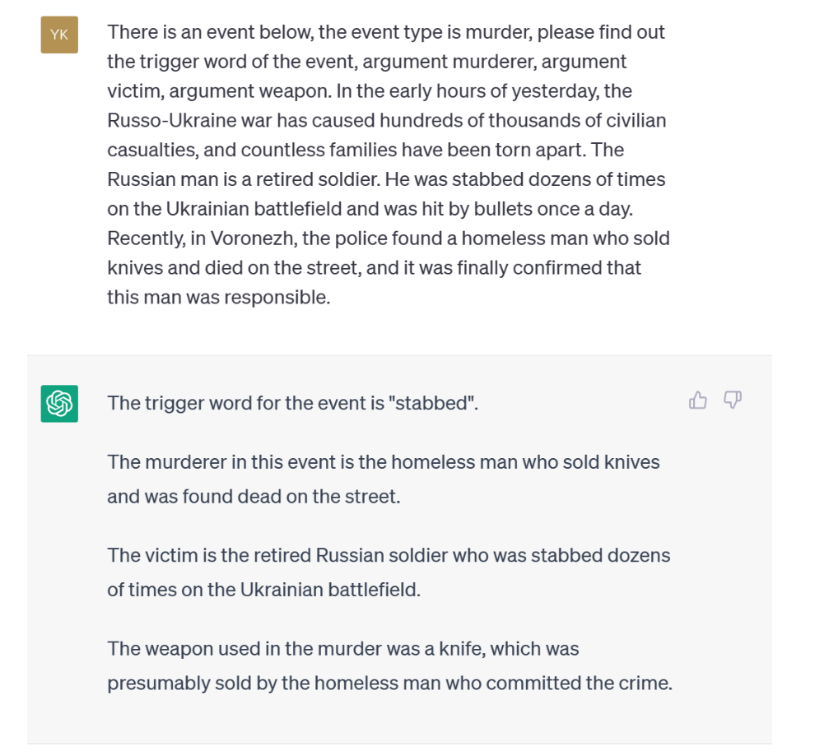
Enlighten
In the early hours of yesterday, the Russo-Ukraine war has caused hundreds of thousands of civilian casualties, and countless families have been torn apart. The Russian man is a retired soldier. He was stabbed dozens of times on the Ukrainian battlefield and was hit by bullets once a day. Recently, in Voronezh, the police found a homeless man who sold knives and died on the street, and it was finally confirmed that this man was responsible.
GPTEVAL: NLG Evaluation using GPT-4 with Better Human Alignment

Slide 12
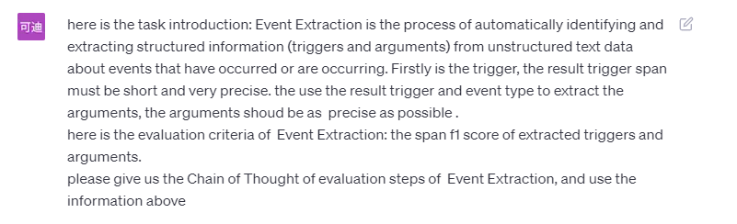

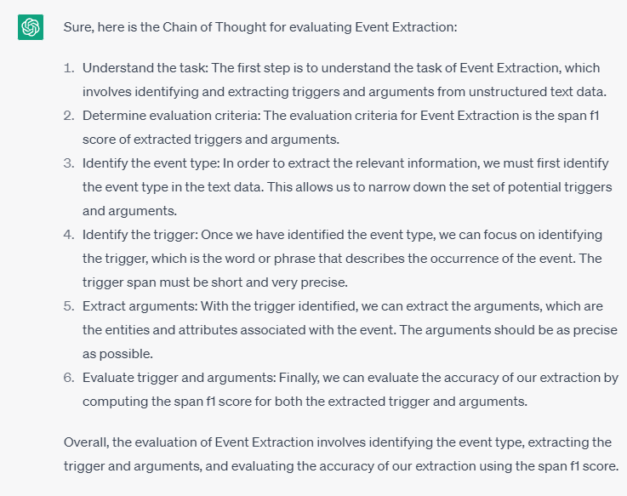
Enlighten
GPTEVAL: NLG Evaluation using GPT-4 with Better Human Alignment

