Slide 1
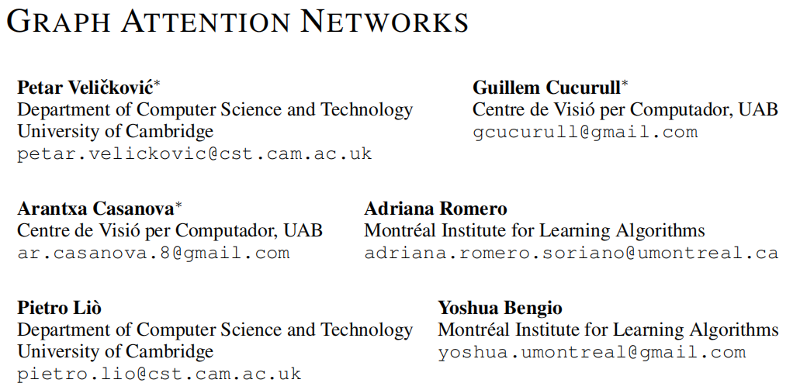
ICLR 2018
51194506092
张钊宁

Slide 2
Outline
Task & Related work
Motivation
Approach
Experiments
Results and Analysis
Conclusion

Slide 3
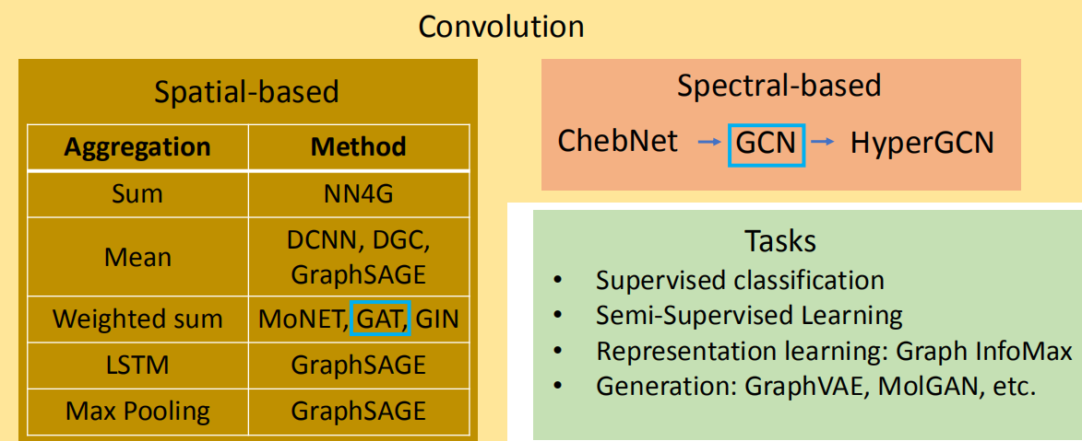
Task & Related work
It address several key challenges of spectral-based graph neural networks simultaneously, and make our model readily applicable to inductive as well as transductive problems.

Slide 4
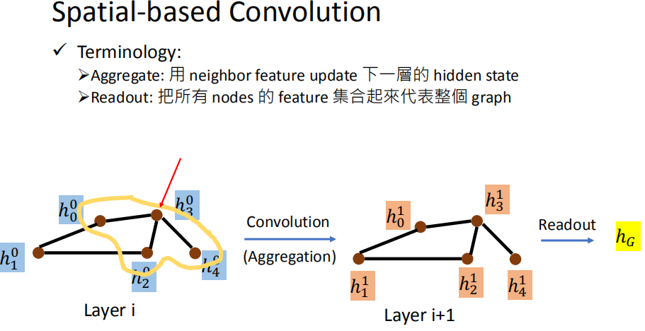
Task & Related work

Slide 5
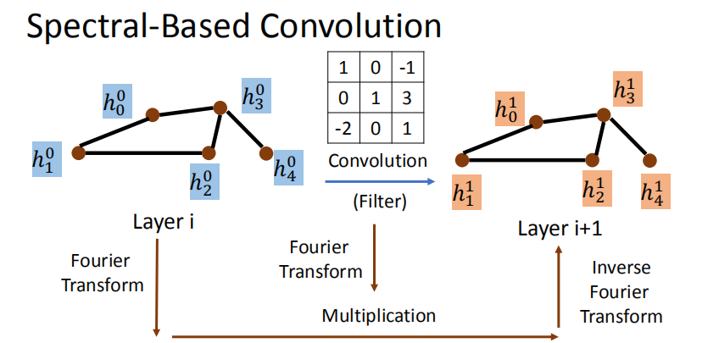
Task & Related work

Slide 6
Task & Related work
It address several key challenges of spectral-based graph neural networks simultaneously, and make our model readily applicable to inductive as well as transductive problems.

Slide 7
Motivation
GCNs models are assigning the same importance to nodes of a same neighborhood
GCNs models cannot handle inductive tasks. The way GCNs combines the features of adjacent nodes is dependent on the structure of the graph

Slide 8
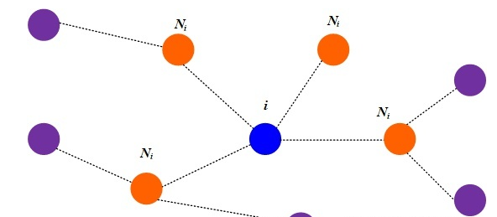

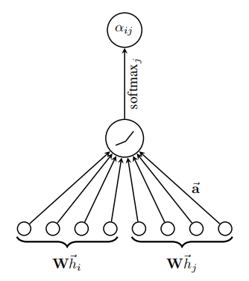

Approach
Calculate attention coefficient

Slide 9
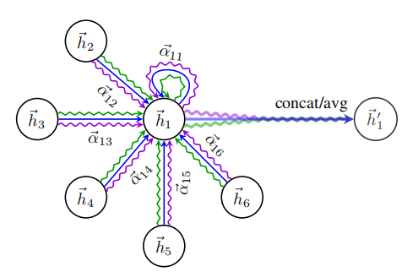

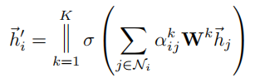

Approach
Aggregate

Slide 10
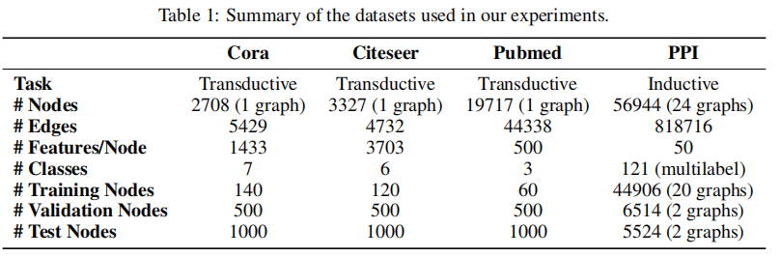
Experiments
Transductive learning
Layer1 :K = 8 attention heads computing F’ = 8 features each
Layer2: a single attention head that computes C features (where C is the number of classes), followed by a softmax activation.
L2 regularization λ = 0.0005
dropout p = 0.6
Spical for Pubmed:
Layer2: K = 8 output attention heads (instead of one)
L2 regularization to λ = 0.001.

Slide 11
Experiments
Inductive learning
Layer1/2 :K = 4 attention heads computing F’ = 256 features each
Layer3: K = 6 output attention heads computing F’ = 121 features each
that are averaged and followed by a logistic sigmoid activation.
The training sets for this task are suffificiently large and no need to apply
L2 regularization or dropout

Slide 12
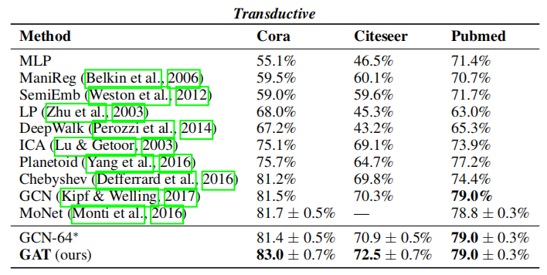
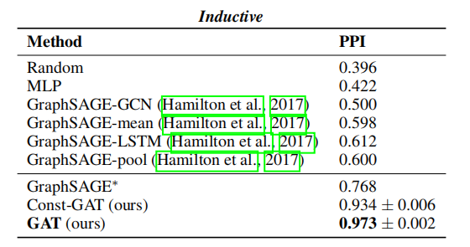
Results and Analysis

Slide 13
Conclusion
Attention mechanism is applied in graph neural network, the model is also more interpretable.
allows for assigning different importances to different nodes within a neighborhood while dealing with different sized neighborhoods
Does not require costly matrix operations, and is parallelizable across all nodes in the graph
Does not depend on knowing the entire graph structure upfront
The graph is not required to be undirected
It makes this technique directly applicable to inductive learning
achieved or matched state-of-the-art performance across four well-established node classification benchmarks

Slide 14
THANKS

Slide 15
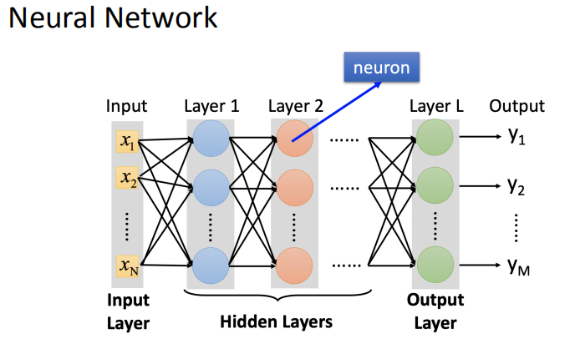
Review

Slide 16
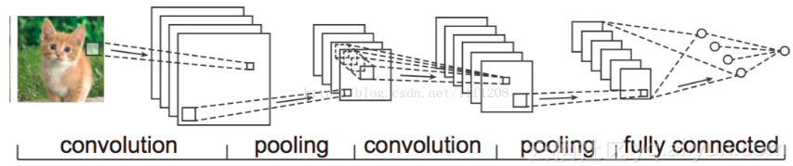
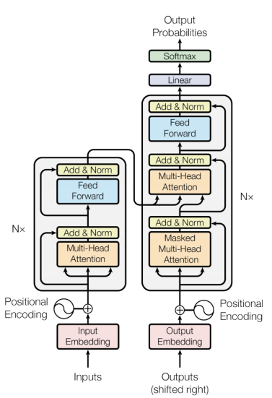
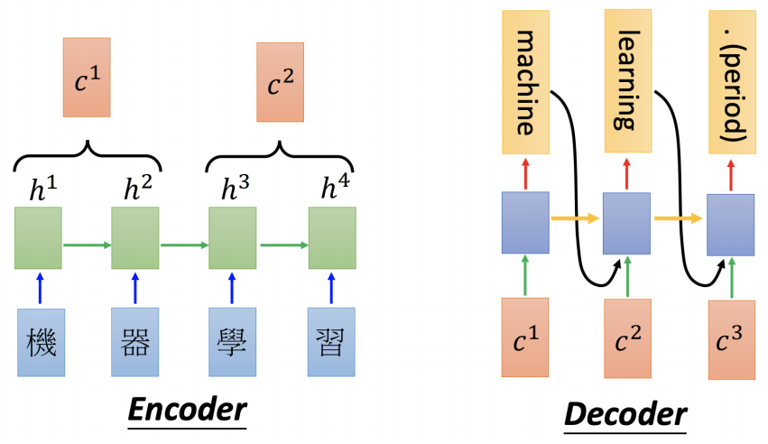
Review
CNN
Transformer
RNN

Slide 17
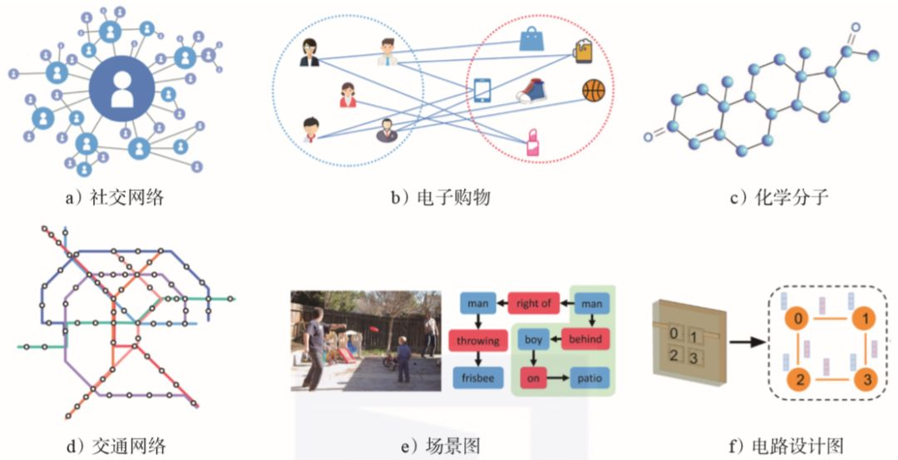
Review
Graph

Slide 18
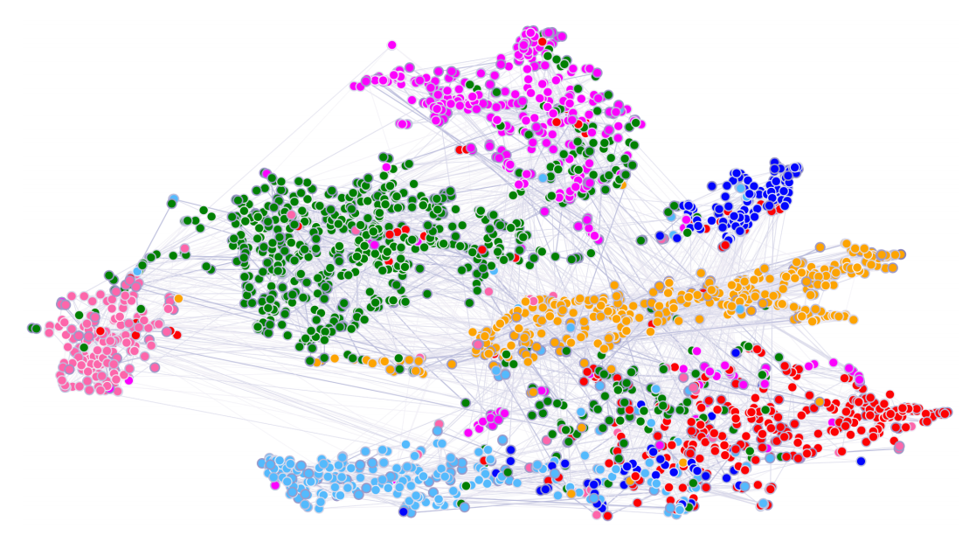
Review
Graph Neural Network

Slide 19
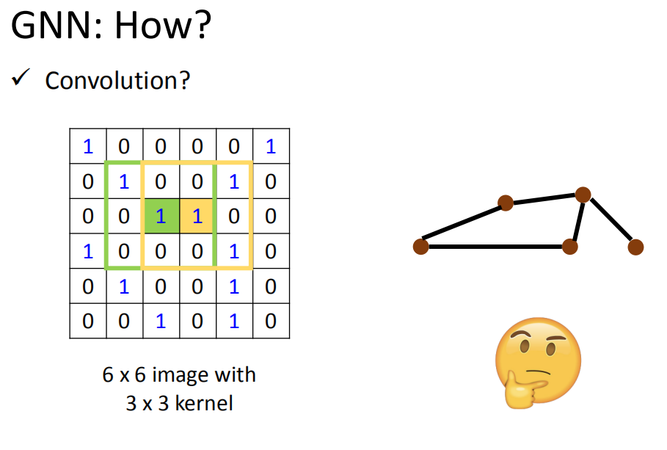
Related Work

Slide 20
Review

