Slide 1
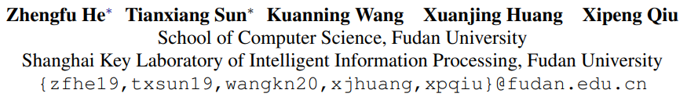
DiffusionBERT: Improving Generative Masked Language Models with Diffusion Models
ACL2023
汇报人：李雨倩
1

Slide 2

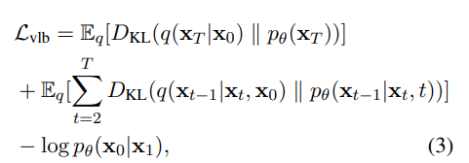
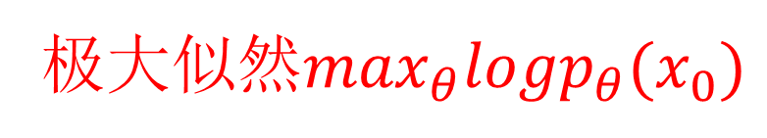
Diffusion model
Forward process:
马尔可夫假设
Reverse process:
参数
利用重采样可推
极大似然$\max_{θ}logp_{θ}(x_{0})$
Loss function:
变分下界
根据贝叶斯可推
2
Notes:
前向过程，就是在x0（原样本）的基础上不断添加高斯噪声，使最后的状态XT接近于标准高斯分布
当 �� 足够小时，在扩散过程的逆过程（生成过程）中， �(��−1|��) 也将（近似）符合高斯分布
逆向过程，从标准高斯分布采样开始，不断去噪，获得最后的结果，没有解析形式的，因而需要学习每个t时刻的均值和方差参数

Slide 3

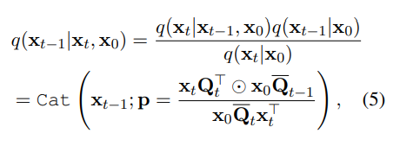
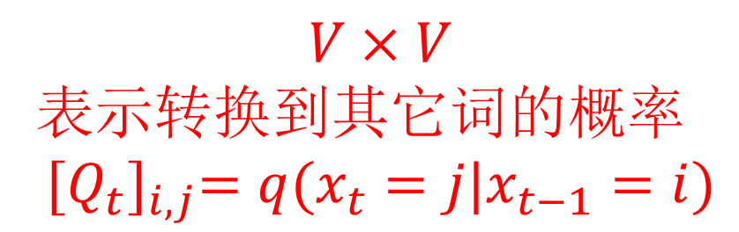
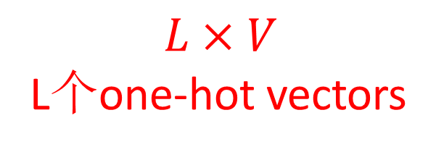
Diffusion model in Discrete Domain
连续：高斯分布
离散：类别分布category distribution
$$L×V$$
L个one-hot vectors
$$V×V$$
表示转换到其它词的概率
$${[Q_{t}]}_{i,j}=q(x_{t}=j|x_{t−1}=i)$$
3

Slide 4
DiffusionBERT
Overview:
Find a discrete absorbing state according to plm
Introduce a new noise schedule of the forward diffusion process, called spindle schedule
Investigate several alternatives of incorporating the time step into PLMs
4
Notes:
1. 吸收态就是在马尔可夫链中无论从哪个状态开始最终都会转移到的状态

Slide 5
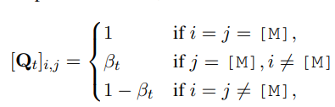
A Discrete Absorbing State
Each token in the sequence either stays the same or transitions to [MASK] with some probability.
5

Slide 6
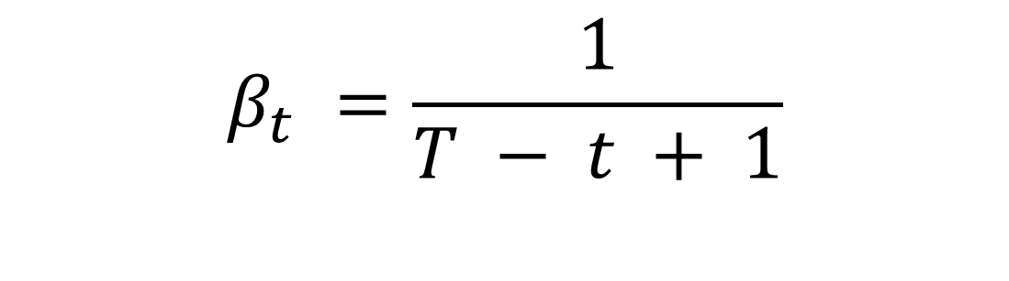
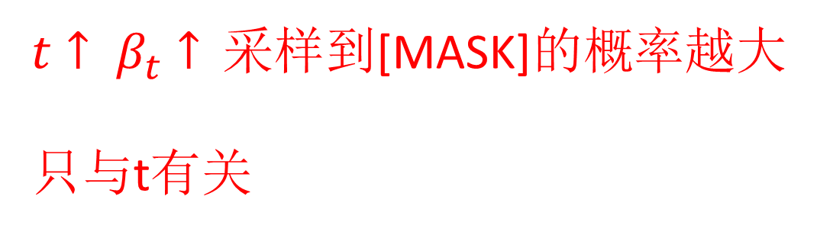
Spindle Noise Schedule
$$β_{t} =\frac{1}{T − t + 1}$$
$t↑ β_{t}↑$采样到[MASK]的概率越大
只与t有关
Assumes all tokens carry the same amount of information and does not consider the linguistic difference among the tokens in a sequence
Violates the easy-first-generation nature of denoising language models.
6
Notes:
在从纯噪音还原数据的过程中，会出现一种easy-first-generation的现象，即模型优先生成出现频率最高的token
每个t步骤

Slide 7
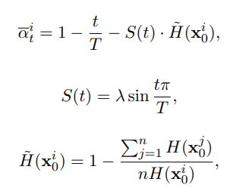
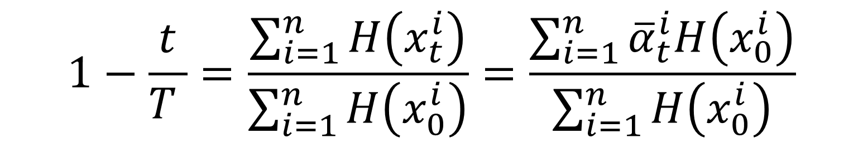


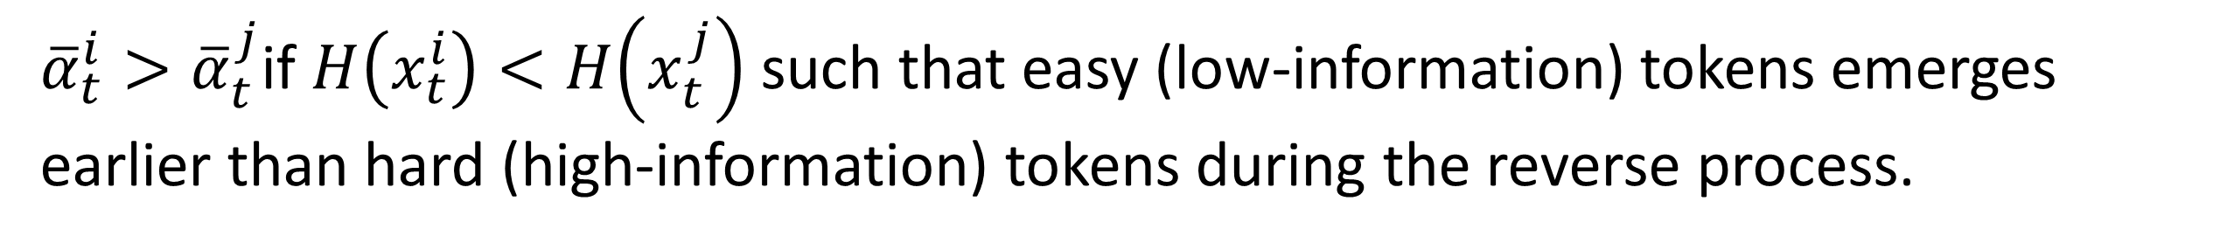
Spindle Noise Schedule
具体而言，前向过程中mask掉均匀的信息量可以被表示为
$$1−\frac{t}{T }=\frac{\sum_{i=1}^{n}{H\left(x_{t}^{i}\right)}}{\sum_{i=1}^{n}{H\left(x_{0}^{i}\right)}}=\frac{\sum_{i=1}^{n}{{\overline{α}}_{t}^{i}H\left(x_{0}^{i}\right)}}{\sum_{i=1}^{n}{H\left(x_{0}^{i}\right)}}$$
$信息量$用熵计算，熵越大，信息量越大
${\overline{α}}_{t}^{i}>{\overline{α}}_{t}^{j}$if $H\left(x_{t}^{i}\right)<H\left(x_{t}^{j}\right)$ such that easy (low-information) tokens emerges earlier than hard (high-information) tokens during the reverse process.
$破坏$马尔可夫假设
7
Notes:
在从纯噪音还原数据的过程中，会出现一种easy-first-generation的现象，即模型优先生成出现频率最高的token
每个t步骤

Slide 8

Feeding Time Steps
Layer-wise Time Embedding: include the time step as the same way as positional encoding
Prefix Time Embedding: including a time step token embedding v(t) as a prefix of the input token embeddings
Time-Agnostic Decoding: not to explicitly incorporate the time step t because it can be implied by the noised sample xt
8

Slide 9
Experiments
Setup:
Dataset: LM1B a language corpus with about 30 million sentences(one billion word ) and a vocabulary of about 793k
Model: BERT-BASE-UNCASED with about 110M parameters
Training: using the AdamW optimizer for 1.9 million steps with learning rate of 3e-6, dropout probability of 0.1, batch size of 32, NVIDIA A100 of 4
9
Notes:
关系抽取为例子

Slide 10
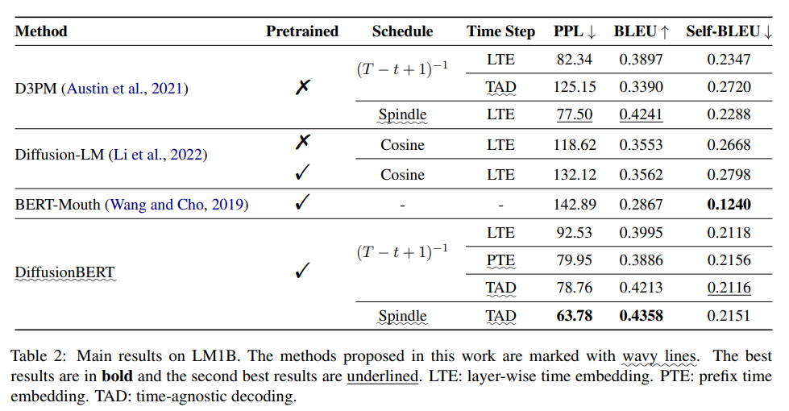
Experiments
10
Notes:
D3PM：google research
Bert-Mouth：每次选定一个位置采样出word
Bleu：采样得到的句子和测试集之间的相似度计算
Self-blue：采样得到的句子两两之间的相似度计算
结果：
最好
和连续模型比效果好，可能是因为 离散+预训练。Diffusion-LM预训练差可能是因为bert学习的embedding不适用于高斯分布的diffusion process
关于Time Step，D3PM中LTE比TAD好，而DiffusionBert中TAD最好，可能是因为DiffusionBert有pretrained

Slide 11
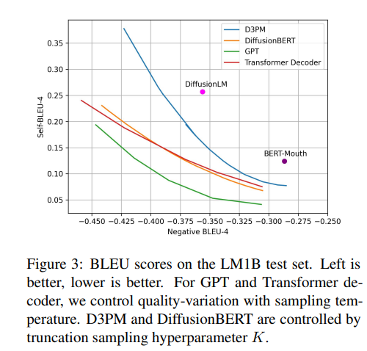
Experiments
11
Notes:
根据不同的采样策略可以去平衡质量和多样性
GPT和Transformer用temperature去平衡
离散的Diffusion可以用topk平衡（在每一次采样的时候）

Slide 12
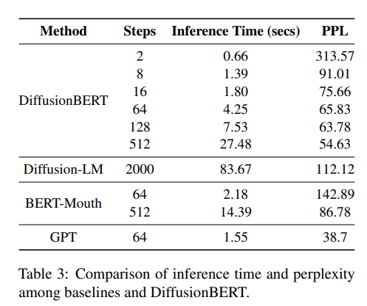
Experiments
12

