Slide 1
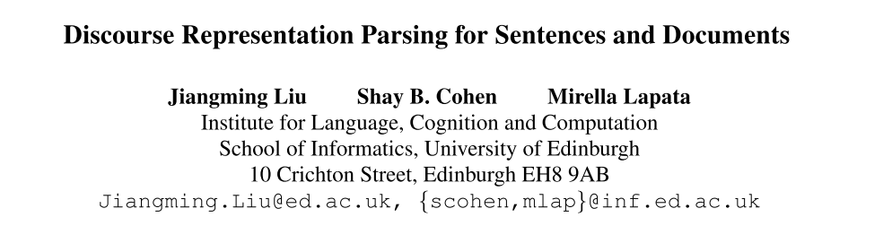
ACL 2019
51194506071
李德健

Slide 2
Outline
Background
Discourse Representation Tree Structures (DRTSs)
Model
Extensions
Experimental & result

Slide 3
1 Background
Semantic Parsing
Discourse Representation Theory (DRT)

Slide 4
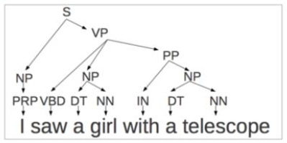
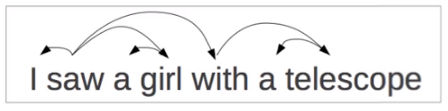
Parsing
Parsing(Syntactic Parsing) is the automatic analysis of a sentence with respect to its syntactic structure
① Dependency parsing ② Constituency parsing
Semantic Parsing
Semantic parsing is the task of mapping natural language to machine interpretable meaning representations.

Slide 5

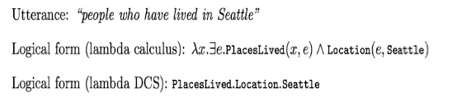
What are semantic representation?
Lambda calculus expressions (with CCG) (Zettlemoyer and Collins, 2005)
Lambda dependency-based compositional semantics(λ-DCS; Liang et al. 2011)
2020/5/14
5

Slide 6
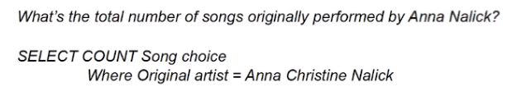
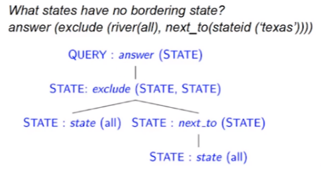
What are semantic representation?
SQL (Yin et al. 2015)
FunQL (logical forms
with tree structures)
(Kate et al. 2005)

Slide 7
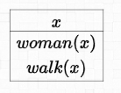
Discourse Representation Theory (DRT)
Discourse Representation Theory (DRT; Kamp and Reyle 1993) is a popular theory of meaning representation designed to account for a variety of linguistic phenomena
the interpretation of pronouns
temporal expressions within and across sentences
A woman walks
2020/5/14
7
Notes:
一种流行的意义表征理论，旨在解释各种语言现象

Slide 8
Discourse Representation Structures (DRS)
DRS
The basic meaning-carrying units in DRT are Discourse Representation Structures (DRSs)
discourse referents (e.g., x1, x2)
representing entities in the discourse
discourse conditions (e.g., max(x1), male(x1))
representing information about discourse referents.
A woman walks
2020/5/14
8
Notes:
discourse referents 话语指示物（x1,x2等),表示实体 ，它代表這個句子中,可以被其他代名詞參考的東西
discourse conditions 话语条件 ( max(x1), male(x1) 等)表示关于话语指示物的一些信息

Slide 9
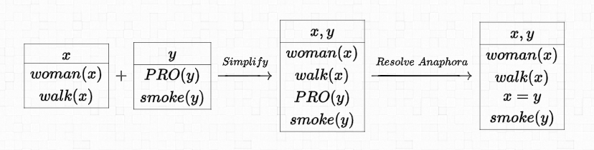
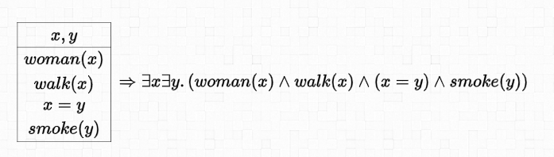
A woman walks. She smokes.
translated into first-order logic
2020/5/14
9
Notes:
Resolve Anaphora 指代
first-order logic 一阶逻辑

Slide 10
Data
Groningen Meaning Bank (GMB, Bos et al. 2017)
a large collection of English texts annotated with DRS
integrates various levels of semantic annotation into a unified formalism
anaphora(指代), named entities, thematic roles, rhetorical relations
providing expressive meaning representations for open-domain texts

Slide 11

Motivation
DRT (theory)
GMB(data)
Encoder-decoder(model)
Discourse Representation Trees
+ document

Slide 12
2 Discourse Representation Trees
Definition
Six types of nodes

Slide 13
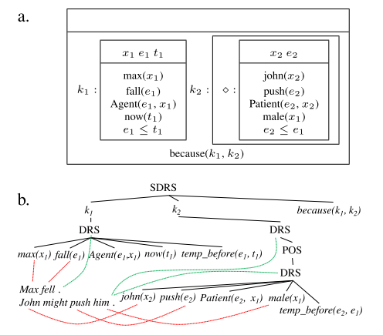


2 Discourse Representation Tree Structures (DRTSs)
preserves most of the content of DRS boxes
referents
conditions
their dependencies
add alignments between sentences and DRTSs nodes
Max fell, John might push him.

Slide 14
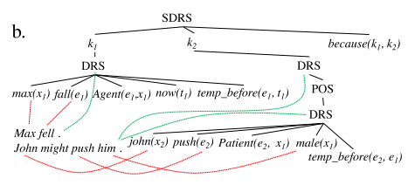



2.1 Definition
R relation symbols
the disjoint union of a set of elementary relations Re and segment relations Rs
V variable symbols
V are indexed and can refer to :
entities x, events e, states s, time t, propositions p, and segments k
C constants
N scoping symbols
conditions involving implication, disjunction, and duplex
Duplex represents wh-questions (e.g., who, what, how).
modality operators expressing possibility, necessity, and negation

Slide 15
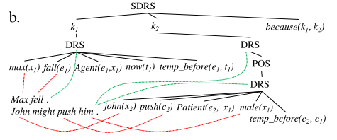




2.2 Six types of nodes
atomic nodes
leaf nodes
their label is an instantiated relation
unary or binary eg:
argument variables from V or constants from C
elementary DRS nodes
labeled with
one or more children
children are atomic nodes (taking relations from Re), simple scoped nodes, or proposition scoped nodes
segmented DRS nodes
labeled with
at least two children nodes
segment scoped nodes and at least one atomic node
the variables allowed are the segment variables that were chosen for the other children nodes and the relations are taken from Rs)
Notes:
其中允许的变量是为其他子节点选择的段变量，并且关系是从Rs中获取的

Slide 16
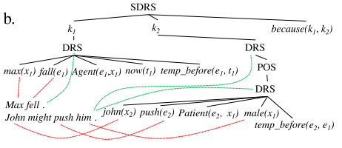


2.2 Six types of nodes
simple scoped nodes
can take one of the labels in N
: one elementary or a segmented DRS node
: two ….
proposition scoped nodes
can take as label one of the proposition variables p
children are elementary or segmented DRS nodes
segment scoped nodes
can take as label one of the segment variables k
children are elementary or segmented DRS nodes

Slide 17
Contribution
formally define Discourse Representation Tree structures for sentences and documents
a general framework for parsing discourse structures of arbitrary length and granularity
meaning representations into three stages following a coarse-to-fine approach
three modeling innovations
a supervised hierarchical attention mechanism,
a linguistically-motivated copy strategy
constraint-based inference to ensure well-formed DRTS output

Slide 18
3 Model
Encoder
word
sentence
Decoder
Multi-Attention
Tree Generation ( 3 stage )
Training

Slide 19
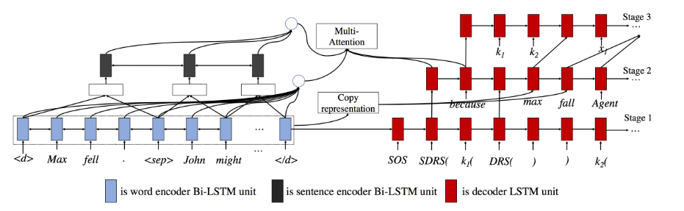
3 Model
based on the encoder-decoder
encoder: obtain word and sentence representations
decoder: generates trees in three stages
elementary DRS nodes, segmented DRS nodes, and scoped nodes are generated.
the relations of atomic nodes are predicted
followed by their variables.
Notes:
encoder: 得到单词和句子表示
decoder: 解码器分三个阶段生成树
1 生成基本DRS、段DRS 和 原子节点
2 预测原子节点之间的关系
3 然后是它们的变量

Slide 20
3 Model
arbitrary length and granularity / document-level information
multi-attention
a supervised attention mechanism for aligning DRTS nodes to sentences
a linguistically-motivated copy strategy
Notes:
为了使得模型能够兼容任意长度和粒度，处理document级别的信息，在decoder上添加了多层注意力，一种用于将DRTS节点与句子对齐的监督注意机制，以及一种出于语言动机的拷贝策略

Slide 21
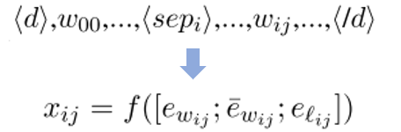



3.1 Encoder
(;) : concatenation
randomly initialized embeddings (randomly initialized and tuned)
pre-trained word embeddings (fixed)
lemma embeddings (randomly initialized and tuned)

Slide 22



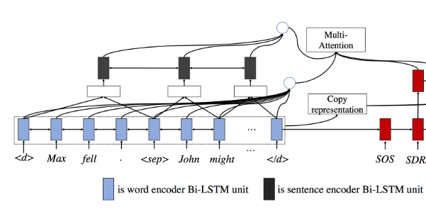


3.1 Encoder
Word Representation
Shallow Sentence Representation
Deep Sentence Representation

Slide 23
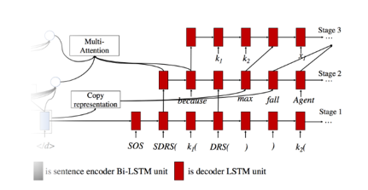
3.2 Decoder
three-stage
each stage can be regarded as a sequential prediction on its own
the backbone of our tree-generation procedure is an LSTM decoder
with multi-attention mechanism

Slide 24
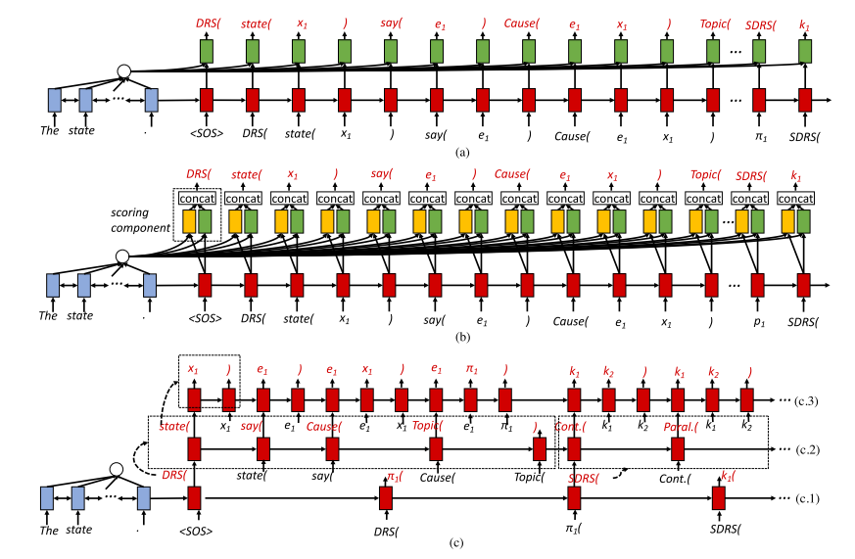

Slide 25

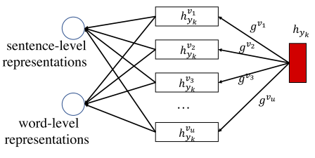




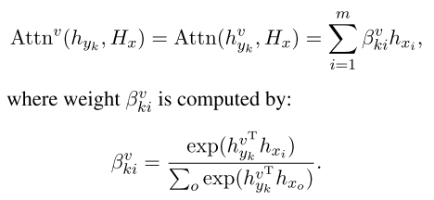
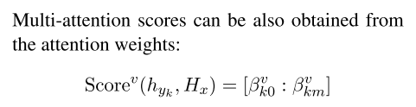
3.2.1 Multi-Attention
Extract features from different encoder representations
hidden representations of the decoder
linear function with the name v
“word”, “sent”, “copy”,
“st2nd” (from first to second stage)
“nd2rd” (from second to third stage)
Given encoder representations
Notes:
得到encoder和decoder的对齐隐藏表示

Slide 26
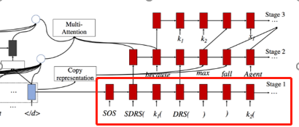




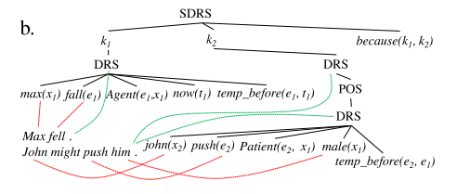

3.2.2 Tree Generation
Stage 1 (st)
Generates non-terminals
encoder representations
hidden representation of the decoder in Stage 1

Slide 27




3.2.2 Tree Generation
Stage 2 (nd)
Copy representations
for each document d of its encoder hidden representations
constructed as follows:
is the set of distinct lemmas in document d

Slide 28
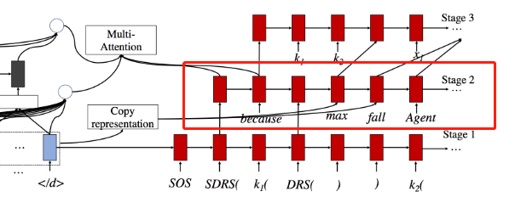





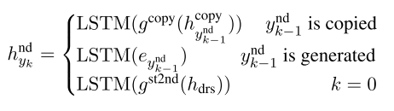

3.2.2 Tree Generation
Stage 2 (nd)
Given elementary or segmented DRS nodes generated in Stage 1,
atomic nodes are predicted
generation and copy scores
hidden representation of the decoder in Stage 2
linear function

Slide 29
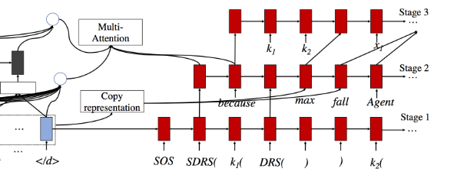
3.2.2 Tree Generation
Stage 2 (nd)
Copy strategy
copy lemmas from the input text
copying is limited to unary nodes which mostly represent entities and predicates (谓词)
Binary atomic nodes denote semantic relations between two variables and do not directly correspond to the surface text
oil(x1)
company(x2)
of(x2, x1)
Notes:
复制仅限于主要表示实体和谓词的一元节点

Slide 30
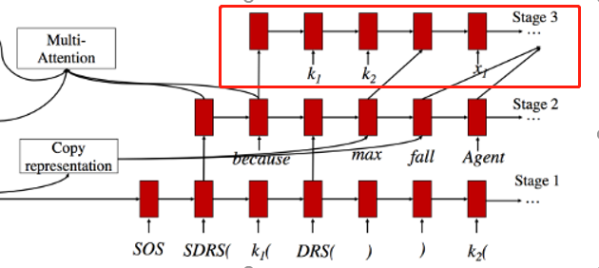





3.2.2 Tree Generation
Stage 3 (rd)
Generates atomic node variables
linear function

Slide 31

3.3 Training
minimize an average cross-entropy loss
the distribution of output tokens

Slide 32
4 Extensions
Supervised Attention
Alignments as Features
Copying from Alignments
Constraint-based Inference
Notes:
基于约束的推理

Slide 33
4 Extensions
a supervised attention mechanism
dedicated to aligning sentences to tree nodes
important when parsing documents
may also enhance the quality of the copy mechanism
the generation of well-formed and meaningful logical forms
generally challenging
especially dealing with long and complex documents

Slide 34
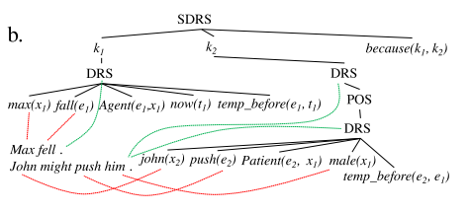
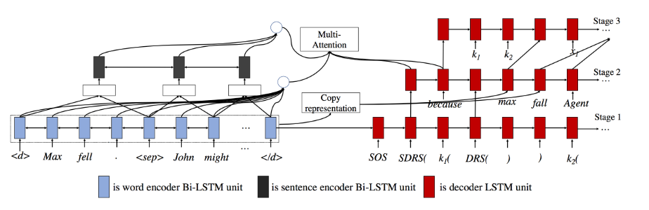
4.1 a supervised attention mechanism
alignments between encoder and decoder hidden representations
alignment information between DRTS nodes and sentences

Slide 35



4.1 a supervised attention mechanism
alignment weights via multi-attention:
add an alignment loss to the objective
the k-th prediction aligned to the m-th sentence.
probability distribution of alignments
Notes:
解码器中从句子到第k个预测的比对上的概率分布

Slide 36




4.1 a supervised attention mechanism
Alignments as Features
Test:
select the sentence with the highest probability
Notes:
解码器中从句子到第k个预测的比对上的概率分布

Slide 37


4.1 a supervised attention mechanism
Copying from Alignments
modulate which information is copied.
allow copying only over sentences aligned to elementary DRS nodes
construct copy representations for each sentence in a document
Test: (first)elementary DRS → aligned sentence → copy its element
a：index of the sentence that is aligned to the
elementary DRS node

Slide 38
4 Extensions
a supervised attention mechanism
dedicated to aligning sentences to tree nodes
important when parsing documents
may also enhance the quality of the copy mechanism
the generation of well-formed and meaningful logical forms
generally challenging
especially dealing with long and complex documents

Slide 39


4.2 Constraint-based Inference
tree output will be well-formed？（three seq2seq）
at each step, we generate the set of valid candidates
then select the highest scoring tree as our prediction:
Notes:
基于约束的推理
回想一下，我们的解码器由三个阶段组成，每个阶段都是一个序列到序列的模型。因此，不能保证树的输出将是格式良好的。为了确保生成语法有效的树，在每个步骤中，我们生成一组有效的候选树Yvalid，这些树都不违反DRTS的定义。然后选择得分最高的树作为我们的预测。

Slide 40
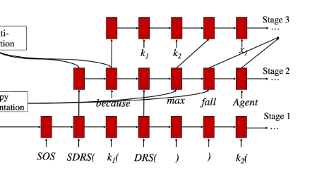
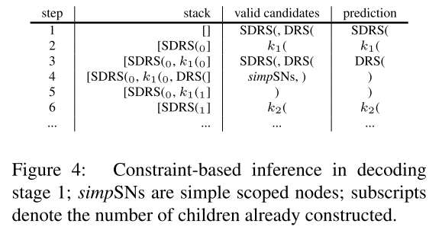
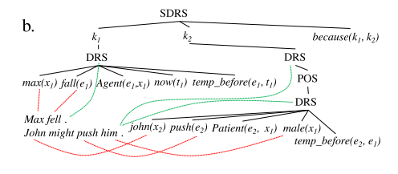
4.2 Constraint-based Inference
Stage 1
partial DRTSs are stored in a stack
check each to obtain a set of valid candidates
Stage 2
when generating relations for elementary DRS nodes, the candidates come from Re and lemmas that are used for copying
when generating relations for segmented DRS nodes, the candidates only come from Rs.
Stage 3
generate only two variables for binary relations
one variable for unary relations

Slide 41
5 Experimental & result

Slide 42
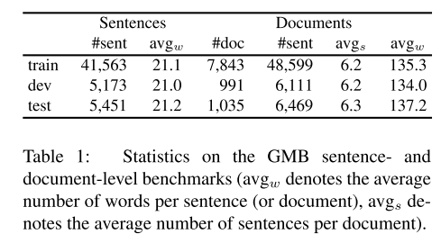
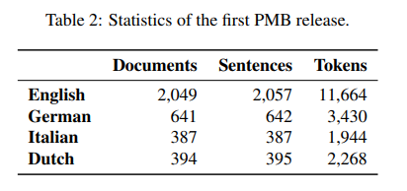
5 Experimental Setup
same empirical hyperparameters for sentence- and document-level parsing
dimensions of word and lemma embeddings were 300 and 100
pre-trained word embeddings (100 dimensions) were generated with Word2Vec on English Gigaword corpus
encoder and decoder had two layers with 300 and 600 hidden dimensions

Slide 43
Model Comparison
sentence-level
Liu et al. (2018) - copy strategies
sequence-to-sequence model
treats DRTSs as linearized trees
document-level
DocSent
treats documents as one long string
DocTree
each sentence in a document with a sentence-level parser
constructs a (flat) document tree by gathering all sentential DRTSs as children of a segmented DRS node
Shallow
multi-attention and shallow sentence representations
Deep
multi-attention and deep sentence representations
DeepFeat
a Deep model with supervised attention and alignments as features
DeepCopy
a Deep model with copying modulated by supervised attention

Slide 44
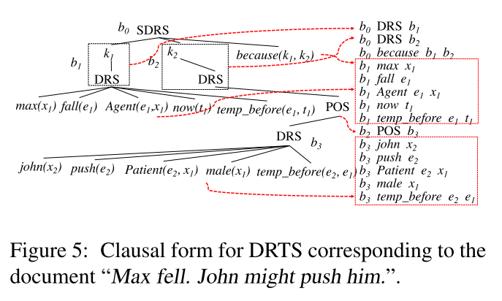



Evaluation
COUNTER (van Noord et al., 2018a)
a recently proposed metric suited to
matching scoped meaning representations.
converts DRSs to sets of clauses
computes precision and recall on
matching clauses.
b variables refer to DRS nodes
children of DRS nodes correspond to clauses
We report F1 using ：
exact match
partial match

Slide 45
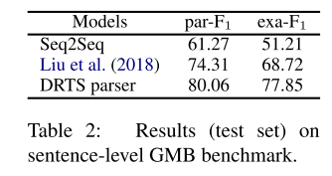
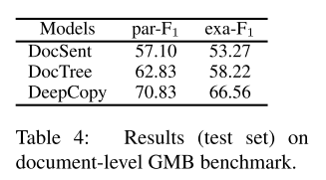
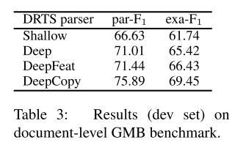
result
Parsing Sentences
Parsing Documents
linguistically-motivated copy strategies
Using alignments as features and as a way of highlighting where to copy from yields

Slide 46
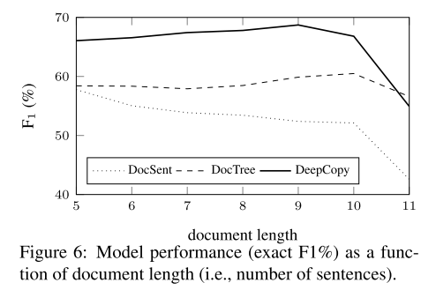
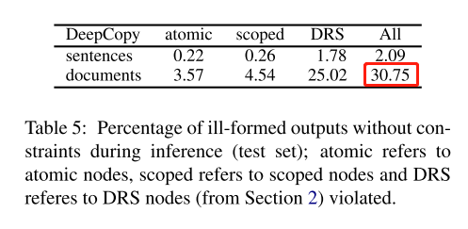
result
Influence of Constraints
Influence of Document size
Notes:
特别地，我们展示了不执行约束时的病态DRTSs的百分比

Slide 47
Thank you!

