Slide 1
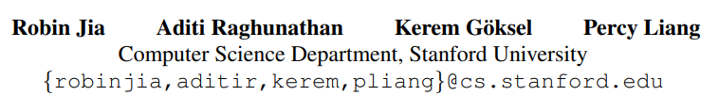
(EMNLP, 19)Certified Robustness to Adversarial Word Substitutions
Presenter: 汤旭东
ID:51194501065
Notes:
有保证的
斯坦福大学

Slide 2
Overview
Problem definition
Method
Experiments
Conclusion
Notes:
问题小众

Slide 3
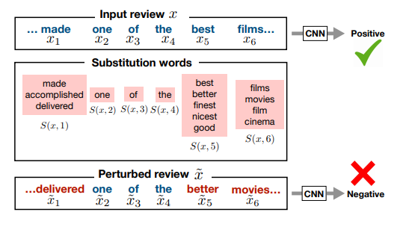
Adversarial Word Substitutions
Models can be easily fooled by adversarially chosen perturbations
But the ideal model would be robust to all combinations of word substitutions
Notes:
尽管语病，不通顺，语义不变

Slide 4





Superset of all perturbations
$f^{0−1}(z,θ)$: the zero-one loss under model $θ$
The set of all allowed perturbations of $z$ :
Losses:
Robust model:
Tractable upper bound:
Notes:
一些简单公式定义， 怎么找这个超集呢
波浪 tilde

Slide 5
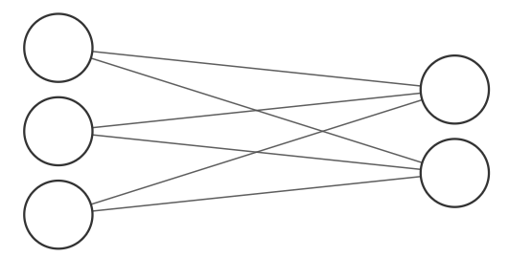
Certification via Interval Bound Propagation(IBP)
Key idea: Compute upper and lower bounds on the activations in each layer of the network, in terms of bounds computed for previous layers.
[-1,1]
[-1,2]
[-2,1]
[-2,0]
[-1,0]
Notes:
相关工作是Deepmind, 后有一篇中ICCV 19
每个神经元多一个区间信息

Slide 6


Certification via Interval Bound Propagation(IBP)
Define: Interval bounds of Node $i$ :
Set of nodes used to compute Node $i$ : $dep(i)$

Slide 7
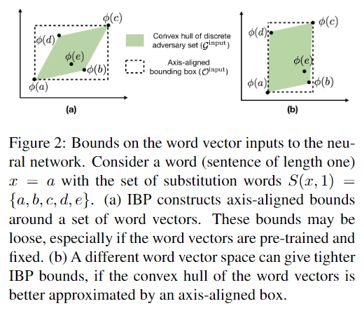
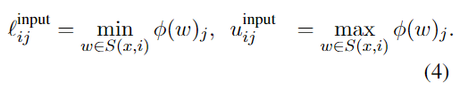
Bounds for the input layer
Notes:
注意隐式输入： 扰动被当作区间输入了
图： 假设 vec 二维; 想要tighter 更紧凑

Slide 8
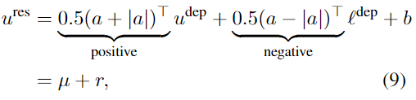

Interval bounds for elementary functions
Affine transformations
Monotonic scalar functions(Some activation functions)
Notes:
之前的工作，简单讲下
A和a绝对值整理分开

Slide 9
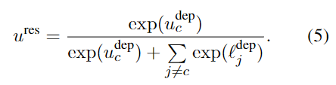
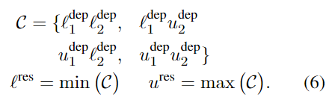

Interval bounds for elementary functions
Softmax layer
Element-wise multiplication
$z^{res}=z_{1}^{dep}z_{2}^{dep},$ where $z^{res}, z_{1}^{dep}, z_{2}^{dep}∈R$
Notes:
考虑符号

Slide 10

Interval bounds for elementary functions
Dot products
${\left(z_{1}^{dep}\right)}^{T}z_{2}^{dep}$ is just the sum of the element-wise product $z_{1}^{dep}\text{⊙}{ z}_{2}^{dep}$

Slide 11

Final layer
Zero-one loss
Cross entropy
We can compute bounds on the loss
from bounds on the logits
Notes:
为什么loss 放final layer? 大家思考

Slide 12
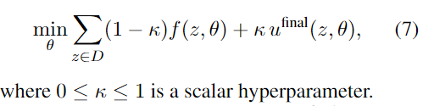
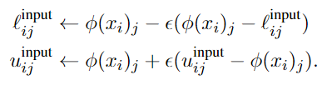
Certifiably Robust Training with IBP
Trick: Optimize easier by making perturbations larger during training
Notes:
由易到难
读音 kappa

Slide 13
Experiments
Task
IMDB sentiment analysis dataset
Classify review: positive or negative
Stanford Natural Language Inference(SNLI)
Input: a premise and a hypothesis
Output: the premise entails, contradicts or is neural with respect to the hypothesis

Slide 14
Classifier model
IMDB
BoW: averages the word vectors for each word in the input
CNN
LSTM
SNLI
BoW: encodes premise and hypothesis, concate them.
DECOMPATTN: use attention between premise and hypothesis to compute richer representations of each word in both sentences.
Notes:
提出的是训练方法，需要基于具体模型

Slide 15


Experiments
Word vector layer
Affects the tightness
$g^{word}$ is a learned linear transformation
$φ^{pre}\left(ω\right)$: 300-dimensional GloVe vectors
$g^{word}$ is applied before bounds for input layer computed !

Slide 16
Word substitution perturbations
Select which word to replace? –Random sample with probabilities proportional to the number of neighbors each word has.
Perturb Subroutine
Computes the N nearest neighbors of selected word according to the distance in GloVe embedding space(use counter-fitting method to ensure that the nearest neighbors are synonyms).
Use language model to filter out words that do not fit within the context surrounding.
Remain set of words that maximize the target label prediction probability when replaced.
Replace the word.
Notes:
Attack method from a paper
Non-target 稍加修改

Slide 17
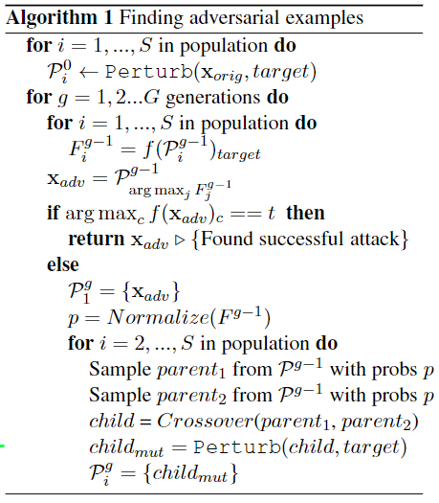
Word substitution perturbations
Notes:
遗传算法 略

Slide 18
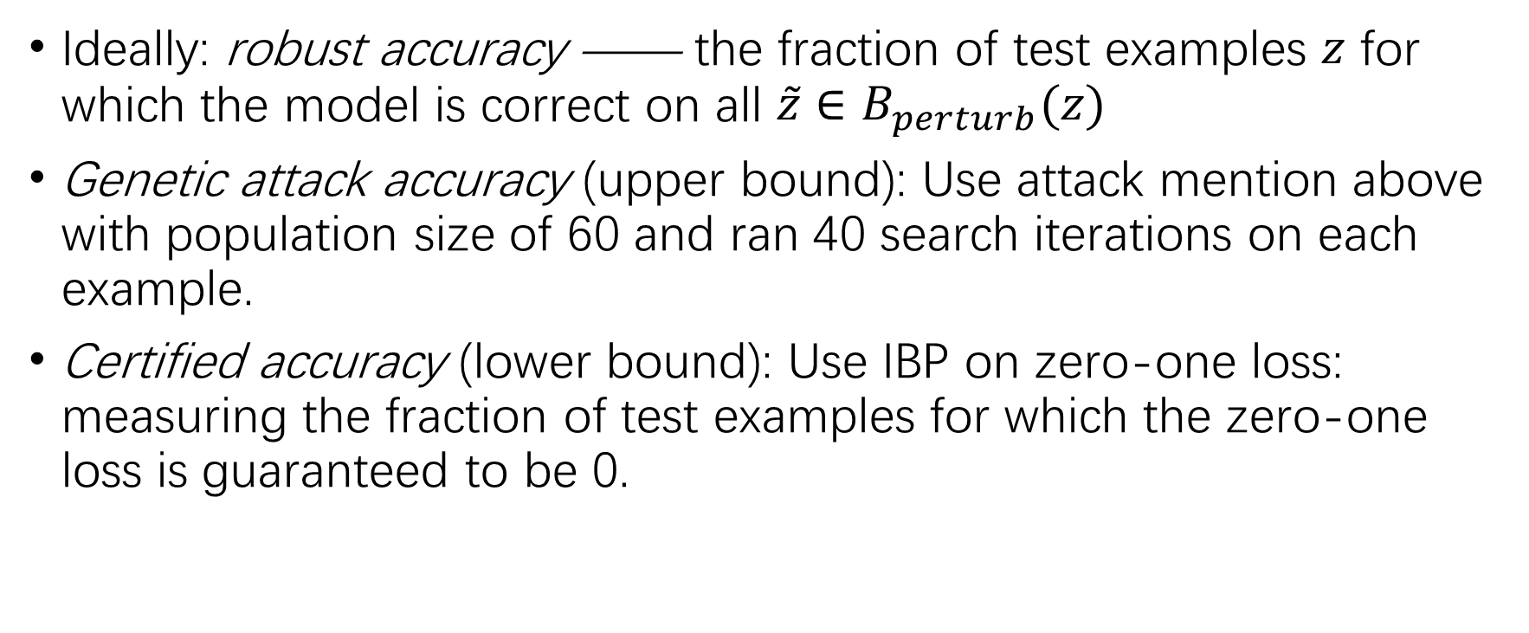
Evaluation of robustness
Ideally: robust accuracy —— the fraction of test examples $z$ for which the model is correct on all $\tilde{z}∈B_{perturb}(z)$
Genetic attack accuracy (upper bound): Use attack mention above with population size of 60 and ran 40 search iterations on each example.
Certified accuracy (lower bound): Use IBP on zero-one loss: measuring the fraction of test examples for which the zero-one loss is guaranteed to be 0.

Slide 19
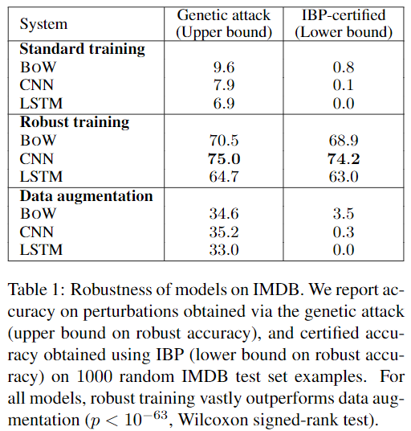
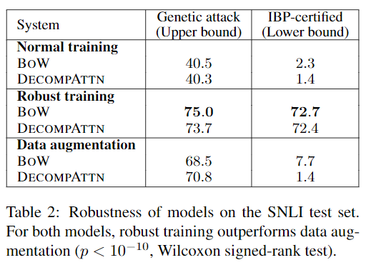
Main results
Effect is especially pronounced on IMDB, where inputs can be hundreds of words long.

Slide 20
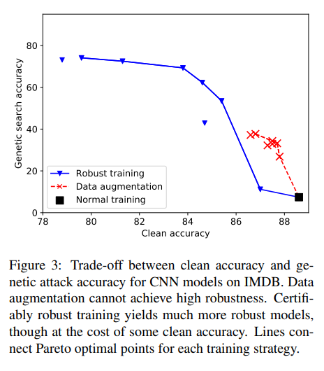
Clean acc vs robust acc
Data augmentation: Vary K, the number of augmented examples per real example (from 1 to 64)
Robust training: Vary Hyperparameter in object function (from 0.01 to 1.0)
Notes:
提升鲁棒性，Clean acc 几乎必然下跌
诚实，没有都好的

Slide 21
Runtime considerations
one epoch takes between 2× and 4× longer than one epoch of standard training.
Notes:
增加了区间参数

Slide 22
Error analysis
Robustness errors of the robustly trained model mostly occurred when it was not confident in its original prediction
Robust error proportion when confidence > 70% for the original input.
System | Robust error proportion
Normal training | 92%
Robust training | 14%
Data augmentation | 87%
Notes:
有可能是robust 都保持将信将疑的态度

Slide 23
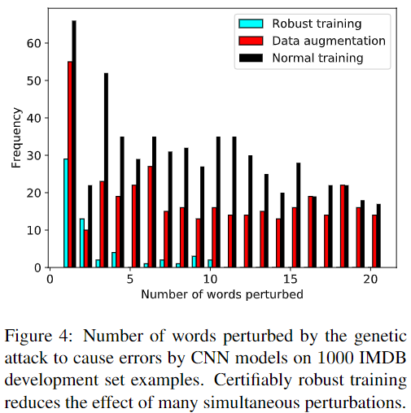
Error analysis
Surprisingly, certifiably robust training nearly eliminated robustness errors in which the genetic attack had to change many words.
Notes:
Fail to attack

Slide 24
Future work
Sequence-to-sequence tasks.
Improve clean accuracy while remain robust.

Slide 25
Conclusion
Recall Title: Certified Robustness to Adversarial Word Substitutions
Certified Robustness: Given input data and corresponding perturbations space, certify interval bound of robustness accuracy.
Contribution
Extend certified robustness from CV to NLP tasks, discrete -> continuous.
Extend Interval Bounds Propagation(IBP) method for some functions.
Limitations: Representation Learning?

