Slide 1

On the Cross-lingual Transferability of Monolingual Representations
Mikel Artetxe, Sebastian Ruder, Dani Yogatama
ACL 2020
汇 报 人：陈 少 斌
1

Slide 2
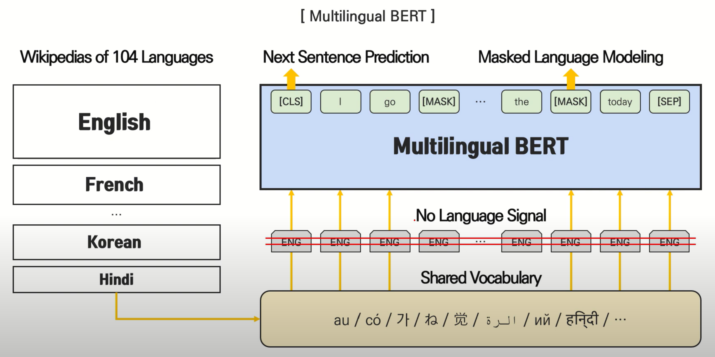
Generalization Ability of Multilingual Models
Multilingual models have been shown to generalize in a zero-shot cross-lingual setting
Hypothesis
Shared vocabulary items that acts as anchor points
Joint training across multiple languages spreads the effect of shared vocabulary
Deep cross-lingual representations that generalize across languages and tasks
2

Slide 3
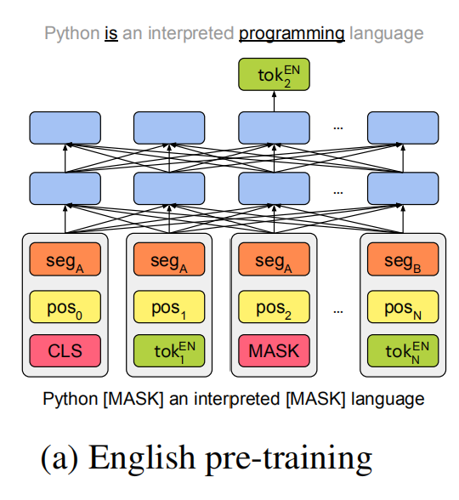
Method: Cross-lingual Transfer of Monolingual Representations
Pre-train a monolingual transformer model in L1 akin to BERT
3

Slide 4
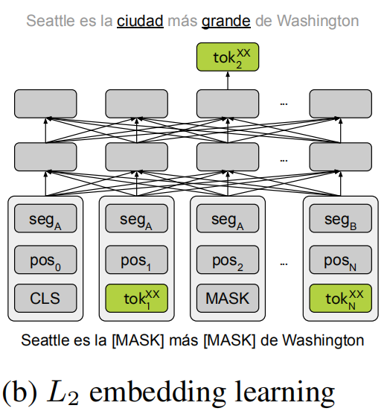
Method: Cross-lingual Transfer of Monolingual Representations
Freeze the transformer body and learn new token embeddings for L2 using the same training objective over its monolingual corpus
4

Slide 5
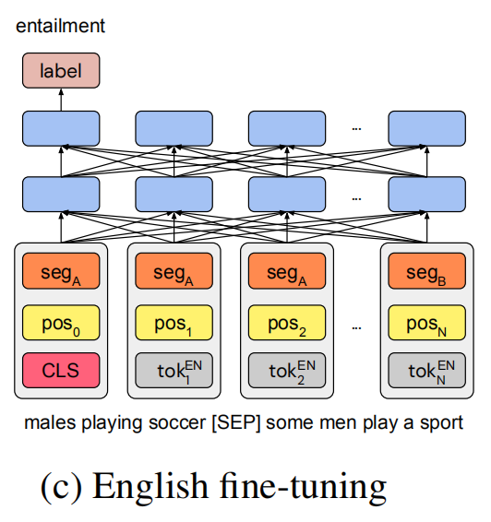
Method: Cross-lingual Transfer of Monolingual Representations
Fine-tune the model on L1 while keeping the embeddings frozen
5

Slide 6
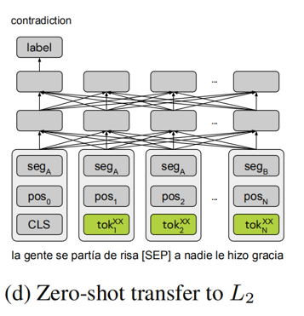
Method: Cross-lingual Transfer of Monolingual Representations
Zero-shot transfer it to the L2 by swapping the token embeddings
6

Slide 7
Extensions to Method
Language-specific Position Embeddings
Learning a separate set of position embeddings for L2
Do not use any position and segment embeddings for the [CLS] symbol
Noise fine-tuning
Add Gaussian noises to word, position, and segment embeddings in Step3
Residual Adapters: bottleneck layers added between layers of a pre-trained model
Purpose: Keep presentation in L1 and that in L2 aligned
7

Slide 8
Main models
Joint multilingual models (JointMulti)
A multilingual BERT model trained jointly on 15 languages
Cross-lingual transfer of monolingual models (MonoTrans)
Using English as L1 and try multiple variants with different extensions
Joint pairwise bilingual models (JointPair)
A multilingual BERT model trained jointly on 2 languages (English and another language)
8

Slide 9
Main models
Closs-lingual word embedding mappings (CLWE)
Train skip-gram embeddings for each language and map them to a shared
space using VecMap
Train an English BERT model using masked language modeling (MLM) and
next sentence prediction (NSP) on the top of the mapping embeddings
Fine-tuned using English labeled data while keeping the embeddings frozen
Zero-shot transfer to a new language by plugging in its respective mapped
embeddings
9

Slide 10
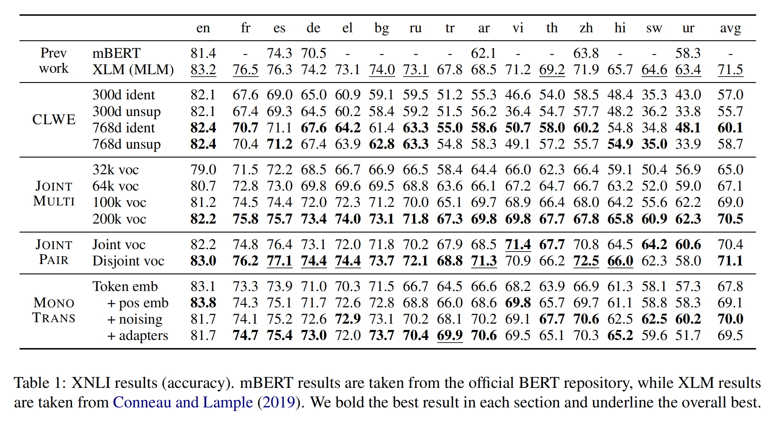
Experiment-Natural Language Inference
Dataset: Train on MultiNLI and evaluate on XNLI(2500 dev and 5000 test instances)
Result
10

Slide 11
Experiment-Natural Language Inference
Findings
Jointmulti is better than mBERT and XLM model
A larger vocabulary is beneficial
More languages do not improve performance
The JointPair model perform comparably with JointMulti
A shared subword vocabulary is not necessary for joint multilingual pre-training
The JointPair models with a disjoint vocabulary for each language perform better
MonoTrans is competitive with joint learning
Language-specific position embeddings and noised fine-tuning is beneficial
Adapters mostly improve performance
The performance of CLWE is below other models
11

Slide 12
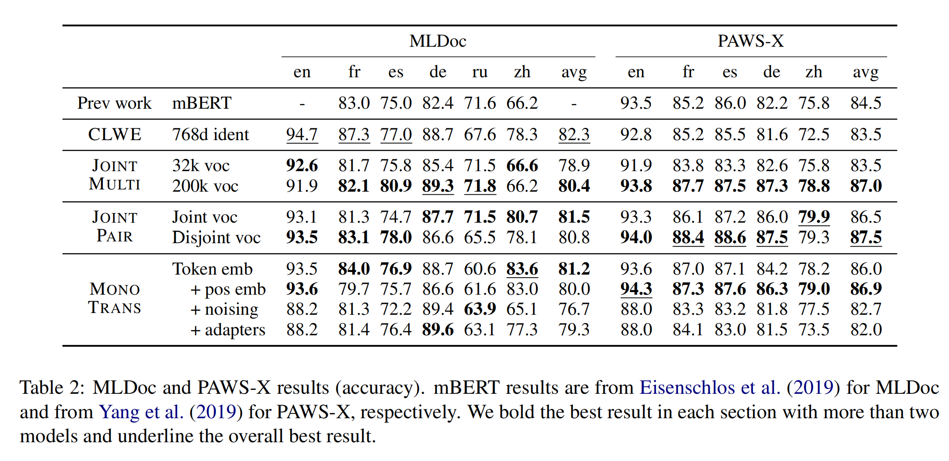
Experiment-Document Classification
Dataset: improved version of the Reuters (1000 training and 4000 test documents in
7 languages, 4 genres)
Result
Finding
All of the four model families obtain similar results
12

Slide 13
Experiment-Paraphrase Identification
Dataset: PAWS-X (Contains pairs of sentences with a high lexical overlap in
six languages)
Result
Finding
All of the four model families obtain similar results
13

Slide 14
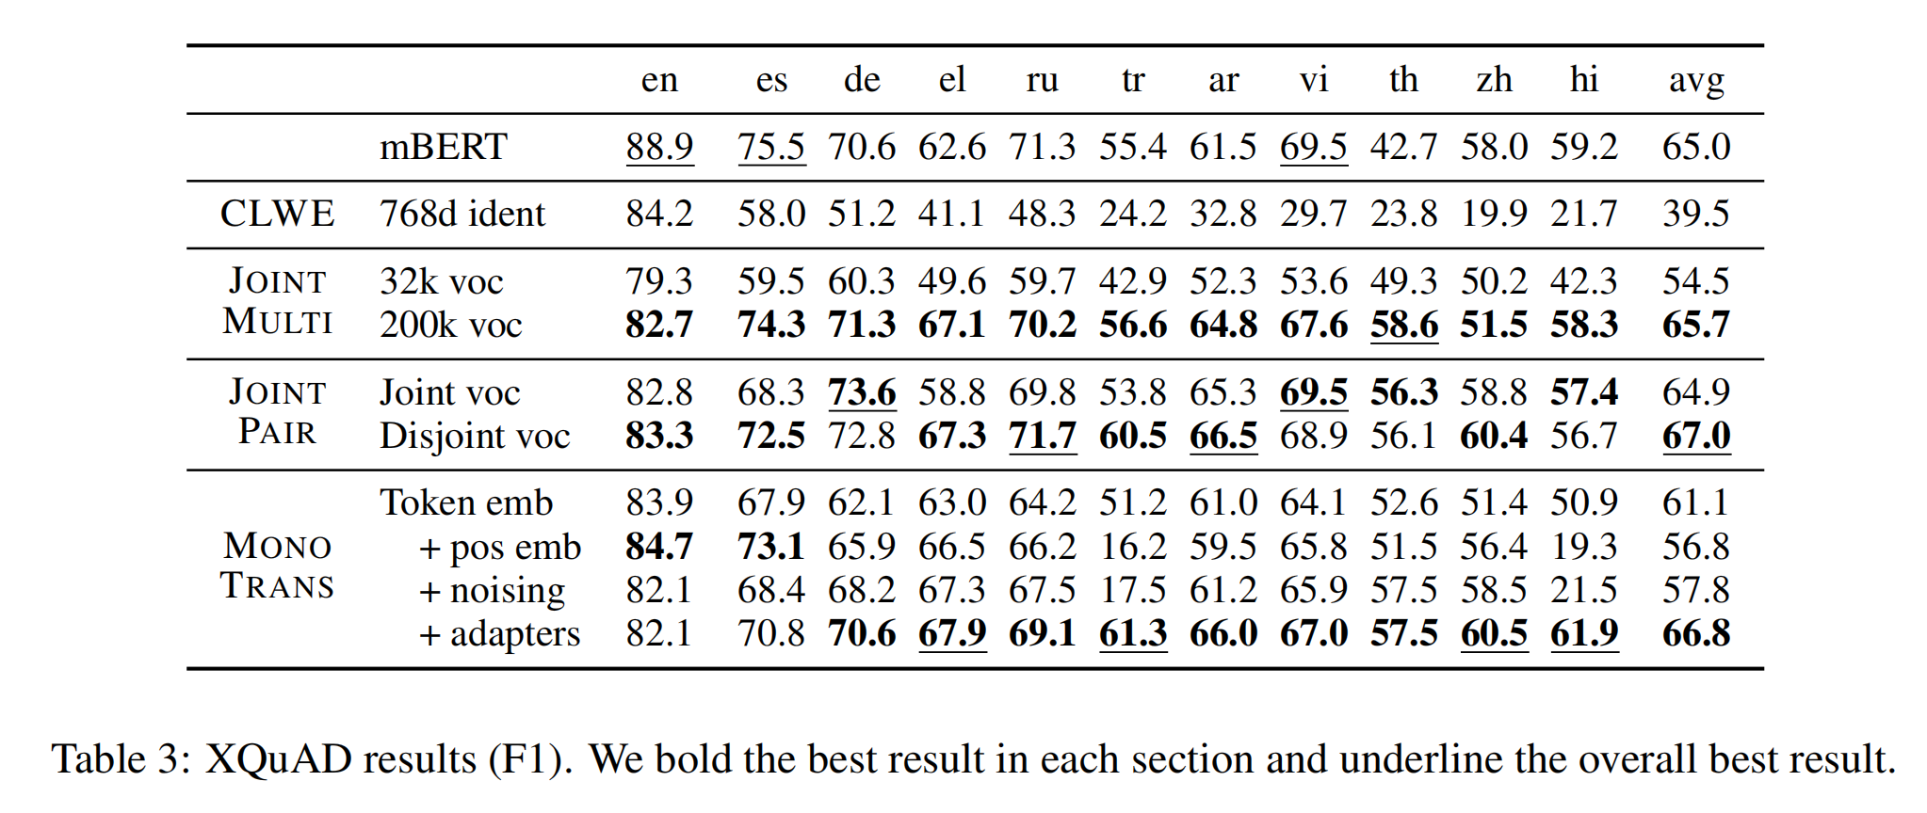
Further Research
XQuAD: a subset of SQuAD v1.1 and contains ten languages
240 paragraphs and 1190 question-answer pairs
Result
Findings
same as before
14

Slide 15
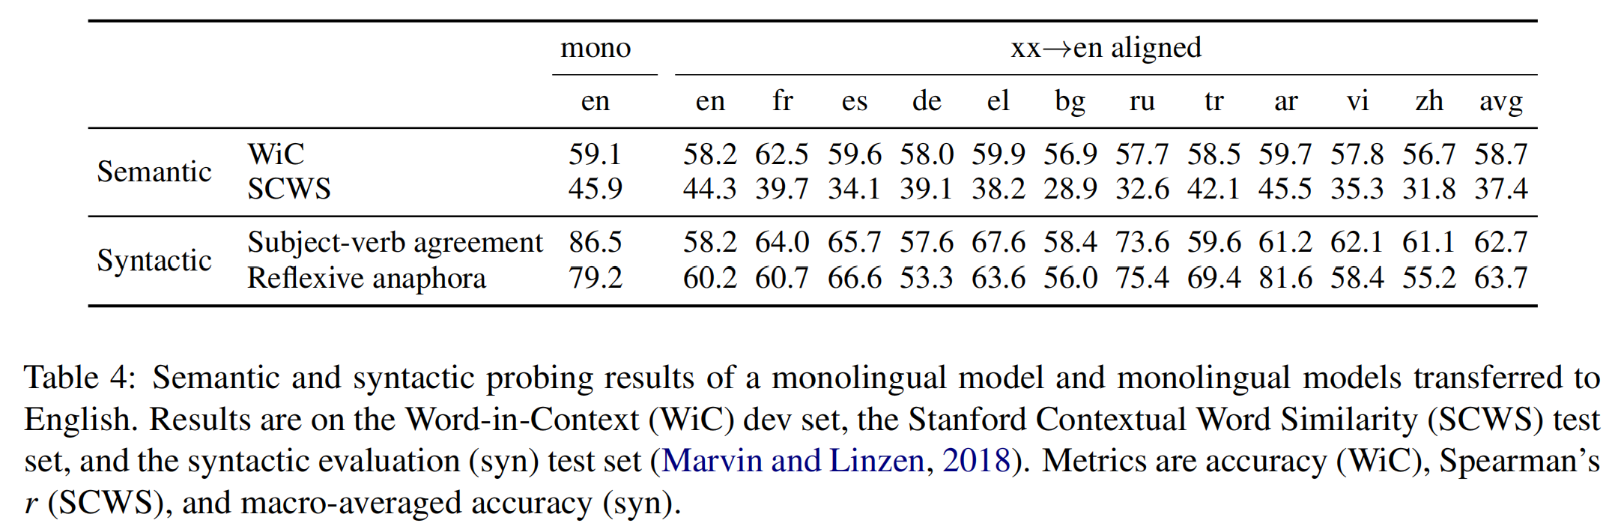
Further Research
Effective vocabulary size is important
More languages do not improve performance
A larger vocabulary is beneficial
Transfer of monolingual representations (Non-English to English)
Dataset: Word in Context (WiC), Stanford Contextual Word Similarity (SCWS)
and the syntactic evaluation
Result
15

Slide 16
Further Research
Findings
Models transferred from non-English languages are comparable
with models trained on English
Transferring syntactic abstractions is challenging
Gaps exist in the syntactic evaluation dataset
16

Slide 17
Thanks for Listening!
Conclusion:
Neither a shared vocabulary nor joint training are necessary
in multilingual models
A monolingual model trained on a particular language learns
some semantic abstractions generalizable to other languages
XQuAD dataset is released for further research
17

