Slide 1
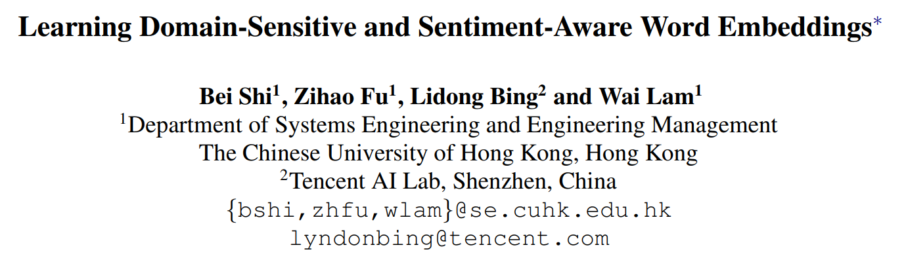
51194506015 洪诗诗

Slide 2
Motivation
Word embeddings have been widely used in sentiment classification.
Some existing methods for word embeddings exploit sentiment information, but they cannot produce domainsensitive embeddings.
Some other existing methods can generate domain-sensitive word embeddings, but they cannot distinguish words with similar contexts but opposite sentiment polarity.

Slide 3
Introduction
the polarity of some sentiment words is domain-sensitive
eg. the word “lightweight” in the electronics domain：positive in the movie domain： negative
Aim: learning word embeddings that are both domain-sensitive and sentiment-aware.

Slide 4
Introduction
Domain-common embeddings
represent the fact that the semantics of a word including its sentiment and meaning in different domains are very similar
eg. the words “good” and “interesting”
have similar embeddings across domains
domain-specific word embeddings
represent the fact that the sentiments or meanings across domains are different.
eg. the word “lightweight”

Slide 5
Contribution
Propose a new method for learning domain-sensitive and sentimentaware embeddings that simultaneously capture the information of sentiment semantics and domain sensitivity of individual words.
Automatically determine and produce domain-common embeddings and domain-specific embeddings.
Provides an effective way to learn domain-sensitive and sentimentaware word embeddings which benefit sentiment classification at both sentence level and lexicon term level.

Slide 6
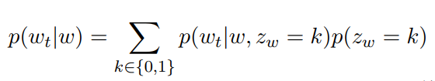
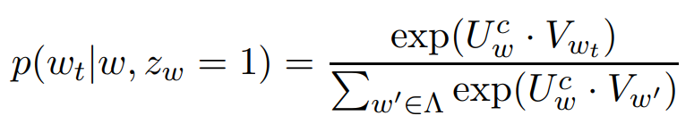
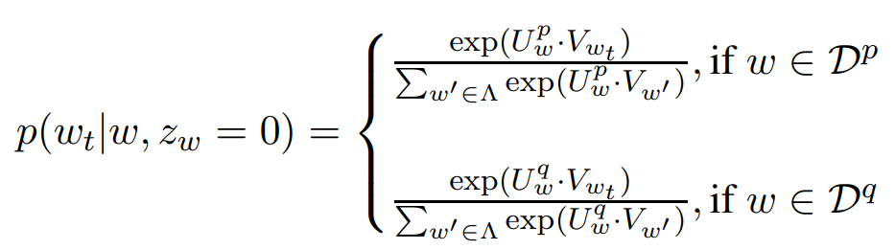
Model Description
1. Design of Embeddings

Slide 7
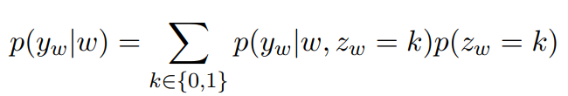

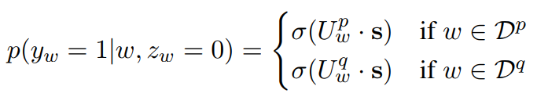
Model Description
2. Exploiting Sentiment Information

Slide 8
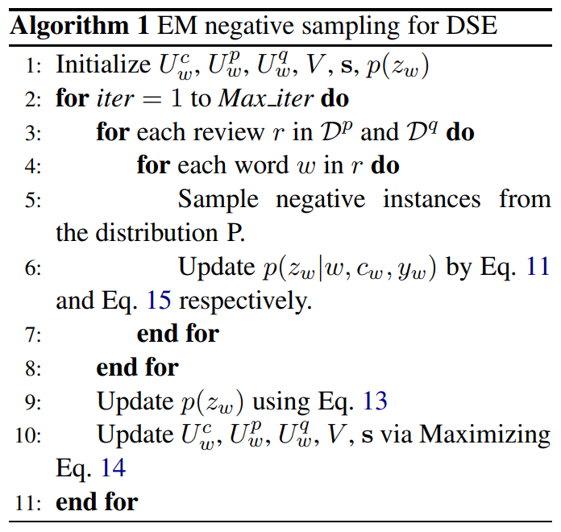
Model Description
3. Inference Algorithm

Slide 9
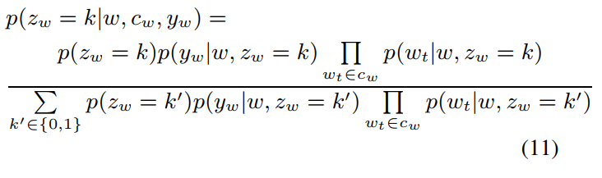

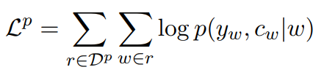
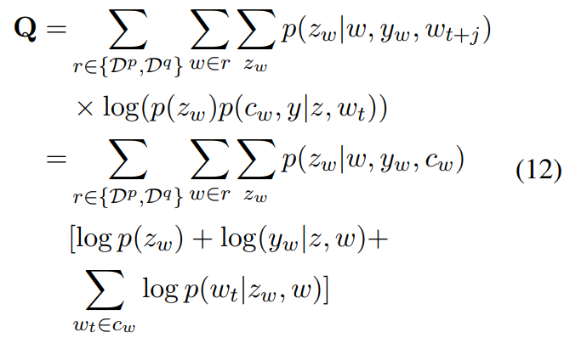
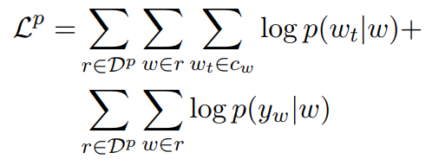
Model Description
3. Inference Algorithm

Slide 10
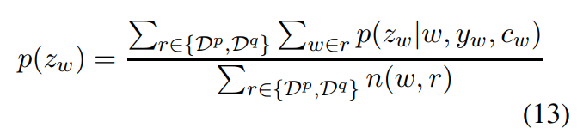
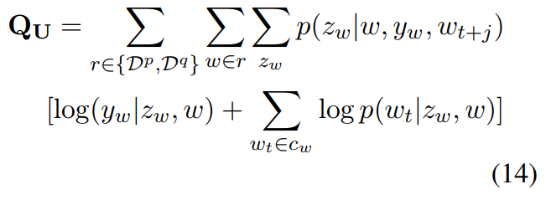
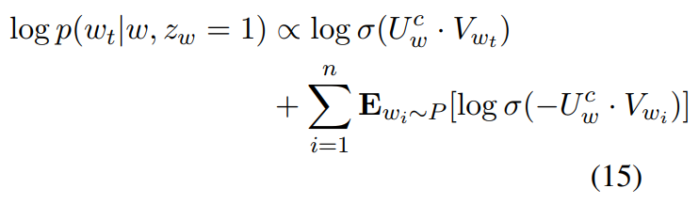
Model Description
3. Inference Algorithm

Slide 11
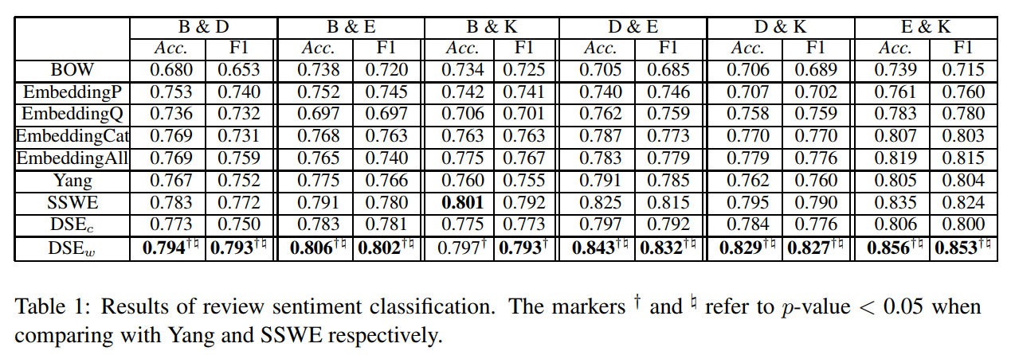
Experiment
1. Review Sentiment Classification

Slide 12
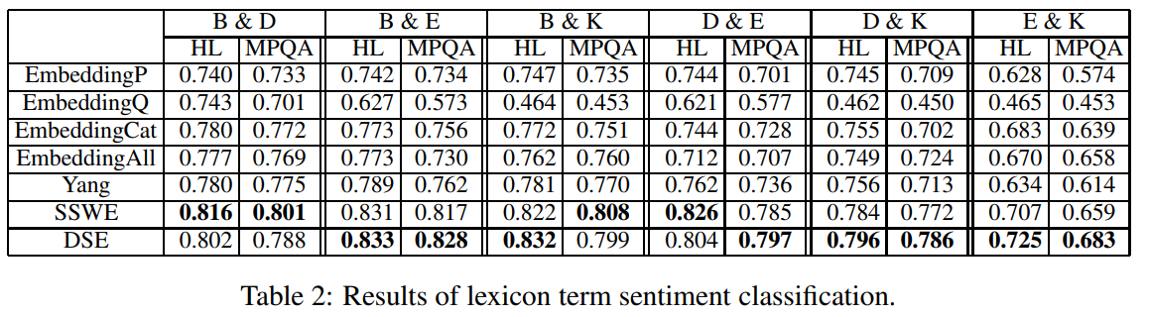
Experiment
2. Lexicon Term Sentiment Classification

Slide 13
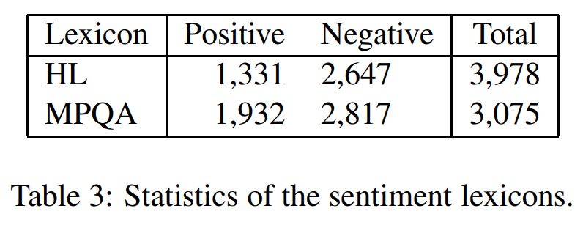
Experiment
3. Lexicon Term Sentiment Classification

Slide 14
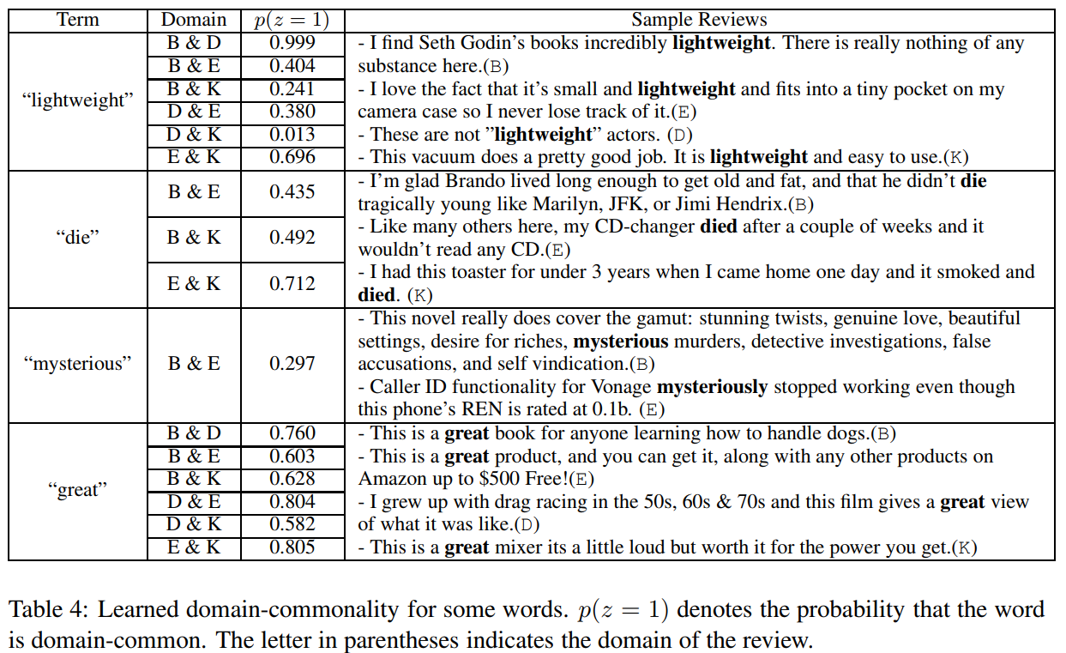
Case Study

Slide 15
Conclusion
propose a new method of learning domainsensitive and sentiment-aware word embeddings.
the model can distinguish domain-common and domain-specific words with the consideration of varied semantics across multiple domains.
the model detects domain-common words according to not only similar context words but also sentiment information.
learned embeddings considering sentiment information can distinguish words with similar syntactic context but opposite sentiment polarity.

