Slide 1
Knowledge Graph Contrastive Learning for Recommendation

Slide 2
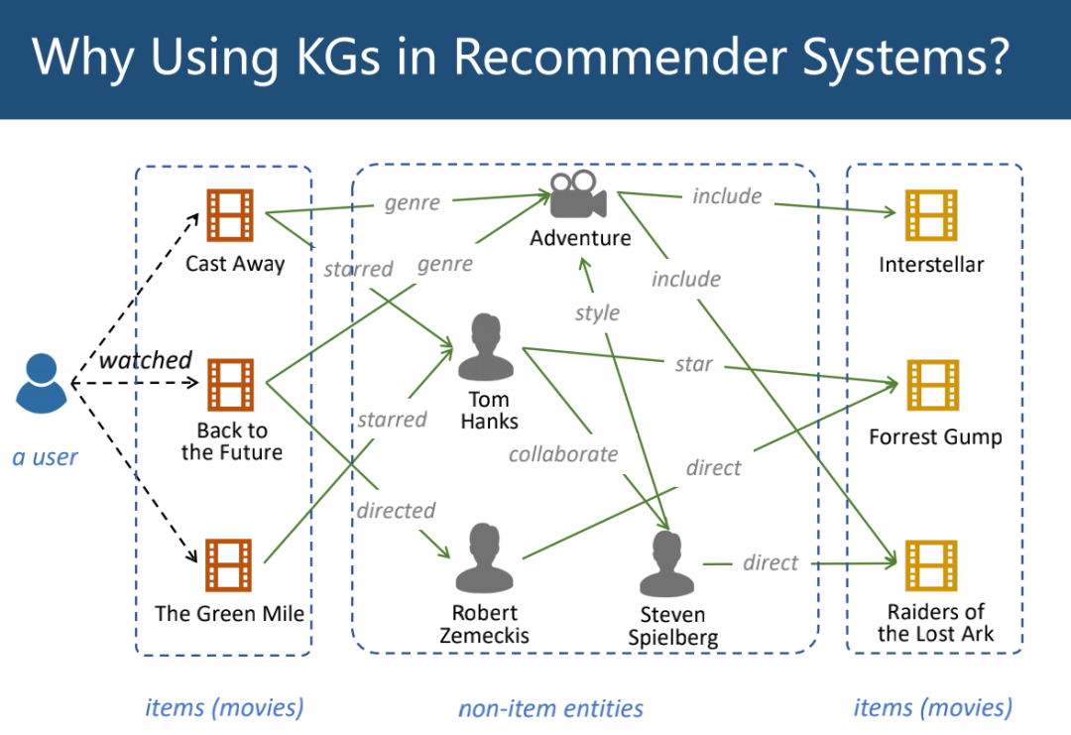
Background:

Slide 3
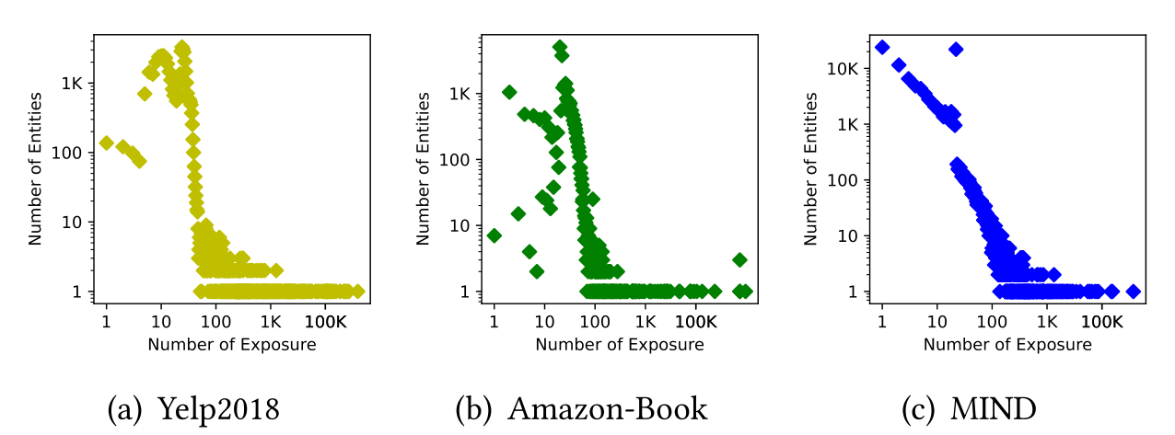
Long-tail entity distributions in real-world KGs:

Slide 4
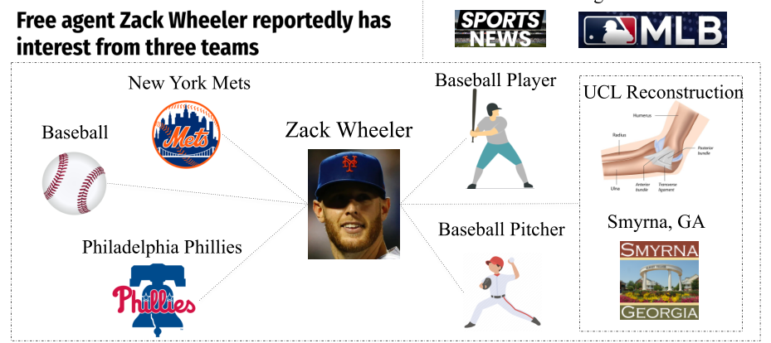
Topic-irrelevant entities

Slide 5
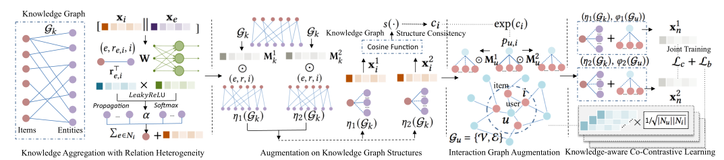
Overall architecture of KGCL

Slide 6
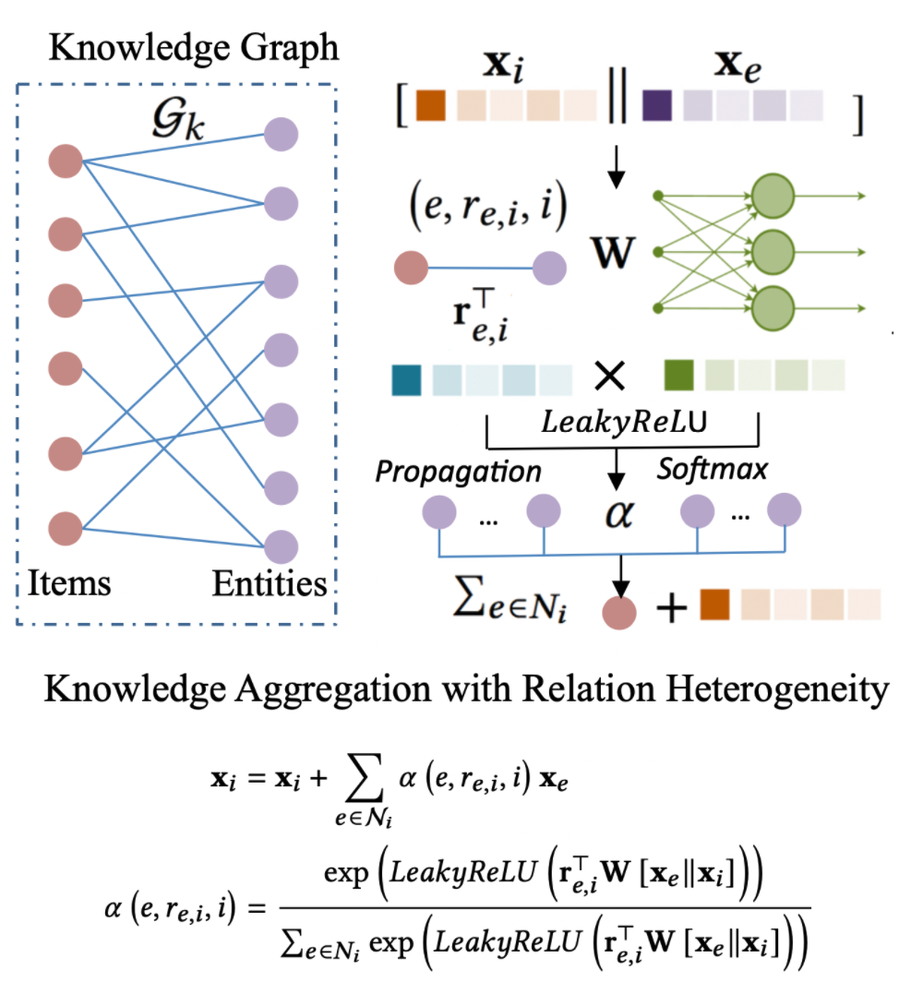
Knowledge Aggregation with Relation Heterogeneity

Slide 7
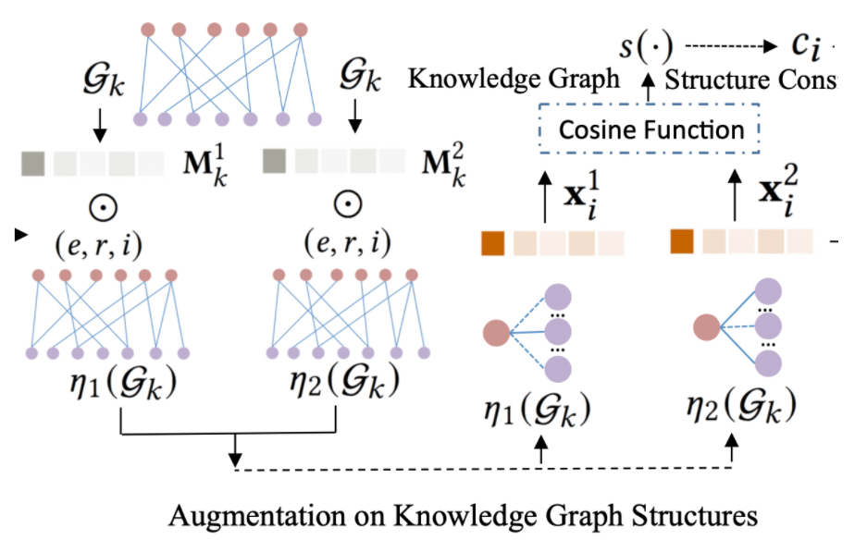


Augmentation on Knowledge Graph Structures

Slide 8
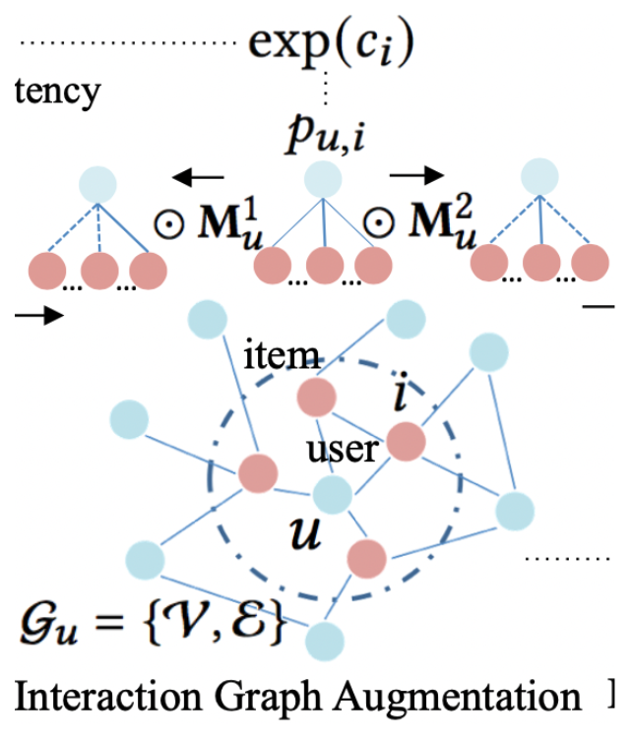
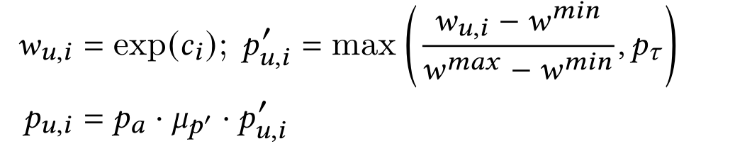

Interaction Graph Augmentation

Slide 9
Interaction Graph Augmentation

Slide 10
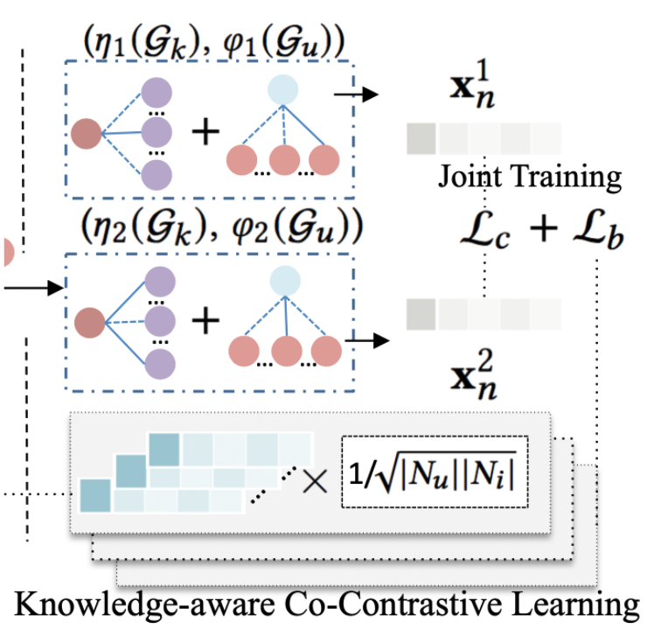
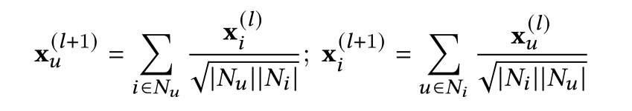
Knowledge-aware Co-Contrastive Learning

Slide 11
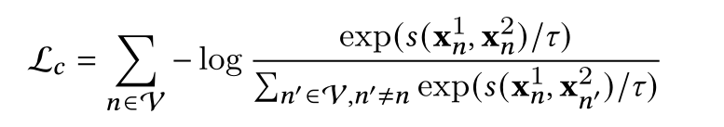
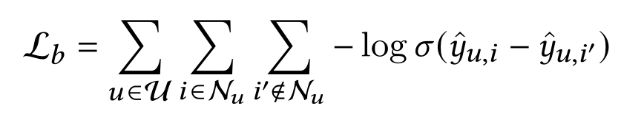

Knowledge-aware Co-Contrastive Learning

Slide 12
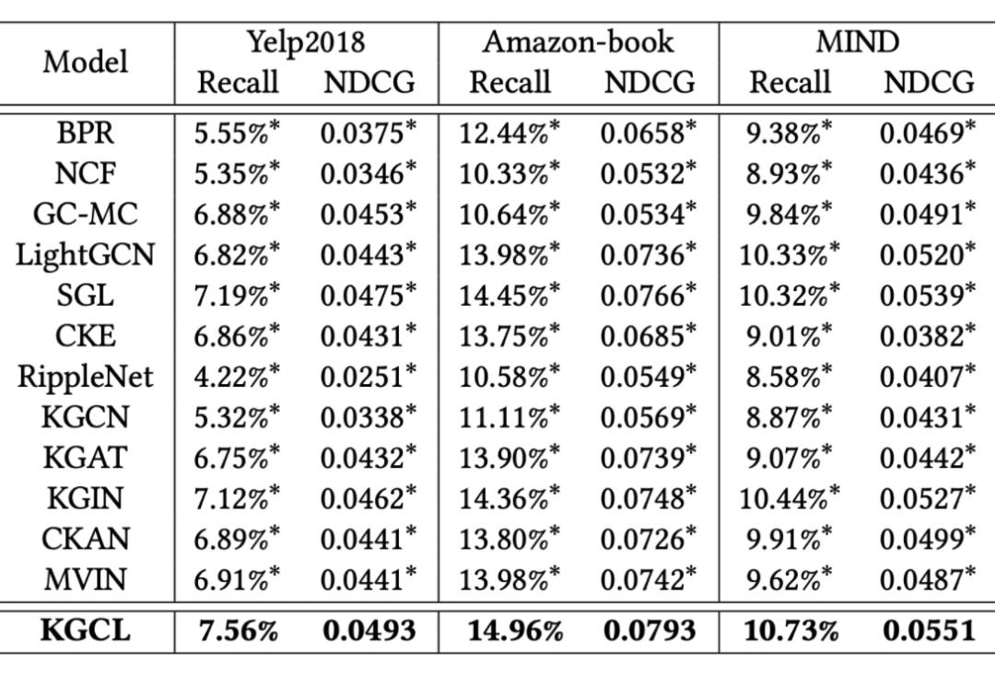
Results

Slide 13
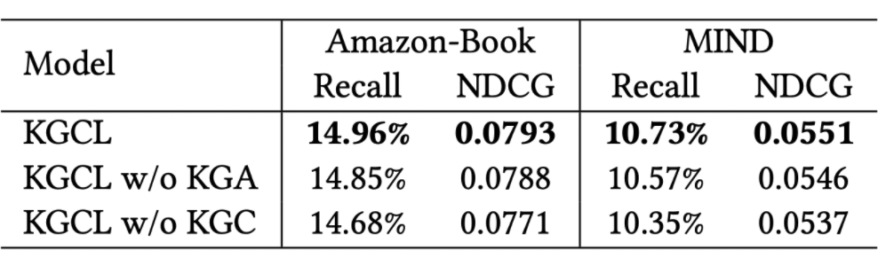
Ablation Study

Slide 14
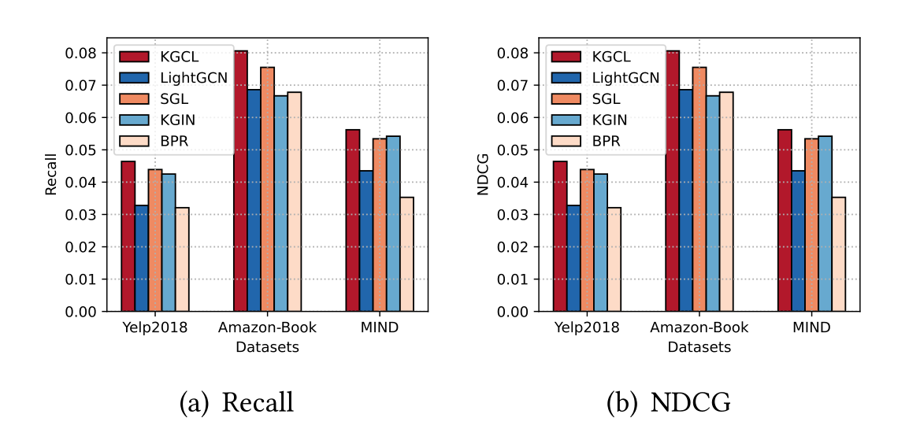
Sparse User Interactions

Slide 15
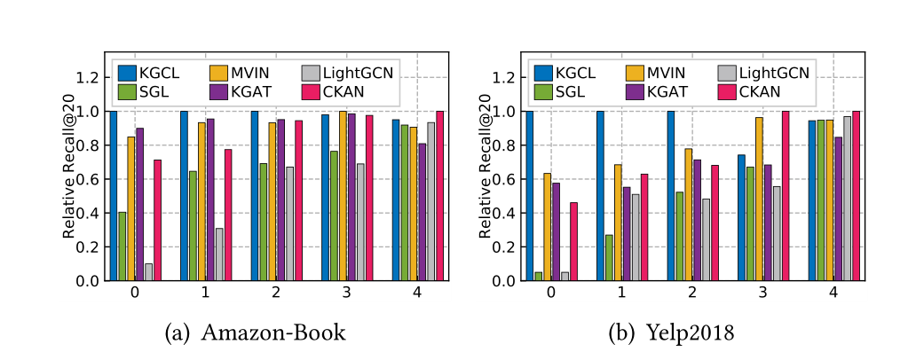
Long-tail Item Recommendation

Slide 16
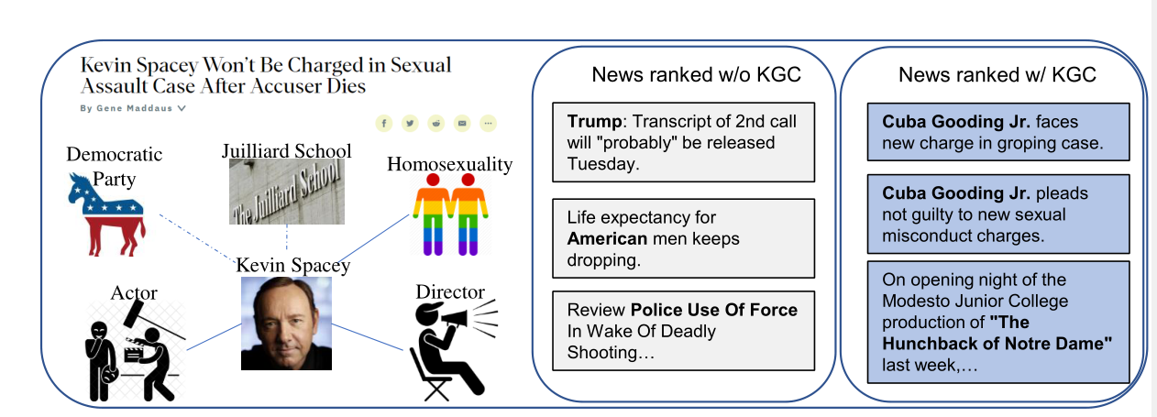
Case Study

Slide 17
THANKS

