Slide 1
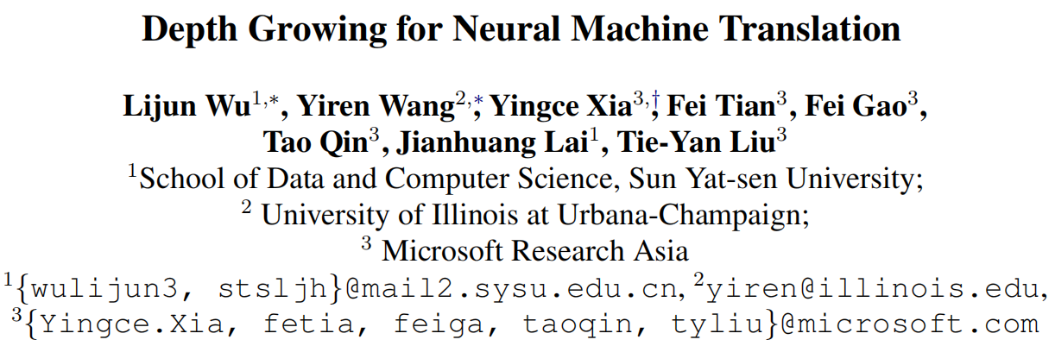
ACL 2019
51194501031
陈聪

Slide 2
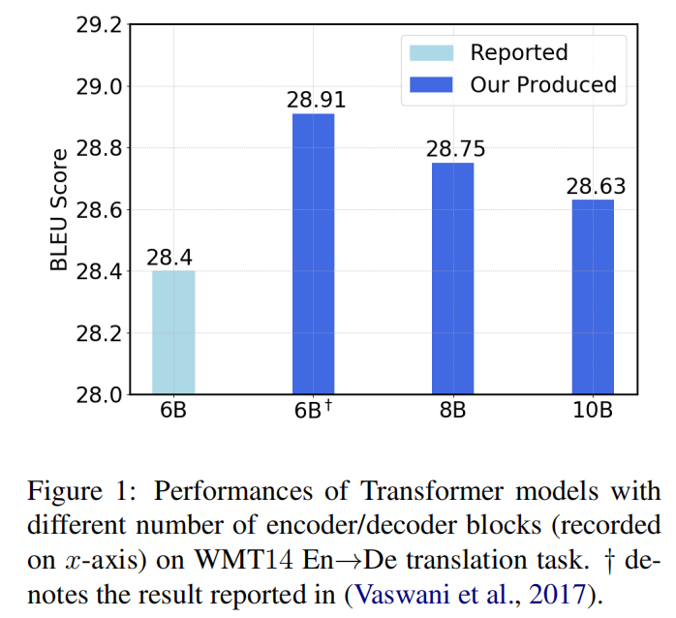
Motivation
NMT models are generally constructed with small numbers of encoder/decoder blocks
How to increase the network depth for better translation quality remains challenging
Directly stacking more blocks results in no improvement and optimization difficulty

Slide 3

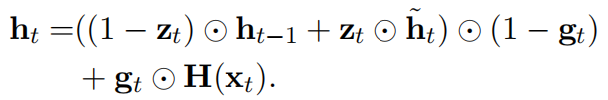

Related Work
Increasing the depth of RNN-based models by introducing linear units between internal hidden states to eliminate the problem of gradient vanishing
LAU *: extends GRU by an additional linear transformation of the input
* Mingxuan Wang, Zhengdong Lu, Jie Zhou, et al. 2017. Deep neural machine translation with linear associative unit. In Proceedings of the 55th Annual Meeting of the Association for Computational Linguistics, pages 136–145.

Slide 4
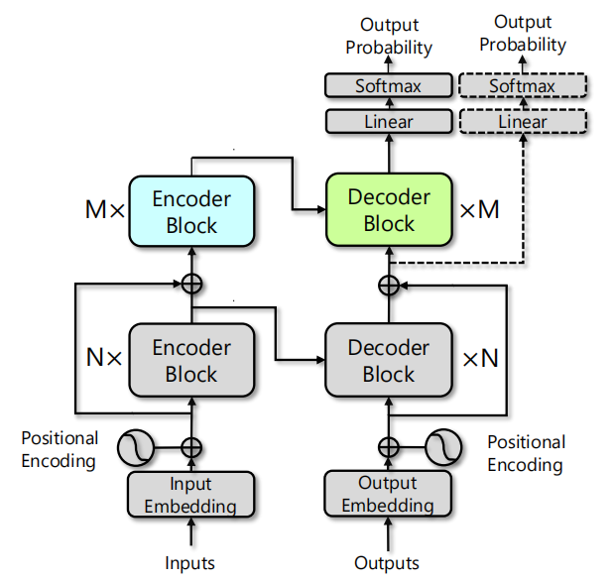
Approach
Overall framework
basic: Transformer
bottom module: N blocks of encoder and decoder
top module: M blocks of encoder and decoder
Two-stage training strategy
stage 1: training bottom module
stage 2: training top module, parameters of
bottom module are fixed
attn2
enc2
dec2
attn1
enc1
dec1

Slide 5
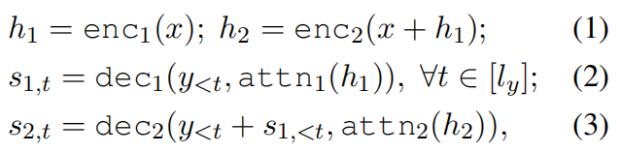
key Components
Cross-module residual connections
input of top module: word embedding, output of bottom module
Hierarchical encoder-decoder attention
calculated with different contextual representations
strong capability of well trained bottom module can be best preserved
top module can leverage the higher-level contextual representations
Deep-shallow decoding
shallow and deep network generate the final translation results through reranking

Slide 6
Discussion
Training complexity
two-stage training eases optimization difficulty and reduces training complexity
future work: jointly training two modules with minimal training complexity
Ensemble learning
what propose in this paper is a single deeper model
deep-shallow decoding is similar to ensemble methods in inference complexity
training multiple diverse models for good performance ?

Slide 7
Experiments
Datasets: WMT14 En->De, WMT14 En->Fr
Baselines: Transformer-big, Transparent Attention
Hyper-parameters: follow Transformer-big settings
Blocks: bottom module N = 6, top module M = 2

Slide 8


Transparent Attention *
Previous Attention: decoder blocks only have direct path to the topmost encoder block
Transparent Attention: an extension to the attention mechanism that behaves akin to creating weighted residual connections along the encoder depth
W: (N+1) × M weight vector, learned during training
softmax to normalize the weights
weighted combination of encoder block outputs
* Ankur Bapna, Mia Chen, Orhan Firat, et al. 2018. Training deeper neural machine translation models with transparent attention. In Proceedings of the 2018 Conference on Empirical Methods in Natural Language Processing, pages 3028–3033.

Slide 9
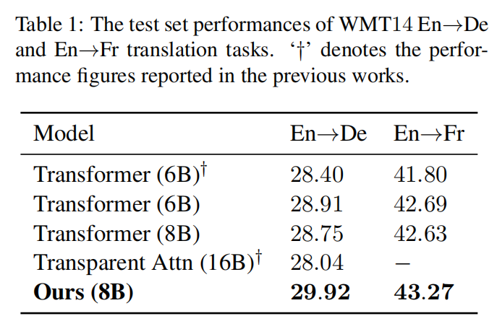
Results

Slide 10
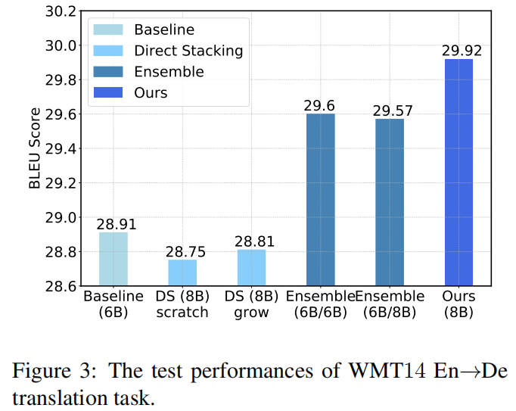
Analysis
Direct stacking (DS)
Ensemble learning (Ensemble)

Slide 11
Conclusion
Two-stage training strategy with three specially designed components
Deeper model with better performance over the state-of-the-art transformer baseline
General approach that can be universally applicable to arbitrary model architectures, including LSTM and CNN
Efficient strategy that can jointly train all modules of the deep model with minimal increase in training complexity will be explored in future work

Slide 12
THANKS

