Slide 1
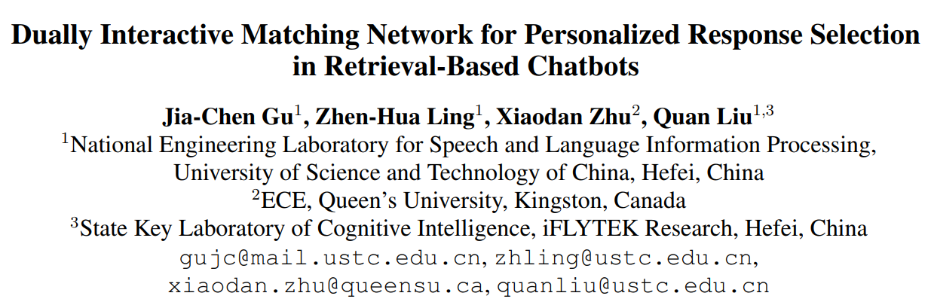
(EMNLP 2019)
51194501150
刘 雪

Slide 2









Task Definition
Dialogue dataset D with personas
Goal
Context
learn a matching model
utterance
For any context-persona-response triple
Persona
measures the matching degree between
Response candidate
Label

Slide 3

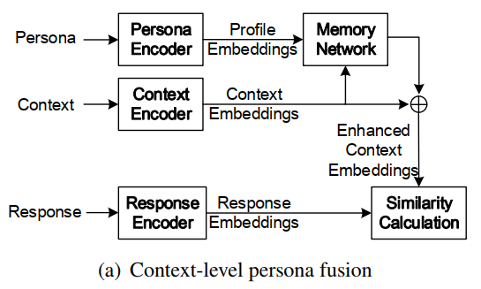

Previous Work
has two main deficiencies:
The utterance-level representations of contexts are not leveraged.
The interactions between the persona and each response candidate are also ignored when deriving the persona representation.
The enhanced context representation fused with persona information:

Slide 4
Contribution
An IMN-based fine-grained persona fusion model is designed in order to consider the utterance-level interactions between contexts and personas.
A dually interactive matching network (DIM) is proposed by formulating the task of personalized response selection as a dual matching problem, aiming to find a response that can properly match the given context and persona simultaneously.

Slide 5

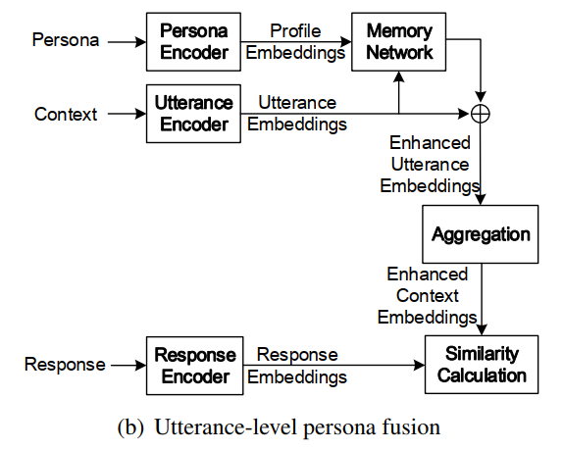


Persona Fusion
the enhanced representation of each context utterance
the enhanced context representation

Slide 6
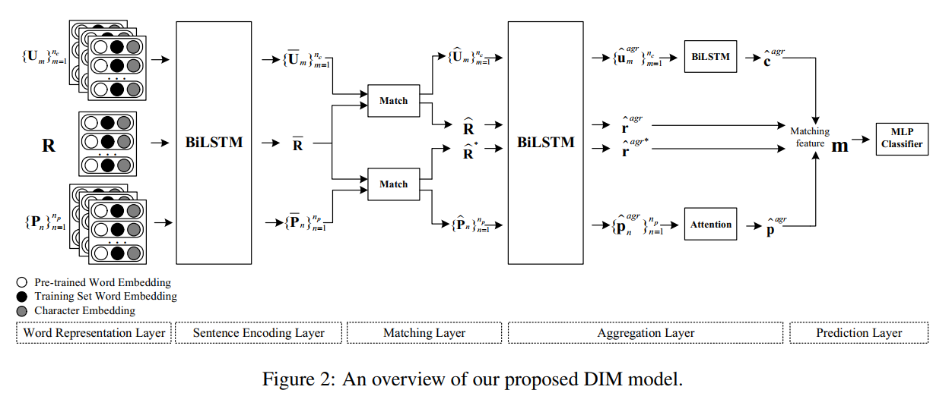
Model
Word Representation Layer
Sentence Encoding Layer
Matching Layer
Aggregation Layer
Prediction Layer

Slide 7
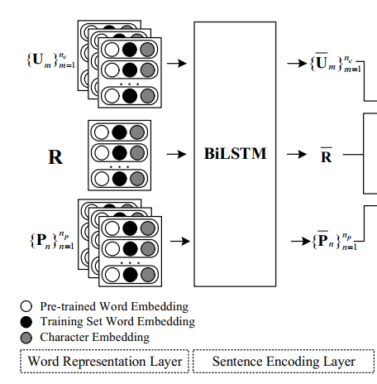



Model
Word Representation Layer
Pretrained word embeddings
Training Set Word Embedding
Character Embedding
Sentence Encoding Layer
context utterances
profile sentences
Response candidate

Slide 8
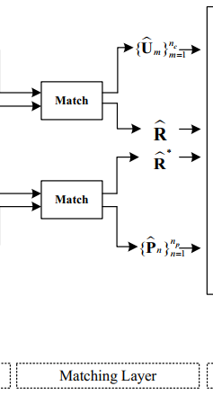



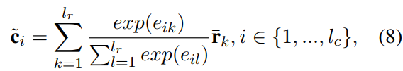

Model
Matching Layer
match the response with the whole context in a global and bidirectional way.
context representation
a soft alignment is performed by computing the attention weight between each tuple
context-to-response relevance representation
enhanced representations

Slide 9
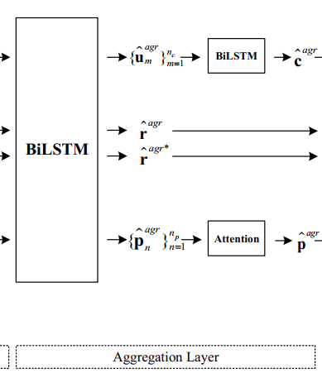

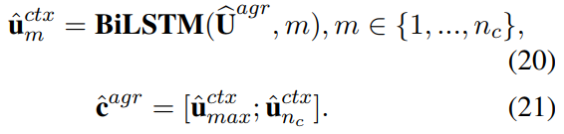
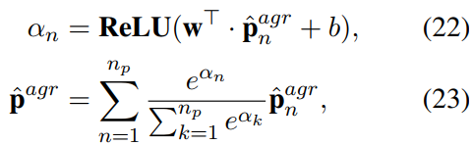

Model
Aggregation Layer
the aggregated embeddings are calculated by max pooling and last-hidden-state pooling operations:
Context aggregation
Persona aggregation (attention-based aggregation)
final matching feature vector

Slide 10
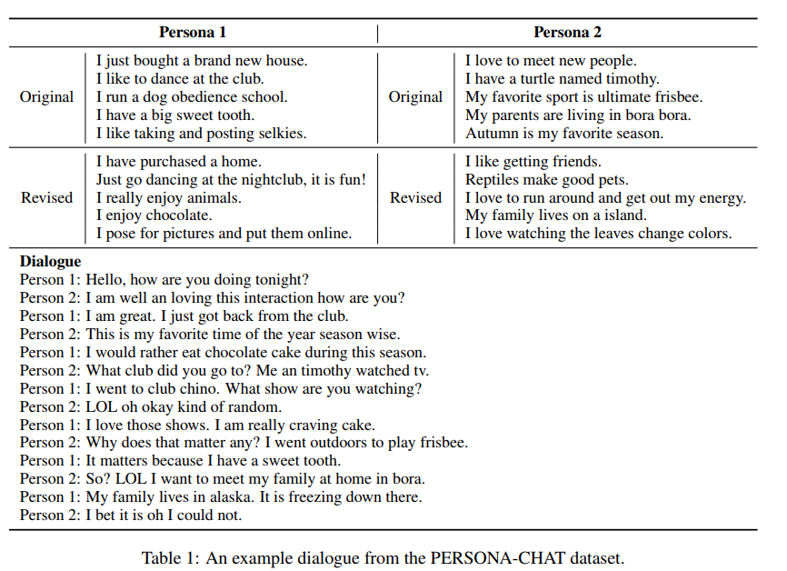
Experiment
Dataset: PERSONA-CHAT

Slide 11
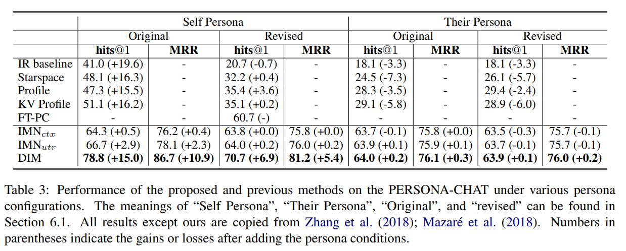
Experiment
Result

Slide 12
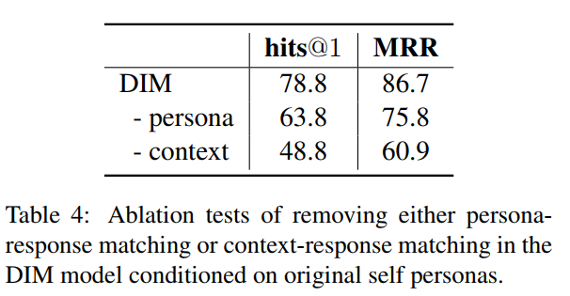
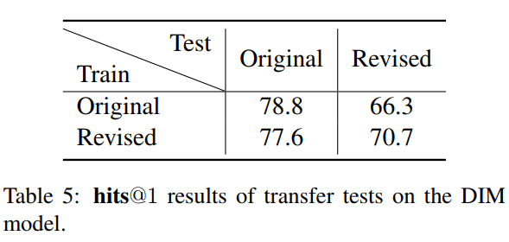
Analysis
The DIM model achieved a better performance when testing on the same type of personas as training.
Both the persona-response matching and the context-response matching contribute to the performance of the DIM model.
The revised personas can provide a better generalization ability to the DIM model than the original ones.

Slide 13
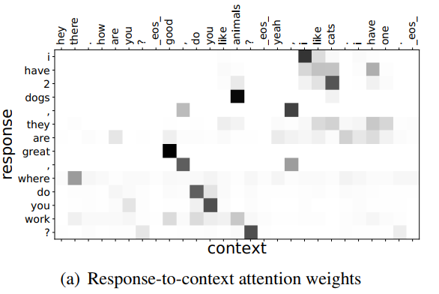
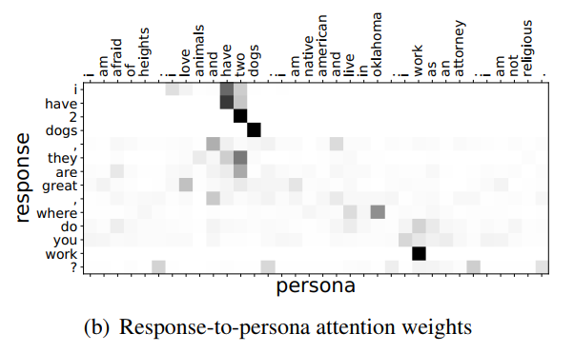
Analysis

Slide 14
Conclusion
Formulate the task of personalized response selection as a dual matching problem to search for a response that can properly match the given context and persona simultaneously.
Propose DIM to perform the interaction matching between the context and response as well as between the persona and response in parallel, in order to derive the final matching features.
Experimental results show that DIM achieves a new state-of-the-art performance on the PERSONACHAT dataset.
Models which can make better use of dialogue partners’ persona for response selection will be explored.

Slide 15
THANKS

