Slide 1
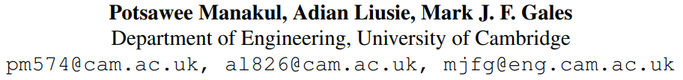
SelfCheckGPT: Zero-Resource Black-Box Hallucination Detection for Generative Large Language Models

Slide 2
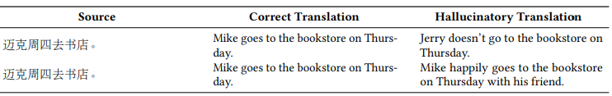
What is Hallucination?
内在幻觉：错误的信息，与提供的原文不符。
外在幻觉：出现原文未出现的信息。

Slide 3
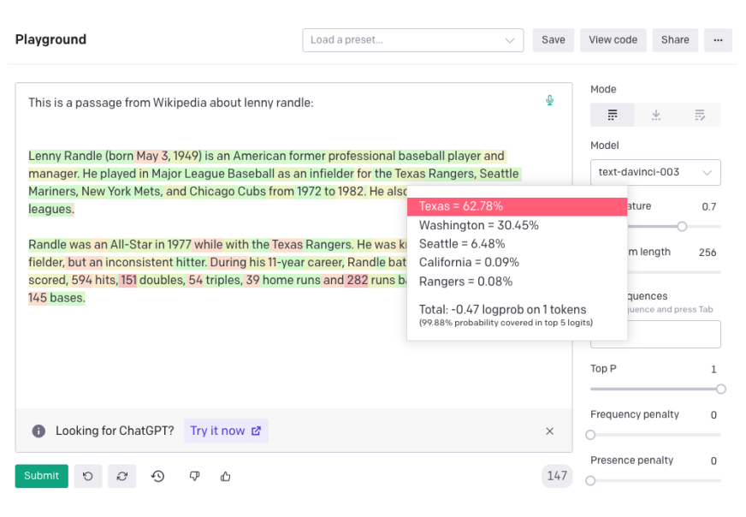
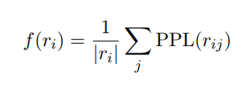

Grey-Box Factuality Assessment
Perplexity
Minimum probability

Slide 4
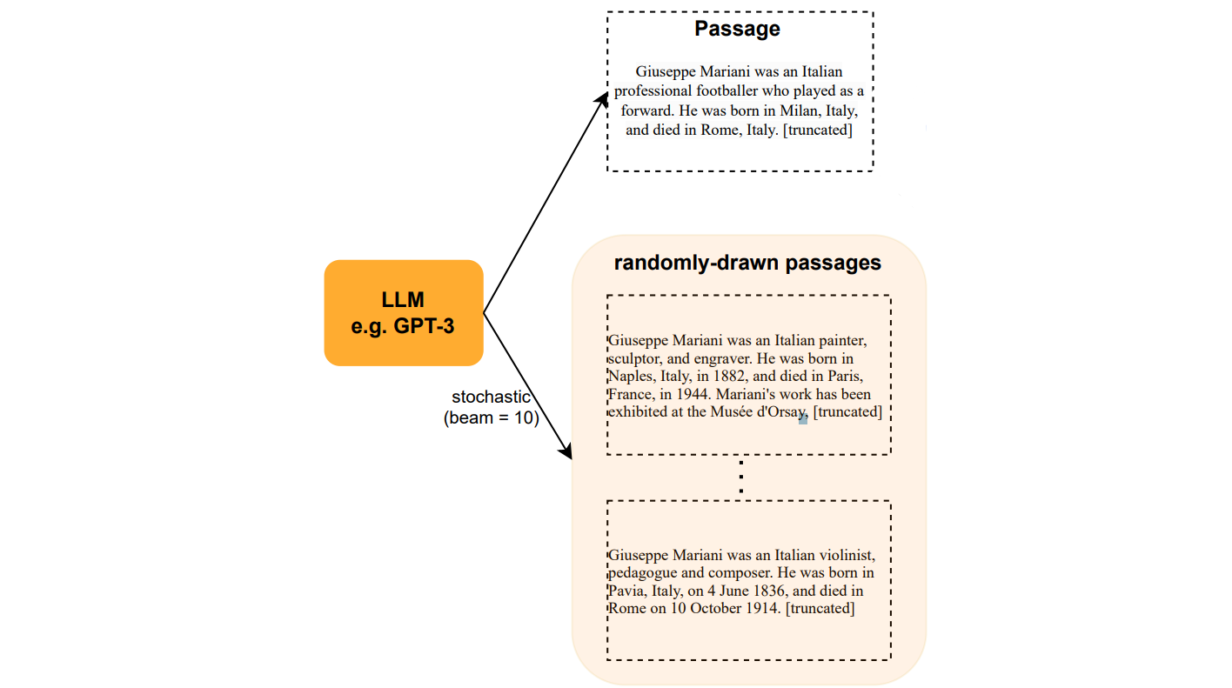
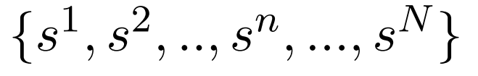
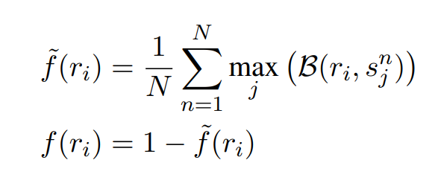
Black-Box Factuality Assessment
N stochastic LLM response samples
B(., .) denote the BERTScore between two sentences
SelfCheckGPT via BERTScore

Slide 5
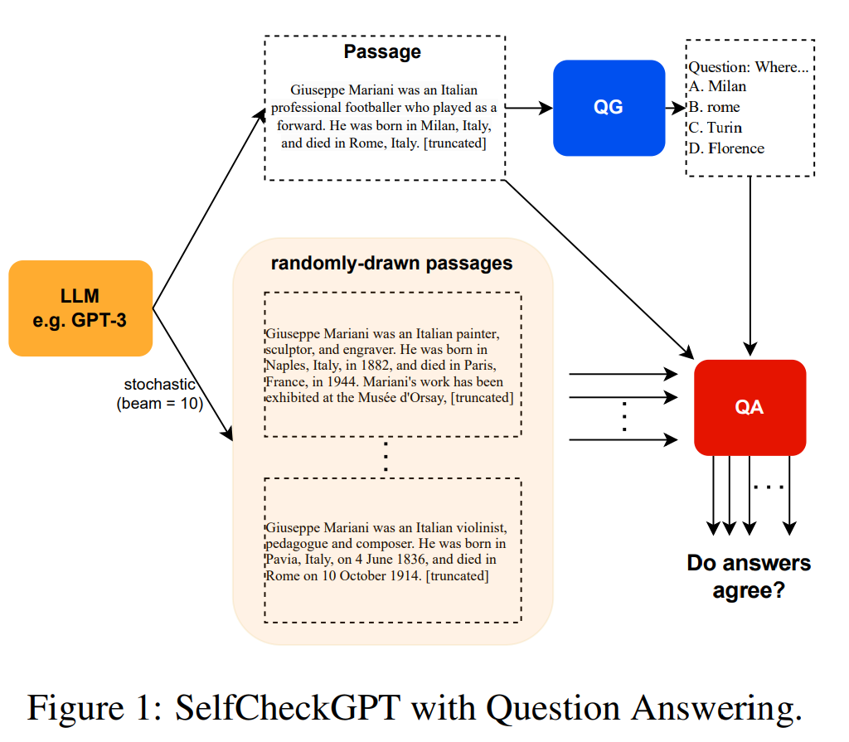
Black-Box Factuality Assessment
SelfCheckGPT via MQAG

Slide 6
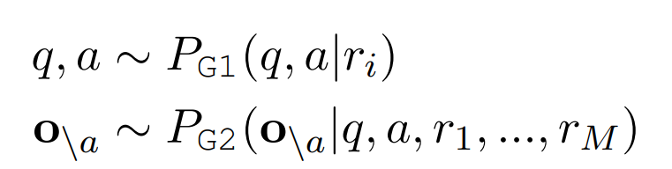
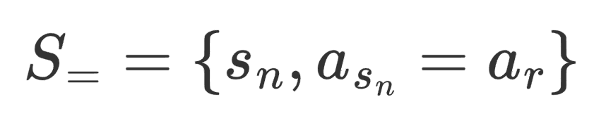
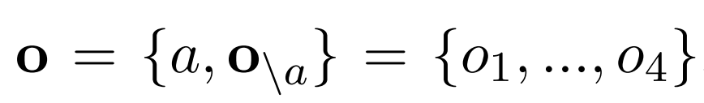
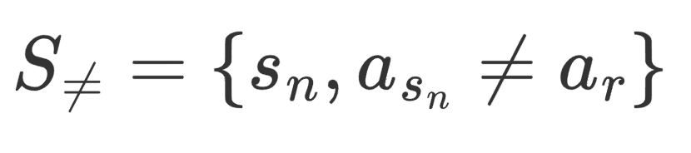
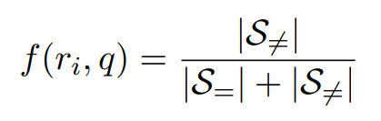
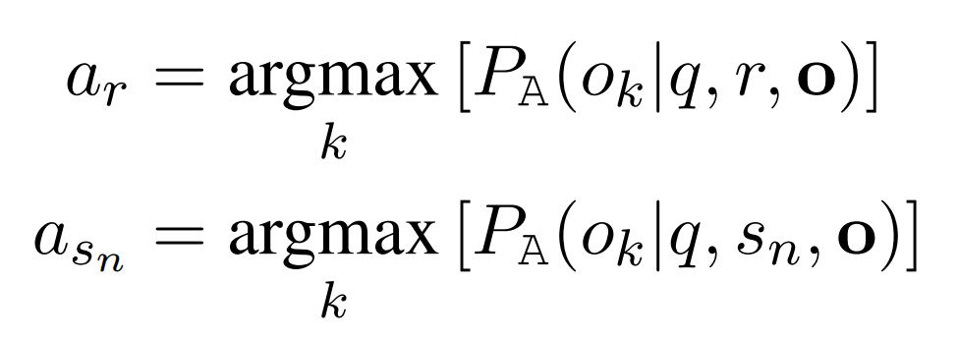
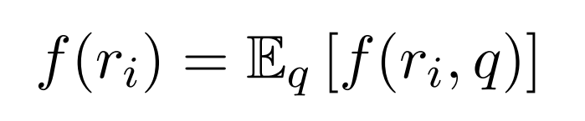
Black-Box Factuality Assessment
N stochastic LLM response samples
SelfCheckGPT via MQAG

Slide 7
Experimental Setup
generating synthetic Wikipedia articles using GPT-3.
manually annotating the factuality of the passage at a sentence level.
measuring system’s ability in detecting hallucinations/validity.

Slide 8
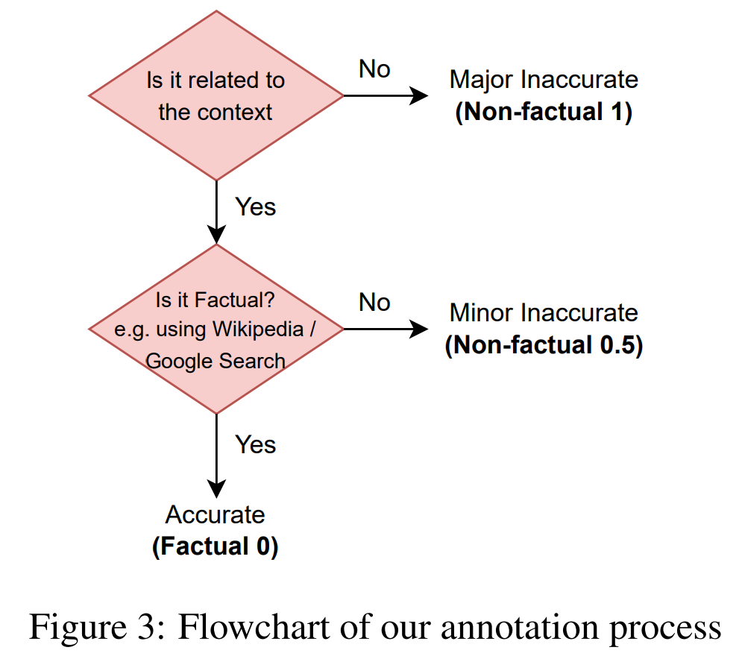
Experimental Setup
Randomly sample 65 articles from the top 5% of longest articles in WikiBio
Using the prompt This is a Wikipedia passage about {concept} and GPT-3
526 sentences from 65 passages were annotated
Data and Annotation

Slide 9
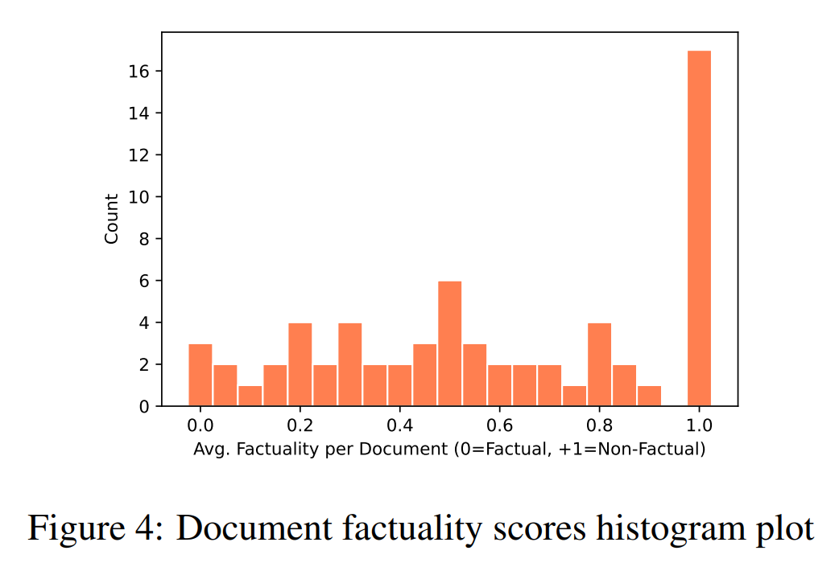
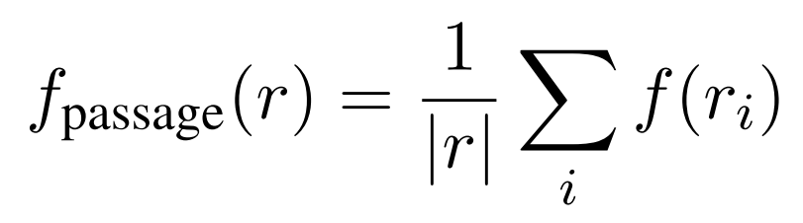
Experimental Setup
Passage-level factuality

Slide 10
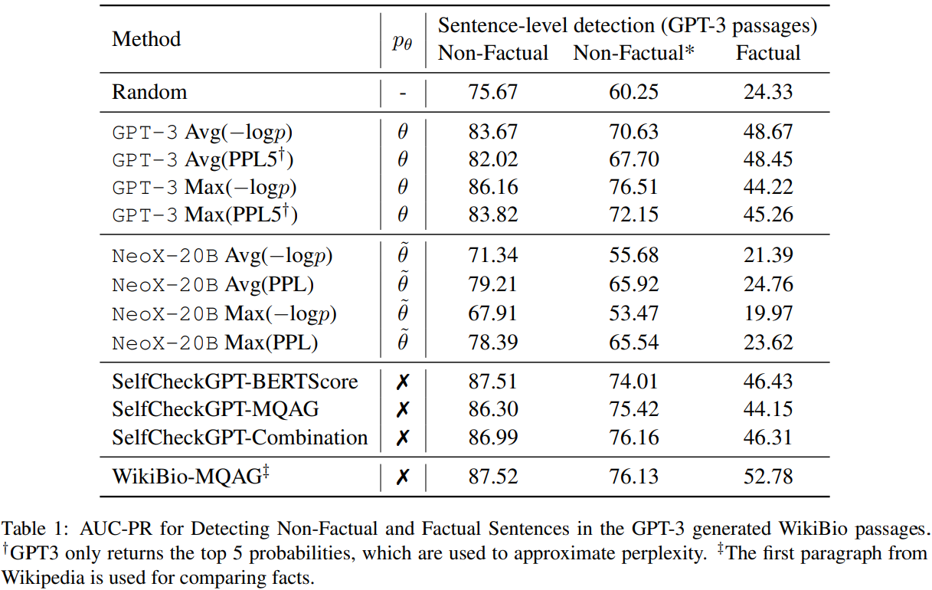
Experimental Results

Slide 11
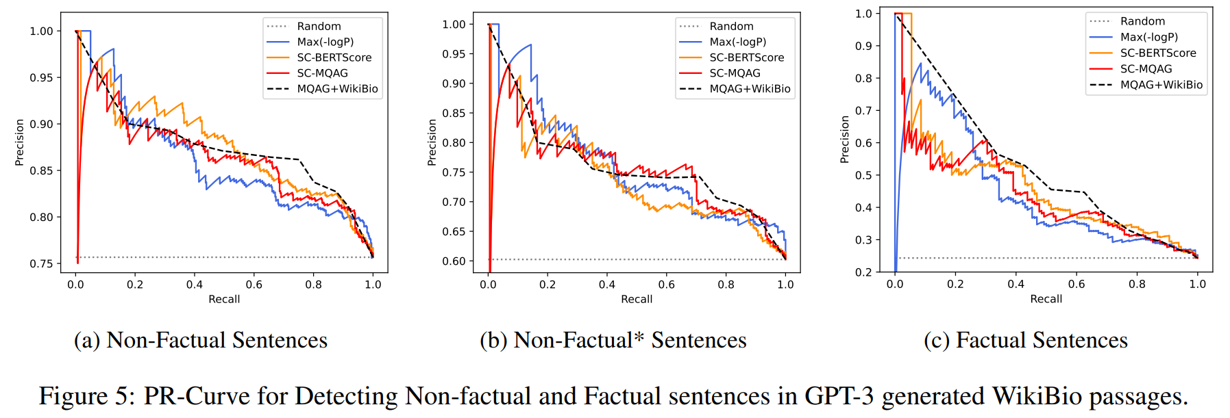
Experimental Results

Slide 12
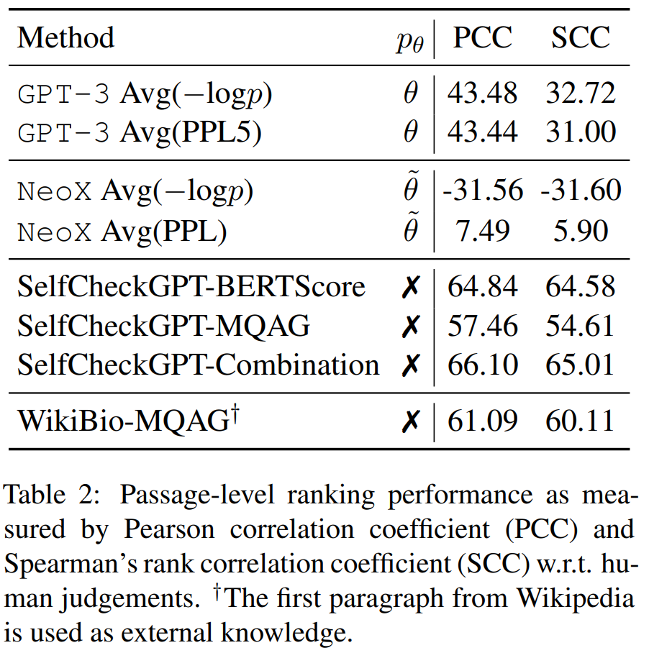
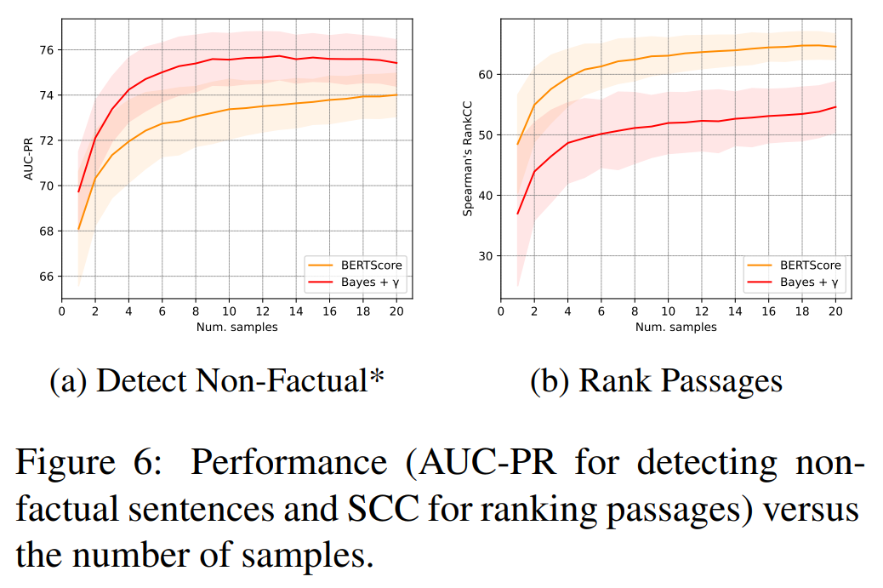
Experimental Results

Slide 13
Conclusions
1）提出了一个零资源的黑盒幻觉检测方法
2）通过实验证明了效果优于灰盒检测和代理语言模型方法

