Slide 1
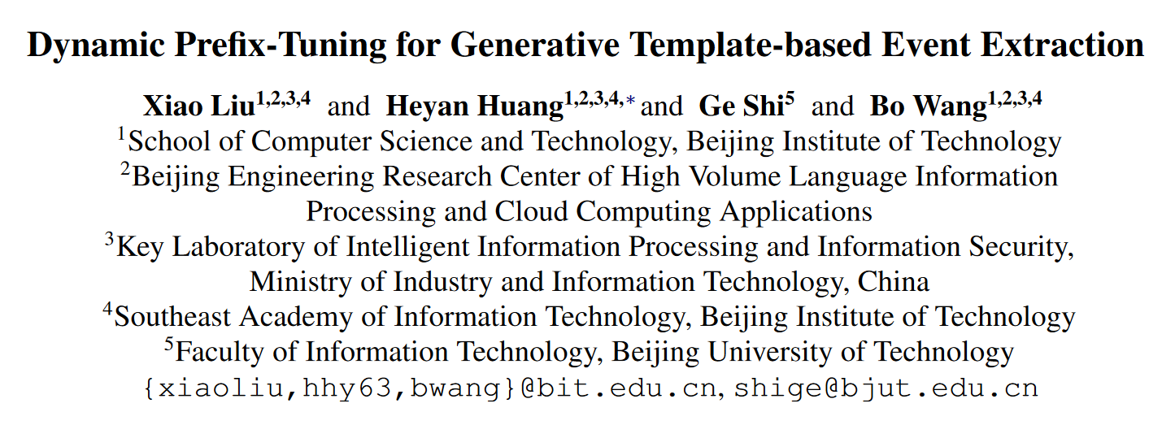
ACL 2022
刘燕婷

Slide 2
Motivation
Treats event extraction as several classification tasks
Cast the task of event extraction as a sequence generation
more data-efficient and flexible
suboptimal prompts
static event type information

Slide 3
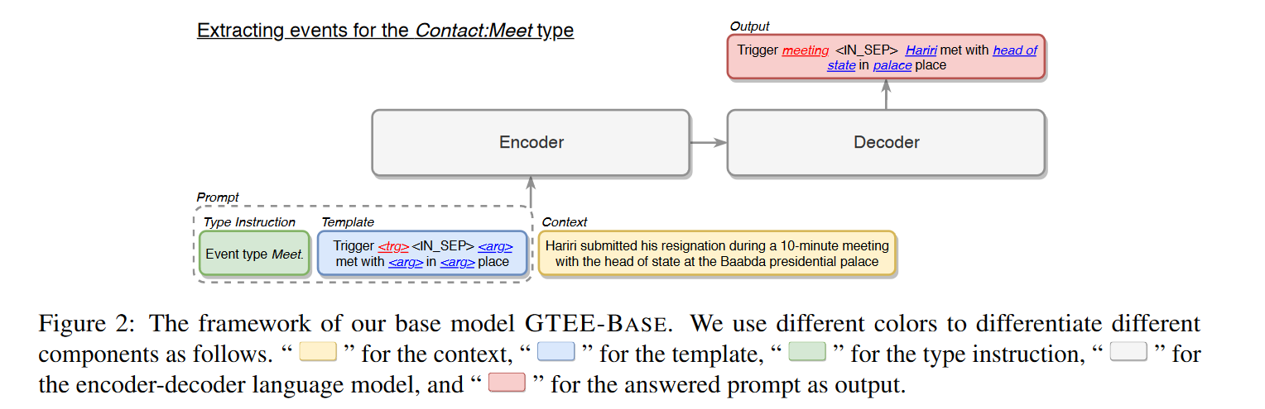
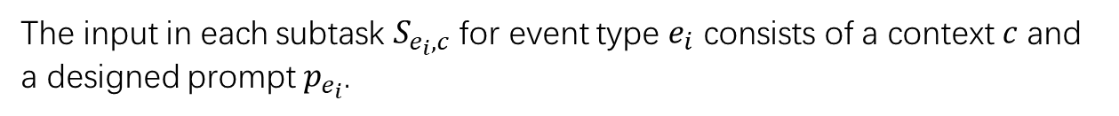
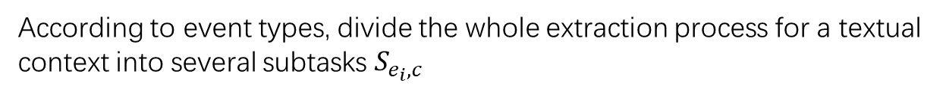
Problem Statement
According to event types, divide the whole extraction process for a textual context into several subtasks $S_{e_{i}, c}$
The input in each subtask $S_{e_{i}, c}$ for event type $e_{i}$ consists of a context $c$ and a designed prompt $p_{e_{i}}$.
the output is the answered prompts $A_{e_{i}}$, containing extracted event records.

Slide 4
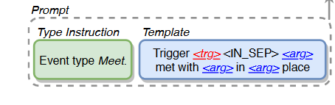
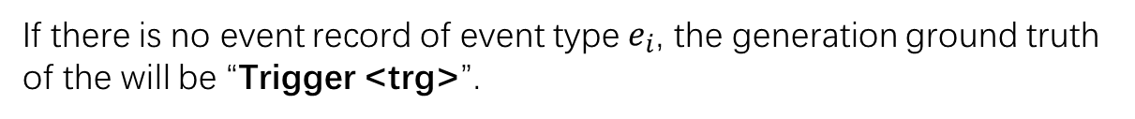
Prompt Design
Type Instruction: Event type is [MASK]
Template:
consists a trigger part and a argument part. The two parts are concatenated by a new seperate marker <IN_SEP>
Trigger part: Trigger <trg>
Ground Truth Construction: fill the gold event records into the template $T_{e_{i}}$
If there is no event record of event type $e_{i}$, the generation ground truth of the will be “Trigger <trg>”.
If several arguments are categorized as the same role, these arguments are first sorted by spans and then concatenated by “and”
If there are multiple event records, they will be sorted by the spans of the triggers, and the filled sequences will be concatenated by a new separate marker <OUT_SEP>.

Slide 5
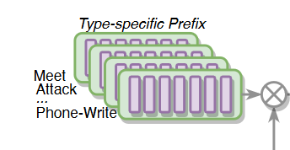
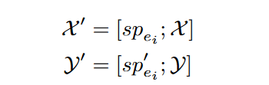
Type-Specific STATIC PREFIX
Inspired by PREFIX-TUNING, event type-specific prefix STAPREF is a pair of two transformer activation sequences {sp, sp′}, each containing L continuous D-dim vectors as the history values for encoder and deocder, respectively
From the view of the encoder and decoder input, in the subtask $S_{e_{i}, c}$ , the prefix is virtually prepended for the sequences X and Y in an encoder-decoder LM.

Slide 6
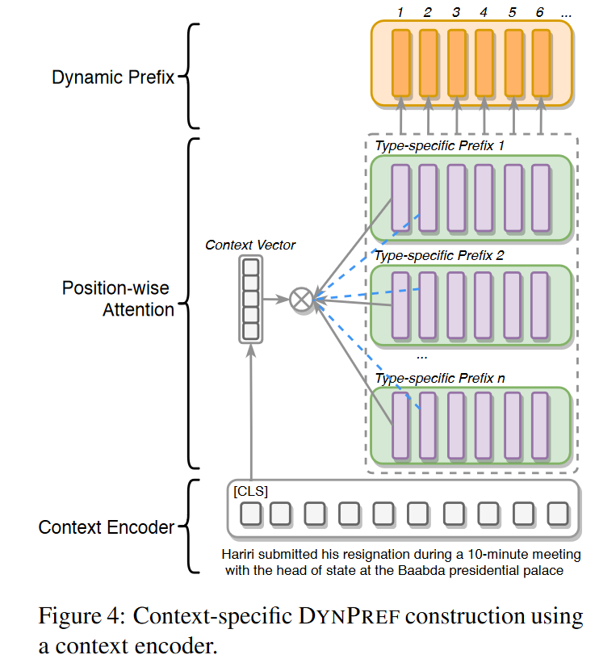
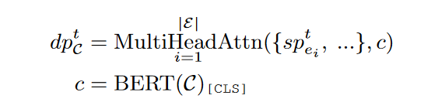
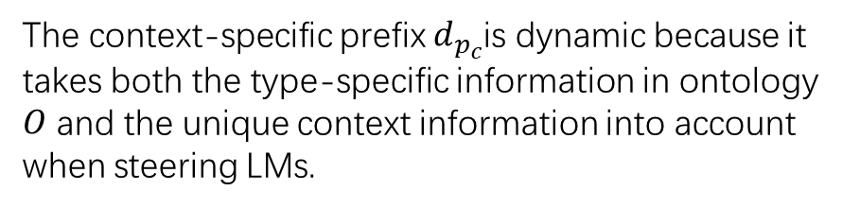
Context-Specific DYNAMIC PREFIX
The context-specific prefix $d_{p_{c}}$is dynamic because it takes both the type-specific information in ontology $O$ and the unique context information into account when steering LMs.

Slide 7
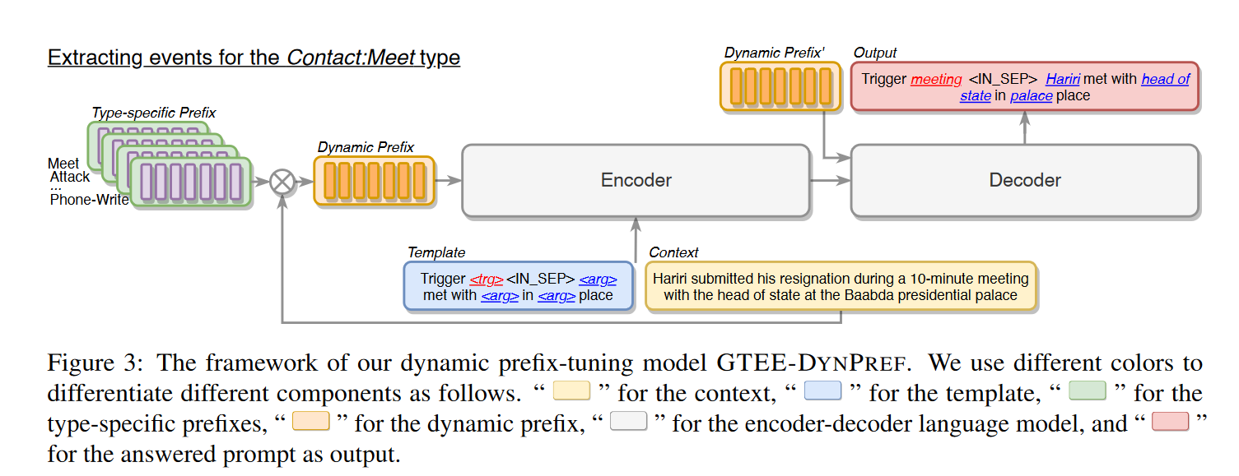
Training
jointly learning the LM parameters φ and the DYNPREF parameters θ requires different scales of training hyperparameters, being difficult to learn the ability to extract event arguments.
First, train φ using GTEE-BASE to learn the task information
Then fix the LM parameters φ and mask all other event types except for ei in each subtask $S_{e_{i}, c}$, only optimizing θ, to learn the typespecific information for each event type.
remove the masking of event types, remaining the LM parameters fixed and only optimizing θ using DYNPREF, to capt-ure the associations between related event types.

Slide 8
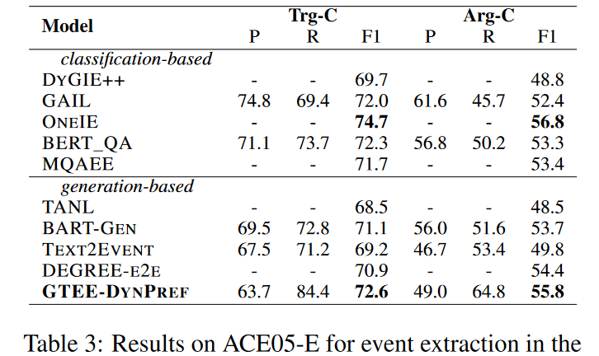
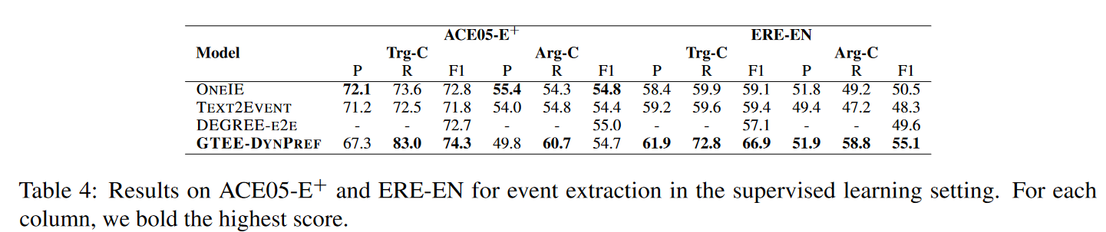
Experiment
New state-of-the-art
Trainable prompts boost the performances
Notes:
contain pronoun roles and multi-token event triggers
Trainable prompts boost the performances. Compared with DEGREE, the event extraction method using fixed templates, and TEXT2EVENT, the generative event extraction method without prompts, GTEE-DYNPREF outperforms them in all the datasets, showing the effectiveness of the trainable dynamic prefix with prompts.

Slide 9
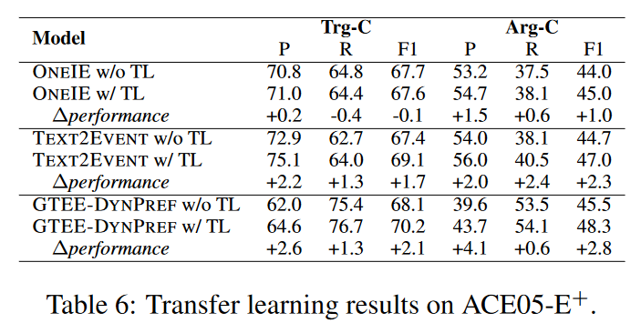
Transfer Learning Setting
utilizes the event type templates and optimize them with context-specific information in the dynamic prefix, which is easy to extend to a new type of event
divide the event mentions whose context contains no less than eight tokens in ACE05-E+ into two subsets, denoted by src and tgt
can be adopted to new types of events more effectively
ONEIE relies on multi-task annotated information, and TEXT2EVENT requires learning the structural information of new types of events.

Slide 10
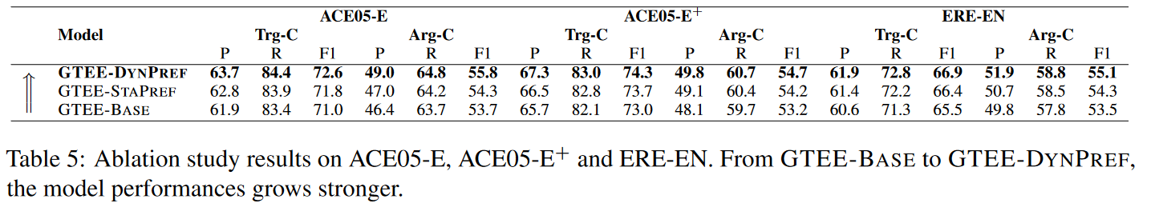
Ablation
demonstrate the effectiveness and flexibility of STAPREF to model the type-specific information
integrating context-specific information into type-specific information and transforming static prefix to dynamic is beneficial for generative template-based event extraction

Slide 11
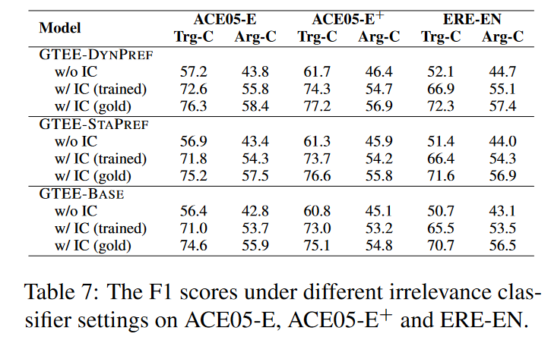
Irrelevant Event Types
The model has the bias to generate event records even for irrelevant event types
Finetune a BERT mdoel by feeding the encoded [CLS] vector to a MLP as a binary classifier to see whether the context contains any event records or is entirely irrelevant
with the help of trained ICs, the Trg-C and Arg-C F1 scores have been improved a lot by more than ten percentage points

Slide 12
Thanks

