Slide 1
[ACL 22]CONTaiNER: Few-Shot Named Entity Recognition via Contrastive Learning
Sarkar Snigdha Sarathi Das, Arzoo Katiyar, Rebecca J. Passonneau, Rui Zhang
Pennsylvania State University
Notes:
Today,im gonna talk about the subject’Game on Leaves’

Slide 2
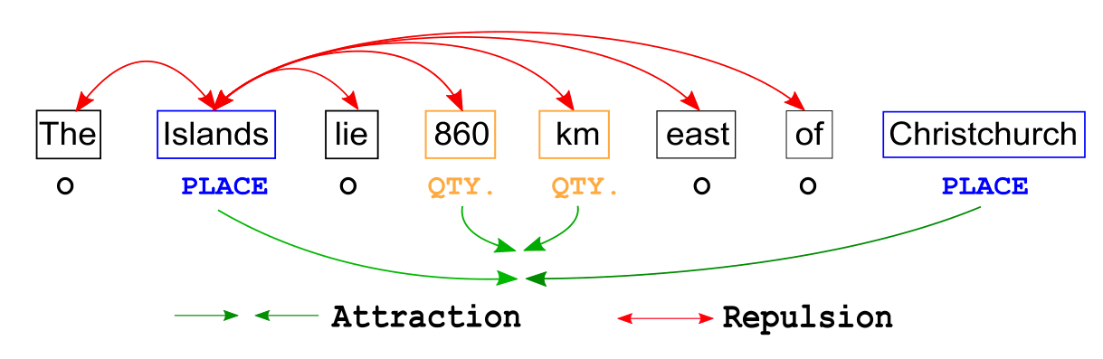
BackGround
Existing approaches only learn class-specific semantic features and intermediate representations from source domains. This affects generalizability to unseen target domains, resulting in suboptimal performances.
To fix this:

Slide 3
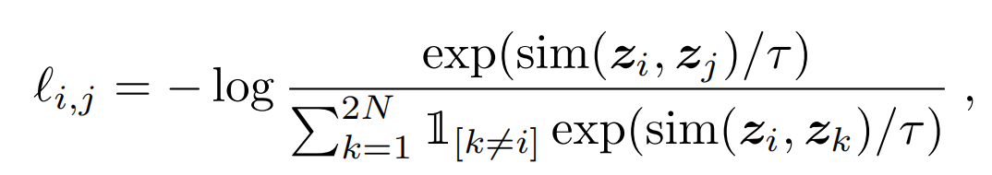
BackGround
Moreover, unlike traditional contrastive learners that optimize similarity objective between point embeddings, CONTAINER optimizes distributional divergence effectively modeling Gaussian Embeddings.
Point embeddings:

Slide 4
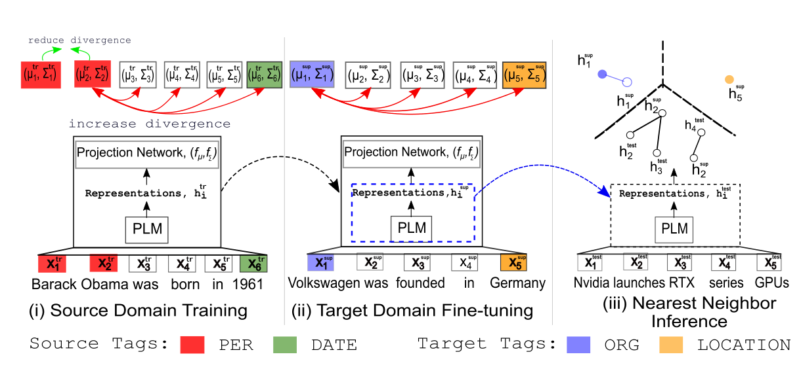
Model

Slide 5
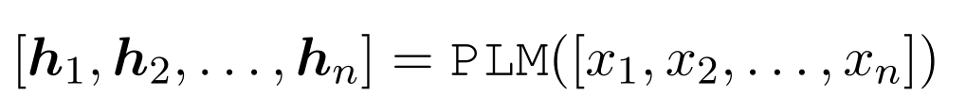
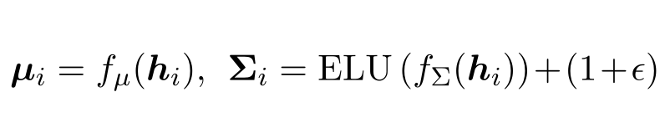
Source domain training
Given a sequence of n tokens [x1, x2, . . . , xn], we take the final hidden layer output of the PLM(BERT) as the intermediate representations hi
These intermediate representations are then channeled through simple projection layer for generating the embedding. Unlike point embedding for contrastive learning, we assume that token embeddings follow Gaussian distributions. Specifically, we employ projection network f_{µ} and f_{Σ} for producing Gaussian distribution parameters:

Slide 6
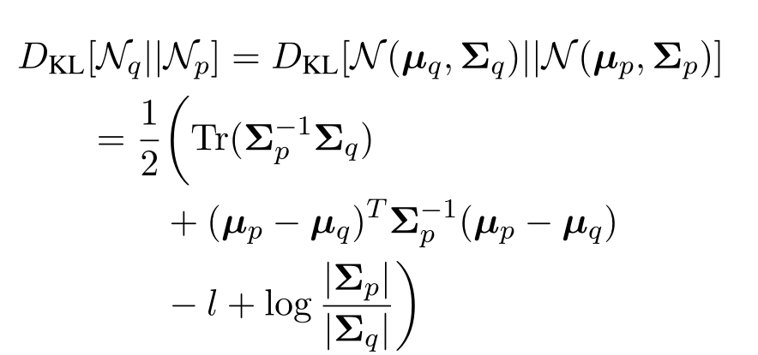
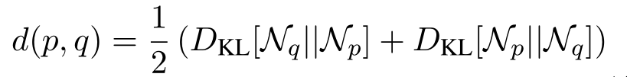
Source domain training
Two tokens x_{p} and x_{q} are considered as positive examples if they have the same label y_{p} = y_{q}. Given their Gaussian Embeddings N (µ_{p}, Σ_{p}) and N (µ_{q}, Σ_{q}), we can calculate their KL-divergence as following:

Slide 7
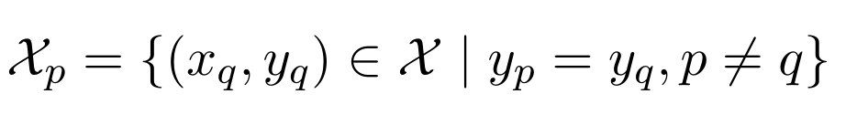
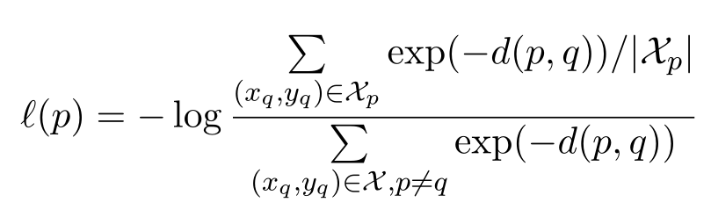
Source domain training
The positive samples at the batch level
Loss Function:

Slide 8
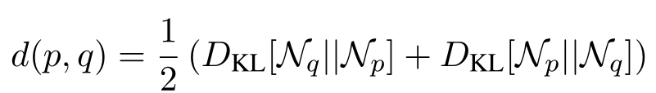

Target domain fine-tuning
When multiple few-shot samples (e.g., 5-shot) are available for the target classes
In contrast, for 1-shot case

Slide 9
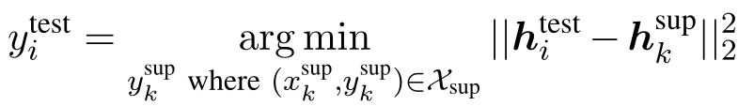
Nearest Neighbor inference
Here we assign $x_{i}^{test}$ the same label as the support token that is nearest in the PLM representation space
$h_{k}^{sup}$ :The PLM representations of each of the support token

Slide 10
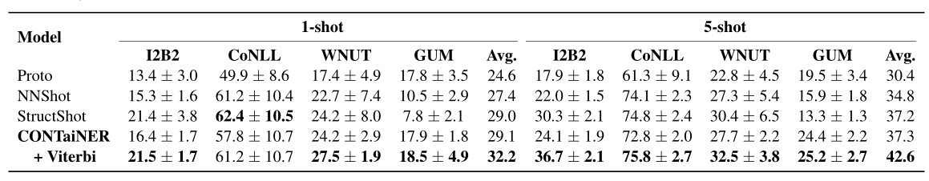
Experiments

Slide 11
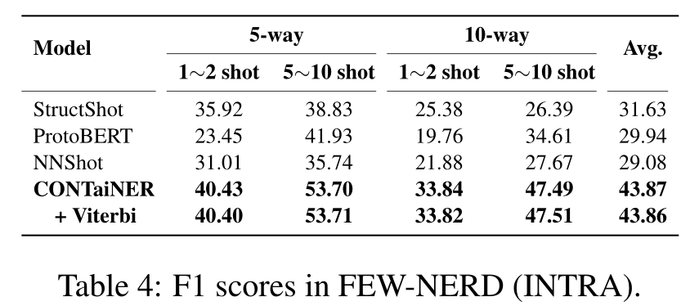
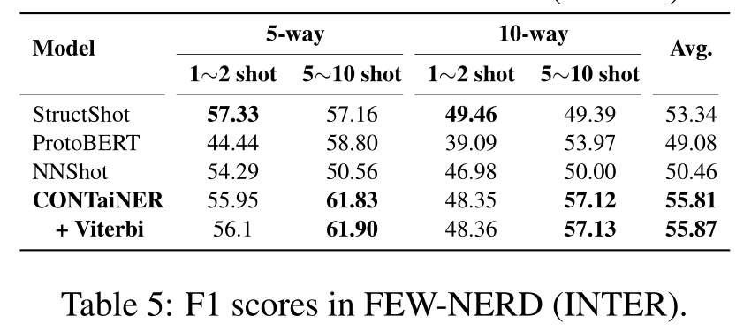
Experiments

Slide 12
THANKS

