Slide 1
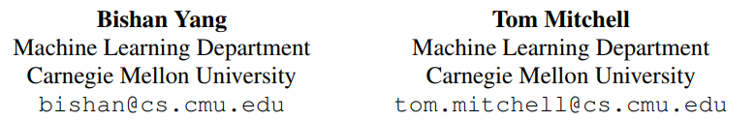
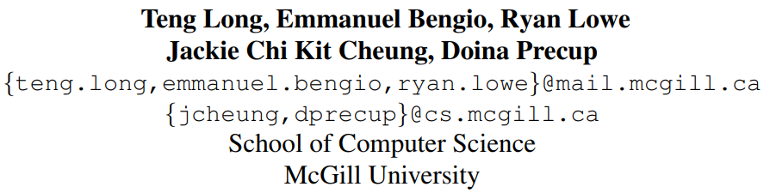
[1] "Leveraging Knowledge Bases in LSTMs for Improving Machine Reading". ACL 2017.
[2] "World Knowledge for Reading Comprehension: Rare Entity Prediction with Hierarchical LSTMs Using External Descriptions". EMNLP 2017.
张琪

Slide 2
引入外部知识的序列模型

Slide 3
[1] "Leveraging Knowledge Bases in LSTMs for Improving Machine Reading". ACL 2017.
Motivation
Traditional Methods
1. Use manually-encoded morphological and syntactic patterns require a lot of task-specific engineering to achieve good performance
2. Furthermore, the usefulness of knowledge features varies across contexts, as general KBs involve polysemy
e.g., “Clinton” can refer to a person or a town. Incorporating KBs irrespective of the textual context could mislead the machine reading process.

Slide 4
[1] "Leveraging Knowledge Bases in LSTMs for Improving Machine Reading". ACL 2017.
Our methods
Focuses on how to take advantage of external knowledge bases (KBs) to improve recurrent neural networks for machine reading.
Take experiment on entity extraction and event extraction on the widely used ACE2005 dataset.
Adaptively leverage knowledge from KBs to improve machine reading

Slide 5
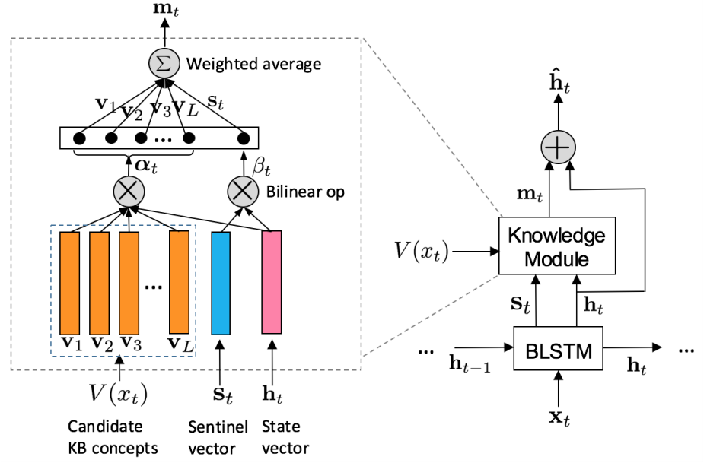
Method
KBLSTM

Slide 6
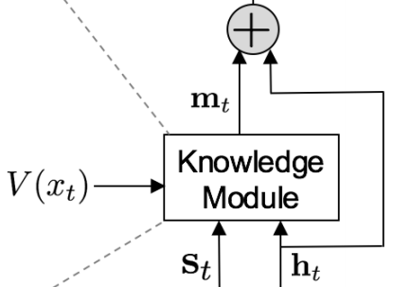
Method
The core of model is the knowledge module, which is responsible for transferring background knowledge into the BiLSTMs.

Slide 7
Method
The KBLSTM model retrieves the embeddings of candidate concepts that are related to the current word being processed and integrates them into its state vector to make knowledge-aware predictions.

Slide 8
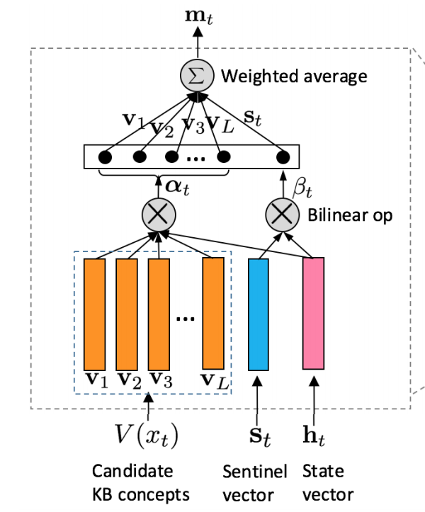

Method
Each candidate KB concept i ∈ V (xt) is associated with a vector embedding vi .
We compute an attention weight αti for concept vector vi via a bilinear operator, which reflects how relevant or important concept i is to the current reading context ht :

Slide 9



Method
Note that the candidate concepts in some cases are misleading.
For example, “Santiago is charged with murder.”
To address this issue, we introduce a knowledge sentinel that records the information of the current context
The weight on the local context is computed as:

Slide 10

Method
Use a mixture model to allow for better tradeoff between the impact of background knowledge and information from the context.
mt can be viewed as a knowledge state vector that encodes external KB information with respect to the input at time t.

Slide 11

Method
We combine mt with the state vector ht of BiLSTMs to obtain a knowledge-aware state vector

Slide 12
Method
Embedding Knowledge Base Concepts
NELL : searching for entities with the current word and collecting the related concept categorie;
WordNet : synsets of the current word as candidate concepts
We employ the BILINEAR model described in (Yang et al., 2015) to learn the representations of the candidate concepts

Slide 13
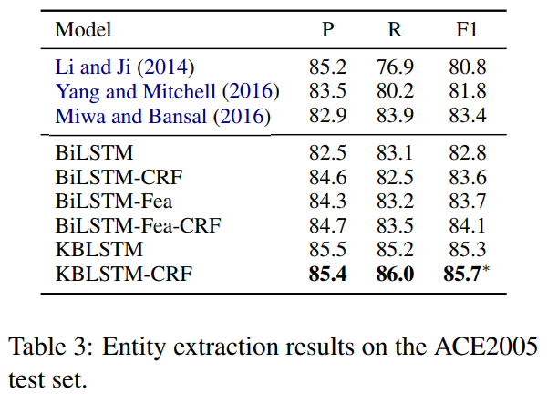
Experiment
Entity Extraction
Dataset: ACE2005 OntoNotes 5.0

Slide 14
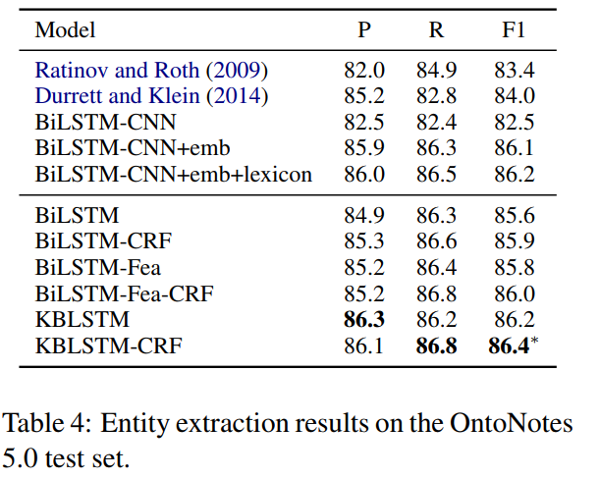
Experiment
Entity Extraction

Slide 15
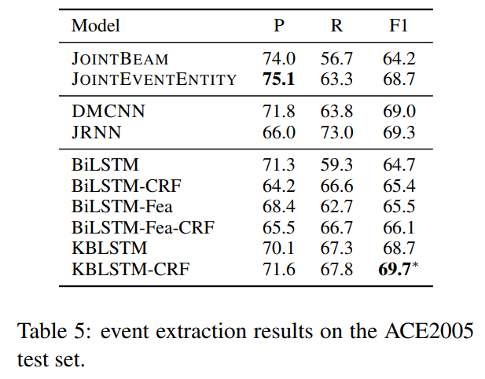
Experiment
Event Extraction
The task is typically addressed as a classification problem where the goal is to label each word in a sentence with an event type
Dataset: ACE2005
Feature based linear models
Previous reported results for neural models
Results of our models

Slide 16
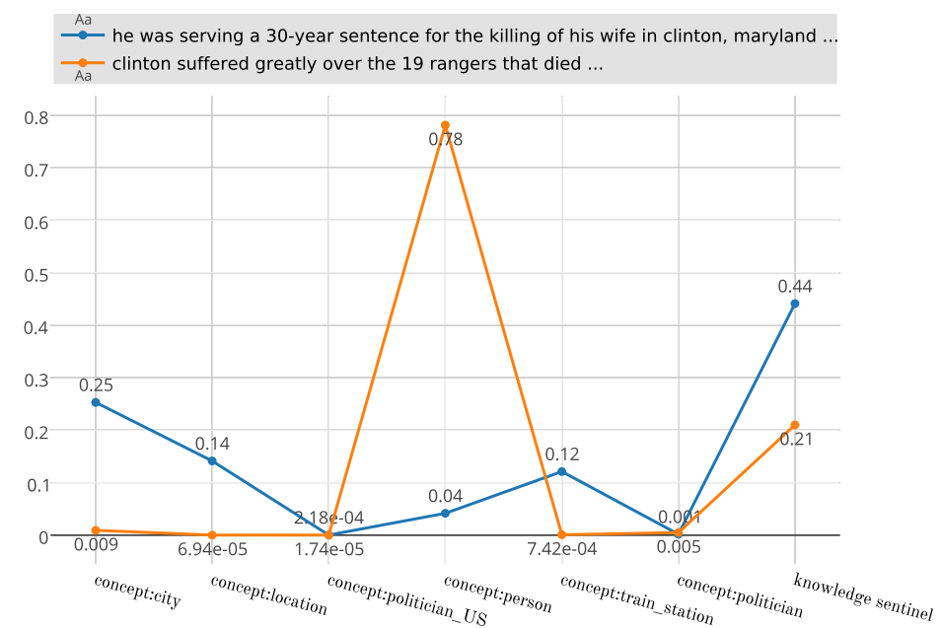
Model Analysis
Visualization of the attention weights for KB features learned by KBLSTM-CRF. Higher weights imply higher importance.
The X-axis represents relevant NELL concepts for the entity mention clinton.
The Y-axis represents the concept
weights and the knowledge sentinel weight.

Slide 17
Conclusion
Introduce the KBLSTM network architecture as one approach to incorporating background KBs for improving recurrent neural networks for machine reading.
This architecture employs an adaptive attention mechanism with a sentinel that allows for learning an appropriate tradeoff for blending knowledge from the KBs with information from the currently processed text.
Our model can also be extended to integrate knowledge from a richer set of KBs in order to capture the diverse variety and depth of background knowledge required for accurate and deep language understanding

Slide 18
Structured Knowledge from NELL and WordNet
Unstructured Knowledge from Freebase

Slide 19
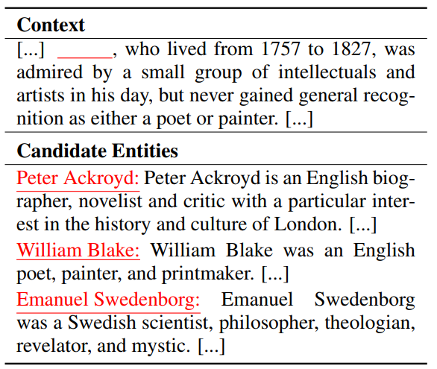
[2] "World Knowledge for Reading Comprehension: Rare Entity Prediction with Hierarchical LSTMs Using External Descriptions". EMNLP 2017.
Wikilinks Rare Entity Prediction.
A missing entity that must be predicted from a list of candidate entities. Each candidate entity is also provided with its description from Freebase.

Slide 20
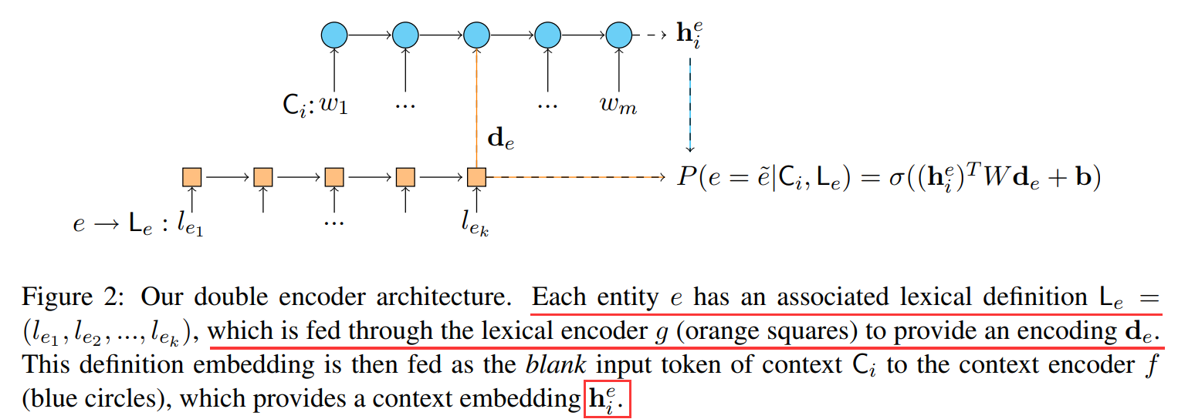
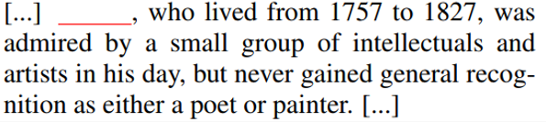

[2] "World Knowledge for Reading Comprehension: Rare Entity Prediction with Hierarchical LSTMs Using External Descriptions". EMNLP 2017.

