Slide 1
AccelerationSemi-Supervised Structured Prediction with Neural CRF Autoencoder
丁超越 51194506010

Slide 2
Motivation
Neural networks are notoriously susceptible to over-fitting unless large amounts of training data are available.
This problem is exacerbated in the structured settings, as accounting for the dependencies between decisions requires even more data. Providing it through manual annotation is often a difficult labor-intensive task.
In this paper we tackle this problem, and propose an end-to-end neural CRF autoencoder (NCRF-AE) model for semi-supervised learning on sequence labeling problems.

Slide 3
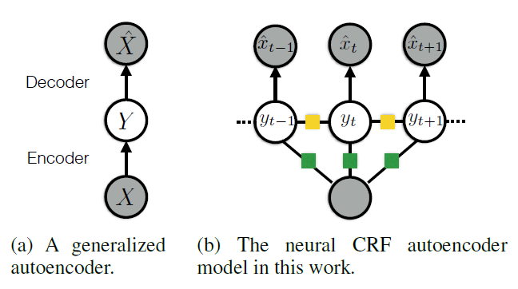
Neural CRF Autoencoder

Slide 4
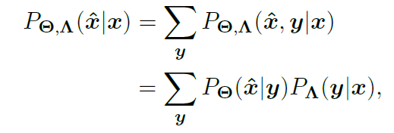
Neural CRF Autoencoder

Slide 5
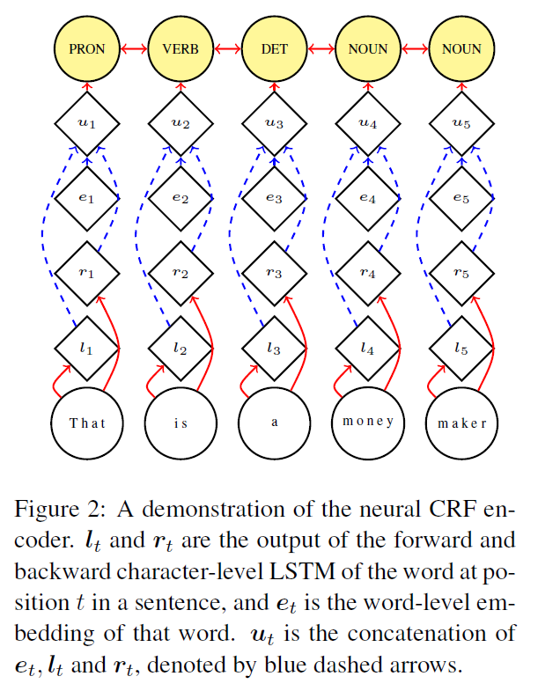
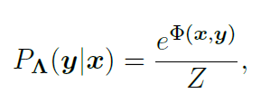


Neural CRF Encoder

Slide 6
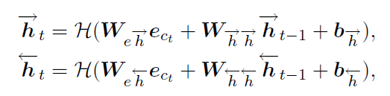
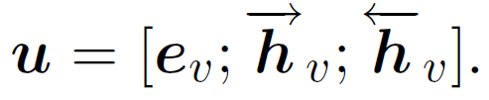
Neural CRF Encoder

Slide 7
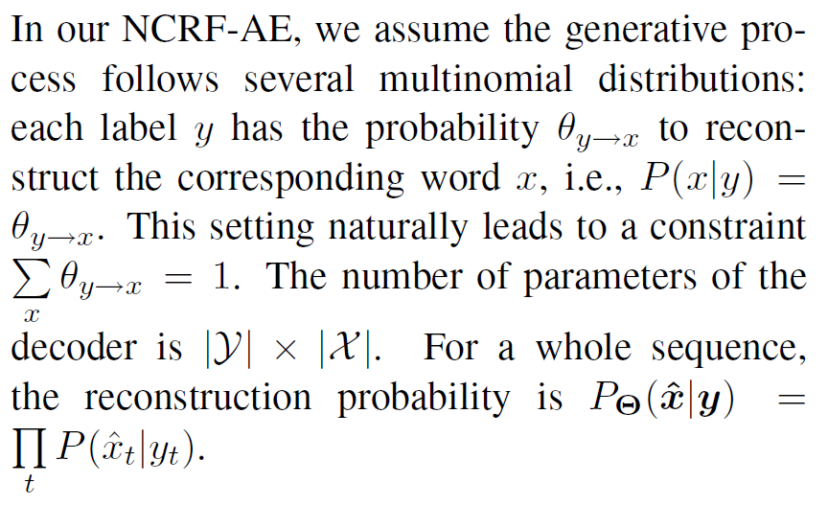
Neural CRF Decoder

Slide 8
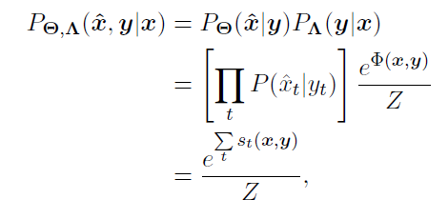
Unified Learning Framework（loss）
For a sequential input with labels, the complete data likelihood given by our
NCRF-AE is

Slide 9
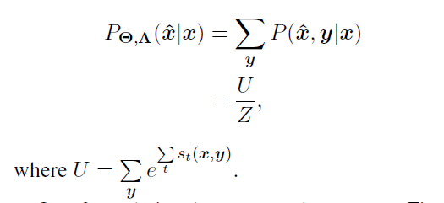
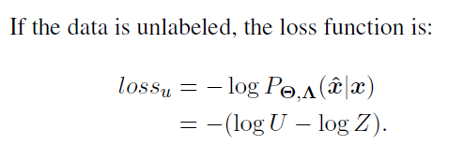
Unified Learning Framework （loss）
If the input sequence is unlabeled, we can simply marginalize over
all the possible assignment to labels. The probability is formulated as

Slide 10
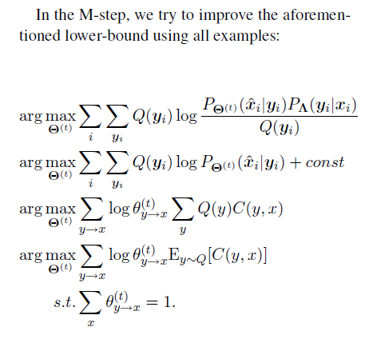

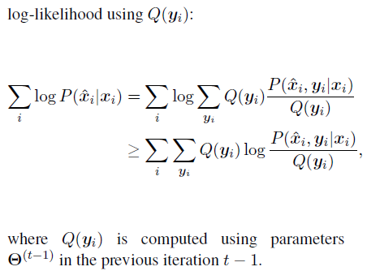
Unified Learning Framework

Slide 11
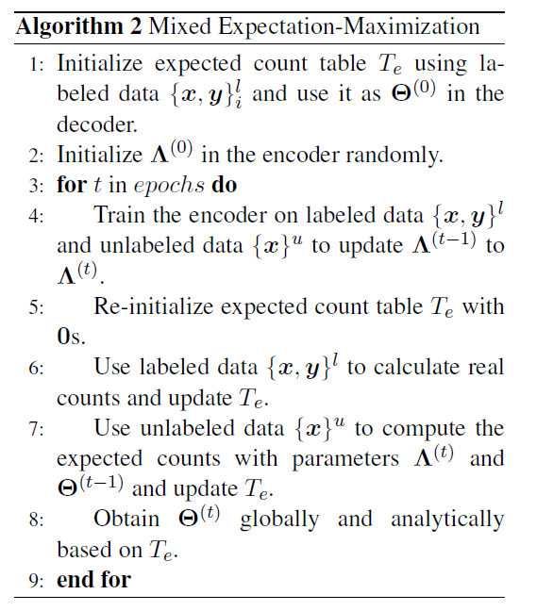
Mixed Expectation-Maximization

Slide 12
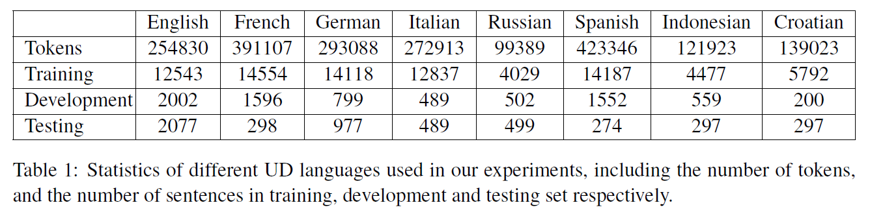
Experiments

Slide 13
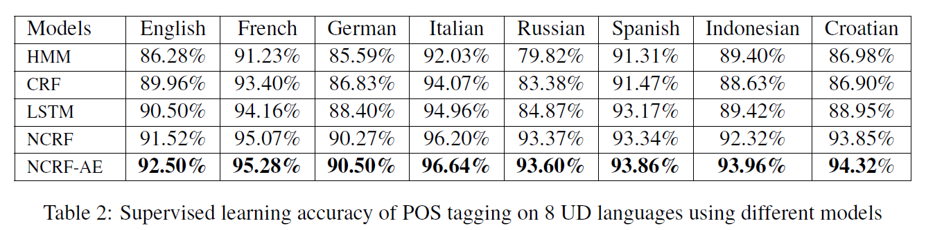
Experiments

Slide 14
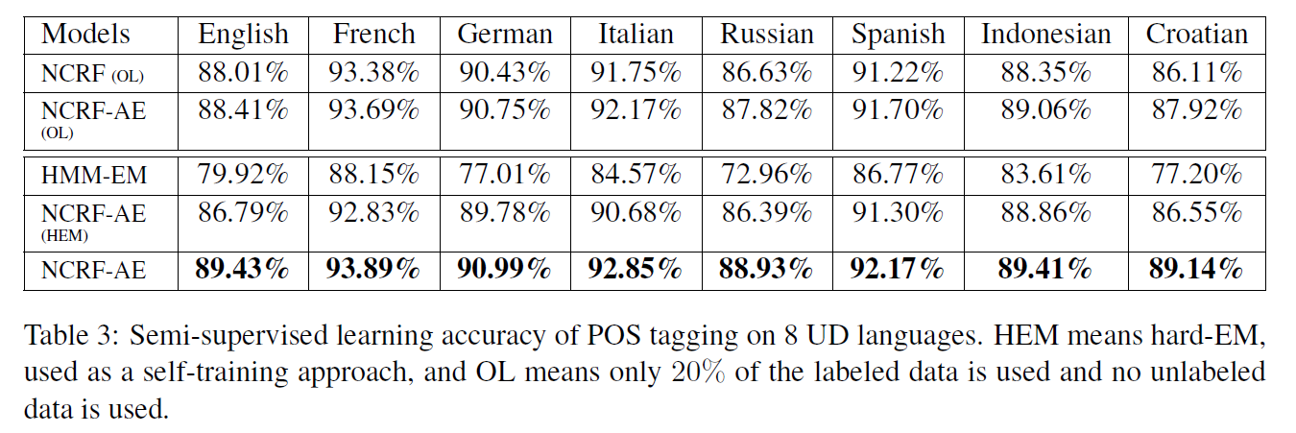
Experiments

Slide 15
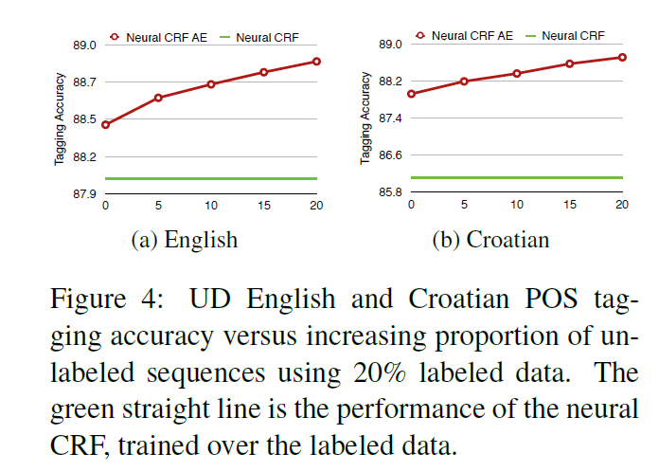
Experiments

Slide 16
Experiments

Slide 17
谢谢观看！

