Slide 1
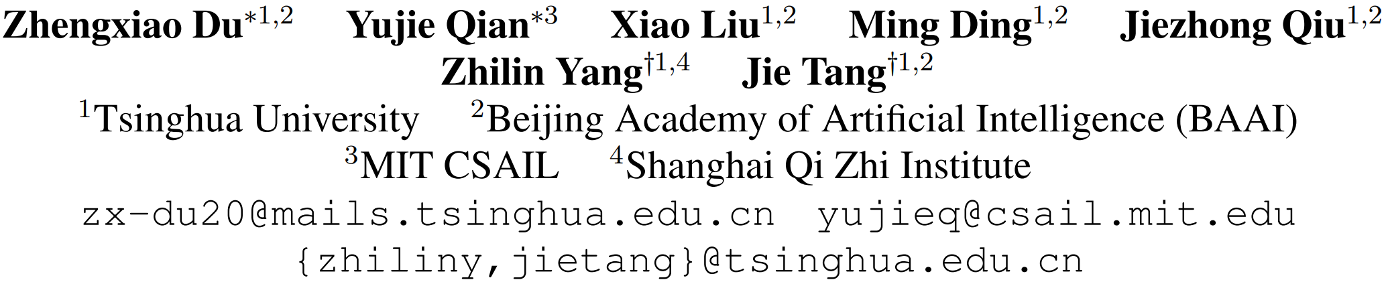
GLM: General Language Model Pretraining with Autoregressive Blank Infilling

Slide 2
Background
Existing Pretraining Framework
Autoregressive
Autoencoding
Encoder-decoder
NLP tasks
Natural language understanding
Unconditional text generation
Conditional text generation

Slide 3
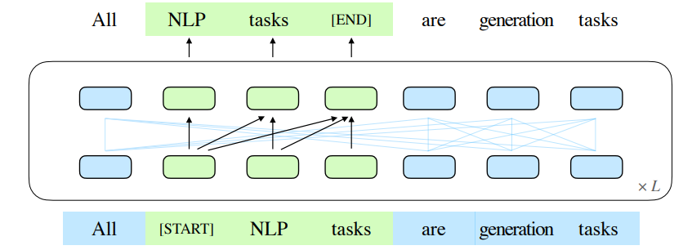
GLM
GLM based on a novel autoregressive blank infilling objective.
randomly blank out continuous spans of tokens from the input text.
train the model to sequentially reconstruct the spans

Slide 4
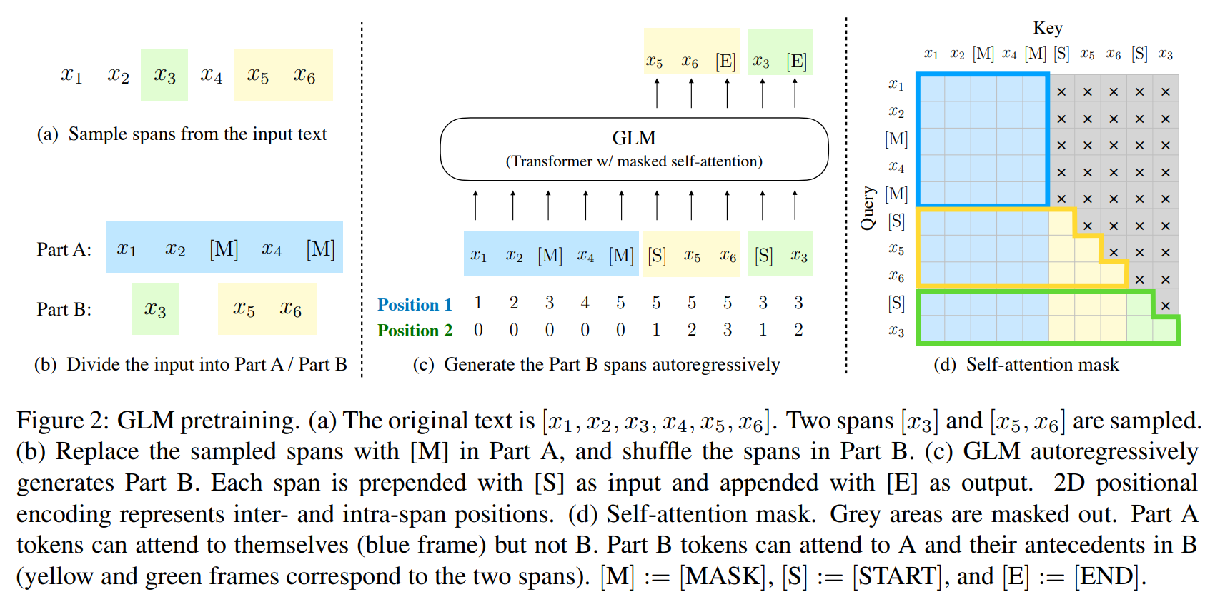
GLM

Slide 5
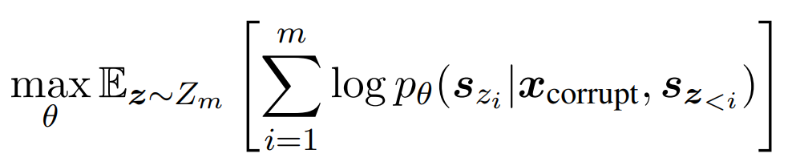
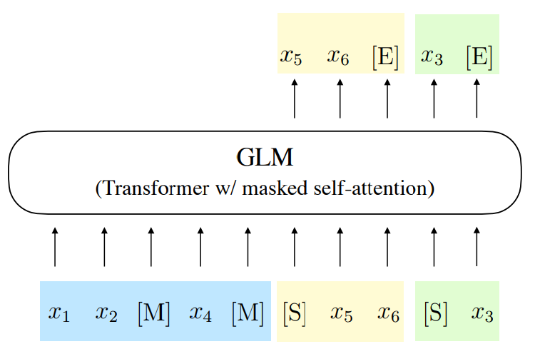

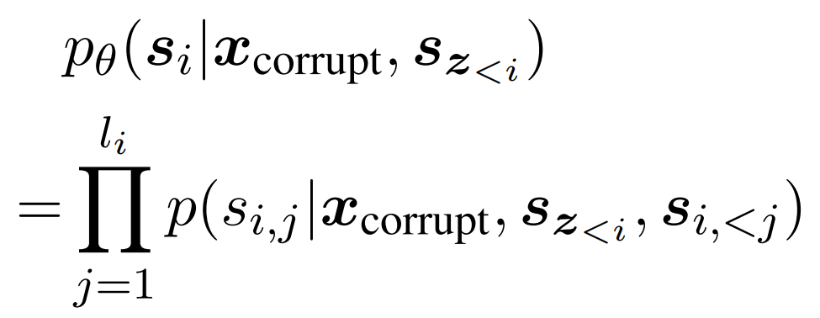
Pretraining Objective
be the set of all possible permutations of the length-m index sequence [1, 2, · · · , m]

Slide 6
Pretraining Details
Randomly sample spans of length drawn from a Poisson distribution with λ = 3.
Repeatedly sample new spans until at least 15% of the original tokens are masked. Empirically, we have found that the 15% ratio is critical for good performance on downstream NLU tasks.
Multi-Task Pretraining
Document-level: sample a single span whose length is sampled from a uniform distribution over 50%–100% of the original length. The objective
Aim: for long text generation.
Sentence-level. restrict that the masked spans must be full sentences. Multiple spans (sentences) are sampled to cover 15% of the original tokens.
Aim: for complete sentences or paragraphs

Slide 7
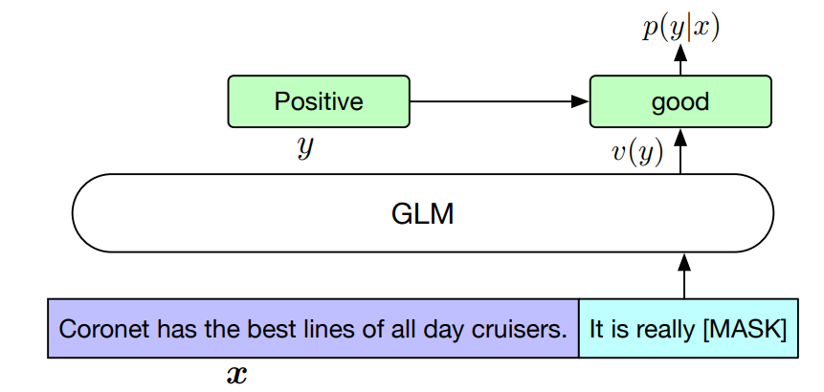
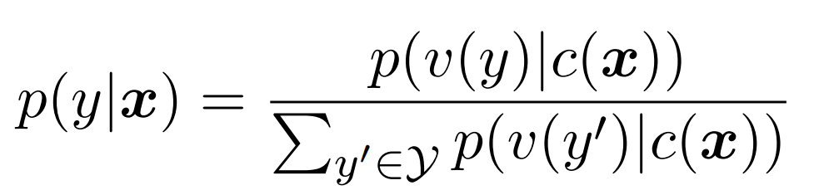
Finetuning GLM with PET (Pattern-Exploiting Training)
Sentiment classification task can be formulated as “{SENTENCE}. It’s really [MASK]”. The labels “positive” and “negative” are mapped to the words “good” and “bad”. The conditional probability of predicting y given x is
Notes:
In sentiment classification, the labels “positive” and “negative” are mapped to the words “good” and “bad”.

Slide 8
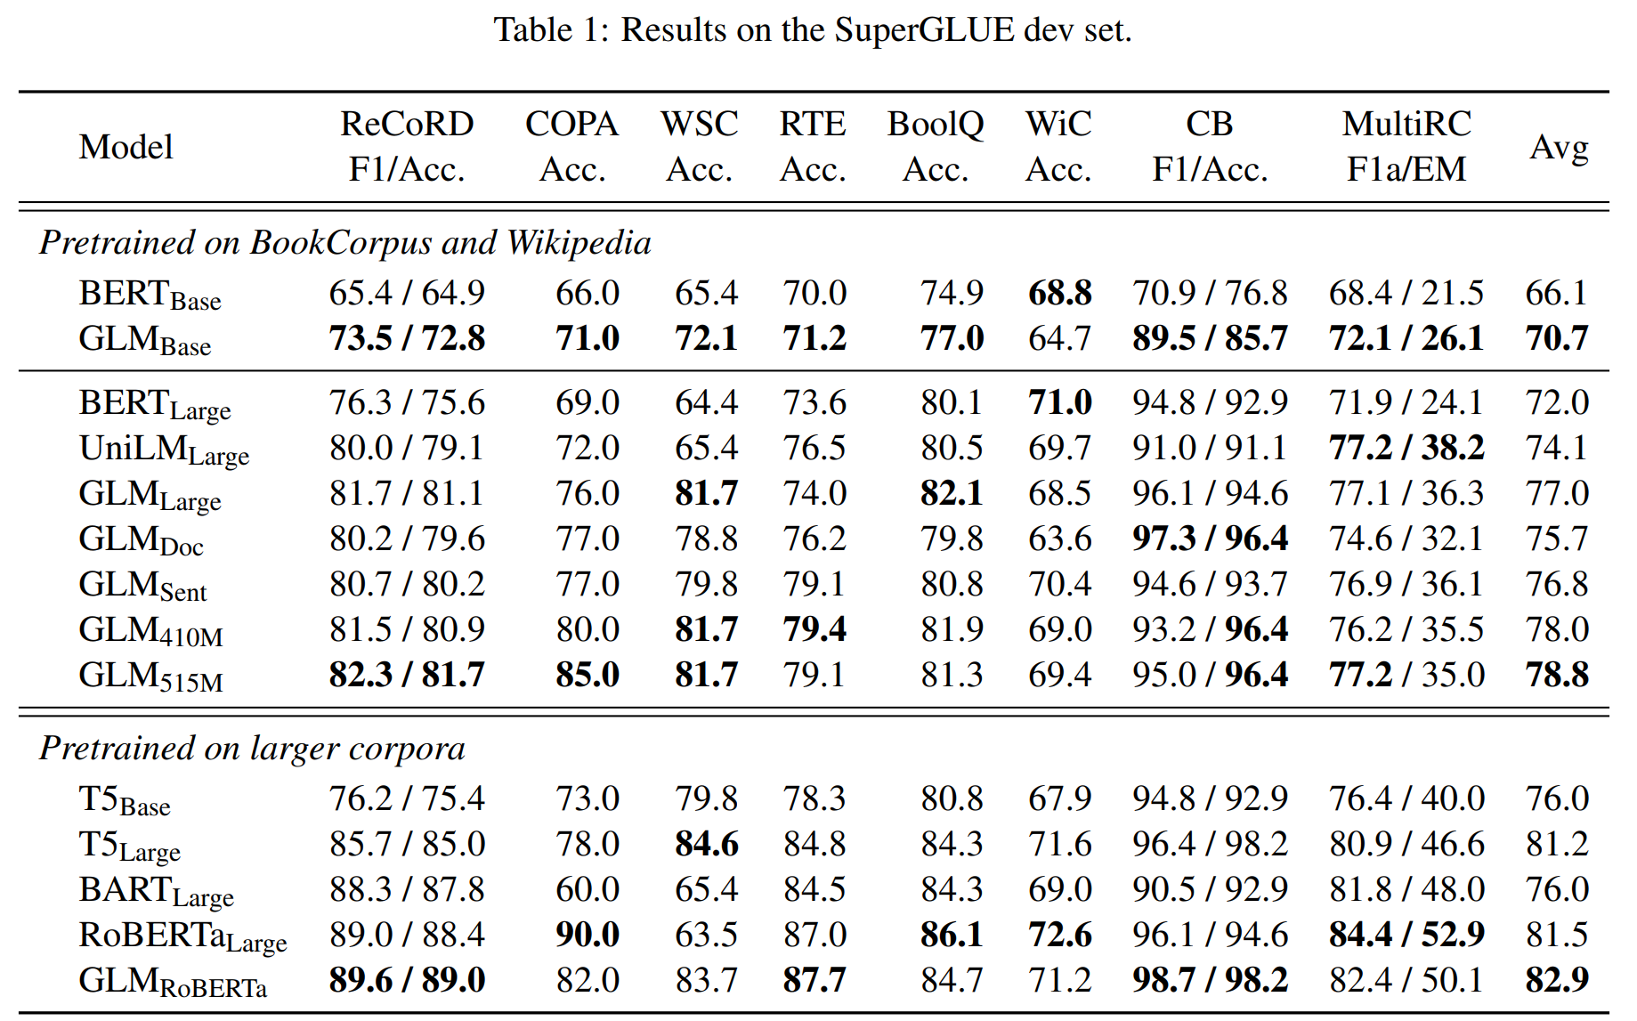
Experiments
Notes:
train GLMBase and GLMLarge with the same architectures as BERTBase and BERTLarge, containing 110M and 340M parameters respectively.
train two Largesized models with a mixture of the blank infilling objective and the document-level or sentencelevel objective, denoted as GLMDoc and GLMSent.
train two larger GLM models of 410M (30 layers, hidden size 1024, and 16 attention heads) and 515M (30 layers, hidden size 1152, and 18 attention heads) parameters with documentlevel multi-task pretraining, denoted as GLM410M and GLM515M.
To compare with SOTA models, we also train a Large-sized model with the same data, tokenization, and hyperparameters as RoBERTa (Liu et al., 2019), denoted as GLMRoBERTa.

Slide 9
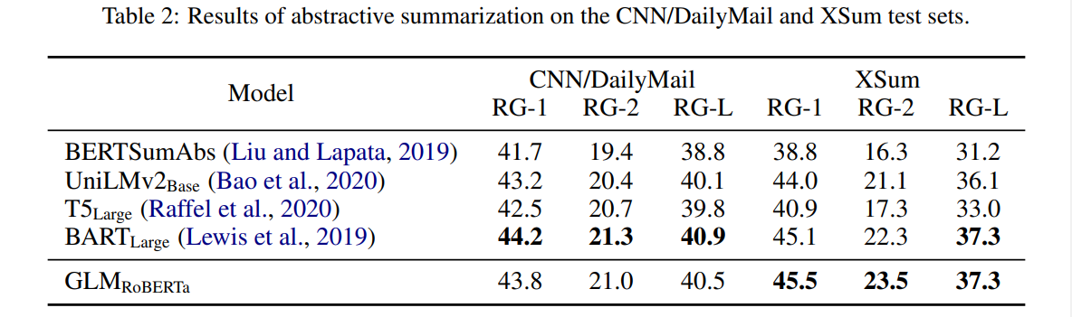
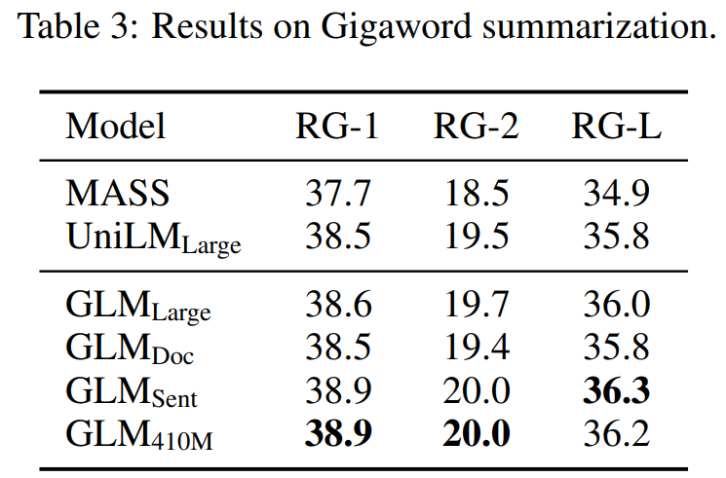
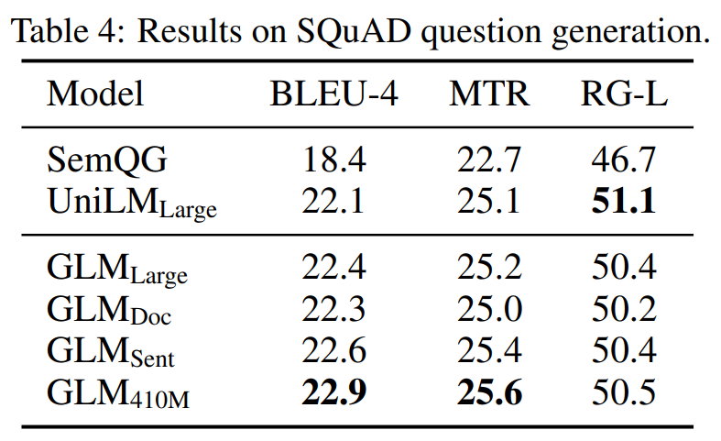
Experiments

Slide 10
Conclusions
GLM is a general pretraining framework for natural language understanding and generation.
GLM unifies the pretraining objectives for different tasks as autoregressive blank infilling, with mixed attention masks and the novel 2D position encodings.
GLM outperforms previous methods for NLU tasks and can effectively share parameters for different tasks

