Slide 1

Zero-Shot Cross-Lingual Transfer with Meta Learning
Farhad Nooralahzadeh, Giannis Bekoulis, Johannes Bjerva, Isabelle Augenstein
EMNLP 2020
汇报人: 陈少斌
日期：2021.03.30

Slide 2
Challenges for Multilingual Applications
Most languages in the world are under-resourced
Collecting annotated data for all languages is time-consuming and expensive
It is not trivial to
Train a model for a task in a particular language
Apply this model directly to other language where only limited training data is available
1

Slide 3
Introduction to Meta Learning
Cross-lingual Transfer
Train a model for a task in a high-source language
Apply it to low-source language where only limited training data is available
Meta Learning
Repeatedly simulating the learning process on low-source tasks
using many high-resource ones
Optimisation-based
—— find good initialisation parameter values and adapt to new tasks quickly
Metric-based
—— learn similarities between feature representations of instances
Model-based
—— adapting models that learn fast for meta learning
2

Slide 4
Model Agnostic Meta-Learning (MAML)
Framework - MAML
Assuming these new target tasks are drawn from the same distribution
Is able to quickly adapt to new target tasks by using only a few instance at test time
Application:
Employ a set of high-resource auxiliary tasks to find an optimal initialization
Learning a target task can be done using a small number of training instance
3

Slide 5
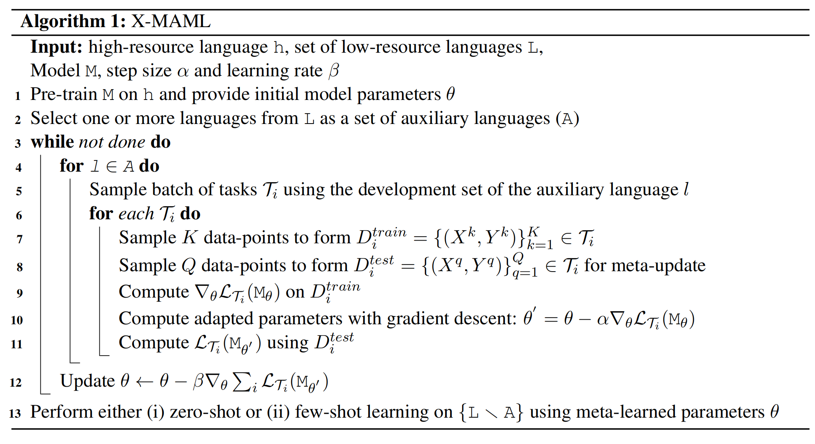
X-MAML
Training steps
4

Slide 6
Natural Language Inference
Two Tasks
Natural Language Inference (NLI)
Question Answering (QA)
NLI
Given premise, predict whether a hypothesis is true, false, or neutral
Dataset
Multi-Genre Natural language inference (Multi-NLI)
433k sentence
10 genres
Cross-lingual natural language inference (XNLI)
5000 test and 2500 dev hypothesis-premise pairs
14 languages
5

Slide 7
Question Answering
Two Tasks
Natural Language Inference (NLI)
Question Answering (QA)
QA
Given a context and a question, identify the span in the context which answers the question
Dataset
Multilingual Question Answering (MLQA)
7 languages
12 QA instances for English & 5k for every other languages
6

Slide 8
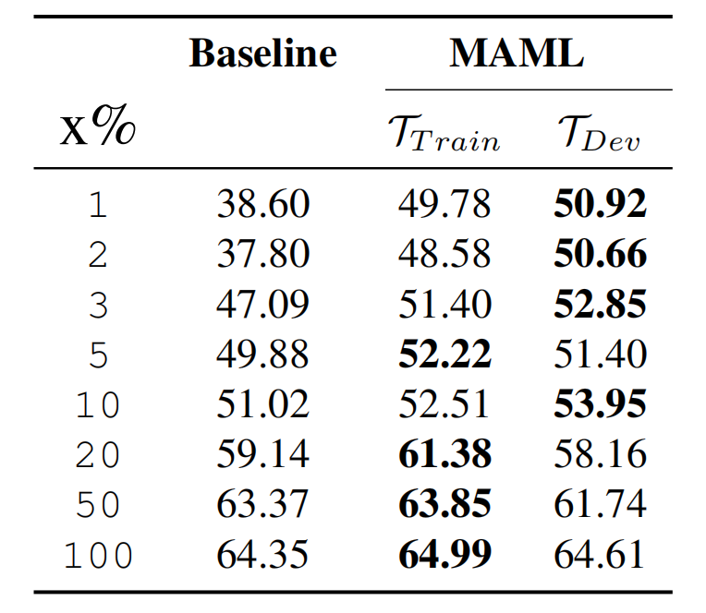
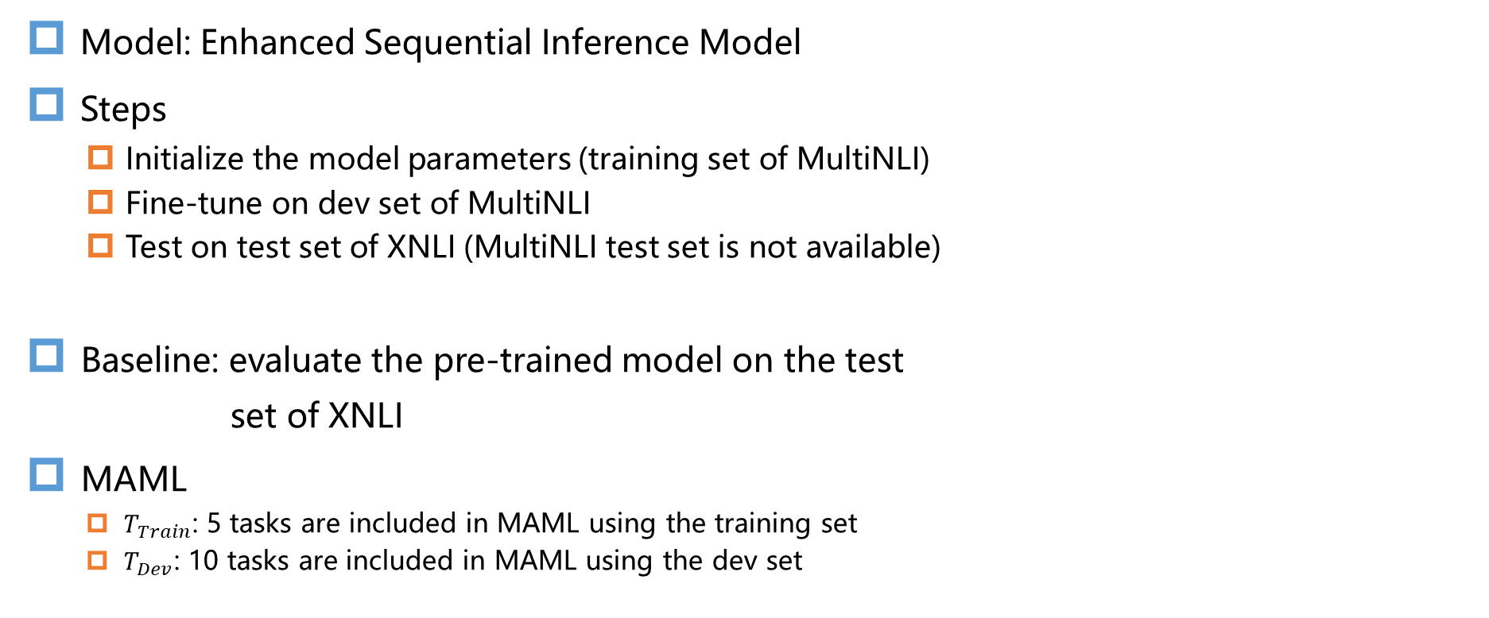
Experiment : Few-shot Cross-domain NLI
Model: Enhanced Sequential Inference Model
Steps
Initialize the model parameters (training set of MultiNLI)
Fine-tune on dev set of MultiNLI
Test on test set of XNLI (MultiNLI test set is not available)
Baseline: evaluate the pre-trained model on the test
set of XNLI
MAML
$T_{Train}$: 5 tasks are included in MAML using the training set
$T_{Dev}$: 10 tasks are included in MAML using the dev set
7

Slide 9
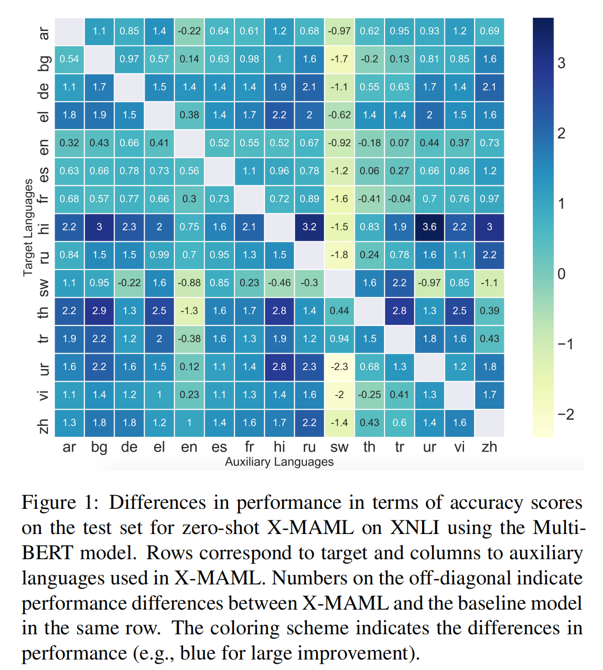
Experiment : Zero- and Few-shot Cross-Lingual NLI
Model: Multilingual BERT
Zero-shot approach with X-MAML
outperforms the baseline model
without MAML
8

Slide 10
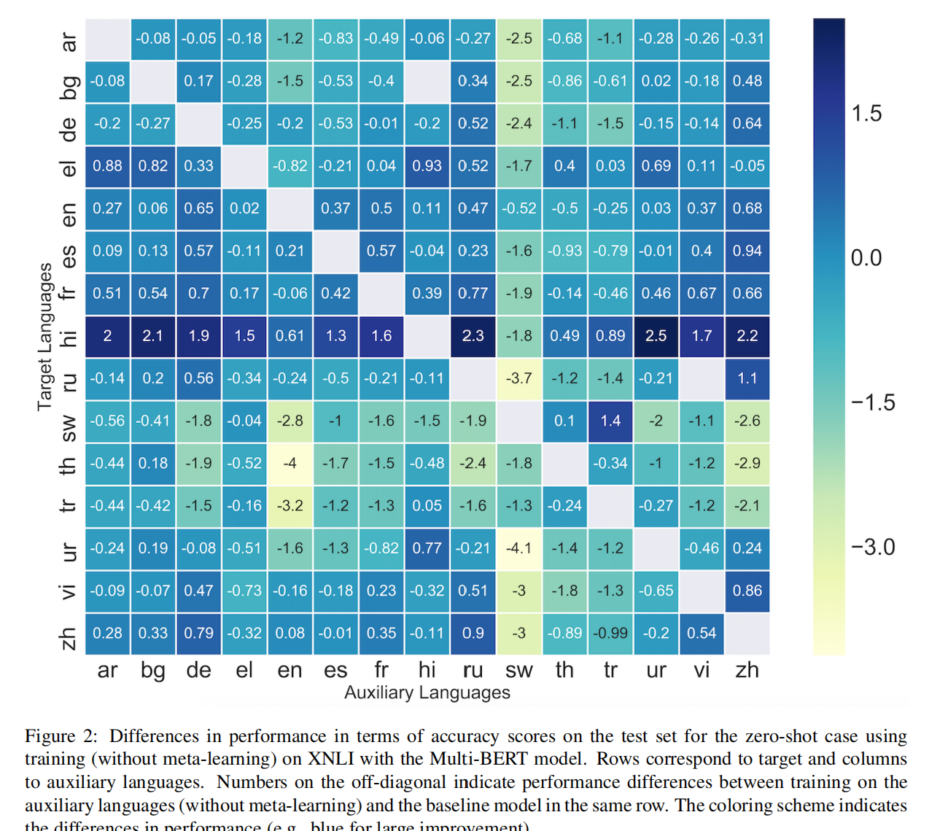
Experiment : Zero- and Few-shot Cross-Lingual NLI
Model: Multilingual BERT
Meta learning has a strongly positive
effect on predictive performance
9

Slide 11
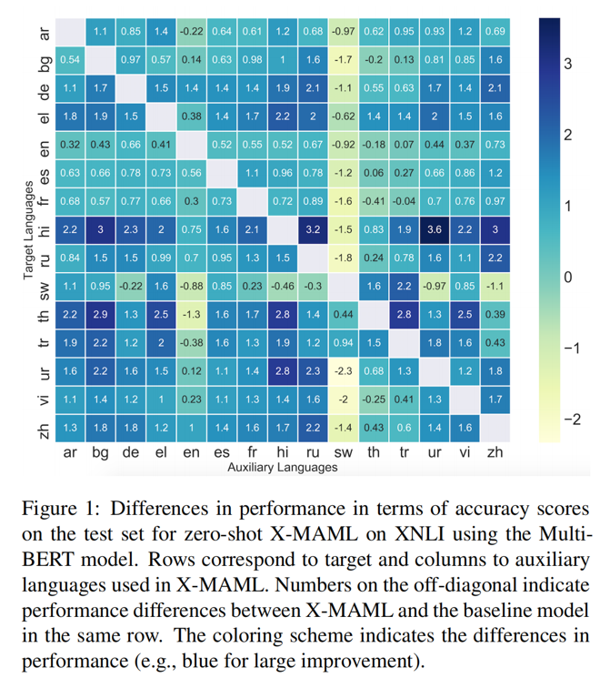
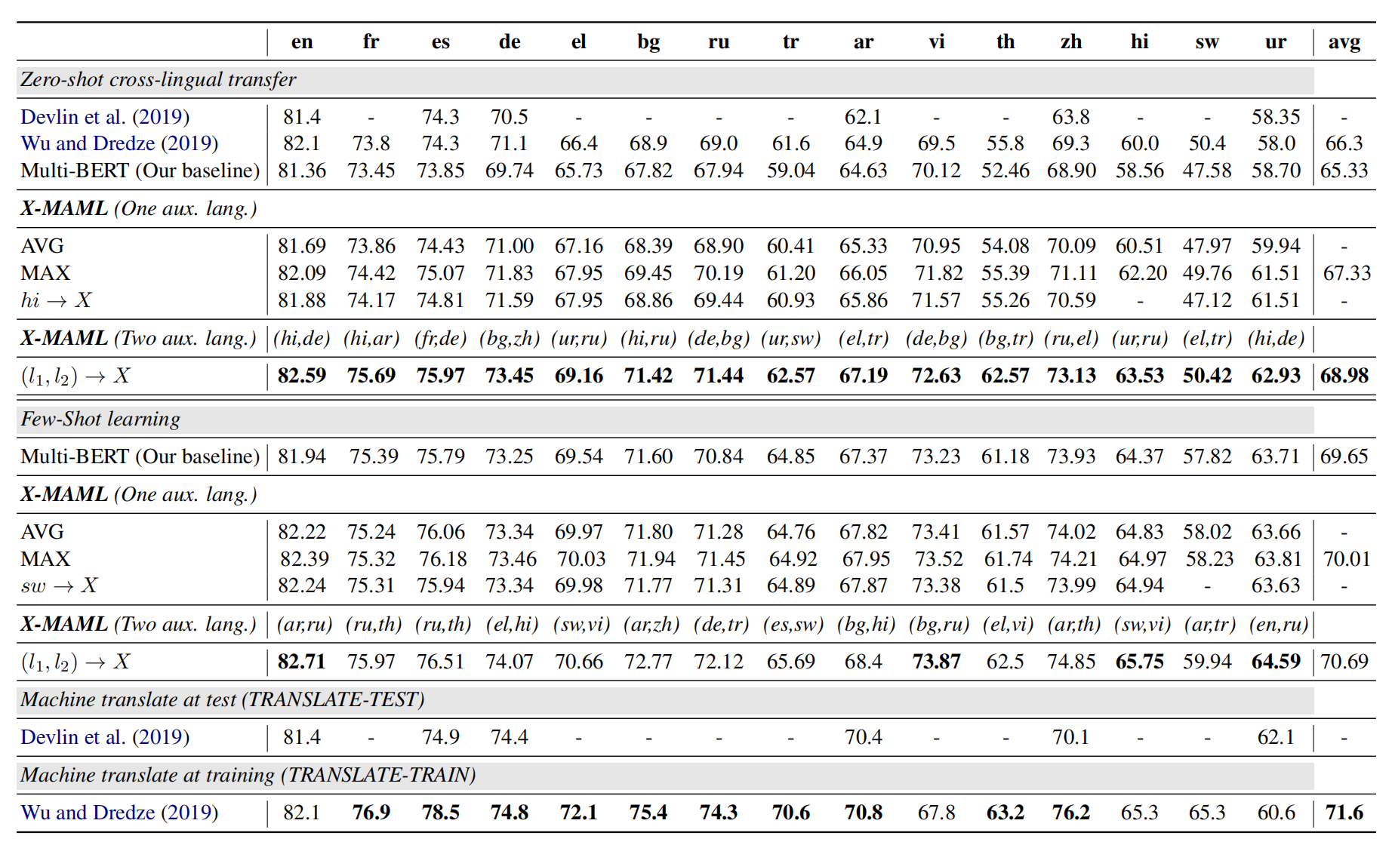
Experiment : Zero- and Few-shot Cross-Lingual NLI
Hypothesis: Typological commonalities among the languages has an effect on
the performance of MAML
X-MAML boosts Multi-BERT performance on XNLI
10

Slide 12
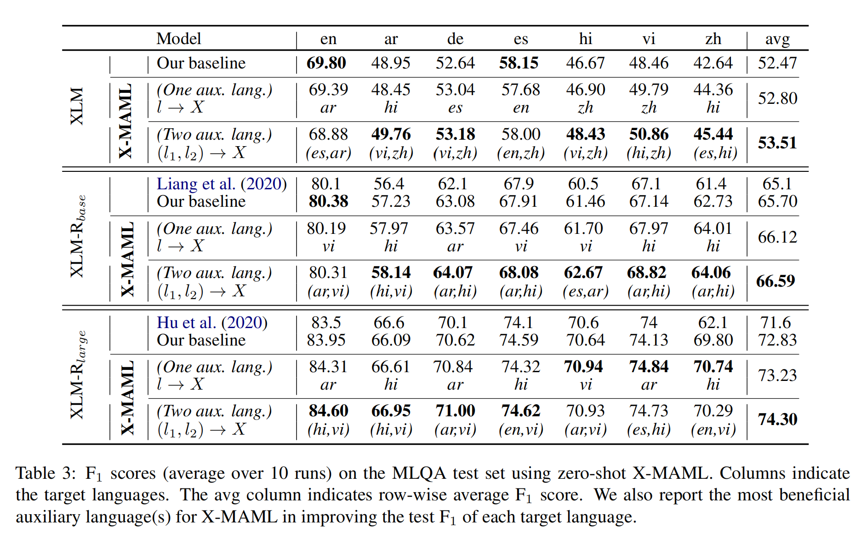
Experiment : Zero shot Cross-Lingual QA
All target languages benefit from meta-learning with at least one of the
auxiliary languages
Using two auxiliary languages in X-MAML further improves results
11

Slide 13
Typological Correlations
World Atlas of Language Structure
Largest Openly Available Typological Database
Approximately 200 linguistic features
More than 2500 languages
Investigate typological features based on the mutual gain/loss in performance
using X-MAML
Task: predict the exact WALS feature value of a language, given the change in accuracy
in combination with other languages
12

Slide 14
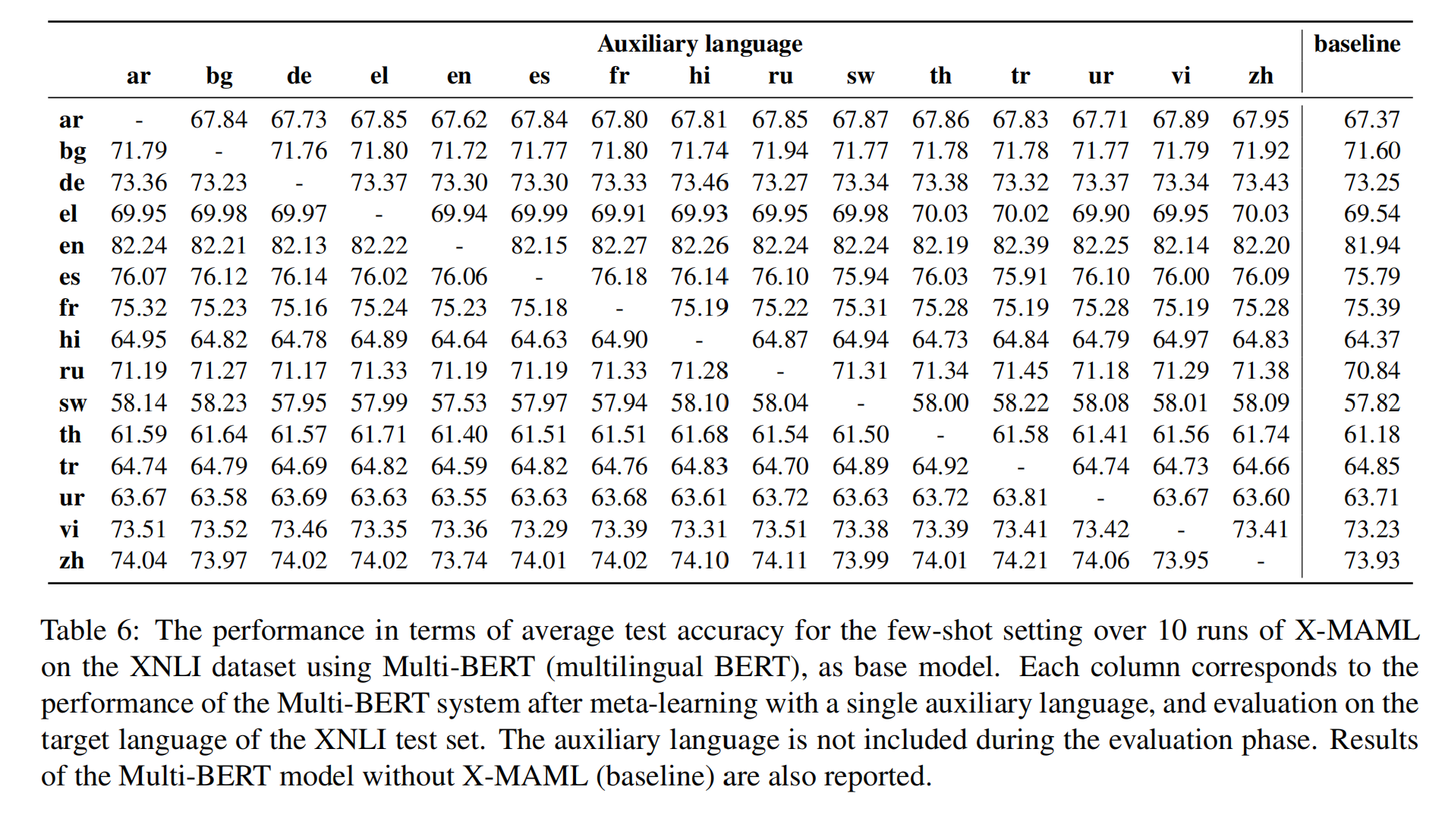
Typological Correlations
Languages sharing the feature value for WALS feature 67A The Future Tense
are beneficial to each other.
Encodes whether or not a language has an inflectional marking of future tense
Can be considered to be a morphosyntactic feature (形态句法特征).
13

Slide 15
Typological Correlations
World Atlas of Language Structure
Largest Openly Available Typological Database
Approximately 200 linguistic features
More than 2500 languages
Investigate whether sharing between two typologically similar languages is beneficial
for performance using X-MAML
Task: predict whether a main and auxiliary language have the same WALS feature value, given the change in accuracy when the two languages are used in X-MAML
14

Slide 16
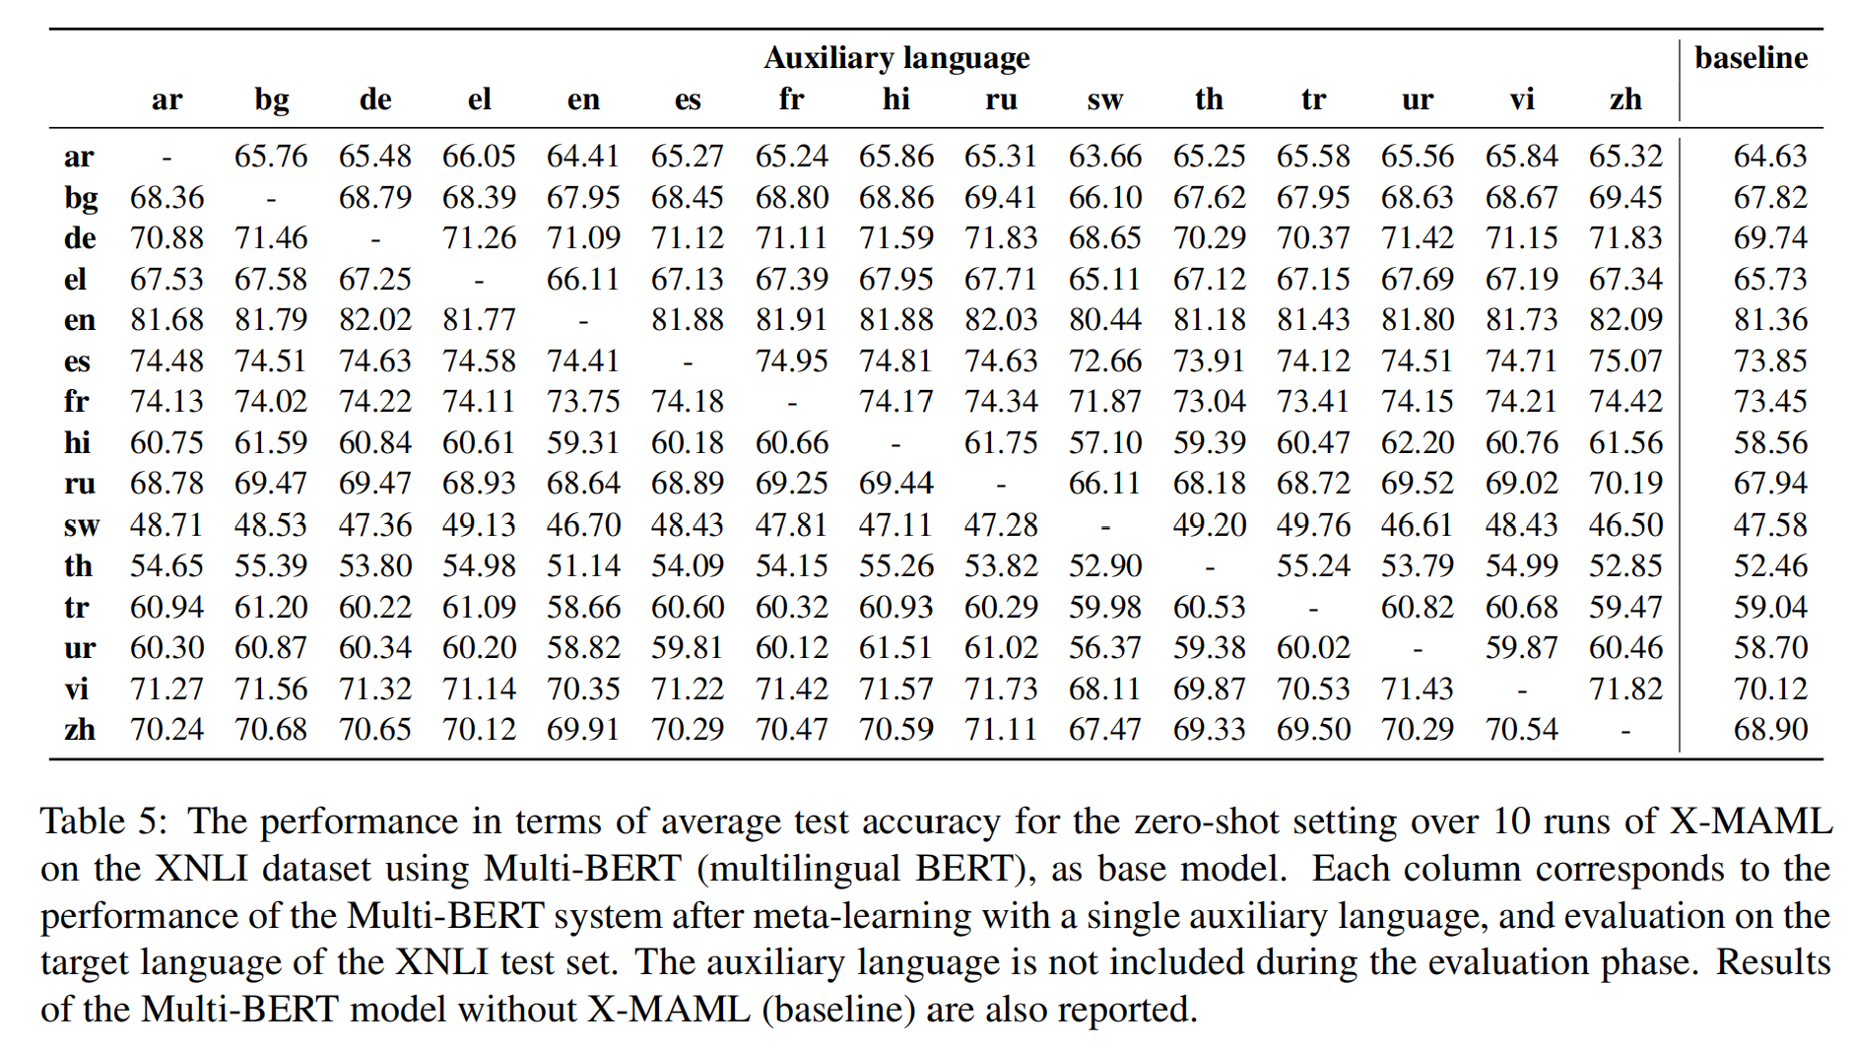
Typological Correlations
Languages sharing a feature value for the WALS feature 25A Locus of Marking:
Whole-language Typology typically help each other.
Describes whether the morphosyntactic marking in a language is on the syntactic heads
or dependents of a phrase.
15

Slide 17
Thanks for Listening!
Conclusion:
Meta-learning effectively leverage training data from an auxiliary language for
zero-shot and few-shot cross-lingual transfer
Languages which share certain morphosyntactic features tend to benefit from this
type of transfer
16

