Slide 1

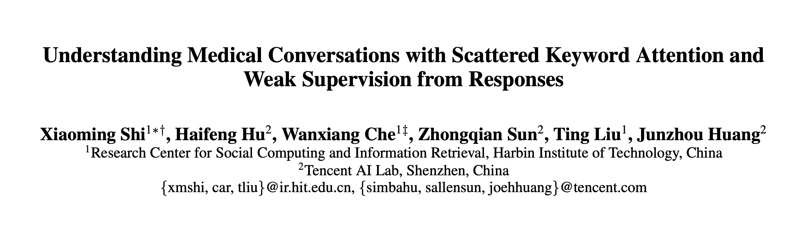
李勇 51194506074
Shi X, Hu H, Che W, et al. Understanding Medical Conversations with Scattered Keyword Attention and Weak Supervision from Responses[C]//AAAI. 2020: 8838-8845.

Slide 2
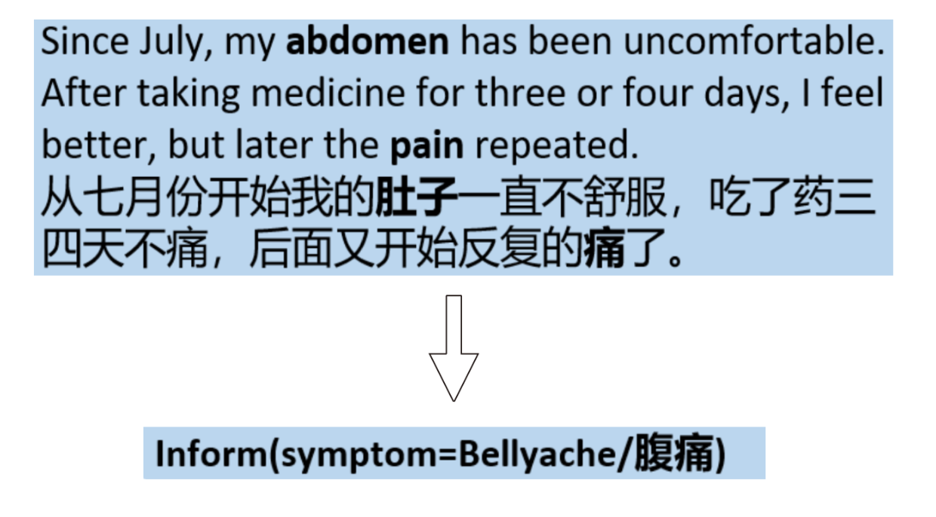
Introduction medical slot filling problem
Shi X, Hu H, Che W, et al. Understanding Medical Conversations with Scattered Keyword Attention and Weak Supervision from Responses[C]//AAAI. 2020: 8838-8845.

Slide 3
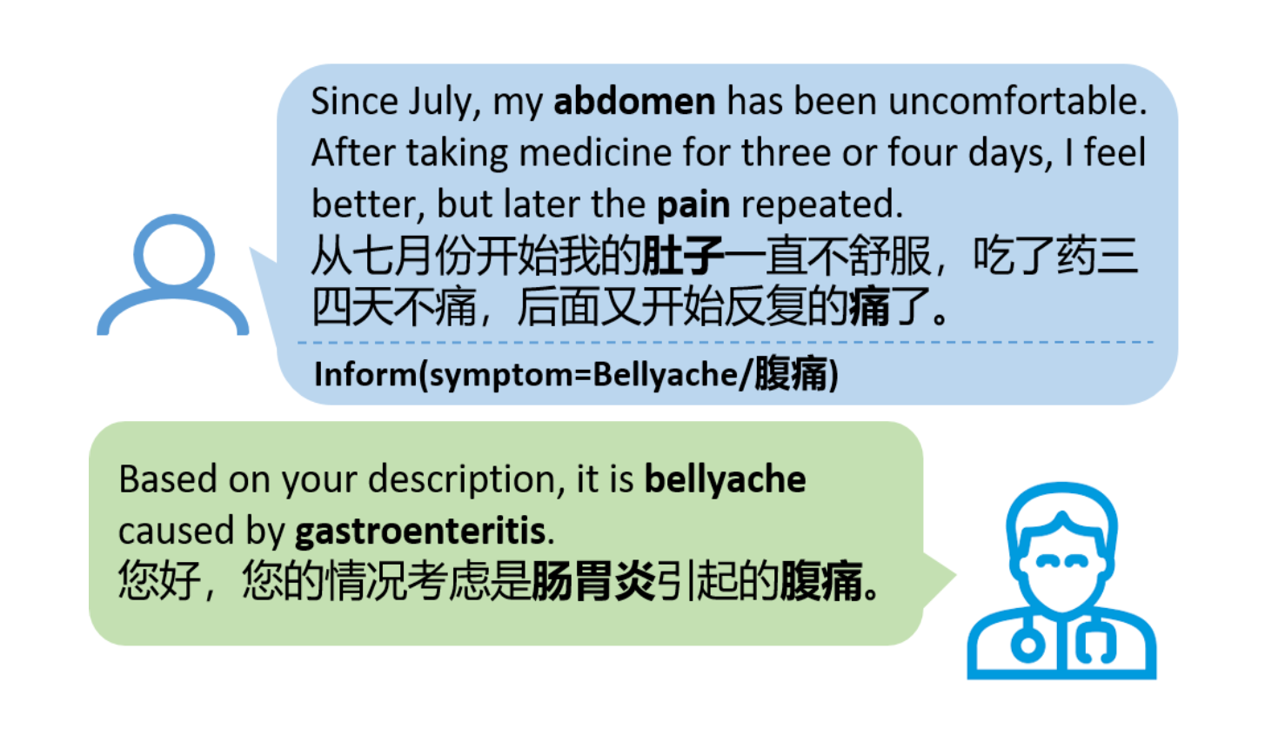
Introduction two challenge of medical slot filling problem
Medical dialogue data is unaligned where slot-values of the structured semantic representation do not explicitly occur in any specific spans;
users’ colloquial expression
scattered keyword
Medical data annotation requires annota tors with professional medical knowledge which leads to the high annotation cost
Shi X, Hu H, Che W, et al. Understanding Medical Conversations with Scattered Keyword Attention and Weak Supervision from Responses[C]//AAAI. 2020: 8838-8845.

Slide 4
Approach
Treat the medical slot filling as a multi-label classification problem that aims to classify the sentences into pre-defined categories
Recognize those discontinuous ones better, we use the label-embedding attentive model (Wang et al. 2018) which makes the model more sensitive to medical keywords.
propose a novel methodology to learn medical slot filling with weak supervision from doctors’ responses as the model pre-training before the fine-tuning on well-annotated data
Shi X, Hu H, Che W, et al. Understanding Medical Conversations with Scattered Keyword Attention and Weak Supervision from Responses[C]//AAAI. 2020: 8838-8845.

Slide 5
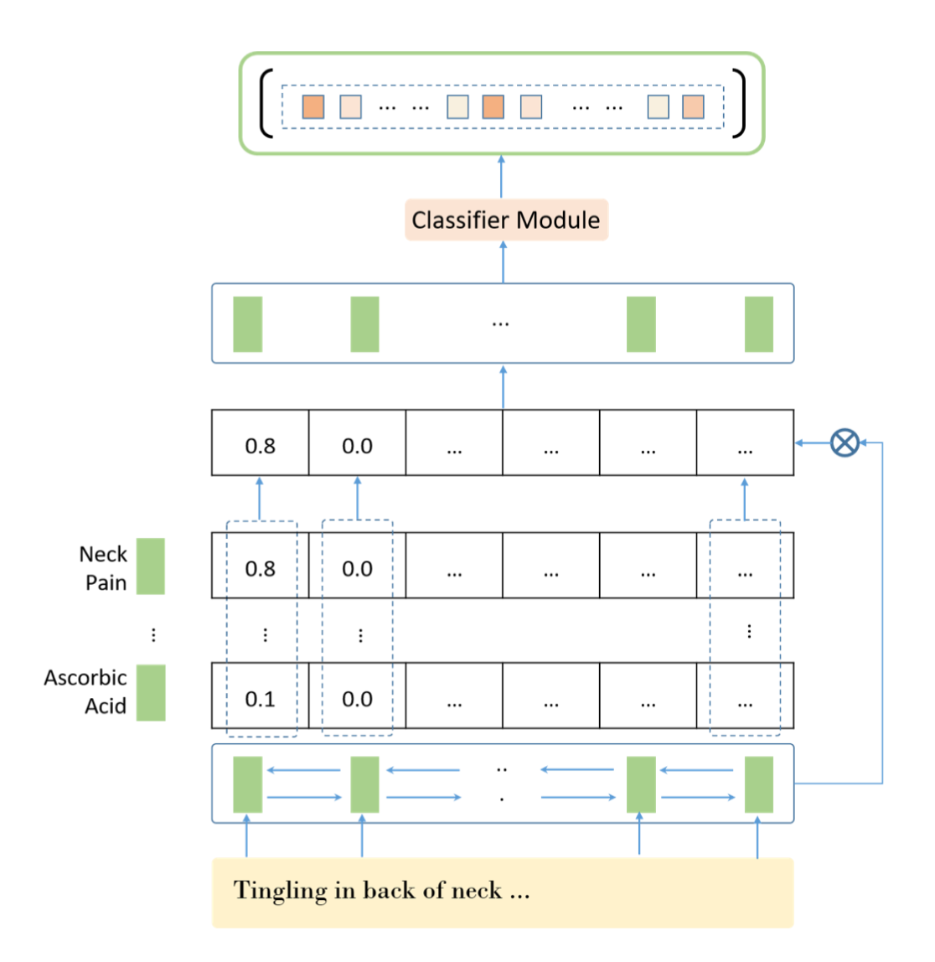
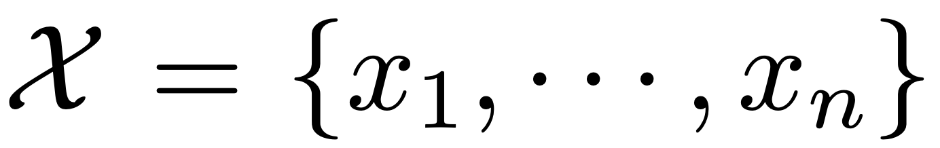
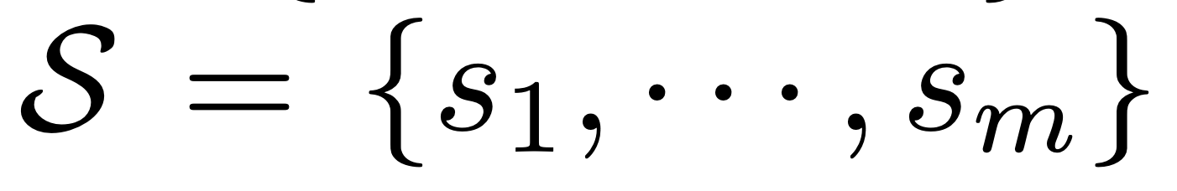
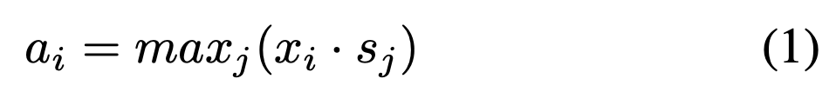
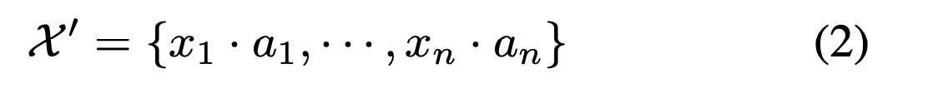
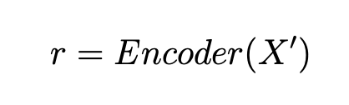
Approach Label-embedding Attentive Model
Shi X, Hu H, Che W, et al. Understanding Medical Conversations with Scattered Keyword Attention and Weak Supervision from Responses[C]//AAAI. 2020: 8838-8845.

Slide 6
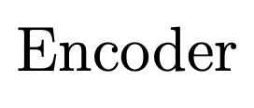

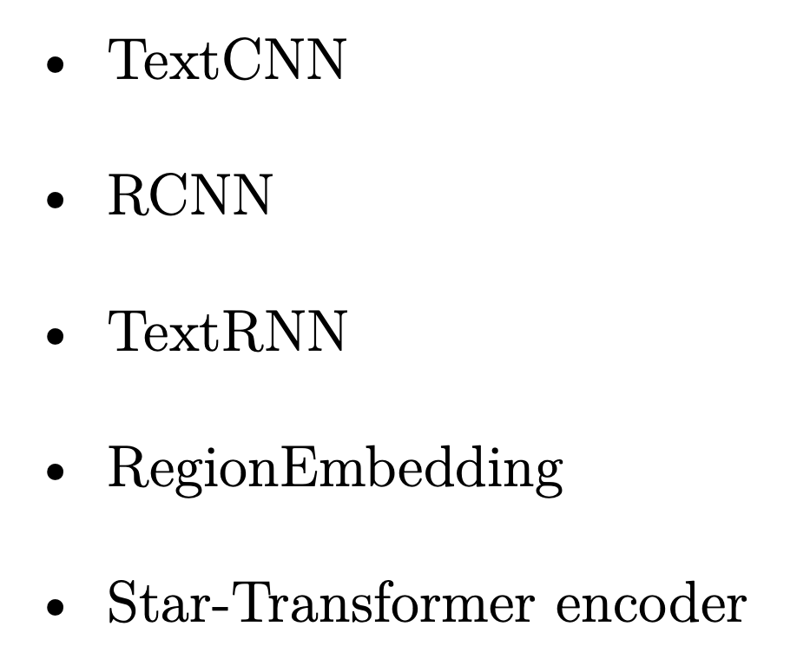
Approach Label-embedding Attentive Model
Shi X, Hu H, Che W, et al. Understanding Medical Conversations with Scattered Keyword Attention and Weak Supervision from Responses[C]//AAAI. 2020: 8838-8845.

Slide 7
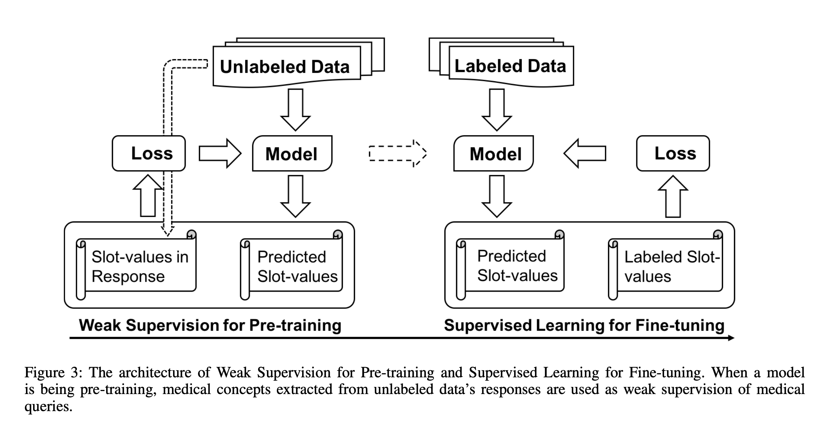
Approach Two Steps for Model Training
Shi X, Hu H, Che W, et al. Understanding Medical Conversations with Scattered Keyword Attention and Weak Supervision from Responses[C]//AAAI. 2020: 8838-8845.

Slide 8
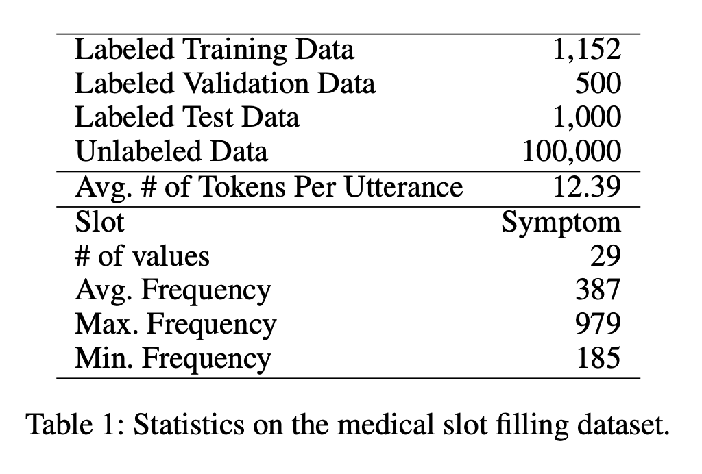
Experiment dataset
Training 1152
validation 500
Test 1000
Shi X, Hu H, Che W, et al. Understanding Medical Conversations with Scattered Keyword Attention and Weak Supervision from Responses[C]//AAAI. 2020: 8838-8845.

Slide 9
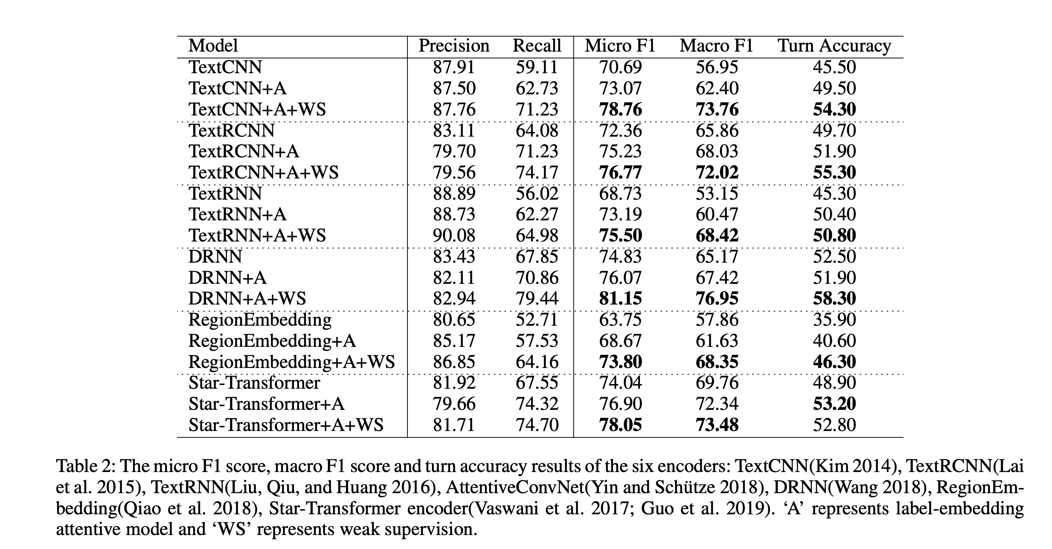
Experiment result
Shi X, Hu H, Che W, et al. Understanding Medical Conversations with Scattered Keyword Attention and Weak Supervision from Responses[C]//AAAI. 2020: 8838-8845.

Slide 10
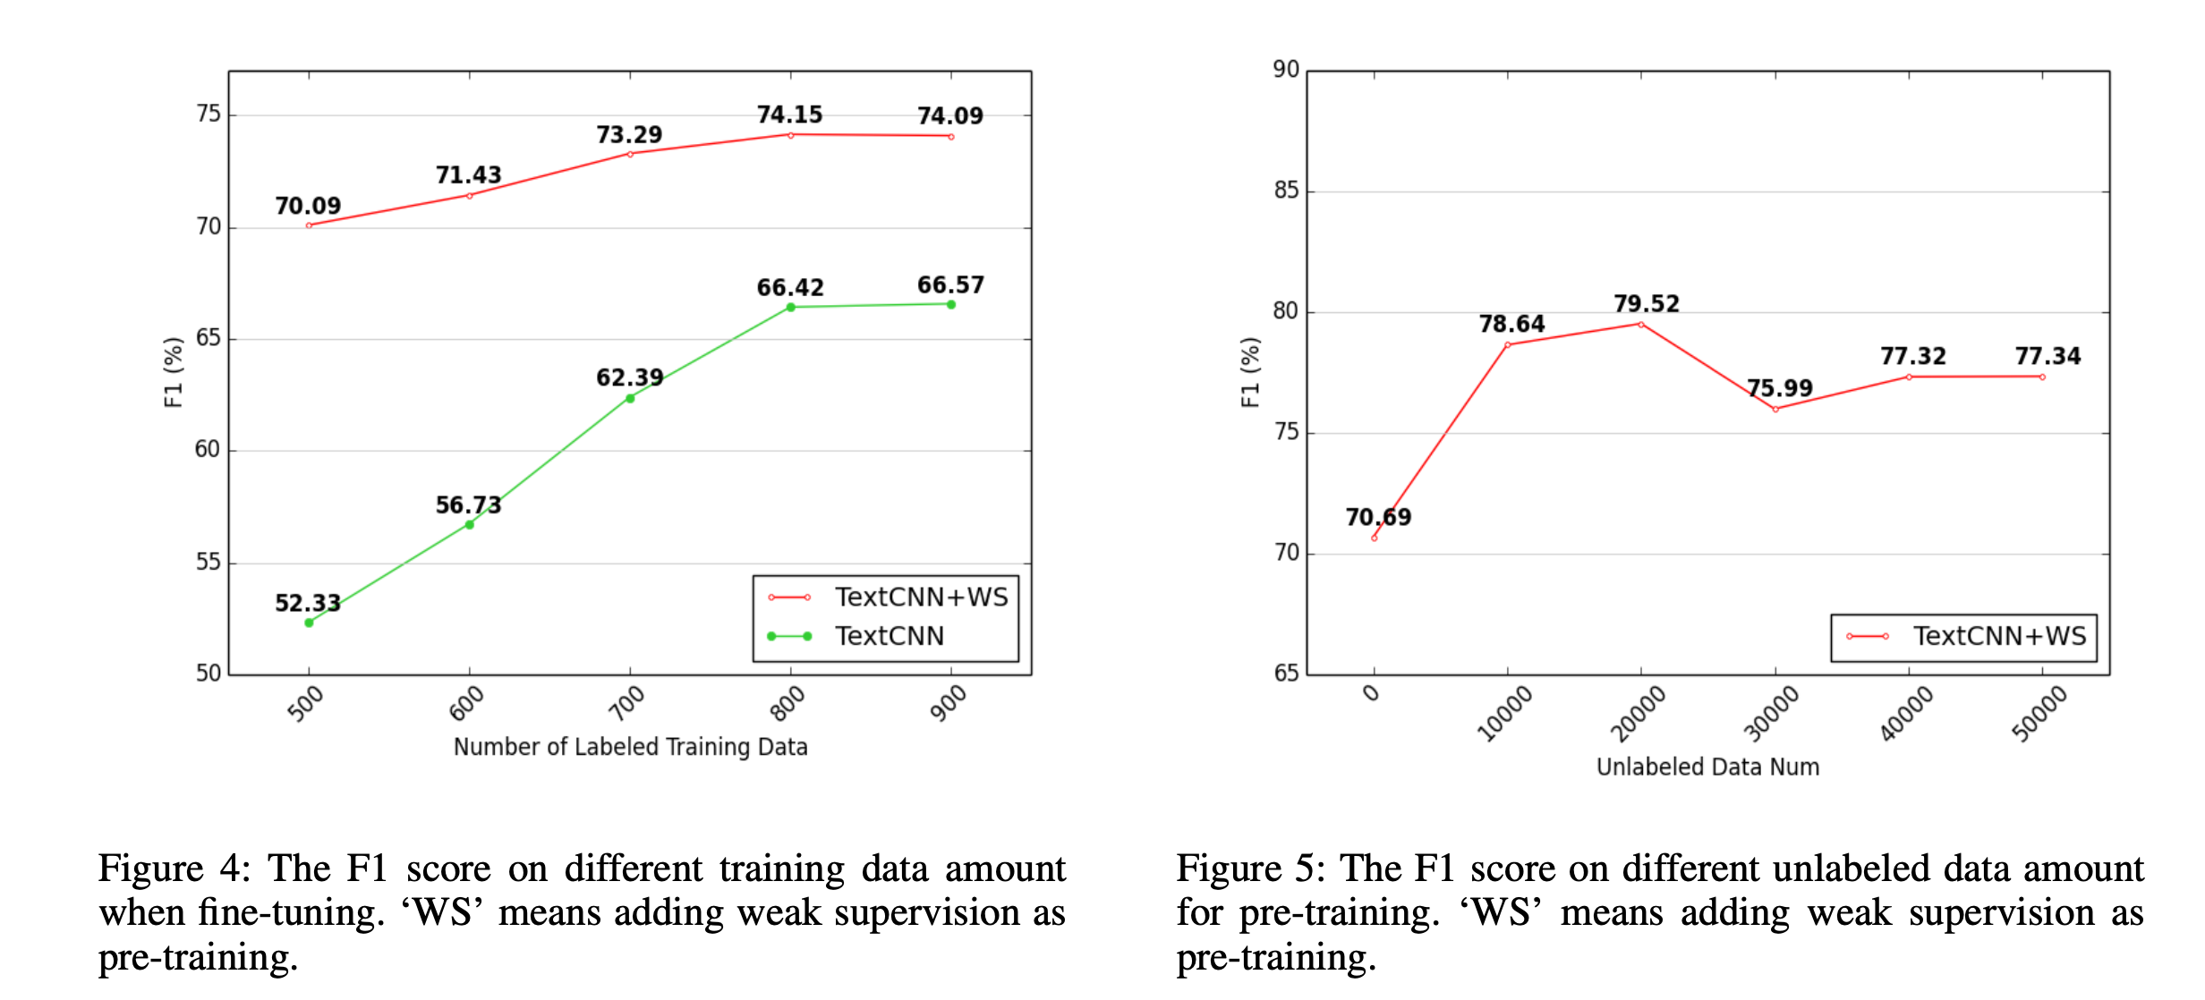
Experiment result
Shi X, Hu H, Che W, et al. Understanding Medical Conversations with Scattered Keyword Attention and Weak Supervision from Responses[C]//AAAI. 2020: 8838-8845.

Slide 11
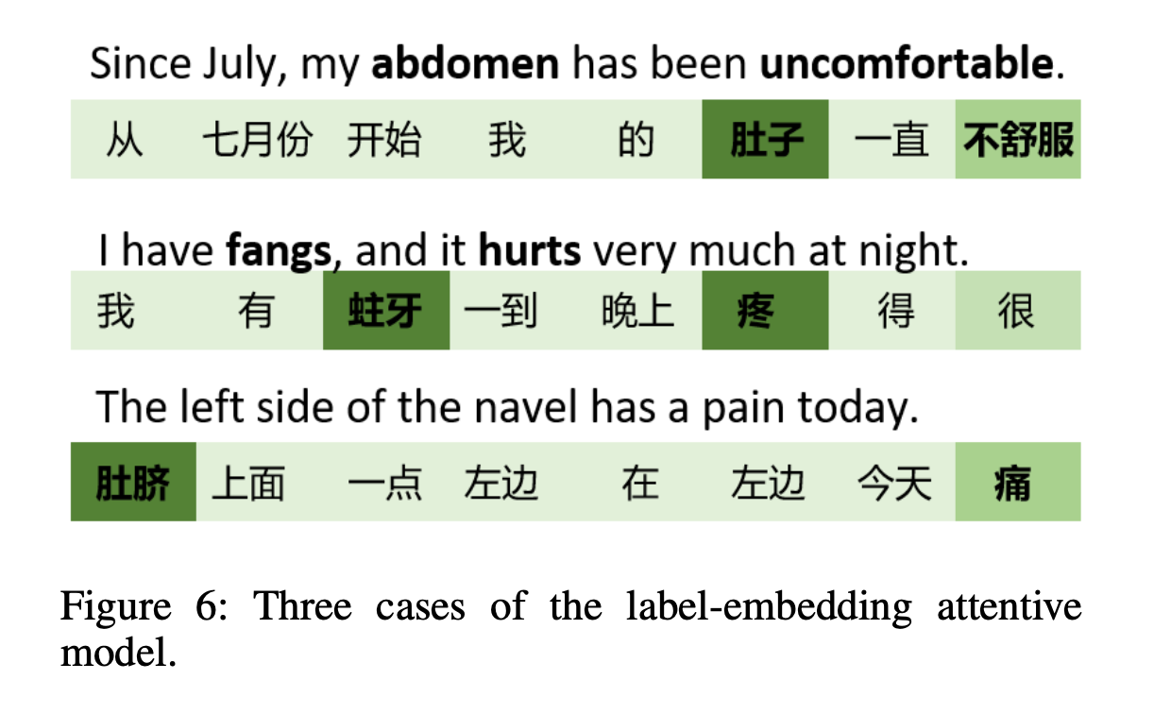
Experiment cases result
Shi X, Hu H, Che W, et al. Understanding Medical Conversations with Scattered Keyword Attention and Weak Supervision from Responses[C]//AAAI. 2020: 8838-8845.

Slide 12
Conclusion
We study medical slot filling and propose to use label-embedding attentive model and weak supervision from responses.
Experiments show that our method signifi- cantly improves the model’s performance.
Shi X, Hu H, Che W, et al. Understanding Medical Conversations with Scattered Keyword Attention and Weak Supervision from Responses[C]//AAAI. 2020: 8838-8845.

