Slide 1
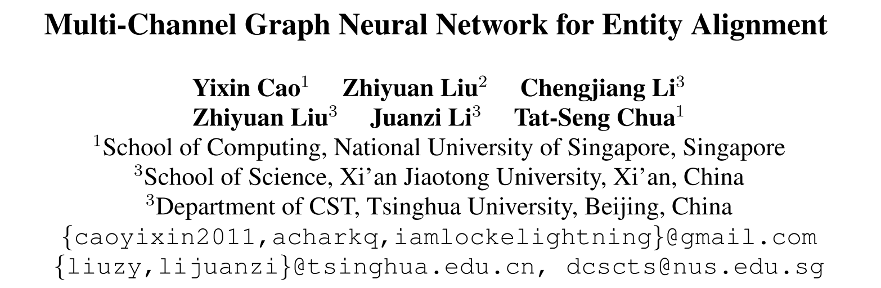
[ACL 2019]
51194501201
杨双吉

Slide 2
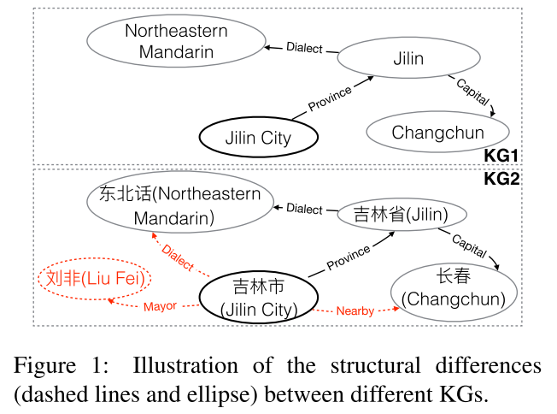
Entity alignment
In recent years, the dominated approach for entity alignment are embedding-based methods
Issue:
Heterogeneity of Structures
Limited Seed Alignments

Slide 3
Basic idea
complete missing relations
prune exclusive entities
complete the missing relations Dialect and Nearby in KG1, and filter out entity Liu Fei exclusive in KG2

Slide 4
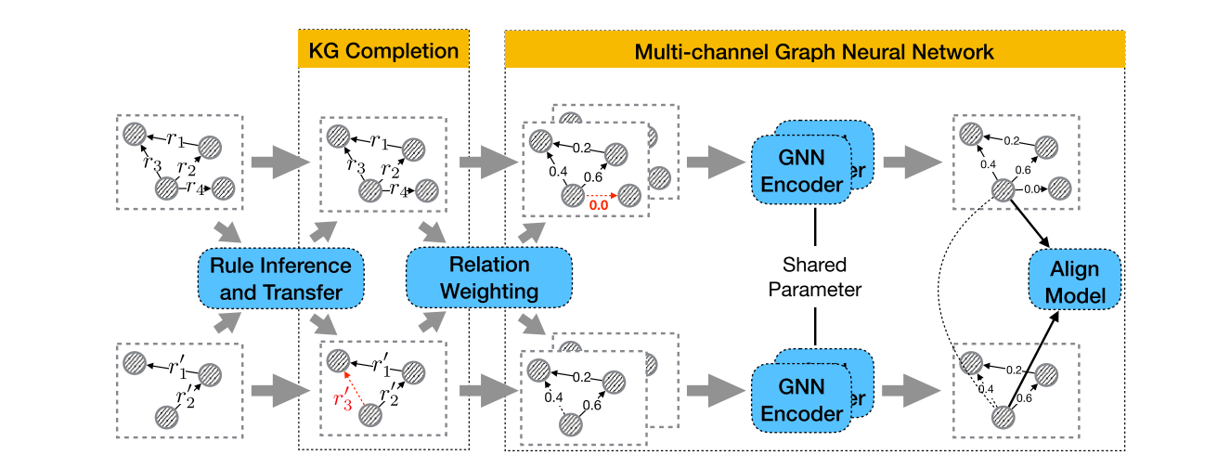
Model
Multi-channel Graph Neural Network model (MuGNN)
Framework
KG completion
Multi-channel Graph Neural Network

Slide 5
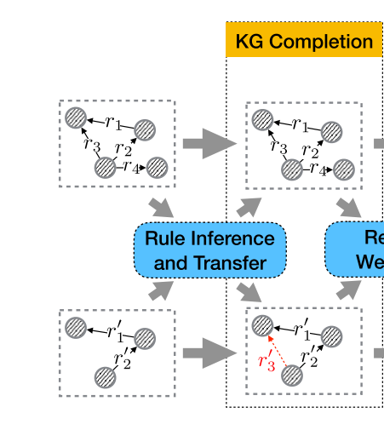

KG Completion
Rule Inference and Transfer
Rule Grounding

Slide 6
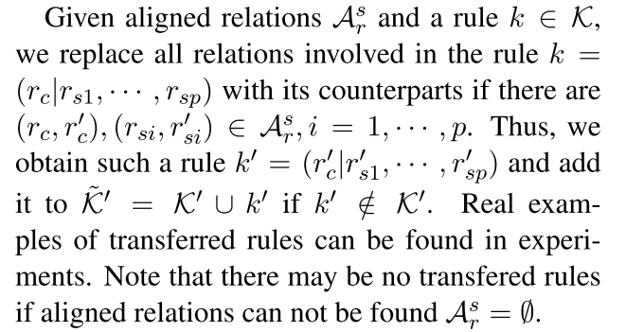
Rule Inference and Transfer
utilize AMIE+ to efficiently find Horn rules from large-scale KG, such as:
Knowledge Invariant Assumption:
Knowledge has universality no matter in which languages or domains.
AMIE+ (Gal´arraga et al., 2015. Fast rule mining in ontological knowledge bases with amie++)

Slide 7
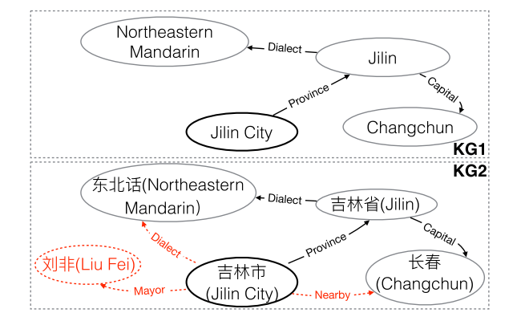
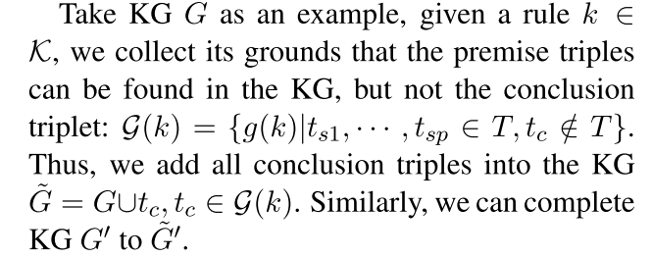


Rule Grounding
Rule:
suitable triplets:
new triplet：

Slide 8
Multi-Channel Graph Neural Network
Relation Weighting
KG Self-Attention
Cross-KG Attention
Multi-Channel GNN Encoder
Align Model

Slide 9



Relation Weighting
to generate weighted connectivity matrix A based on a graph G as the input structural features of GNN encoder
KG Self-Attention
Cross-KG Attention

Slide 10


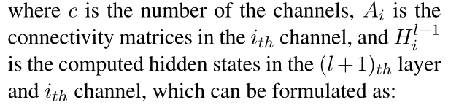

Multi-Channel GNN Encoder
Encoder defined as:
set i = 1, 2

Slide 11


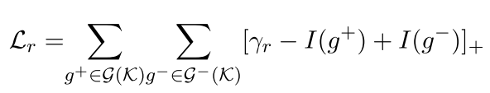


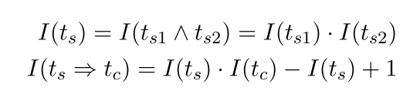


Align Model
The objective of the align model is:
Rule Knowledge Constraints
or
Overall loss:

Slide 12
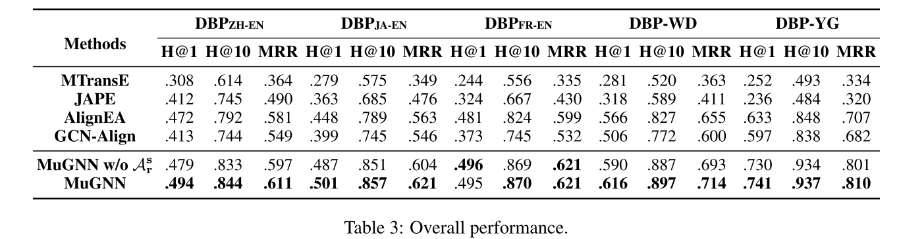
Experiment

Slide 13
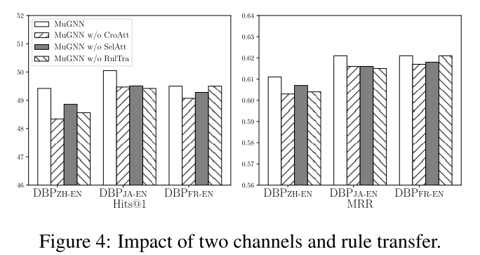
Analysis
Impact of Two Channels and Rule Transfer
the importance of utilizing cross-KG information for entity alignment
rule transfer also contributes much in performance

Slide 14
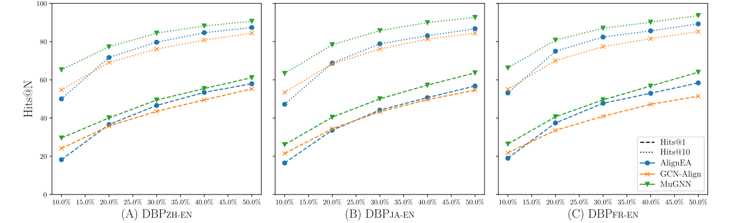
Analysis
Impact of Seed Alignments

Slide 15
Conclusions
propose a novel Multi-channel GNN model MuGNN that learns alignment-oriented embeddings by encoding graphs from different perspectives: completion and pruning, so as to be robust to structural differences.
propose to perform KG inference and alignment jointly, so that the heterogeneity of KGs are explicitly reconciled through completion by rule inference and transfer, and pruning via cross-KG attention.

