Slide 1
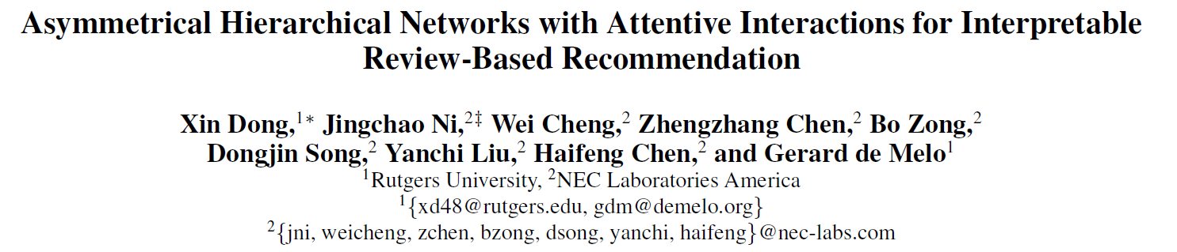
AAAI 2020
51194506001 班启敏

Slide 2
Motivation
Review-Based Recommendation：
using reviews to complement the sparse rating
reviews not only contain detailed aspects of an item , but also the sentiment of users towards these aspects
用户评论
用户表示
融合
评分预测
编码层
物品评论
物品表示
Existing methods typically merge all reviews of a given user or item into the same type of document,
and invoke the same model (or even a shared model) to process them in parallel.
用户评论
用户编码层
用户表示
融合
评分预测
物品评论
物品编码层
物品表示
set of reviews for a user is fundamentally different from the set of reviews for an item.
distinct forms of attention to be paid on user reviews as opposed to item reviews

Slide 3
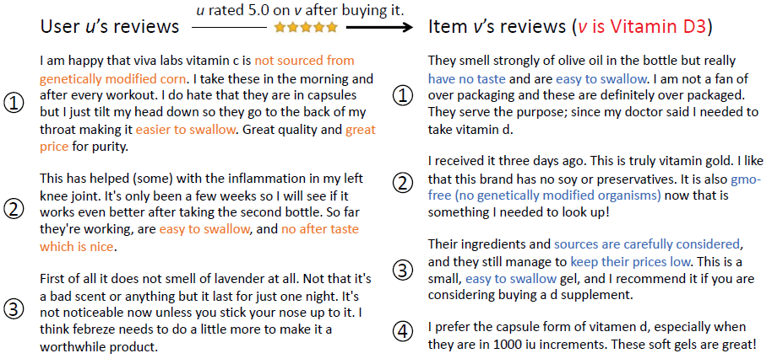
Motivation
Vitamin C
Review-Based Recommendation：
using reviews to complement the sparse rating
reviews not only contain detailed aspects of an item , but also the sentiment of users towards these aspects
Vitamin C
用户评论
用户表示
融合
Anti-inflammatory
medication
评分预测
编码层
物品评论
物品表示
air freshener
用户评论
用户编码层
用户表示
融合
评分预测
物品评论
物品编码层
物品表示
set of reviews for a user is fundamentally different from the set of reviews for an item.
distinct forms of attention to be paid on user reviews as opposed to item reviews

Slide 4
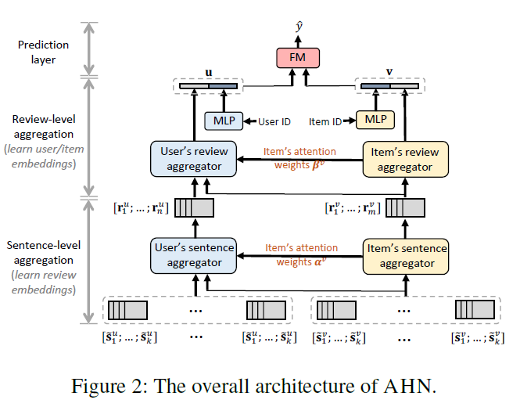
Model
Sentence Encoding
Sentence-Level Aggregation
Sentence Aggregator for Items
Sentence Aggregator for Users
Review-Level Aggregation
Review Aggregator for Items
Review Aggregator for Users
Encoding Latent Rating Patterns
Prediction Layer

Slide 5



Model
Sentence Encoding
transform each sentence (in each review) from a sequence of discrete word tokens to a continuous vector embedding

Slide 6





Model
Sentence-Level Aggregation
Sentence Aggregator for Items
Sentence Aggregator for Users

Slide 7





Model
Review-Level Aggregation
Review Aggregator for Items
Review Aggregator for Users

Slide 8


Model
Encoding Latent Rating Patterns
Prediction Layer
Loss function

Slide 9
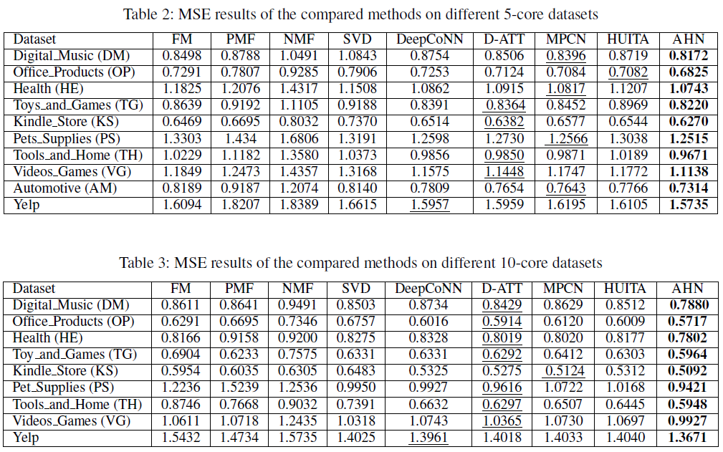
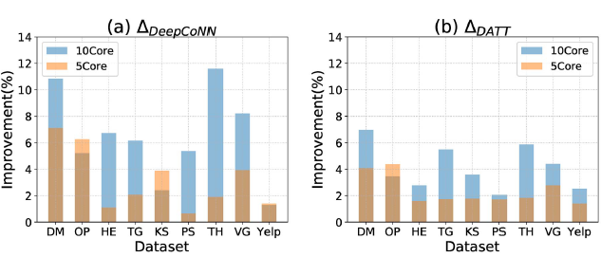
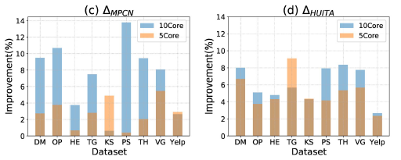
Experiments

Slide 10
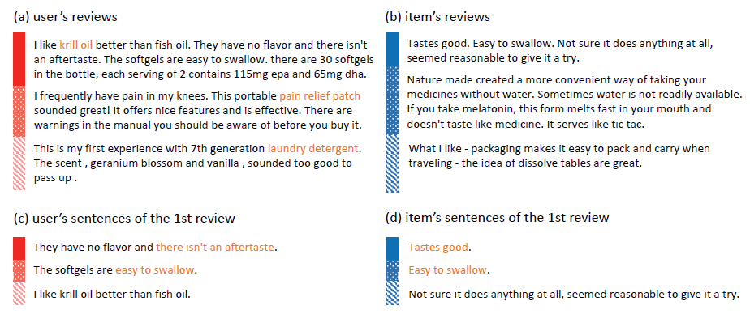
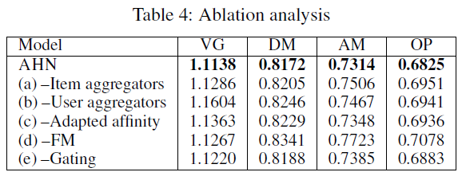
Experiments

Slide 11
Conclusions
propose a flexible neural architecture, AHN, which is characterized by its asymmetric attentive modules for distinguishing the learning of user embeddings and item embeddings from reviews
by hierarchical paradigm to extract fine-grained signals from sentences and reviews.
Extensive experimental results on datasets from different domains demonstrate the effectiveness and interpretability of our method.

Slide 12
THANKS

