Slide 1
ETC: Encoding Long and Structured Inputs in Transformers
Joshua Ainslie, Santiago Onta˜n´on, Chris Alberti, Vaclav Cvicek,
Zachary Fisher, Philip Pham, Anirudh Ravula, Sumit Sanghai, Qifan Wang, Li Yang
Google Research
蔡丽

Slide 2
Motivation
BERT/Transformers: state-of-the-art results in understanding text (up to 512 tokens).
Potential applications:
Classifying or extracting from whole documents(or web pages)
Question answering with long or multiple contexts
Encoding “objects” that are associated with a large set of documents
Moreover, some of these inputs might be more than “flat” sequences
Can we directly encode much larger context?
Can we encode their nesting/hierarchy or graph relationships?

Slide 3
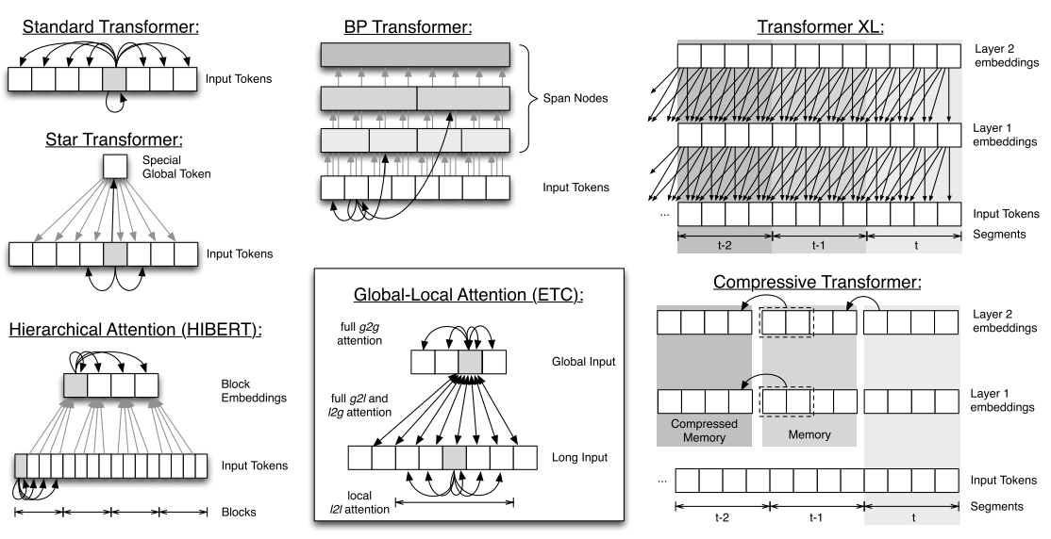
Related work

Slide 4
ETC（Extended Transformer Construction）
Global-Local attention
Input tokens divided into two sets
Global: can attend to all input tokens
Long: can only locally attend to nearby tokens
Related to Longformer [1]
Relative position representations[2]
Allow encoding arbitrary structure relations between input tokens.
Contrastive Predictive Coding(CPC)[3]
Pre-training objective that helps the model learn how to use global summary tokens.

Slide 5
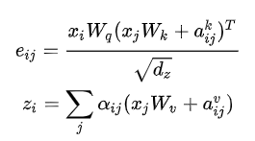
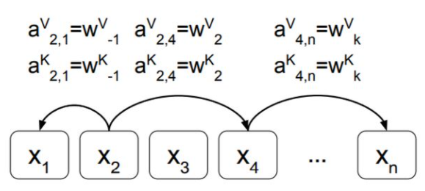
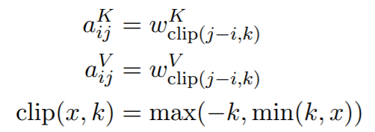
RPP：Relative Position Representations

Slide 6
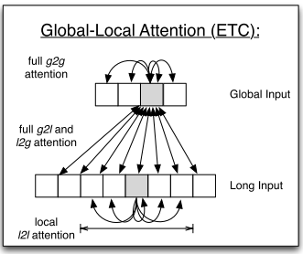
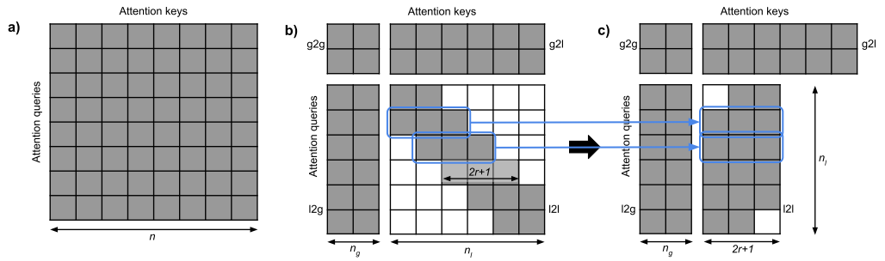
Global-Local attention

Slide 7

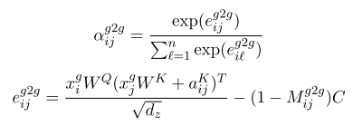
Global-Local attention
以g2g为例：

Slide 8
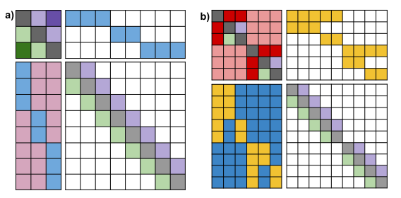
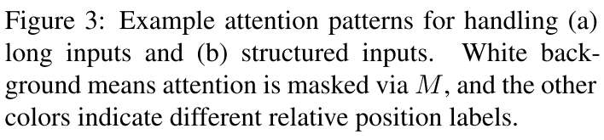
long inputs & structured input

Slide 9
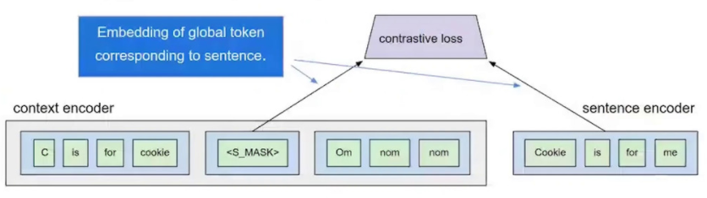
Pre-training
MLM(Masked Language Model)
Whole word masking
CPC(Contrastive Predictive Coding)

Slide 10
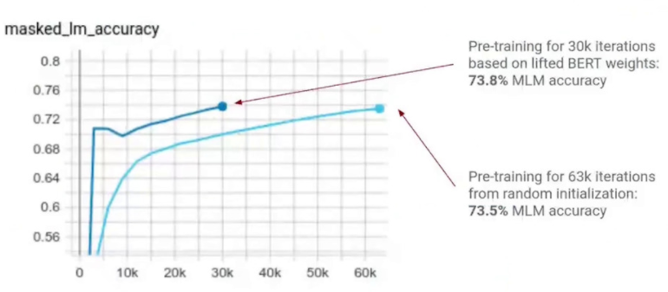
Pre-training from lifted BERT weights vs. from scratch

Slide 11
Technique Summary
Long inputs encoded by ETC global-local attention
Structured inputs encoded by:
Relative position representations
Flexible masking
CPC pre-training task for hierarchical global tokens
Lifting from BERT/RoBERTa to speed up pre-training

Slide 12
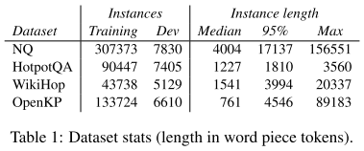
Experiments
Datasets
Question answering
Natural Questions(NQ)
HotpotQA
WikiHop
Keyphrase extraction
OpenKP
Pre-trained using BERT configuration
Fine-tuned in each dataset separately

Slide 13
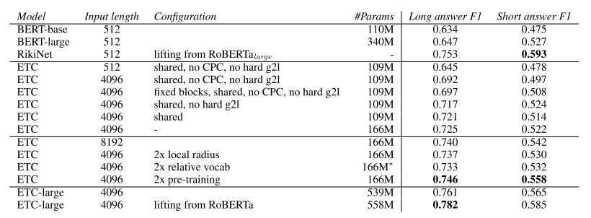
Natural Questions(NQ)

Slide 14
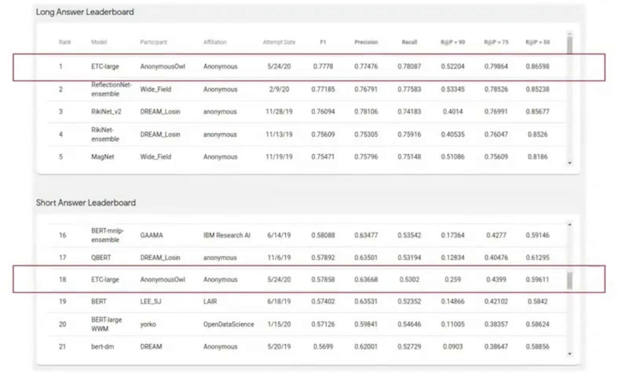
NQ-Leaderboard

Slide 15
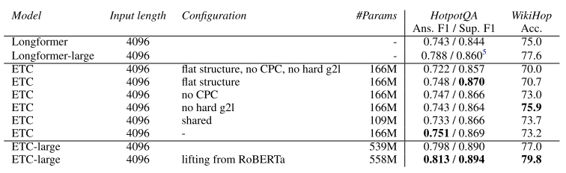
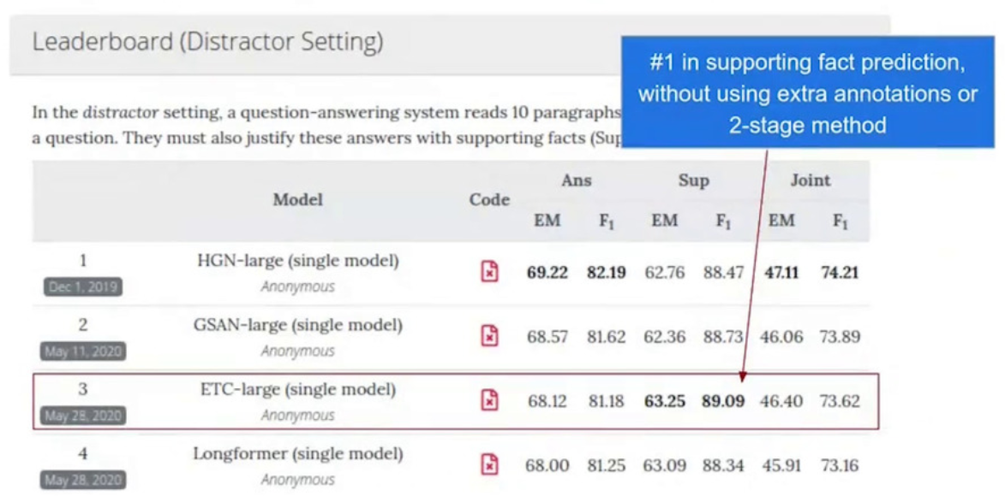
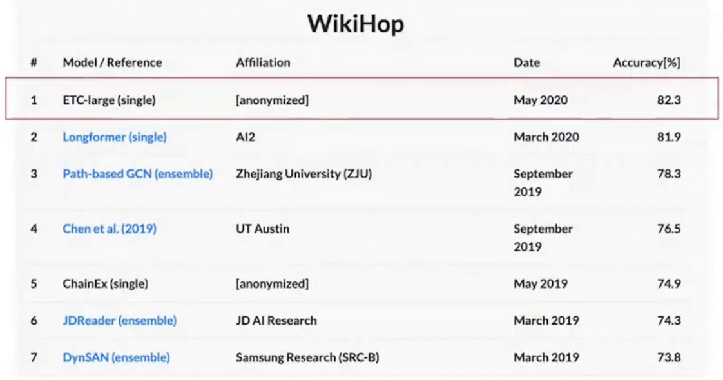
HotpotQA & WikiHop
https://hotpotqa.github.io/
http://qangaroo.cs.ucl.ac.uk/leaderboard.html

Slide 16
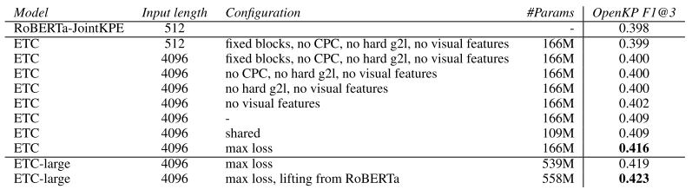
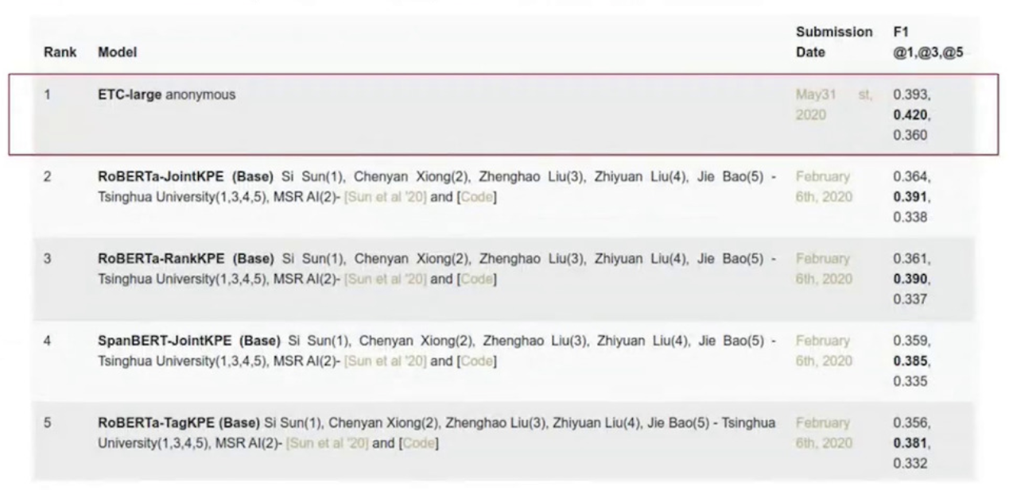
OpenKP(Web Page Key Phrase Extraction)
https://microsoft.github.io/msmarco/

Slide 17
Conclusions
ETC(Extended Transformer Construction)
Long inputs
Up to ~22k tokens for BERT-base setting(on v3 TPUs)
Up to 8k tokens for BERT-large setting(on v3 TPUs)
Structured inputs
State-of-the-art results in many challenging NLP benchmarks
Core ideas
global-local attention
Relative position representations
CPC pre-training task
Further related work
BigBird

Slide 18
Longformer: The Long-Document Transformer
Iz Beltagy∗ Matthew E. Peters∗ Arman Cohan∗
Allen Institute for Artificial Intelligence, Seattle, WA, USA

Slide 19
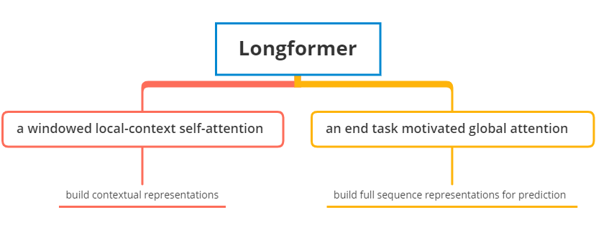
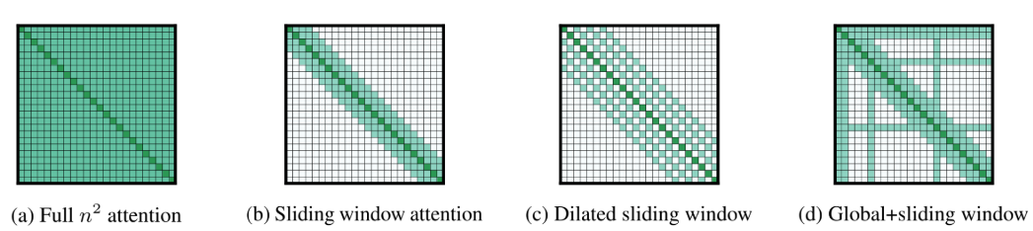
Contributions
Notes:
哪些地方要做global attention? 根据具体任务来定。分类任务[CLS]，QA任务：所有问题的tokens。

Slide 20
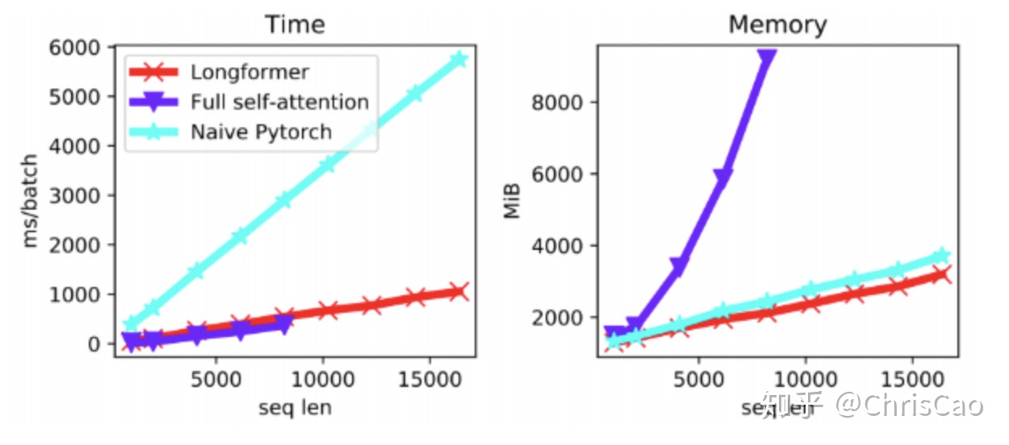
CUDA kernel

Slide 21
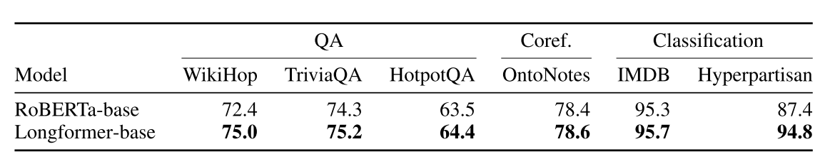
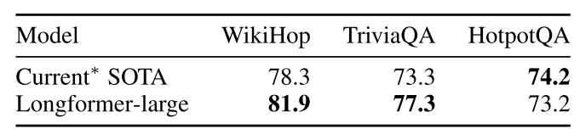
Experiments

Slide 22
Big Bird: Transformers for Longer Sequences
Manzil Zaheer, Guru Guruganesh, Avinava Dubey,Joshua Ainslie, Chris Alberti, Santiago Ontanon, Philip Pham, Anirudh Ravula, Qifan Wang, Li Yang, Amr Ahmed
Google Research

Slide 23
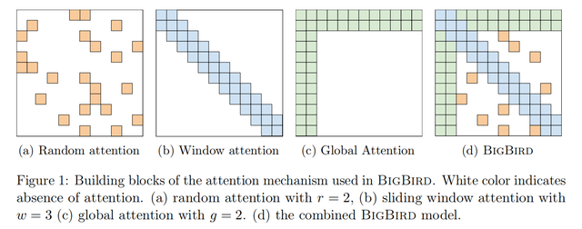
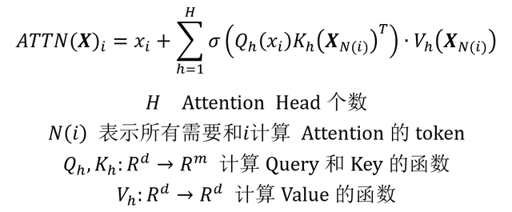
Contributions

Slide 24
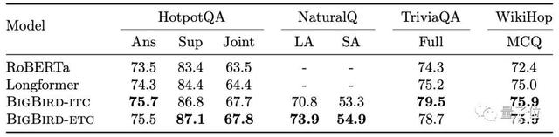
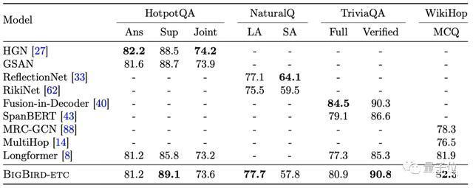
Experiments--QA
模型微调后：

Slide 25
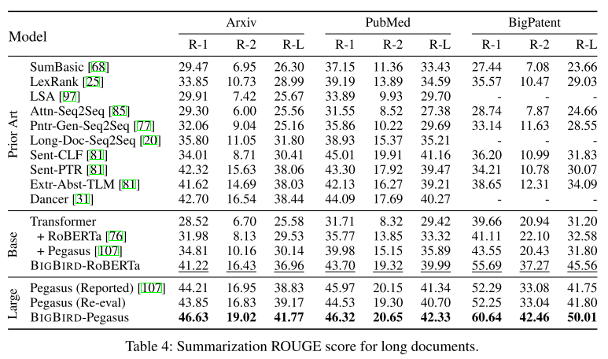
Experiments--Summarization
Notes:
S2S

Slide 26
Thank you!

