Slide 1
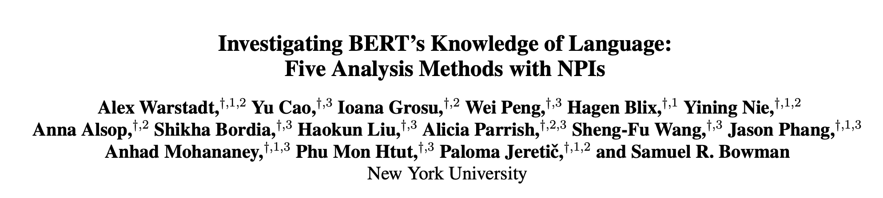
51194506082 孙宇翔
Notes:
有保证的
斯坦福大学

Slide 2
Overview
Motivation
NPIs & Data
Methods
Result
Conclusion
Notes:
问题小众

Slide 3
Motivation
Recent sentence representation models have attained state-of-the-art results on language understanding tasks, but standard methodology for evaluating their knowledge of grammar has been slower to emerge.
Recent work evaluating grammatical knowledge of sentence encoders like BERT (Devlin et al., 2018) has employed a variety of methods. The author has not yet seen any substantial direct comparison between these methods, and it is not yet clear whether they tend to yield similar conclusions about what a given model knows.
Notes:
尽管语病，不通顺，语义不变

Slide 4
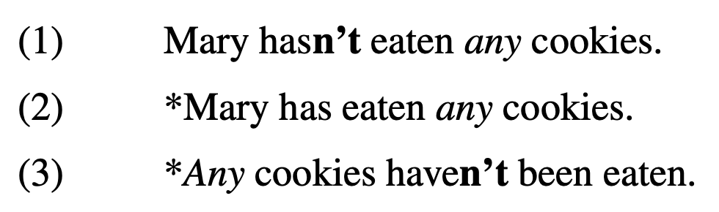
NIPS
NPI-related Boolean meta-data variable
The Licensor feature indicates whether an NPI licensor is present in the sentence.
The NPI feature indicates whether an NPI is in the sentence or if it is substituted by an NPI re-placement with similar structural distribution
The Scope feature indicates whether the NPI/NPI replacement is within the scope of the licensor/licensor replacement.
Notes:
一些简单公式定义， 怎么找这个超集呢
波浪 tilde

Slide 5
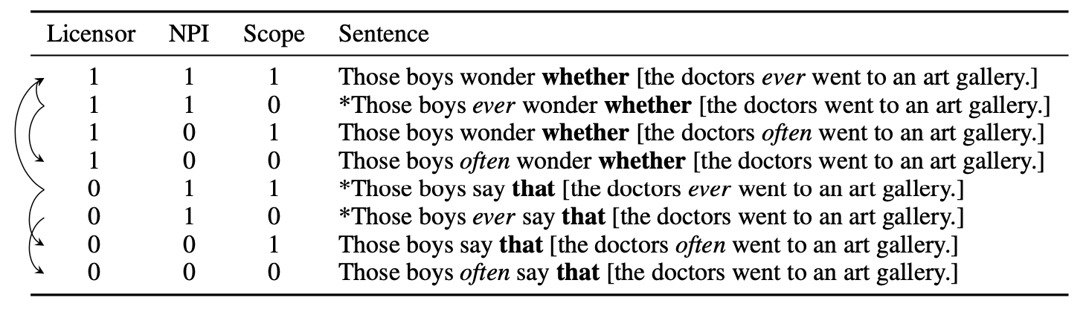
NIPS (Minimal Pair)
Minimal Pair: Two sentences form a minimal pair if they differ in only one NPI-related Boolean
meta-data variable within a paradigm, but have different acceptability.
Notes:
相关工作是Deepmind, 后有一篇中ICCV 19
每个神经元多一个区间信息

Slide 6
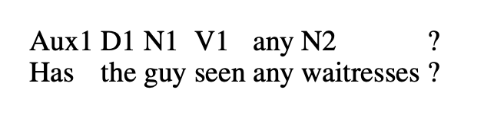
Data
words were sampled from a vocabulary of over 1000 lexical items annotated with 30 syntactic, morphological, and semantic features
Notes:
相关工作是Deepmind, 后有一篇中ICCV 19
每个神经元多一个区间信息

Slide 7
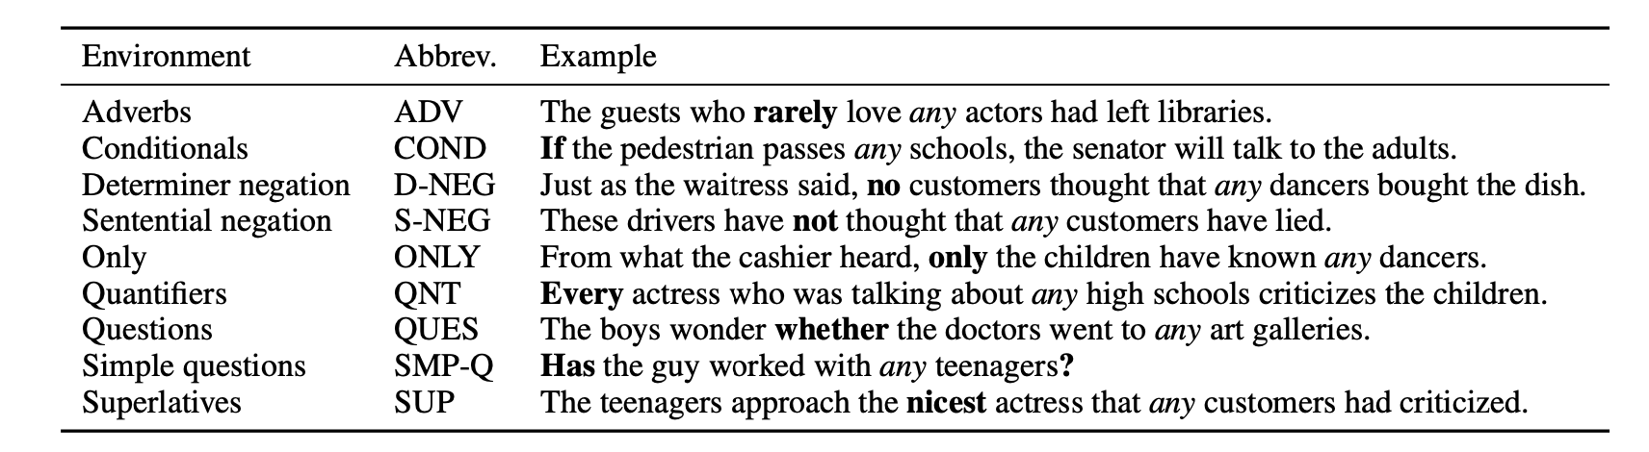
Data
Notes:
相关工作是Deepmind, 后有一篇中ICCV 19
每个神经元多一个区间信息

Slide 8
Methods
1. Boolean Acceptability
The author tests the model’s ability to judge the grammatical acceptability of the sentences in the NPI
dataset. Following standards in linguistics, sentences for this task are assumed to be either totally
acceptable or totally unacceptable.
2. Absolute Minimal Pair
Two sentences form a minimal pair if they differ in only one NPI-related Boolean meta-data variable within a paradigm, but have different acceptability.
Notes:
相关工作是Deepmind, 后有一篇中ICCV 19
每个神经元多一个区间信息

Slide 9
Methods
3. Gradient Minimal Pair
The author counts a pair as correctly classified as long as the Boolean classifier’s output for the acceptable
class is higher for the acceptable sentence than for the unacceptable sentence.
4. Cloze Test
The minimal pairs tested are a subset of those in the absolute and gradient minimal pair experiments, where both sentences must be equal in length and differ in only one token. This differing token is replaced with [MASK], and the minimal pair is taken to be classified correctly if the MLM assigns a higher probability to the token from the acceptable sentence.
Notes:
相关工作是Deepmind, 后有一篇中ICCV 19
每个神经元多一个区间信息

Slide 10
Methods
5. Feature Probing
The author freezed the sentence encoders both with and without fine-tuning from the acceptability judgment
experiments and train lightweight classifiers on top of them to predict meta-data labels corresponding
to the key properties a model must learn in order to judge the acceptability of NPI sentences.
Notes:
相关工作是Deepmind, 后有一篇中ICCV 19
每个神经元多一个区间信息

Slide 11
Experimental Settings
Model
1. GloVe BoW: a bag-of-words baseline obtained by max-pooling of 840B tokens 300-dimensional GloVe word embeddings
2. BERT: the cased version of BERT-large model
3. BERT→MNLI: BERT fine-tuned on the Multi-Genre Natural Language Inference corpus
4. BERT→CCG: BERT fine-tuned on Combinatory Categorial Grammar Bank corpus
Evaluation standard
Matthews Correlation Coefficient (MCC)
Notes:
相关工作是Deepmind, 后有一篇中ICCV 19
每个神经元多一个区间信息

Slide 12
Experimental Settings
Training-Evaluation Configurations
CoLA: training on CoLA, evaluating on the environment
1 NPI: training and evaluating on the same NPI environment.
Avg Other NPI: training independently on every NPI environment except one, averaged over the evaluation results on that environment.
All-but-1 NPI: training on all environments except for one environment, evaluating on that environment.
All NPI: training on all environments, evaluating on the environment.
Notes:
相关工作是Deepmind, 后有一篇中ICCV 19
每个神经元多一个区间信息

Slide 13
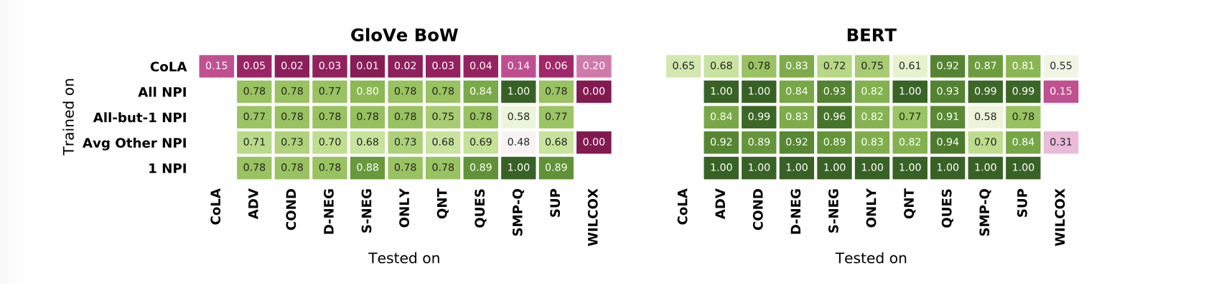
Result (Boolean Acceptability)
Notes:
相关工作是Deepmind, 后有一篇中ICCV 19
每个神经元多一个区间信息

Slide 14
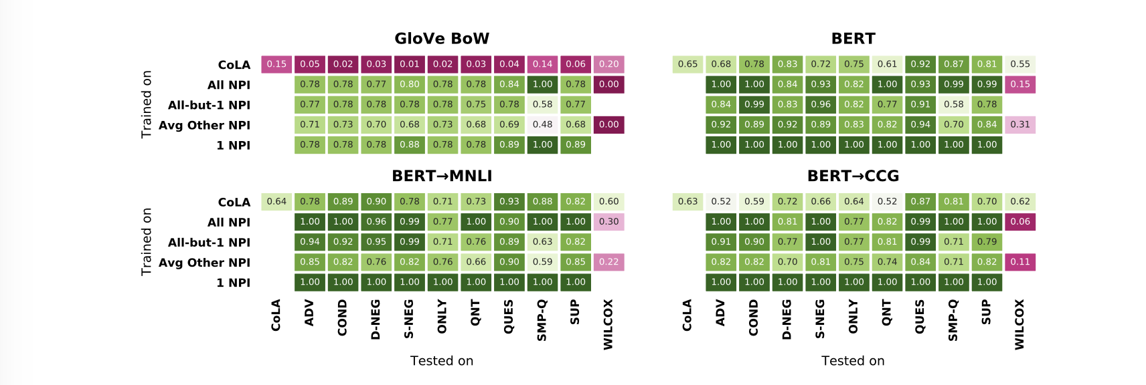
Result (Boolean Acceptability)
Notes:
相关工作是Deepmind, 后有一篇中ICCV 19
每个神经元多一个区间信息

Slide 15
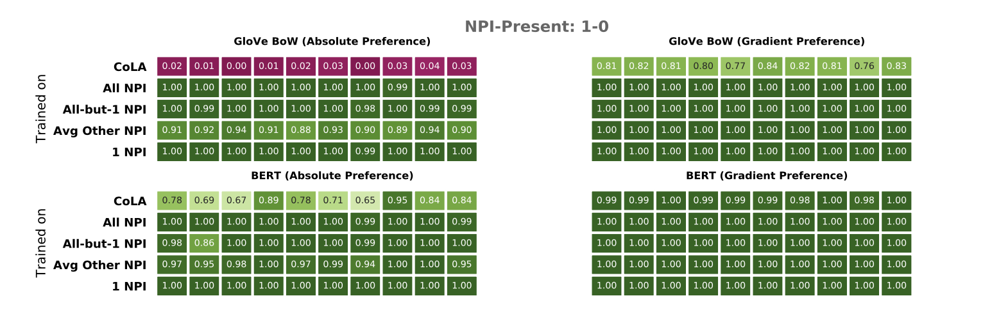
Result (Absolute Minimal Pair & Gradient Minimal Pair)
Notes:
相关工作是Deepmind, 后有一篇中ICCV 19
每个神经元多一个区间信息

Slide 16
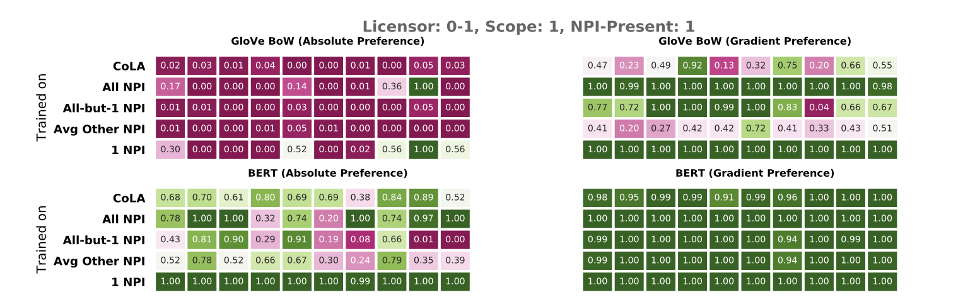
Result (Absolute Minimal Pair & Gradient Minimal Pair)
Notes:
相关工作是Deepmind, 后有一篇中ICCV 19
每个神经元多一个区间信息

Slide 17
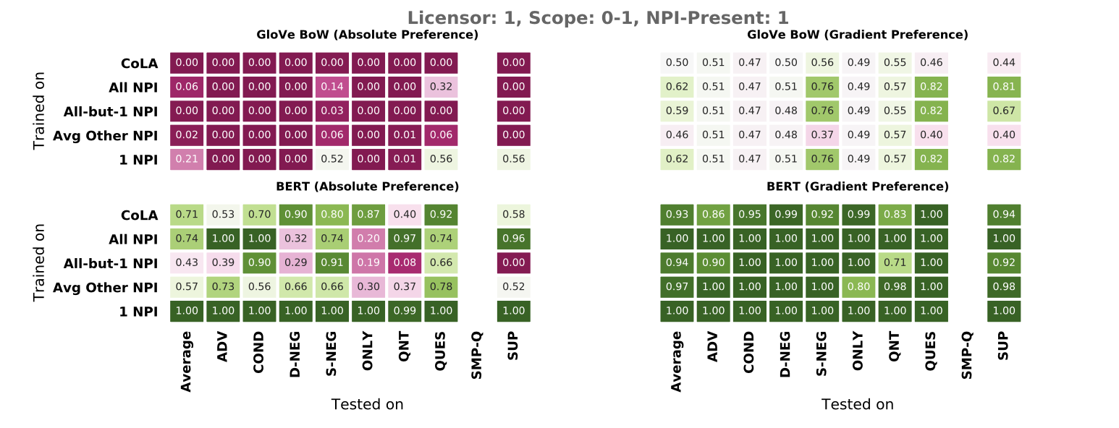
Result (Absolute Minimal Pair & Gradient Minimal Pair)
Notes:
相关工作是Deepmind, 后有一篇中ICCV 19
每个神经元多一个区间信息

Slide 18
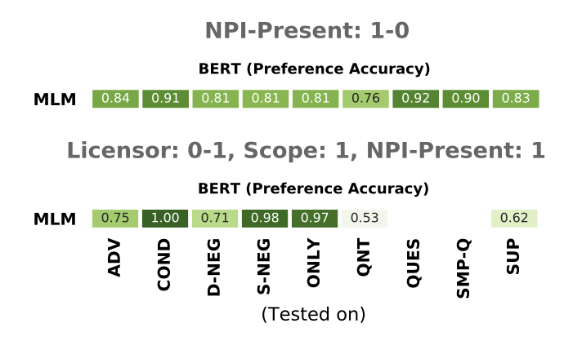
Result (Cloze Test)
Notes:
相关工作是Deepmind, 后有一篇中ICCV 19
每个神经元多一个区间信息

Slide 19
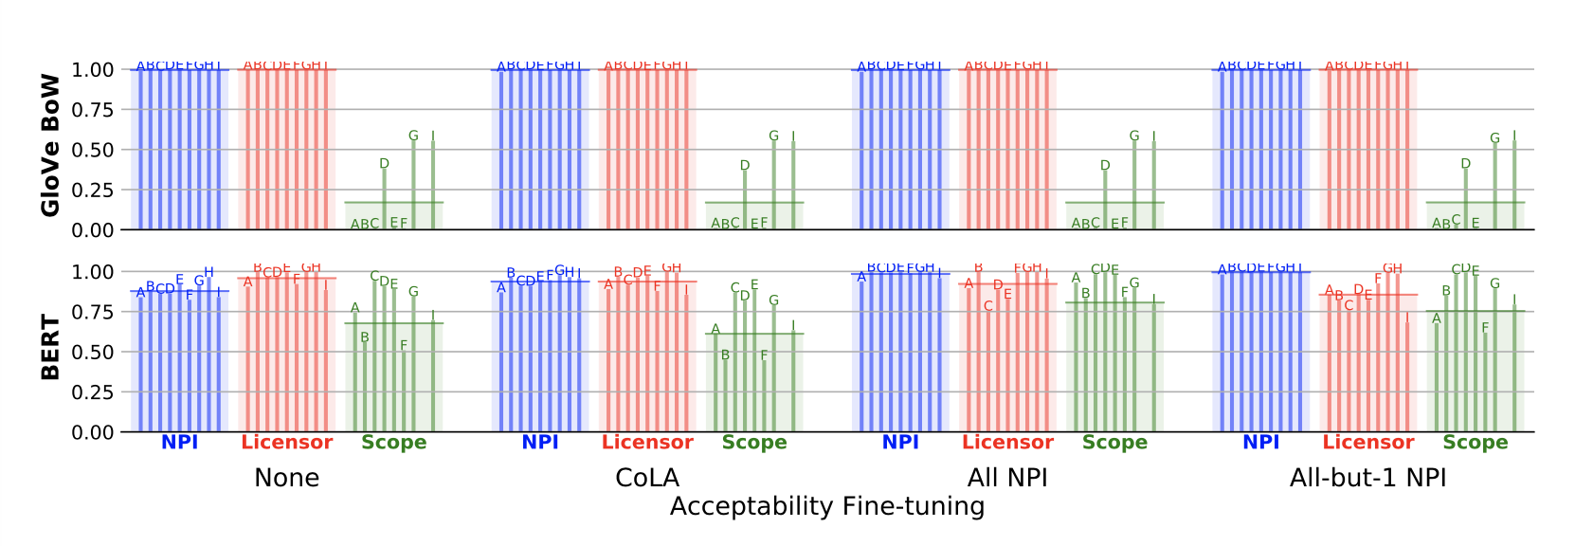
Result (Feature Probing)
Notes:
相关工作是Deepmind, 后有一篇中ICCV 19
每个神经元多一个区间信息

Slide 20
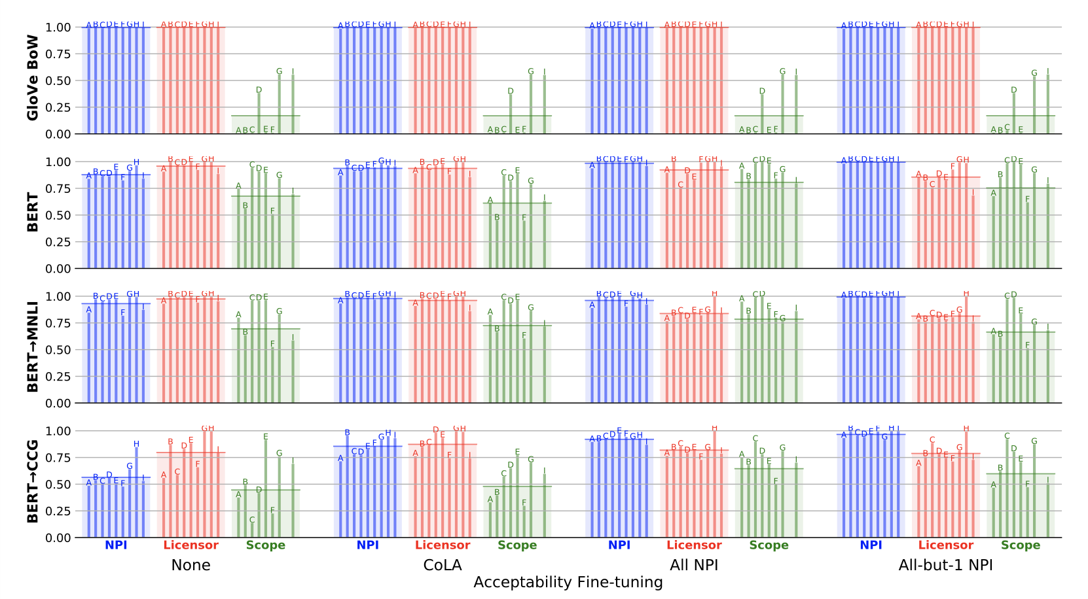
Result (Feature Probing)
Notes:
相关工作是Deepmind, 后有一篇中ICCV 19
每个神经元多一个区间信息

Slide 21
Conclusion
By considering results from several evaluation methods, the author demonstrates that BERT has systematic knowledge of NPI licensing
Future studies would benefit from employing a variety of different methodologies for assessing model performance within a specified domain.
This knowledge is unequal across the different features relevant to this phenomenon, and does not reflect the Boolean effect that these features have on acceptability.
Notes:
相关工作是Deepmind, 后有一篇中ICCV 19
每个神经元多一个区间信息

