Slide 1
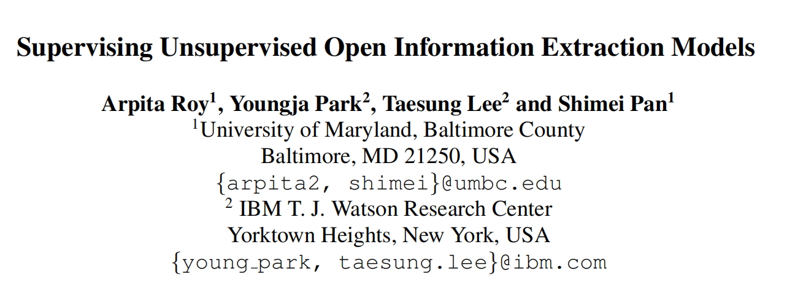
空白演示
单击输入您的封面副标题
EMNLP-2019
汇报人：胡楠
学号：51194501046
Roy, Arpita & Park, Youngja & Lee, Taesung & Pan, Shimei. (2019). Supervising Unsupervised Open Information Extraction Models. 728-737. 10.18653/v1/D19-1067.

Slide 2
RE简介
motivation
methods
experiment

Slide 3
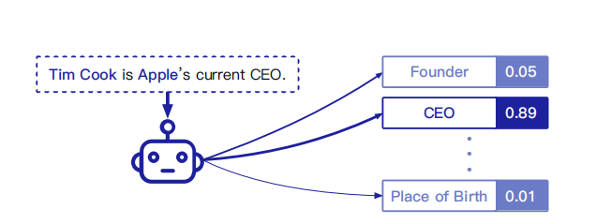
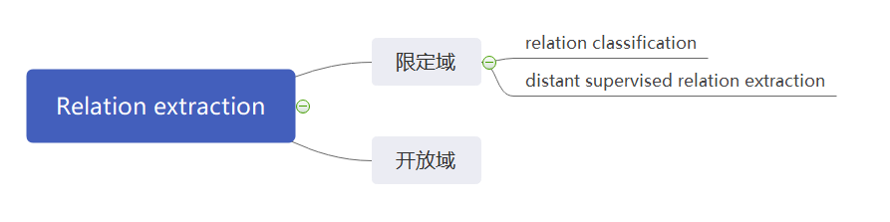
RE简介
More Data, More Relations, More Context and More Openness: A Review and Outlook for Relation Extraction

Slide 4
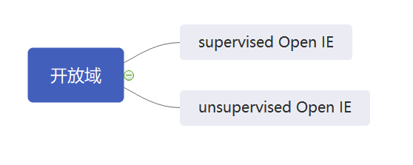
RE简介
goal： extract a set of relation tuples T from S
T consists tuples<e1,r,e2>
S is a sentence
We frame this task as a sequence tagging, and the model annotates each word in the sentence to E1, E2, R or O (EOR tags).
Supervised Open Information Extraction

Slide 5
some problem in supervised RE
First, supervised IE relies heavily on labeled training data. Since manual relation annotation is very expensive, this method does not scale to a large number of relations and is very dif- ficult to adapt to new domains
Second, supervised IE systems require the target relations to be predetermined and learn to extract only the predefined relations
In contrast, Open IE operates in a completely domain-independent manner and is suitable when the target relations are not known in advance

Slide 6
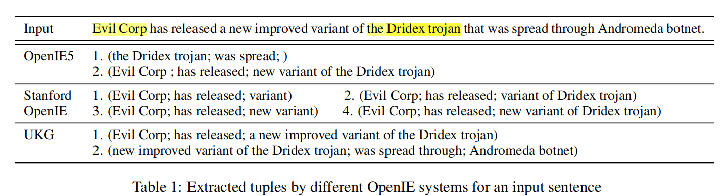
motivation
This observation motivates us to explore an ensemble model which can learn from multiple existing Open IE systems which performs better than the underlying systems.

Slide 7
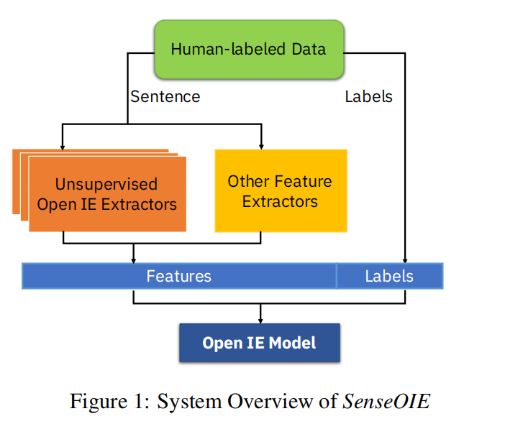
空白演示
methods
单击输入您的封面副标题

Slide 8
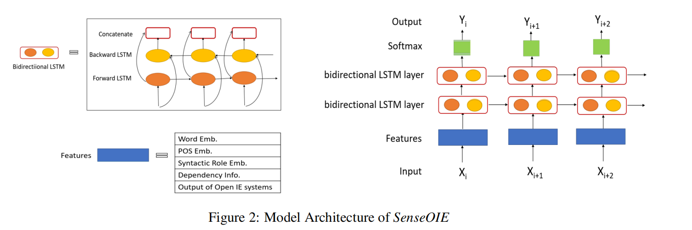
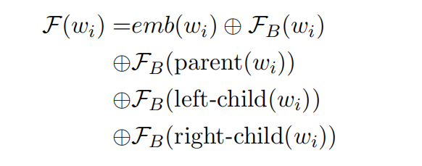
methods

Slide 9
experiments
Baselines：
RnnOIE（supervised）is the first supervised model built for Open IE
Stanford Open IE（unsupervised）is heavily based on dependency parsers.
OpenIE 5（unsupervised）is a combination of four Open IE systems
UKG（unsupervised）It extracts verbal binary relations based on noun phrase detection, named entity recognition, dependency parsing

Slide 10
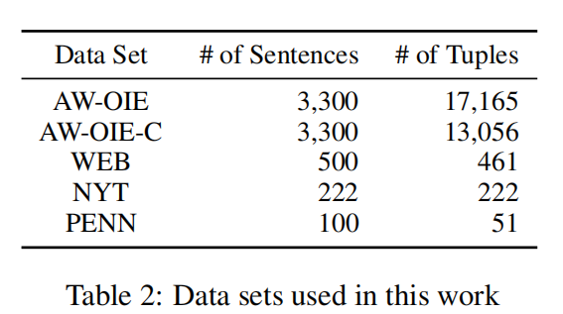
experiments
AW-OIE
This dataset is the largest dataset available for supervised open information extraction.
WEB
This contains many incomplete and grammatically unsound sentences
NYT
contains formal, well written news stories from the New York Times Corpus.
We use AW-OIE-C for training and testing purpose and other three datasets only for testing

Slide 11
experiments
metric：
precision, recall and F1-score
two-level：
word：For each word, we match the tag generated by the system with the word's label.
tuple：We consider each argument or predicate correct, if it partially matches with the benchmark data over a certain threshold.

Slide 12
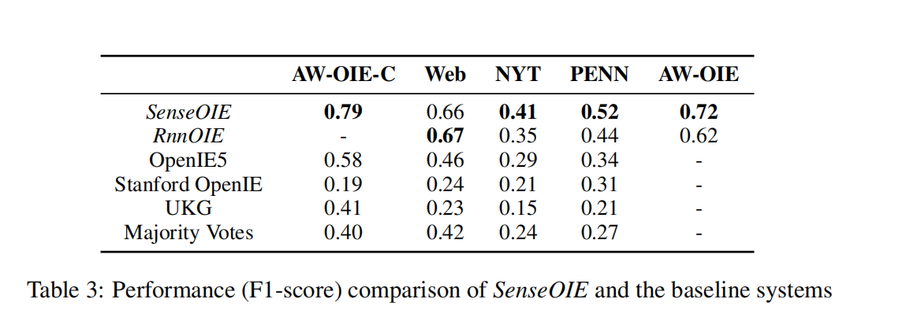
空白演示
experiments
单击输入您的封面副标题

Slide 13
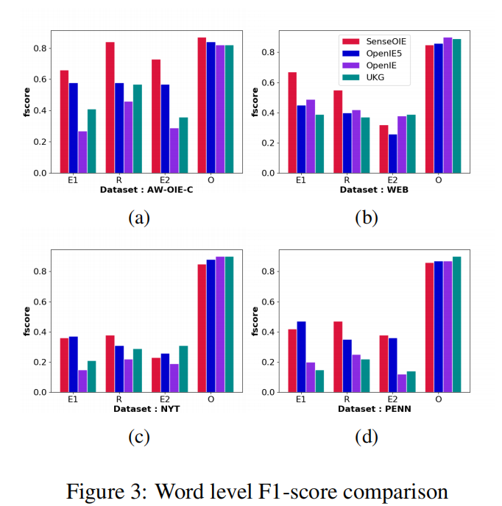
experiments
The results also demonstrate that SenseOIE works better than the other systems. Especially, SenseOIE shows much higher accuracy in detecting words belonging to the arguments and the relation, but a slightly lower accuracy for other words

Slide 14
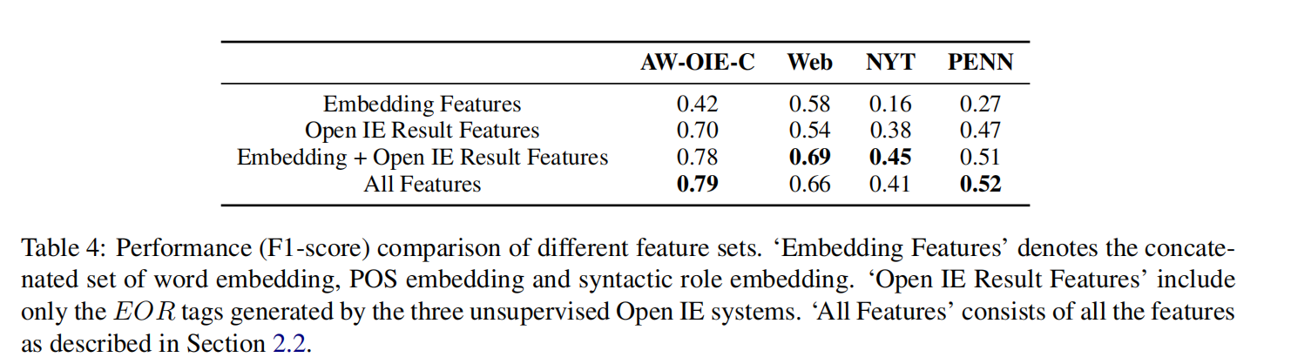
Feature Ablation Study
This performance boost proves that using an ensemble of multiple unsupervised OpenIE systems is very effective.
The results also show that the ensemble of unsupervised Open IE results is more effective than the embedding features, and the combined features of the embeddings and Open IE results produce the best results.

Slide 15
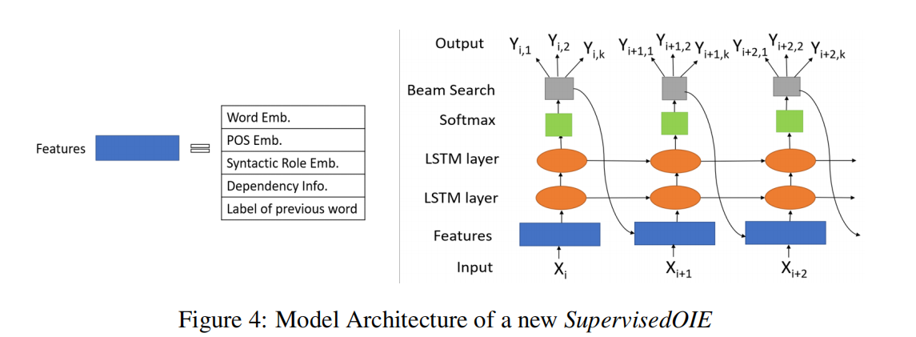
experiments
we investigate if SenseOIE can be used to bootstrap a supervised Open IE model for new domains by automatically producing annotated data
we run SenseOIE on the 3,600 instances from AW-OIE-C and use its extraction results as the ground truth to train a supervised model.

Slide 16
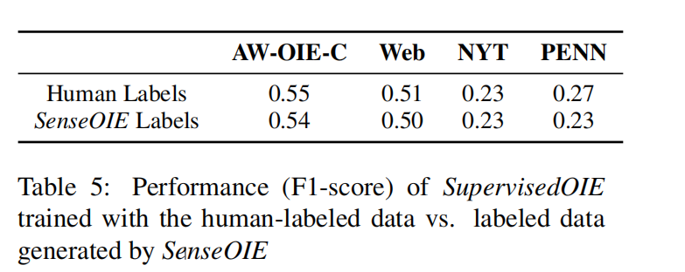
空白演示
experiments
单击输入您的封面副标题

Slide 17
Thank you！

