Slide 1
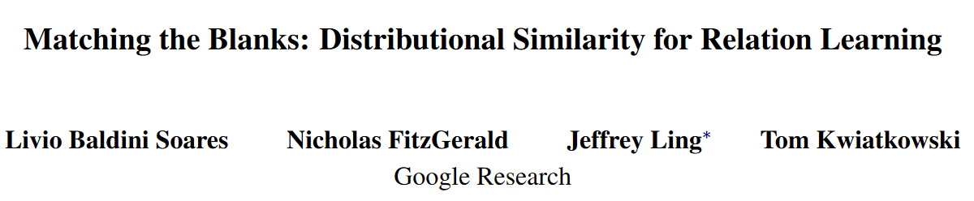
Matching the Blanks: Distributional Similarity for Relation Learning
[ACL 2019]
蔡泽锐 51194501028

Slide 2
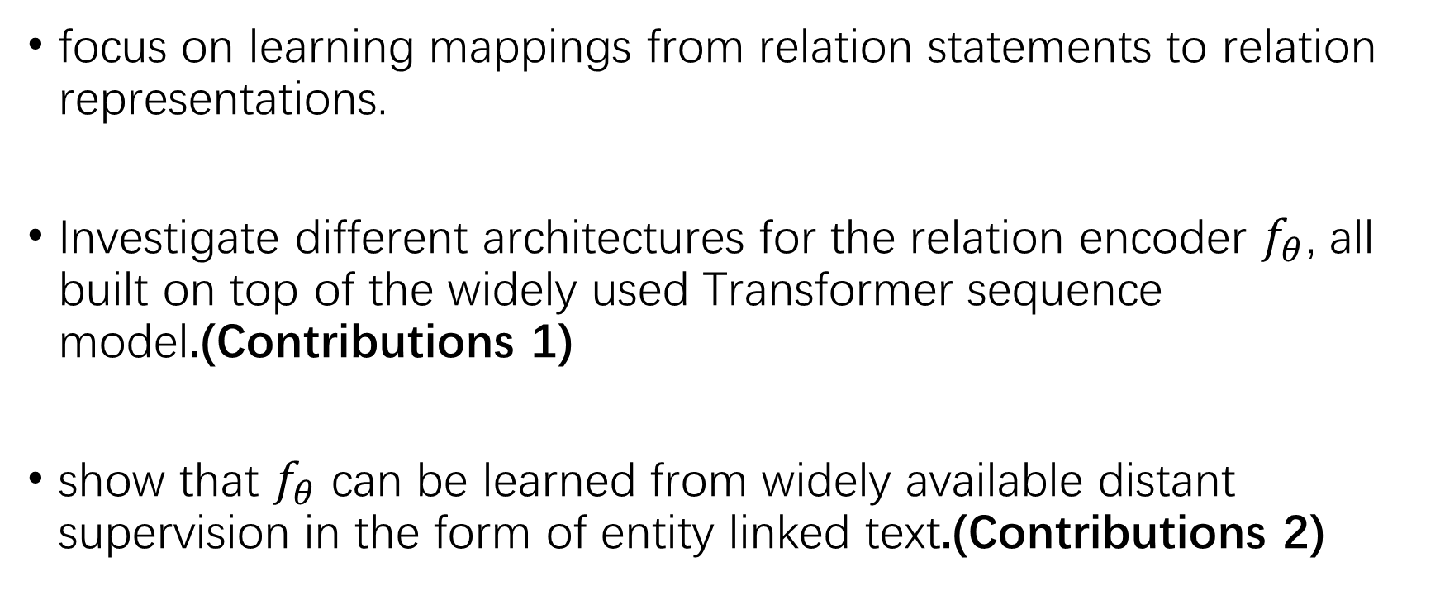
Main Idea
focus on learning mappings from relation statements to relation representations.
Investigate different architectures for the relation encoder $f_{θ}$, all built on top of the widely used Transformer sequence model.(Contributions 1)
show that $f_{θ}$ can be learned from widely available distant supervision in the form of entity linked text.(Contributions 2)

Slide 3
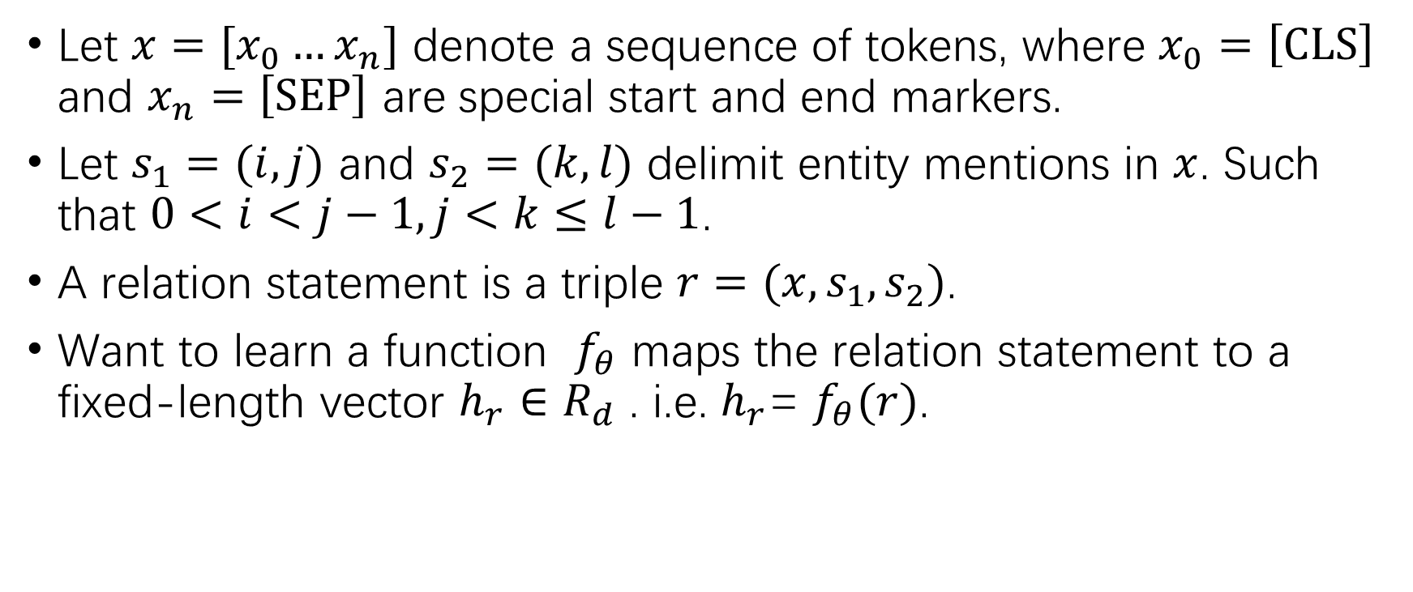
Task definition
Let $x=[x_{0}…x_{n}]$ denote a sequence of tokens, where $x_{0}=\left[CLS\right]$ and $x_{n}=\left[SEP\right]$ are special start and end markers.
Let $s_{1}=(i,j)$ and $s_{2}=(k,l)$ delimit entity mentions in $x$. Such that $0<i<j−1, j<k≤l−1$.
A relation statement is a triple $r=(x,s_{1},s_{2})$.
Want to learn a function $f_{θ}$ maps the relation statement to a fixed-length vector $h_{r}∈R_{d}$ . i.e. $h_{r}$= $f_{θ}(r)$.

Slide 4

Task definition (NEXT)
Fully supervised relation extraction: given a relation statement $r$, predict a relation type $t∈T$. $T$ is a fixed dictionary of relation types.
Few-shot relation matching: a set of candidate relation statements are ranked, and matched, according to a query relation statement.

Slide 5
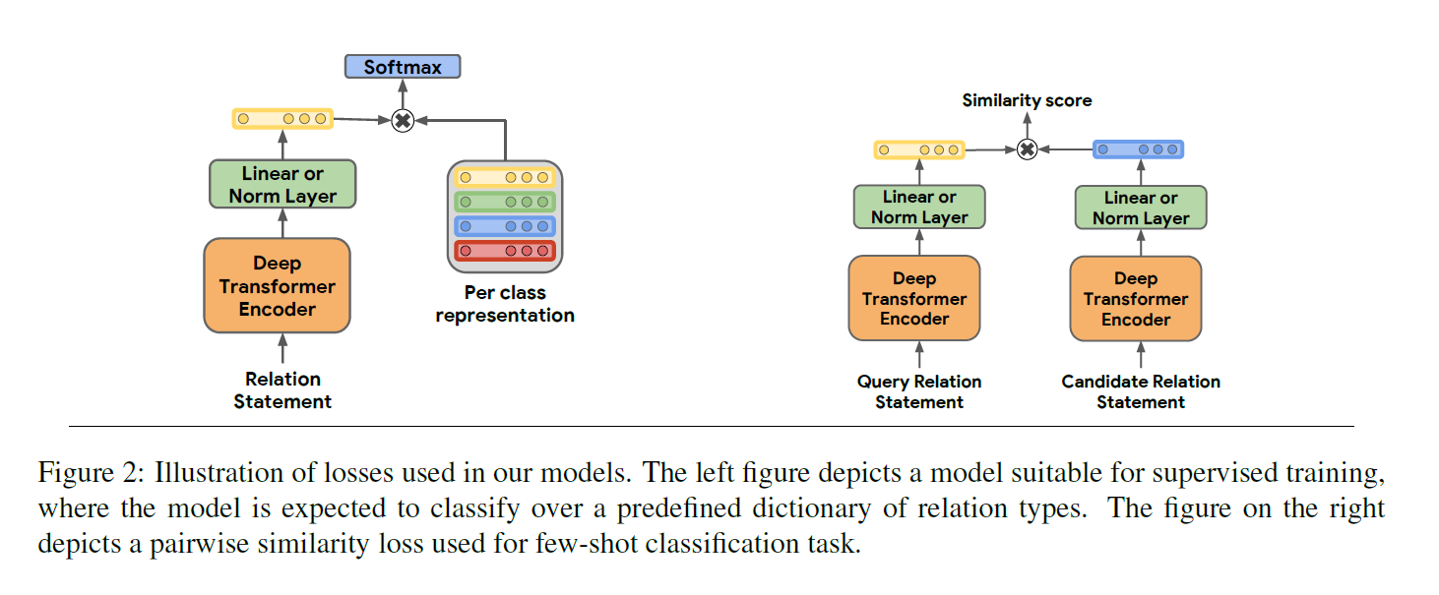
Architectures (BERT-Based) for Relation Learning
Adopt Devlin et al. (2018)’s BERT model as the basis for our work.
How do we represent entities of interest in the input to BERT?
Standard input, Positional embeddings, Entity marker tokens.
How do we extract a fixed length representation of a relation from BERT’s output.
[CLS] token, Entity mention pooling, Entity start state.

Slide 6
Architectures (BERT-Based) for Relation Learning
How do we represent entities of interest in the input to BERT?
Standard input, Positional embeddings, Entity marker tokens.
How do we extract a fixed length representation of a relation from BERT’s output.
[CLS] token, Entity mention pooling, Entity start state.

Slide 7
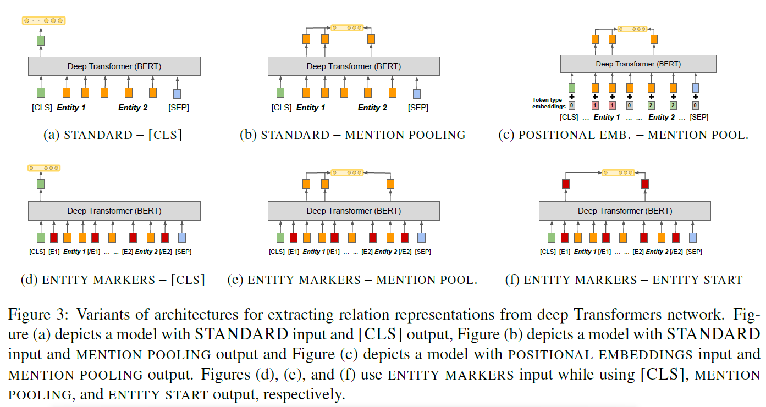

Slide 8
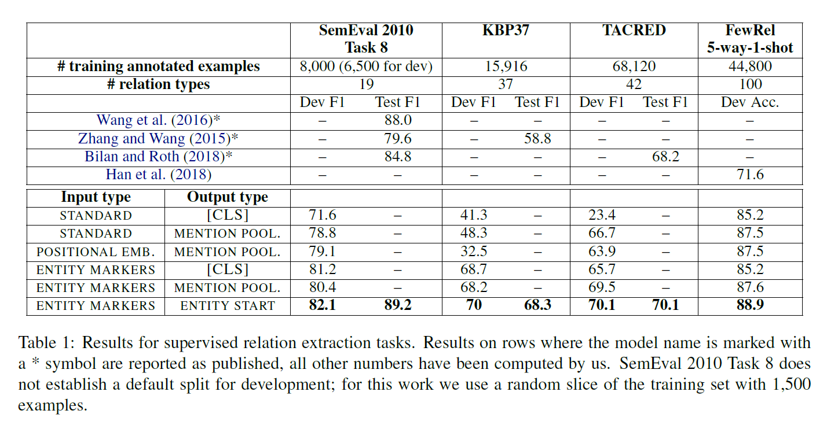

Slide 9
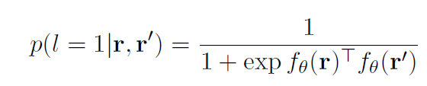
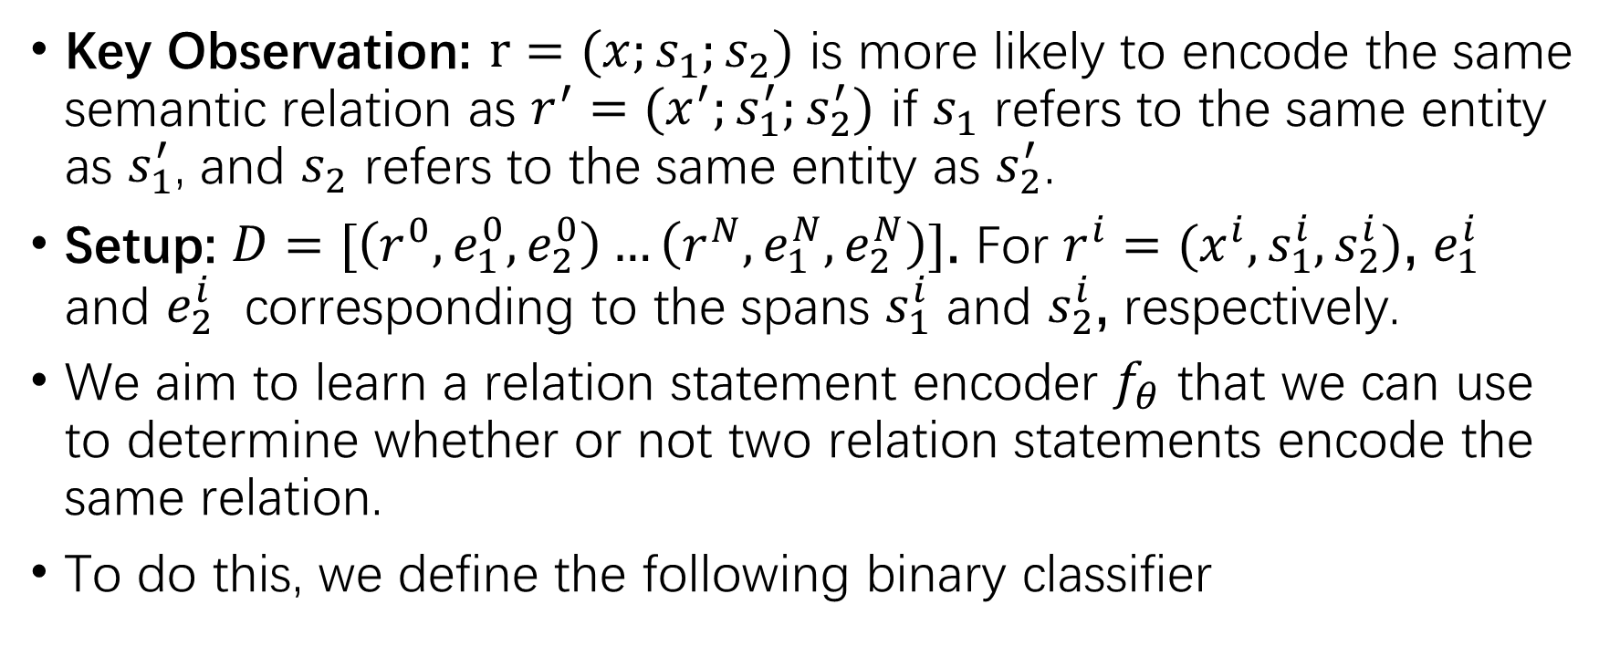
Learning by Matching the Blanks
Key Observation: $r=(x;s_{1};s_{2})$ is more likely to encode the same semantic relation as $r^{′}$ $=(x^{′};s_{1}^{′};s_{2}^{′})$ if $s_{1}$ refers to the same entity as $s_{1}^{′}$, and $s_{2}$ refers to the same entity as $s_{2}^{′}$.
Setup: $D=[\left(r^{0},e_{1}^{0},e_{2}^{0}\right)…\left(r^{N},e_{1}^{N},e_{2}^{N}\right)]$. For $r^{i}=(x^{i},s_{1}^{i},s_{2}^{i})$, $e_{1}^{i}$ and $e_{2}^{i}$ corresponding to the spans $s_{1}^{i}$ and $s_{2}^{i}$, respectively.
We aim to learn a relation statement encoder $f_{θ}$ that we can use to determine whether or not two relation statements encode the same relation.
To do this, we define the following binary classifier

Slide 10
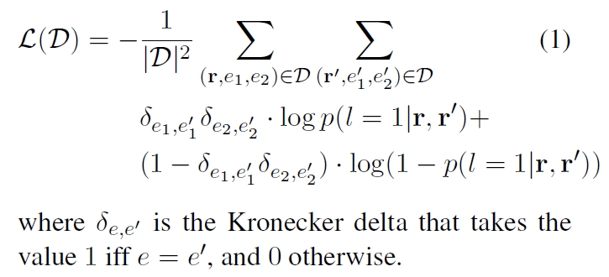

Learning Setup
Learn the parameterization of $f_{θ}$ that minimizes the loss:

Slide 11
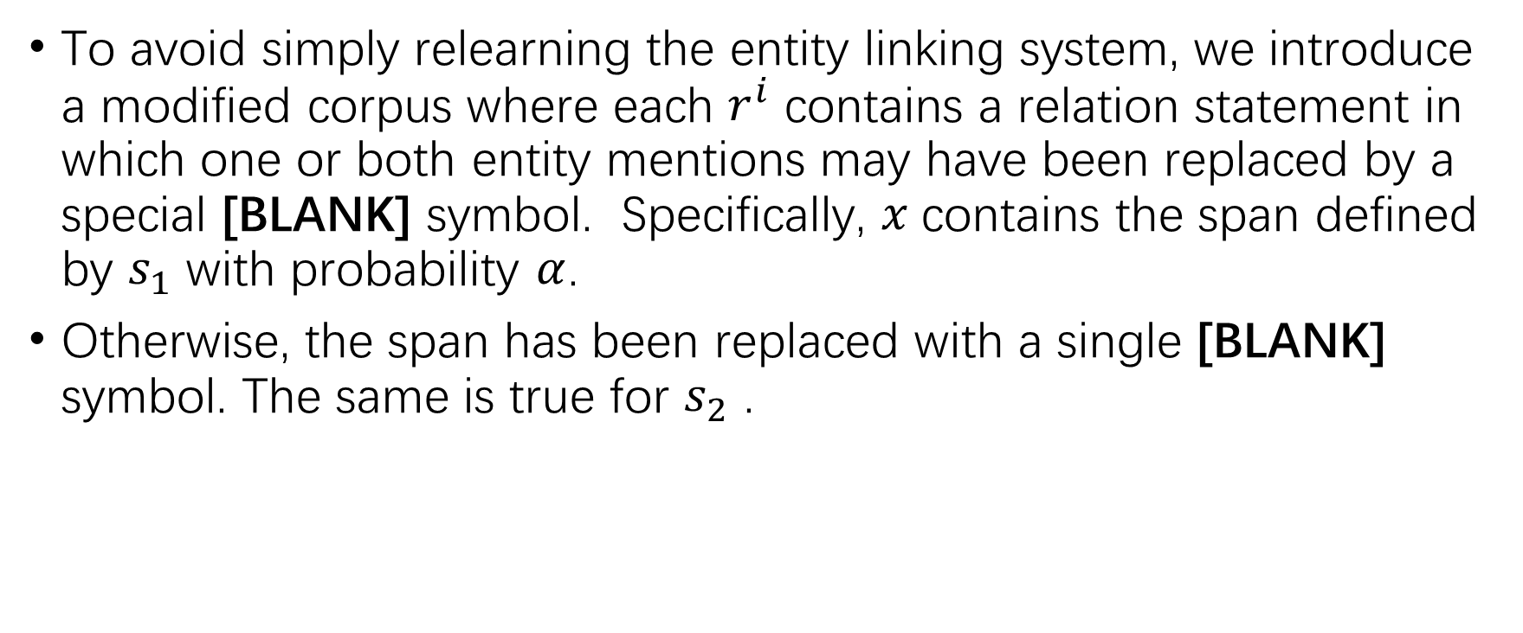
Introducing Blanks
To avoid simply relearning the entity linking system, we introduce a modified corpus where each $r^{i}$ contains a relation statement in which one or both entity mentions may have been replaced by a special [BLANK] symbol. Specifically, $x$contains the span defined by $s_{1}$ with probability $α$.
Otherwise, the span has been replaced with a single [BLANK] symbol. The same is true for $s_{2}$ .

Slide 12
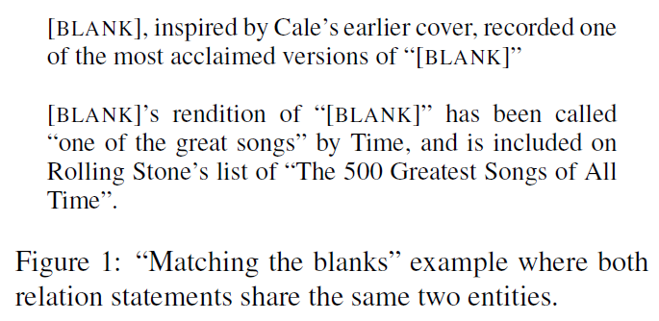
Learning by Matching the Blanks

Slide 13
Matching the Blanks Training
Training corpus: English Wikipedia and extract text passages from the HTML paragraph blocks. Public Google Cloud Natural Language API was used to annotate text spans with a unique knowledge base identifier.
Training pair: From this annotated corpus we extract relation statements where each statement contains at least two grounded entities within a fixed sized window of tokens and limit the number of relation statements that contain the same entity.

Slide 14
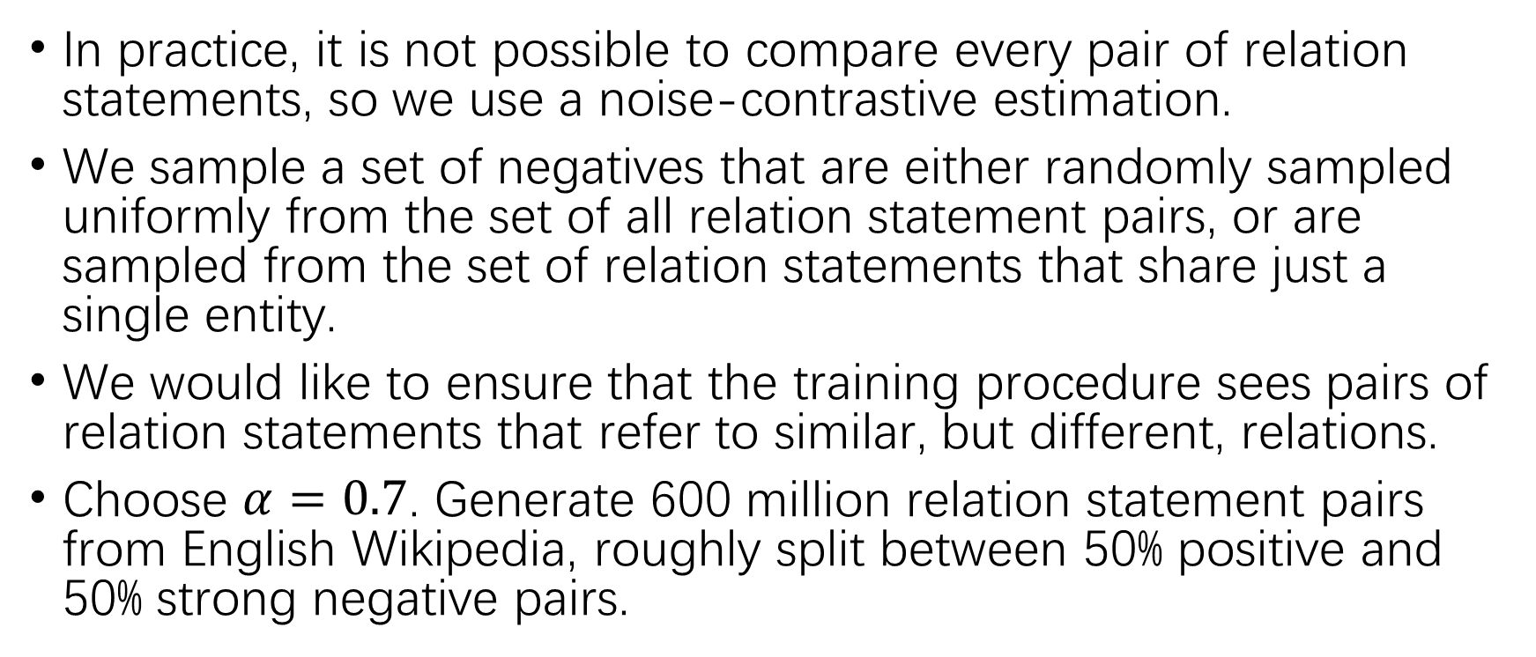
Matching the Blanks Training
In practice, it is not possible to compare every pair of relation statements, so we use a noise-contrastive estimation.
We sample a set of negatives that are either randomly sampled uniformly from the set of all relation statement pairs, or are sampled from the set of relation statements that share just a single entity.
We would like to ensure that the training procedure sees pairs of relation statements that refer to similar, but different, relations.
Choose $α=0.7$. Generate 600 million relation statement pairs from English Wikipedia, roughly split between 50% positive and 50% strong negative pairs.

Slide 15

Experimental Evaluation
Start with the best BERT based model ($BERT_{EM}$)from previous evaluation, and get it trained with matching the blanks task ( $BERT_{EM+MTB}$).
using the same task-specific training methodology for both $BERT_{EM}$ and $BERT_{EM+MTB}$.

Slide 16
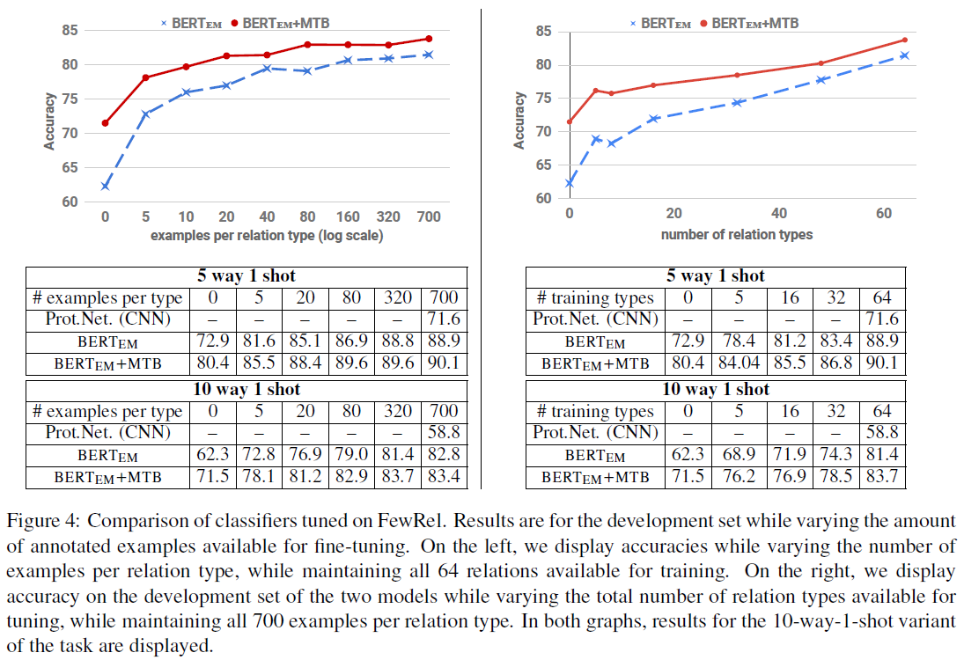
Few-shot Relation Matching

Slide 17
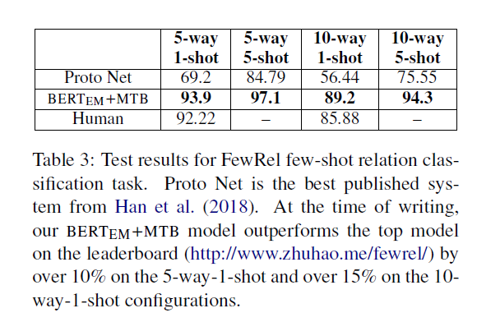
Few-shot Relation Matching

Slide 18
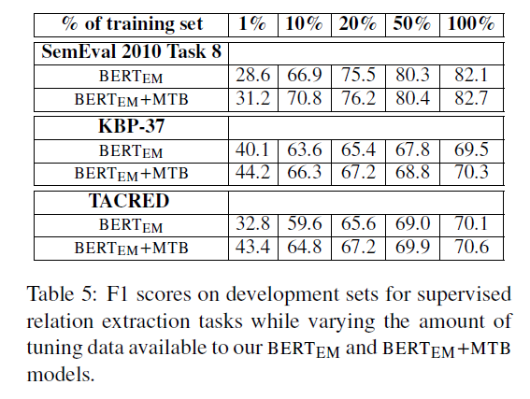
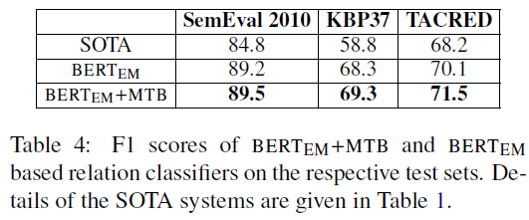
Supervised Relation Extraction

Slide 19
Conclusion
We describe a novel training setup, which we call matching the blanks, which relies solely on entity resolution annotations.
When coupled with a new architecture for fine-tuning relation representations in BERT, our models achieves SOTA results
We show how the new model is particularly effective in low-resource regimes, so it could significantly reduce the amount of human effort.

