Slide 1
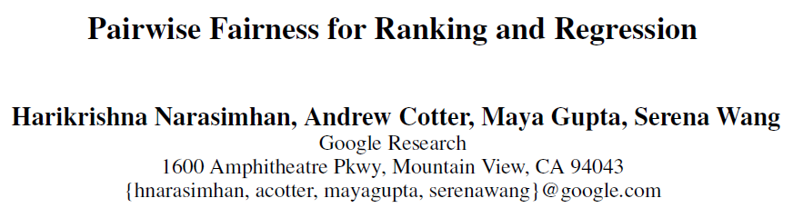
AAAI 2020
刘少凡 51194506021

Slide 2
Fairness problem in machine learning
Ranking model
Regression model
Classification model

Slide 3
Fairness metrics
Equal opportunity
Equal accuracy
Supervised
Unsupervised

Slide 4

Pairwise fairness metrics for Ranking model
Group-dependent pairwise accuracy
A more general form
Equal opportunity metric
Marginal Equal Opportunity

Slide 5
Pairwise fairness metrics
Within-Group vs. Cross-Group Comparison
How to choose?
Statistical Parity--unsupervised fairness metrics

Slide 6
Pairwise fairness metrics for Regression model
One can compute and constrain the pairwise fairness metrics as in Ranking setting.
The only different is Loss function.

Slide 7


Continuous Protected Features

Slide 8

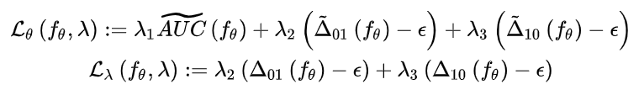
Training
Ranking model:
For regression problems, replace AUC with MSE.
The final optimization problem^{[1]}:
[1] Two-player games for efficient non-convex constrained optimization

Slide 9
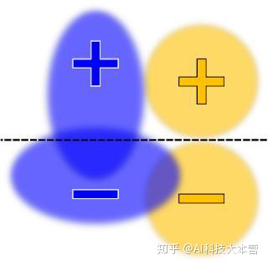

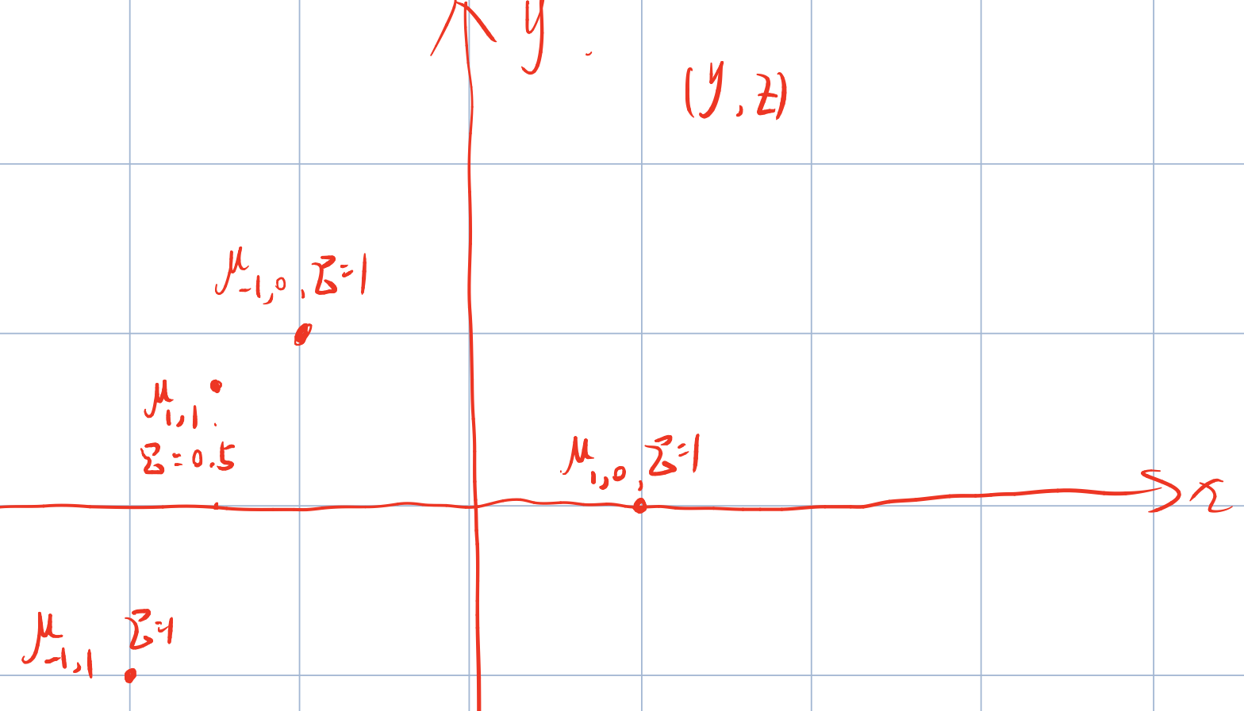
Dataset
5000 queries, and each query has 11 candidates
Label y
Randomly pick one of the 11 candidates to have positive label +1, and others -1
Protected attribute z
z~Bernoulli(0.1)
Normal feature
from Gaussian distribution:

Slide 10

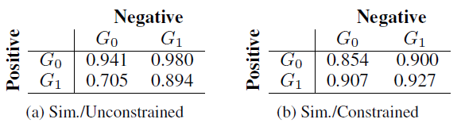
Constraint and result
Train linear ranking functions and impose a cross-group equal opportunity:
Constraint of optimization problem:
Result of synthetic dataset(pairwise accuracy matrices):

Slide 11
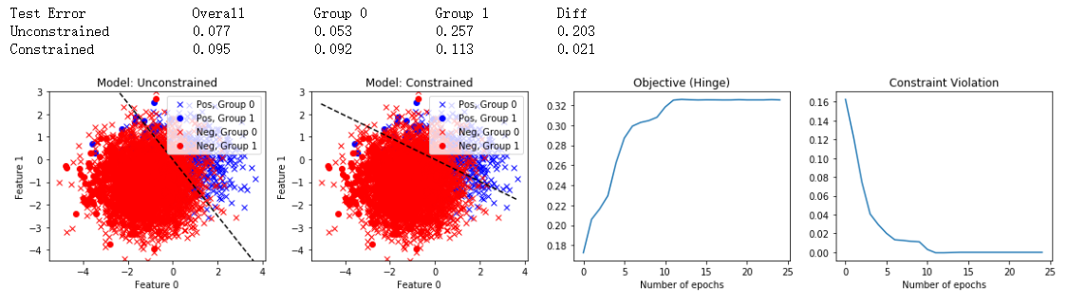
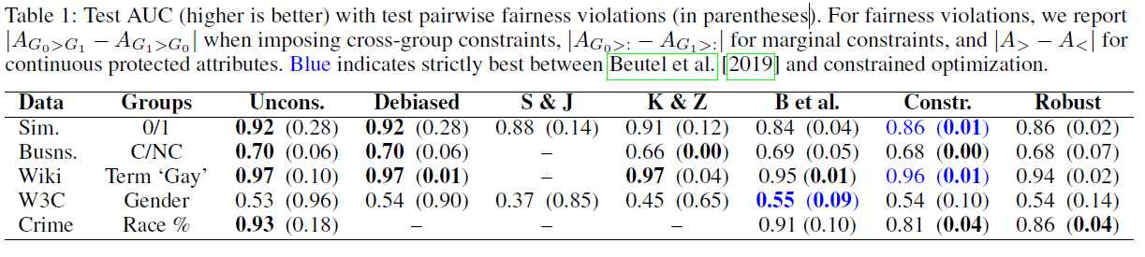
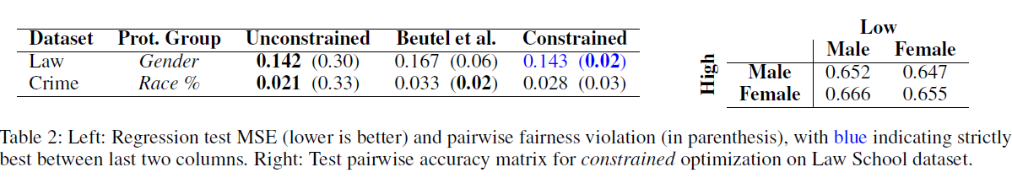
More experiments
Experiments in regression model

Slide 12
Conclusion and discussion
The new fairness metrics is useful
Experimentally, the different methods compared often produced different trade-offs between AUC (or MSE) and fairness, making it hard to judge one as strictly better than others.
The key way one specifies pairwise fairness metrics is by the selection of which pairs to consider
Maybe we can use side information to select or weight candidate pairs, the idea is also appropriate to regression model.

Slide 13
End
Thanks for your watching.

