Slide 1
Dialogue-Based Relation Extraction
Dian Yu¹ Kai Sun² Claire Cardie² Dong Yu¹
¹Tencent AI Lab, Bellevue, WA
²Cornell University, Ithaca, NY
Reporter：李东阳

Slide 2
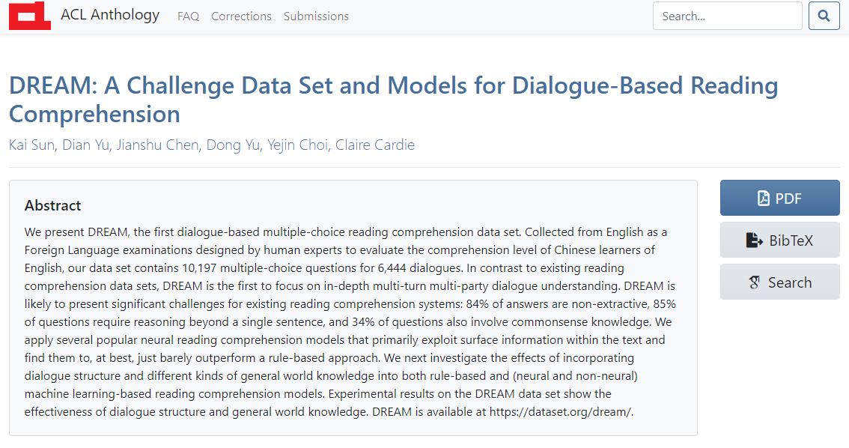

Slide 3
Dialogue-Based Relation Extraction
Dian Yu¹ Kai Sun² Claire Cardie² Dong Yu¹
¹Tencent AI Lab, Bellevue, WA
²Cornell University, Ithaca, NY
Reporter：李东阳

Slide 4
Introduction
Cross-sentence relation extraction
Vs. sentence-level relation extraction (e.g., NYT, TACRED)
Identify relations between two arguments that are not mentioned in the same sentence or relations that cannot be supported by any single sentence.
Previous Work
Focus on texts from formal genres such as professionally written and edited news reports or well-edited websites.
This Work
An initial step toward studying relation extraction in dialogues.

Slide 5
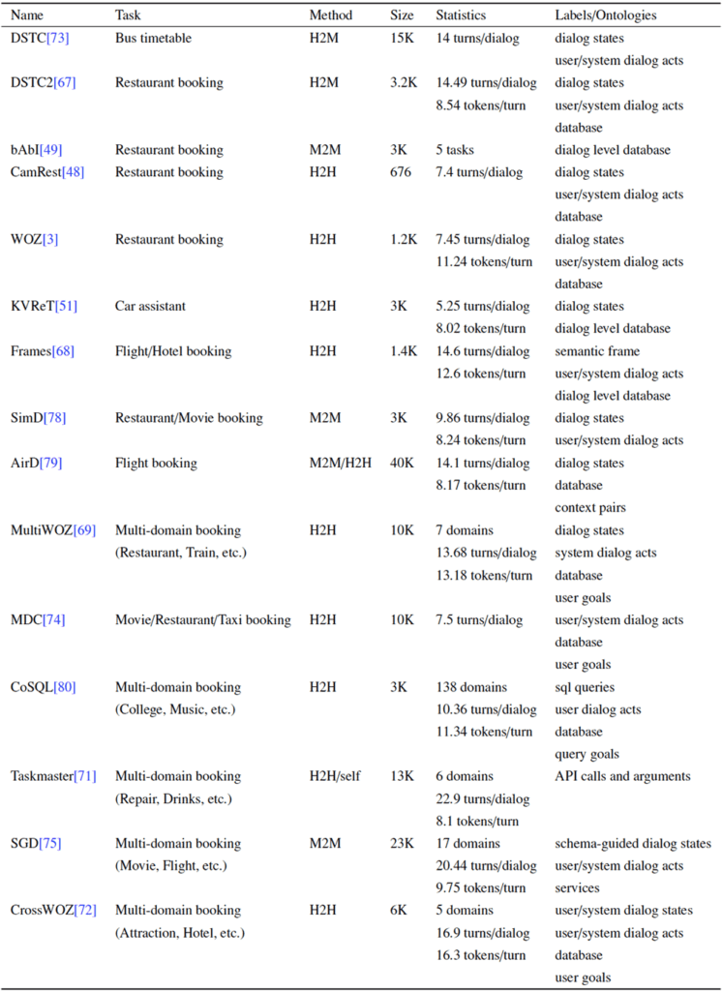

Slide 6
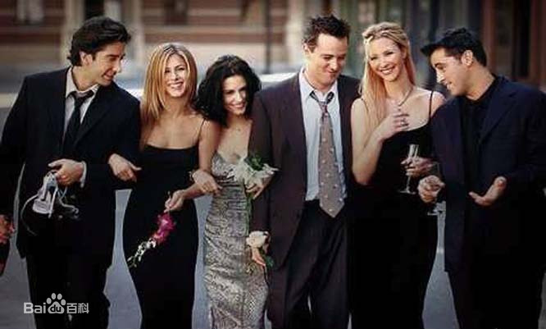
Introduction
S1: Hey Pheebs.
S2: Hey!
S1: Any sign of your brother?
S2: No, but he’s always late.
S1: I thought you only met him once?
S2: Yeah, I did. I think it sounds y’know big sistery, y’know, ‘Frank’s always late.’
S1: Well relax, he’ll be here.
Argument pair | Trigger | Relation type
R1 (Frank, S2) | brother | per: siblings
R2 (S2, Frank) | brother | per: siblings
R3 (S2, Pheebs) | none | per: alternate_names
R4 (S1, Pheebs) | none | unanswerable

Slide 7
Introduction
Display the dataset-DialogRE

Slide 8
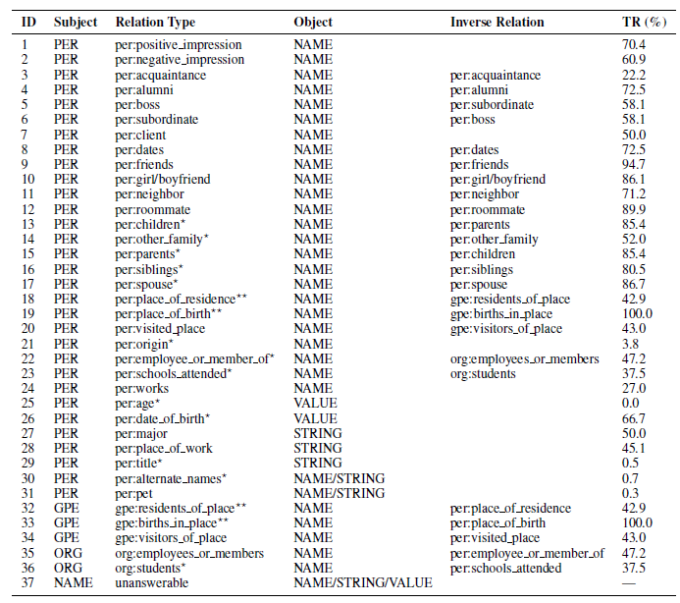
Introduction

Slide 9
Data Construction
Use the transcripts of all ten seasons (263 episodes) of Friends
1,788 dialogues
Annotate relational triples in each scene in all transcripts and form a dialogue by extracting the shortest snippet of contiguous turns that covers all annotated relation triples and sufficient supportive contexts in this scene
36 relation types (8,068 triples)
Slot descriptions of the Slot Filling (SF) task in the Text Analysis Conference Knowledge Base Population (TAC-KBP)
New relation types (e.g., per: neighbor)

Slide 10
Data Construction
Annotation:
1. Annotator A annotates relational triples in each scene in all transcripts and form a dialogue by extracting the shortest snippet of contiguous turns that covers all annotated relational triples and sufficient supportive contexts in this scene.
2. Annotator B annotates the possible relations between candidate pairs annotated by annotator A.

Slide 11
Data Construction
Trigger annotation
Fine-grained explanations, which are seldom provided in previous relation extraction datasets
Negative Instance generation(2100 triples)
Two arguments are in “no relation”
Speaker name anonymization
Rachel --> S1
Phoebe --> S2
…

Slide 12
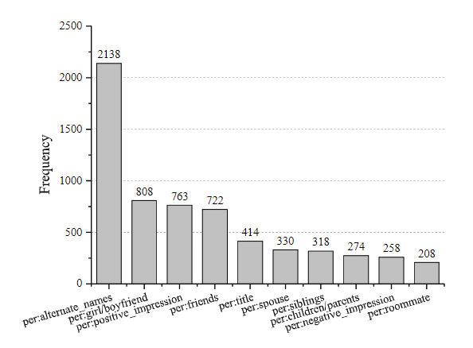
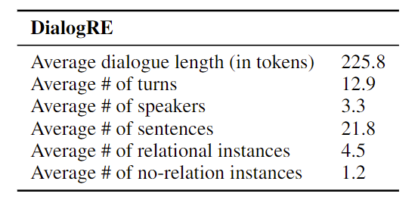
Data Construction
Statistics per dialogue of DialogRE
Relation type distribution in DialogRE

Slide 13
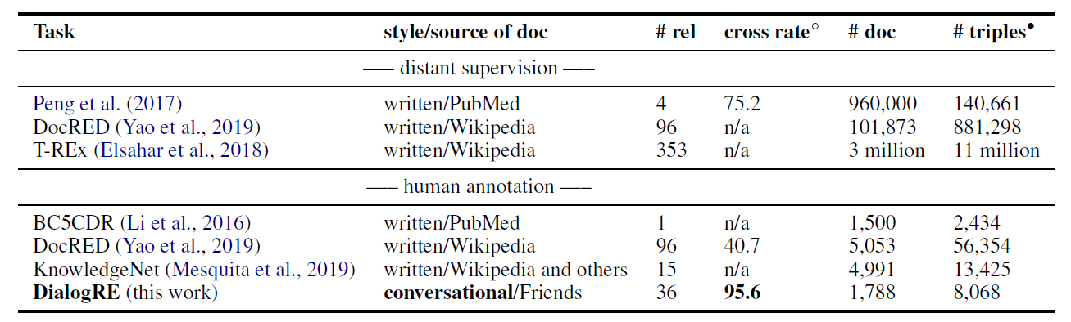
Data Construction

Slide 14
Data Construction
Low information density in conversational speech
The average annotated triple per sentence in DialogRE is 0.21.
Comparison: ACE (0.73) , KnowledgeNet (1.44)
Speaker-centric
Higher person pronoun frequency.
The subjects of 77.3% of relational triples are speaker names.
More than 90.0% of relational triples contain at least one speaker argument.

Slide 15
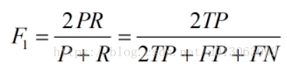
Metrics
Motivation：
Read entire document, rely on existence of multiple mentions → Real time based, identify relationships as early as possible , evaluation metric F1_{C}.
Standard Setting (F1)

Slide 16
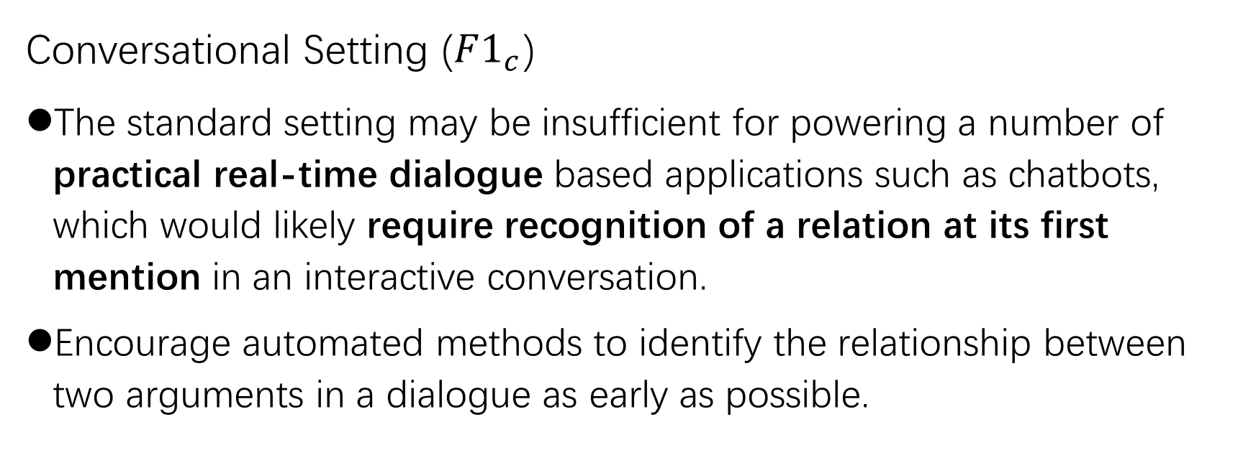
Metrics
Conversational Setting ($F1_{c}$)
The standard setting may be insufficient for powering a number of practical real-time dialogue based applications such as chatbots, which would likely require recognition of a relation at its first mention in an interactive conversation.
Encourage automated methods to identify the relationship between two arguments in a dialogue as early as possible.

Slide 17
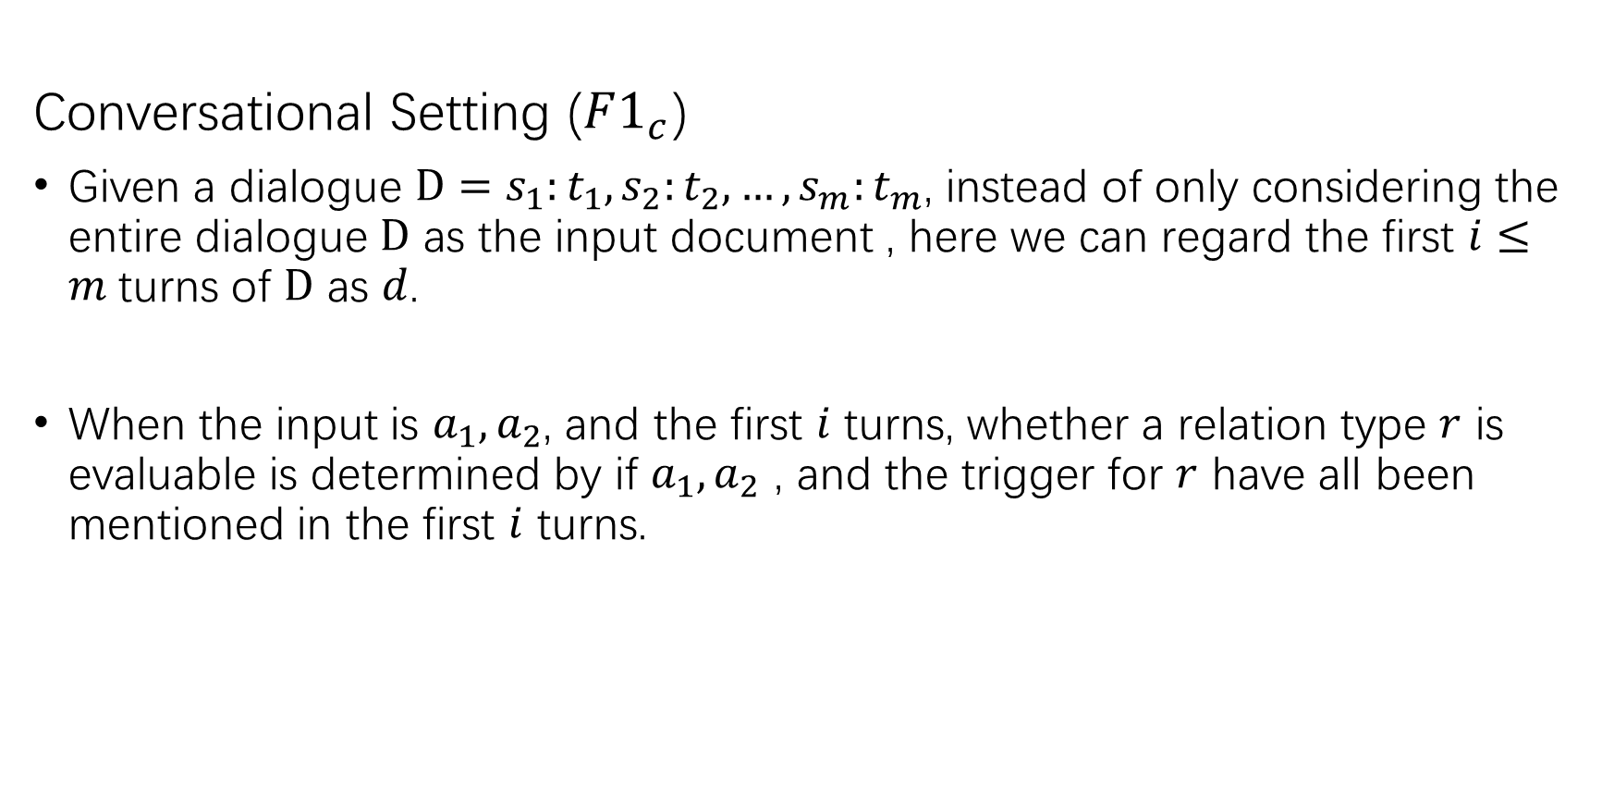
Metrics
Conversational Setting ($F1_{c}$)
Given a dialogue $D=s_{1}:t_{1}, s_{2}:t_{2}, …, s_{m}:t_{m}$, instead of only considering the entire dialogue $D$ as the input document , here we can regard the first $i≤m$turns of $D$ as $d$.
When the input is $a_{1}, a_{2}$, and the first $i$ turns, whether a relation type $r$ is evaluable is determined by if $a_{1}, a_{2}$ , and the trigger for $r$ have all been mentioned in the first $i$ turns.

Slide 18
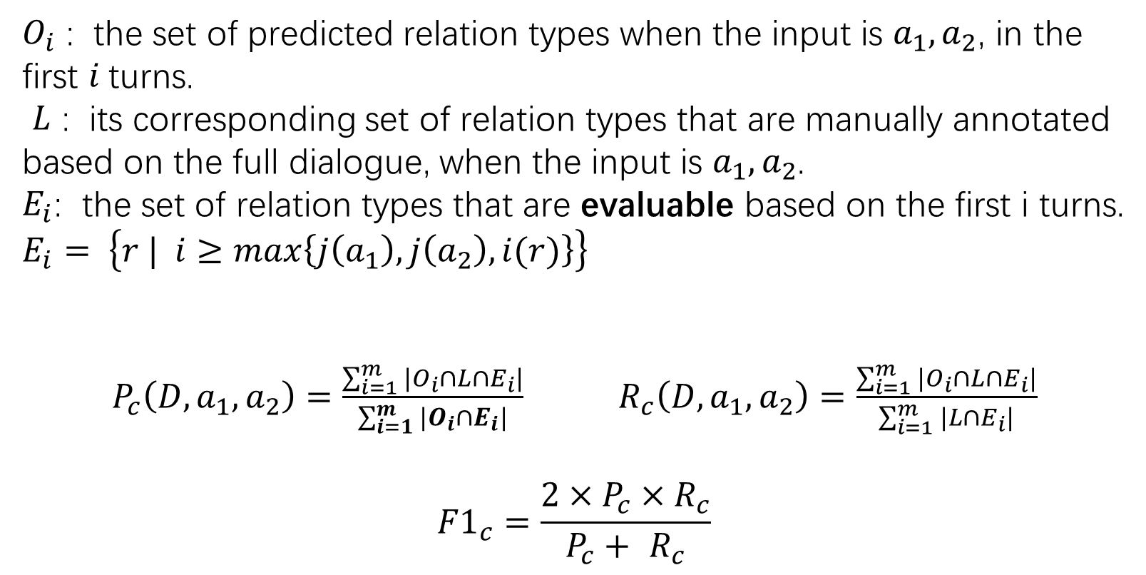
Metrics
$O_{i}$ : the set of predicted relation types when the input is $a_{1},a_{2}$, in the first $i$turns.
$L$ : its corresponding set of relation types that are manually annotated based on the full dialogue, when the input is $a_{1},a_{2}$.
$E_{i}$: the set of relation types that are evaluable based on the first i turns. $E_{i}= \left\{r | i≥max\left\{j\left(a_{1}\right),j\left(a_{2}\right),i(r)\right\}\right\}$
$P_{c}\left(D,a_{1},a_{2}\right)=\frac{\sum_{i=1}^{m}{|O_{i}∩L∩E_{i}|}}{\sum_{i=1}^{m}{|O_{i}∩E_{i}|}}$ $R_{c}\left(D,a_{1},a_{2}\right)=\frac{\sum_{i=1}^{m}{|O_{i}∩L∩E_{i}|}}{\sum_{i=1}^{m}{|L∩E_{i}|}}$
$${F1}_{c}=\frac{{2×P}_{c}×R_{c}}{P_{c}+ R_{c}}$$

Slide 19
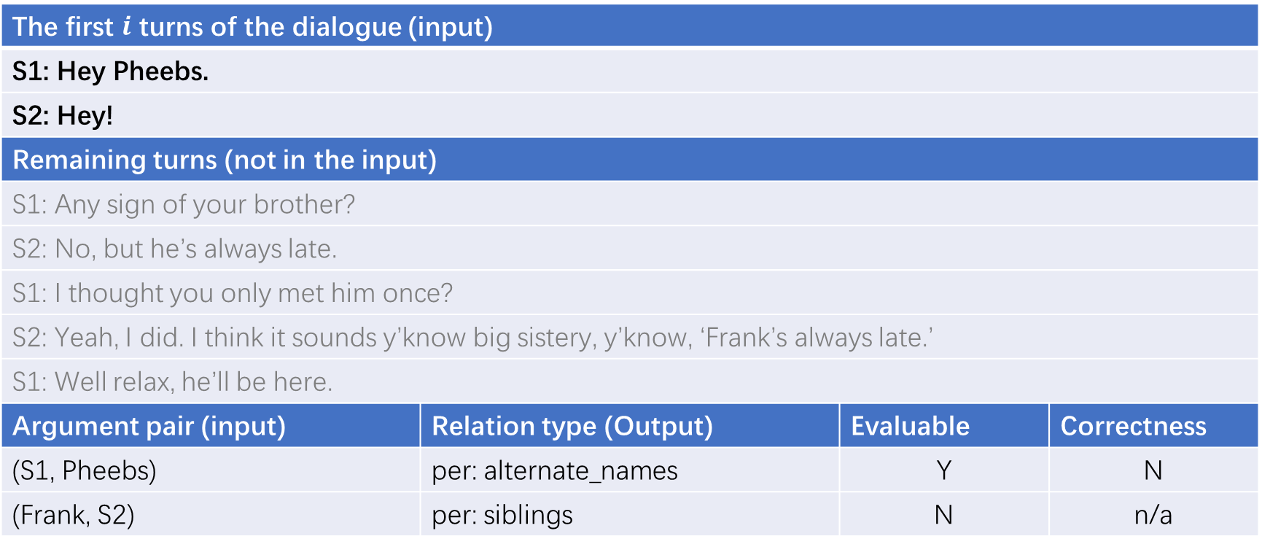
Metrics
Argument pair | Trigger | Relation type
R1 (Frank, S2) | brother | per: siblings
R2 (S2, Frank) | brother | per: siblings
R3 (S2, Pheebs) | none | per: alternate_names
R4 (S1, Pheebs) | none | unanswerable
The first $i$ turns of the dialogue (input)
S1: Hey Pheebs.
S2: Hey!
Remaining turns (not in the input)
S1: Any sign of your brother?
S2: No, but he’s always late.
S1: I thought you only met him once?
S2: Yeah, I did. I think it sounds y’know big sistery, y’know, ‘Frank’s always late.’
S1: Well relax, he’ll be here.
Argument pair (input) | Relation type (Output) | Evaluable | Correctness
(S1, Pheebs) | per: alternate_names | Y | N
(Frank, S2) | per: siblings | N | n/a

Slide 20
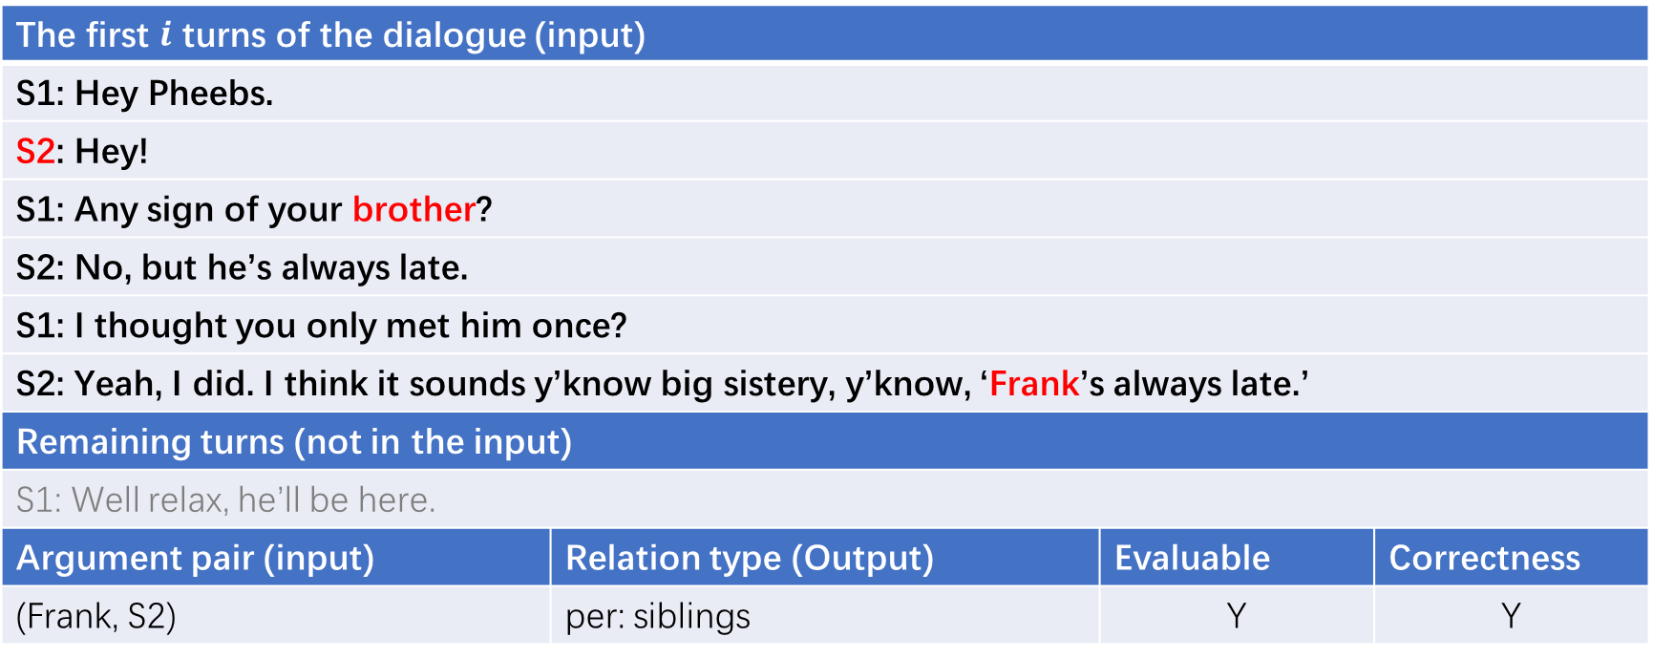
Metrics
Argument pair | Trigger | Relation type
R1 (Frank, S2) | brother | per: siblings
R2 (S2, Frank) | brother | per: siblings
R3 (S2, Pheebs) | none | per: alternate_names
R4 (S1, Pheebs) | none | unanswerable
The first $i$ turns of the dialogue (input)
S1: Hey Pheebs.
S2: Hey!
S1: Any sign of your brother?
S2: No, but he’s always late.
S1: I thought you only met him once?
S2: Yeah, I did. I think it sounds y’know big sistery, y’know, ‘Frank’s always late.’
Remaining turns (not in the input)
S1: Well relax, he’ll be here.
Argument pair (input) | Relation type (Output) | Evaluable | Correctness
(Frank, S2) | per: siblings | Y | Y

Slide 21
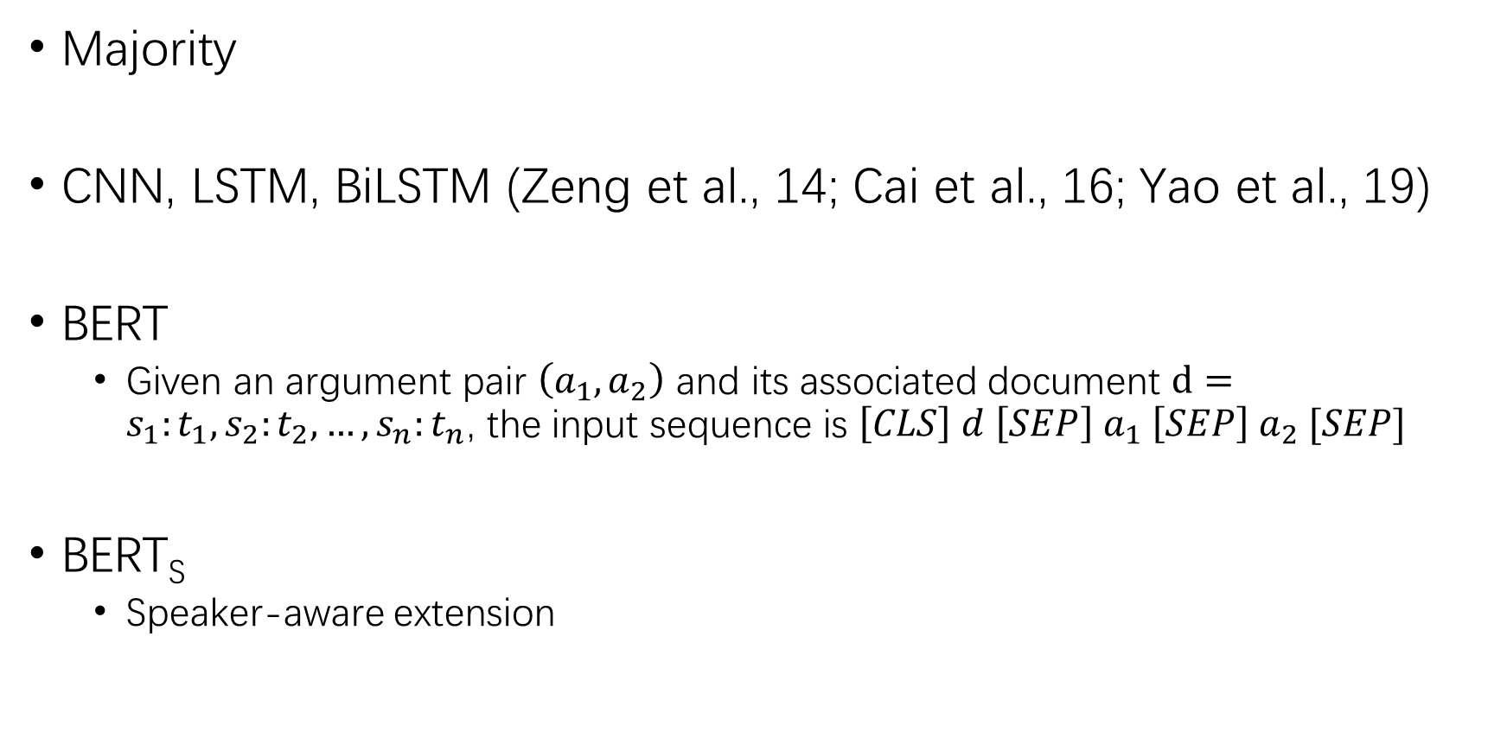
Baselines
Majority
CNN, LSTM, BiLSTM (Zeng et al., 14; Cai et al., 16; Yao et al., 19)
BERT
Given an argument pair $\left(a_{1}, a_{2}\right)$ and its associated document $d=s_{1}:t_{1}, s_{2}:t_{2}, …, s_{n}:t_{n}$, the input sequence is $\left[CLS\right] d \left[SEP\right] a_{1} \left[SEP\right] a_{2} [SEP]$
BERT_{S}
Speaker-aware extension

Slide 22
Speaker-Aware Extension
Motivations
High percentage of “speaker-centric” relational triples.
Help a model locate the start positions of relevant turns based on the arguments that are speaker names.
Prevent a model from overfitting to the training data.

Slide 23

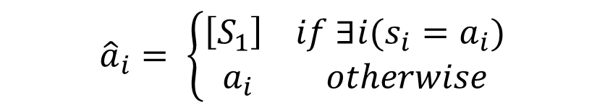
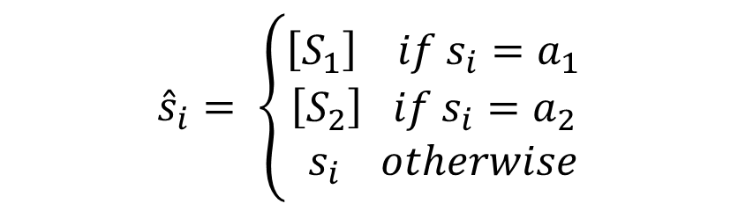
Speaker-Aware Extension
BERT_{S}
Given an argument pair $\left(a_{1}, a_{2}\right)$ and its associated document $d=s_{1}:t_{1}, s_{2}:t_{2}, …, s_{n}:t_{n}$, we construct $\hat{d}={\hat{s}}_{1}:t_{1}, {\hat{s}}_{2}:t_{2}, …, {\hat{s}}_{n}:t_{n}$ and ${\hat{a}}_{1},{\hat{a}}_{2}$
The input sequence is $\left[CLS\right]\hat{d}\left[SEP\right]{\hat{a}}_{1}\left[SEP\right]{\hat{a}}_{2}[SEP]$
$${\hat{s}}_{i}= \left\{\begin{aligned}\left[S_{1}\right] if s_{i}=a_{1} \\ \left[S_{2}\right] if s_{i}=a_{2} \\ { s}_{i} otherwise\end{aligned}\right.$$
$${\hat{a}}_{i}= \left\{\begin{aligned}\left[S_{1}\right] if ∃i(s_{i}=a_{i}) \\ a_{i} otherwise\end{aligned}\right.$$

Slide 24
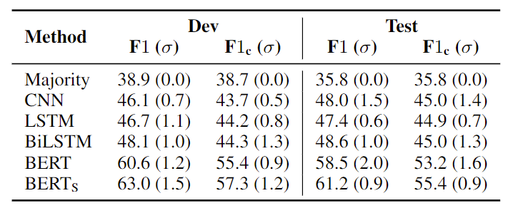
Results
Performance of relation extraction methods on DialogRE in both the standard and conversational settings.

Slide 25
Discussion
Limitations
All transcripts for annotation are from Friends, which may limit the diversity of scenarios and generality of the relation distributions
Dialogues in Friends presents less variation based on linguistic features than natural conversations

Slide 26
Summary
Present DialogRE, the first human-annotated dialogue-based relation extraction dataset.
Design a new metric to evaluate the performance of relation extraction methods in a conversational setting.
Establish a set of baseline results and demonstrate the importance of explicit recognition of speaker arguments in dialogue-based relation extraction.

Slide 27
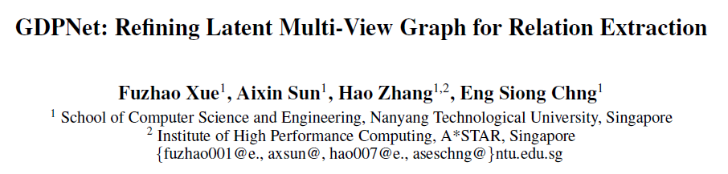
Application
AAAI2021

Slide 28
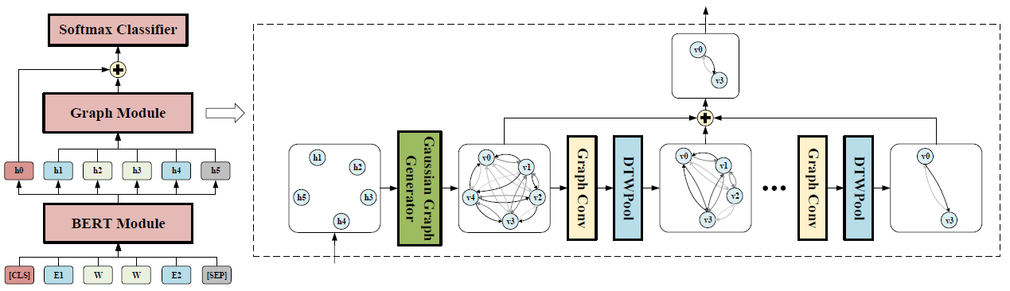



Slide 29
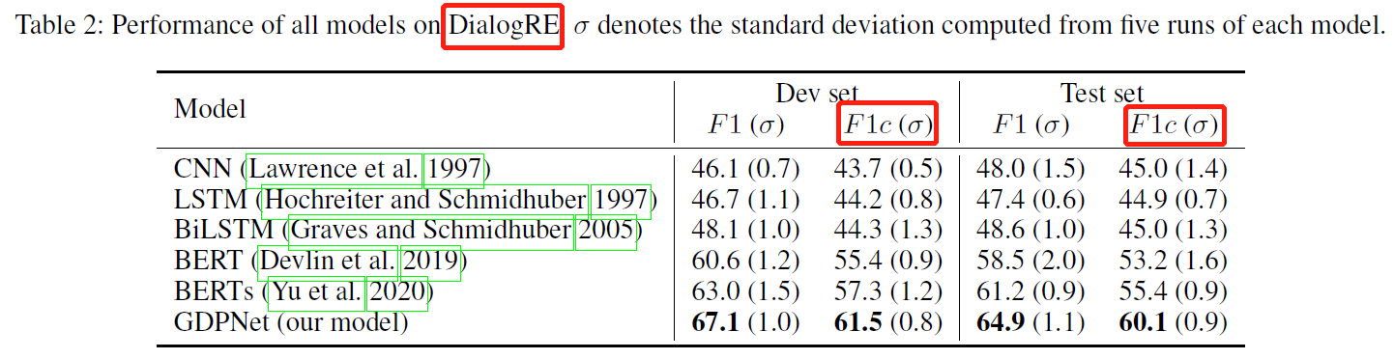

Slide 30
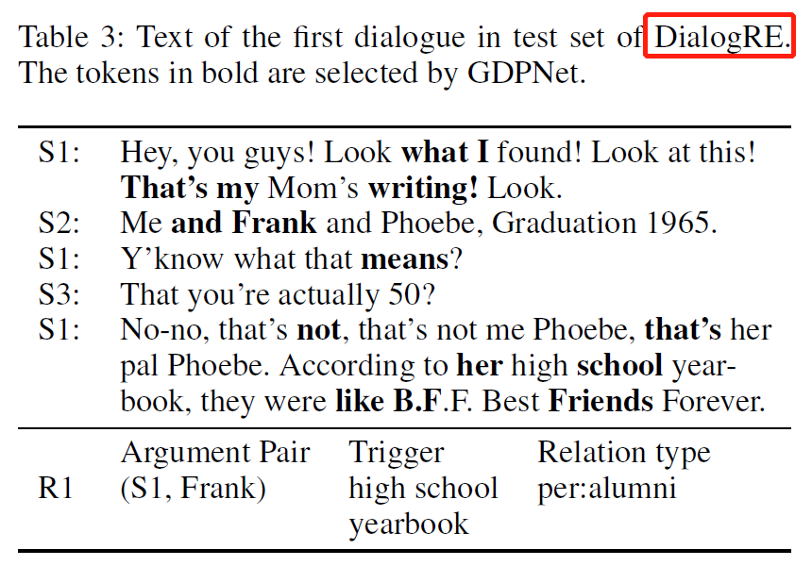
BTW：Why not DocRED?

Slide 31
Thanks!

