Slide 1
Cross-Sentence N-ary Relation Extraction with Graph LSTMs
叶加博 52194506006

Slide 2
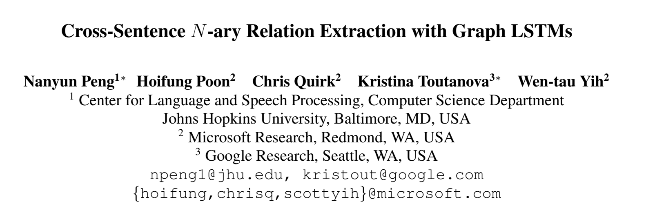
TACL 2017 https://arxiv.org/abs/1708.03743

Slide 3
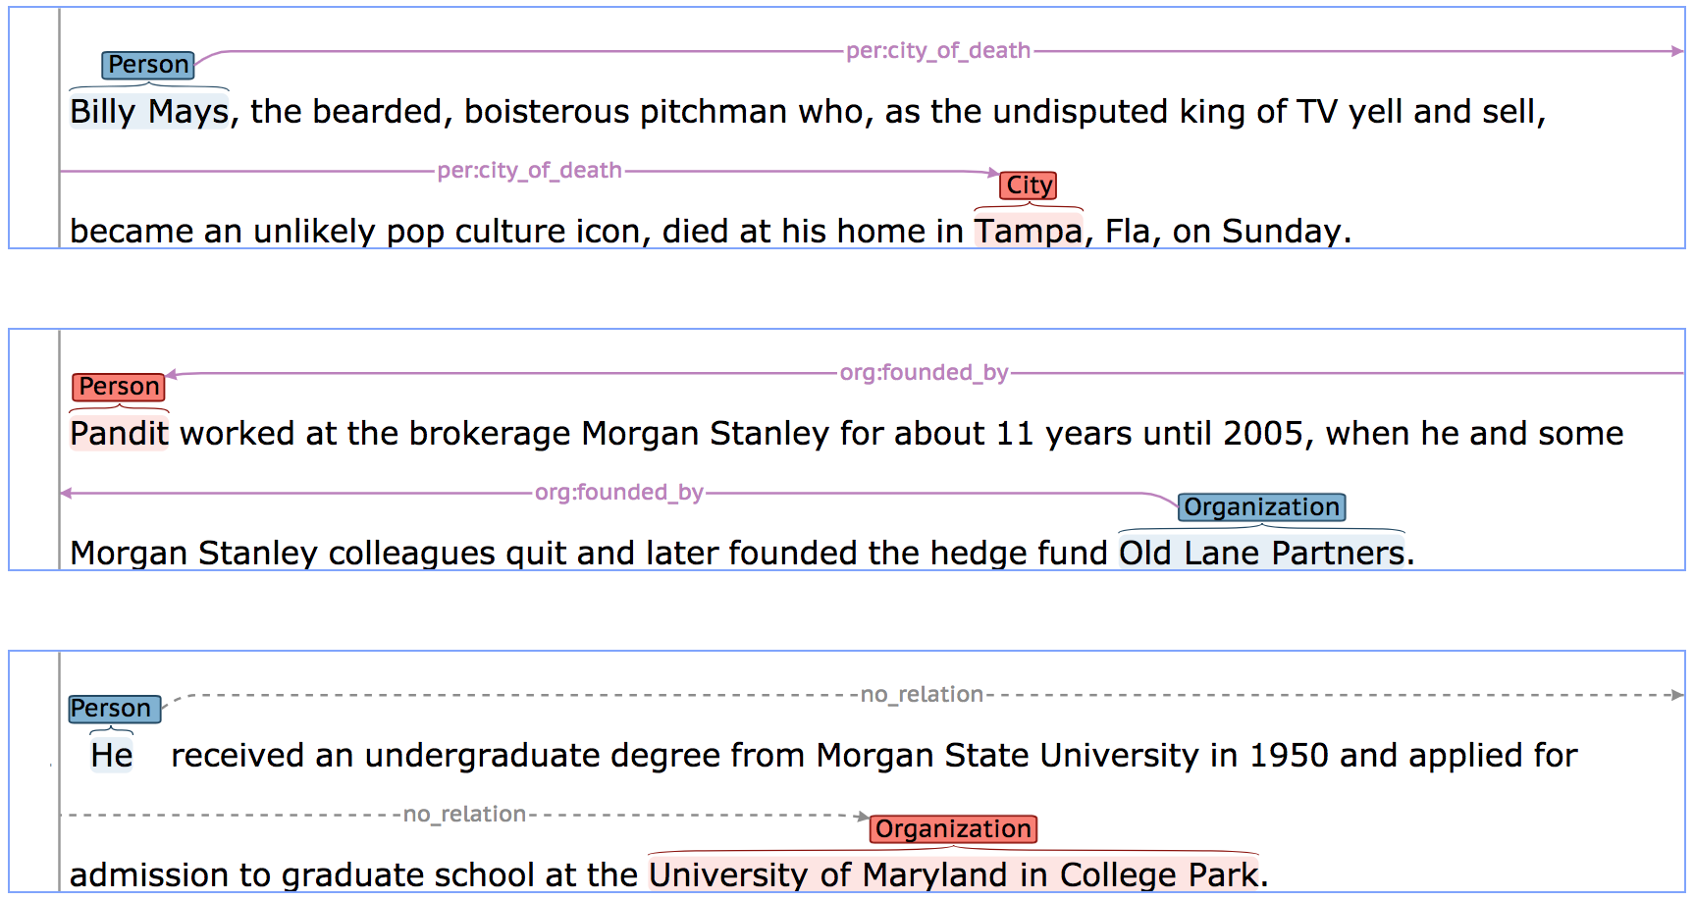
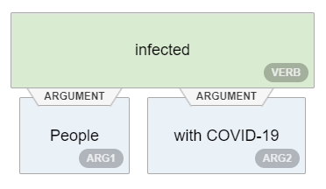
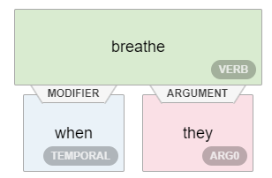
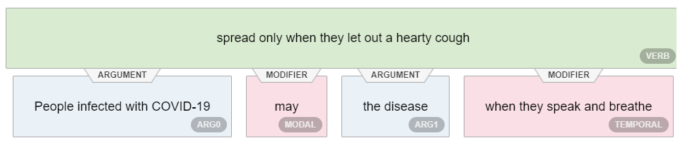
Background
People infected with COVID-19 may spread the disease when they speak and breathe, not only when they let out a hearty cough.
Relations Extraction Task
Open Information Extraction
Niklaus, Christina, et al. "A Survey on Open Information Extraction." Proceedings of the 27th International Conference on Computational Linguistics. 2018.
Notes:
Open IE systems must rely on unsupervised extraction strategies, i.e. instead of specifying target relations in advance, possible relations of interest must be automatically detected while making only a single pass over the corpus. Moreover, the manual labor of creating suitable training data or extraction patterns must be reduced to a minimum by requiring only a small set of hand-tagged seed instances or a few manually defined extraction patterns.

Slide 4
Cross-Sentence N-ary Relation Extraction
Cross-Sentence
N-ary
Related entities appear in different sentences
The deletion mutation on exon-19 of EGFR gene was present in 16 patients, while the L858E point mutation on exon-21 was noted in 10. All patients were treated with gefitinib and showed a partial response.
<e1>Ayn Rand</e1> was a Russian-born American novelist, philosopher, playwright, and screenwriter.
Relation Template
She is known for her two best-selling novels, <e2>The Fountainhead</e2> and <e2>Atlas Shrugged</e2> and for developing a philosophical system she called Objectivism.
Tumors with m mutation in g gene can be treated with 𝑑.
$$\left(drug=gefitinib,gene=EGFR,mutation=L858E\right)$$
Notes:
跨句子主要的问题在于关系实体会出现在不同句子中，模型需要更好地捕获实体的上下文表示。之前的方法往往引入共指的标注或使用远程监督的方法减轻对模型的要求。
N-ary的难点在于原先二元关系抽取中可以用最短依存路径引导模型编码特征做出判断，这并不太容易推广到多元并保持较高的效率，一种思路是指定一个主要短语，将多元关系转化为多对1的若干二元关系判断，但一般不容易指定出这个主要短语，也需要数据集做额外的标注（标注主要短语）。

Slide 5
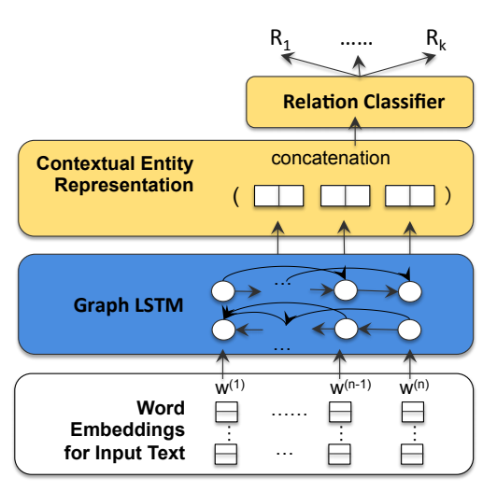
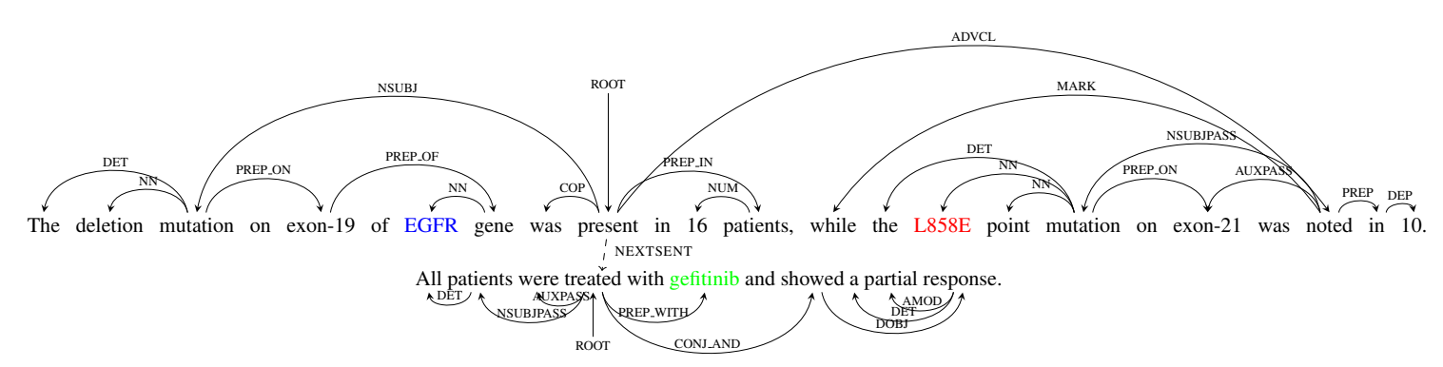
Graph-LSTM based Framework
Graph LSTM on Semantic Dependency
Advantage:
Can learn multi-sentential contextual representation
New Challenges:
Graph is unfriendly to backpropagation
How to parametrize edge types.
Notes:
说明一下这篇文章面对任务的局限性：实体标注用相关工具抽取（文中只说了检测出实体，不知道有没有标注类型），仅在有限范围内做关系推断。
把关系抽取转化为关系推断，也就是给定实体，做关系分类(Sec.2)。
关于concatenation这步怎么做的，作者没有在论文里详细说明，源码中是每个句子已经标注了实体，直接拼接到一起做预测

Slide 6
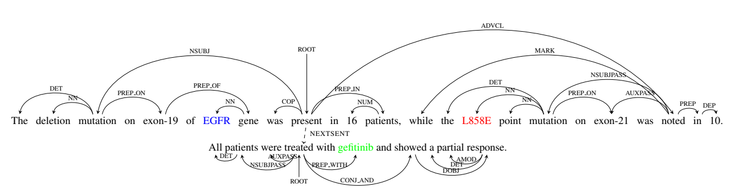
Document Graph
node: words
edges: dependencies
adjacent words
syntactic dependencies
discourse relations
Quirk, Chris, and Hoifung Poon. "Distant Supervision for Relation Extraction beyond the Sentence Boundary." Proceedings of the 15th Conference of the European Chapter of the Association for Computational Linguistics. 2017.
Notes:
discourse relations 表示的是句子段之间的关系，比如因果关系、转折关系

Slide 7
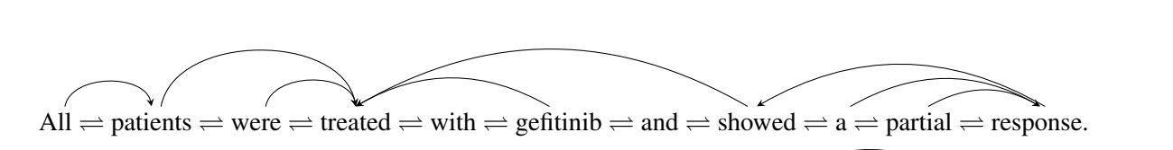
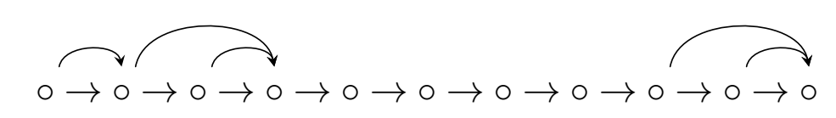
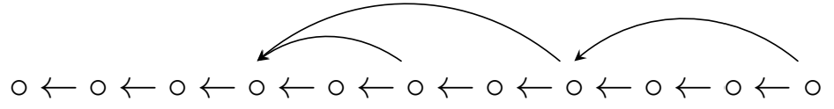
Propagation
Partition the document graph into two directed acyclic graphs (DAGs)
From left to right
From right to left
Notes:
反向传播存在问题

Slide 8
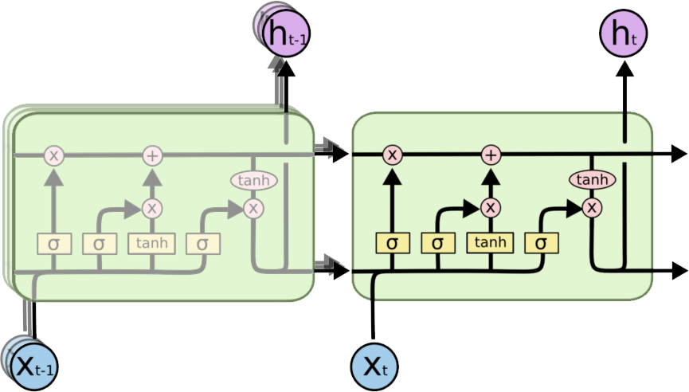
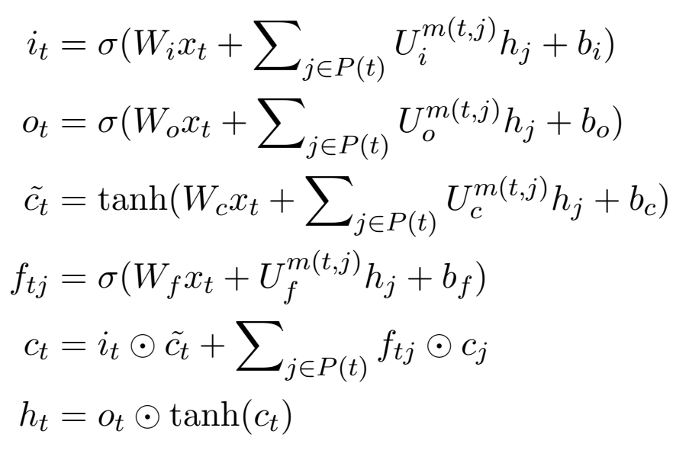
Propagation
Basic Recurrent Propagation Unit
Precedents of t
Notes:
每类前驱训练单独的input gate, output gate和forget gate，并通过sum up聚合各前驱的信息

Slide 9
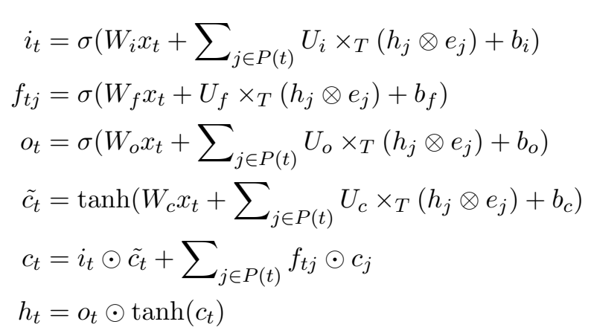
Edge-Type Embedding
Recurrent Propagation Unit with Edge-Type Embedding
Precedents of t
Notes:
为了避免对边的编码存在于门参数中使得参数数目过多，作者为每种类型的边建立了embedding，其首先和隐藏状态做外积并展开，再被门权重U通过做矩阵乘法消掉，得到一个向量。
边的embedding作者设置为3，这样原先门权重U的数目和边的类型数目挂钩，现在这样就只是普通全连接层的3倍。

Slide 10



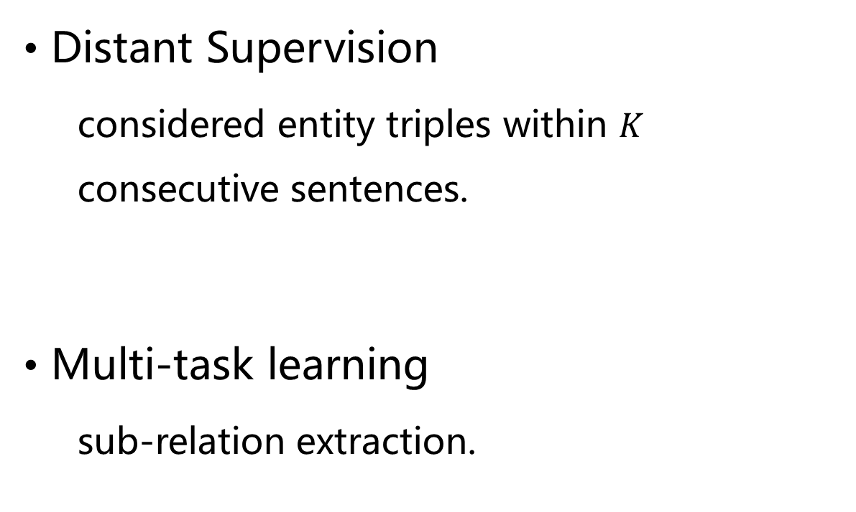


Training
Existing Knowledge Base
Distant Supervision
considered entity triples within $K$ consecutive sentences.
Multi-task learning
sub-relation extraction.
Labeled sentences
Unlabeled corpus
$$\left(drug,gene,mutation\right)$$
$$\left(drug,gene\right)$$
$$\left(drug,mutation\right)$$
Notes:
远程监督，基于两个在KG中有关系的实体出现在一句话中就认定这句话存在对应关系的假设，推广到多句话
多任务学习，也做子关系抽取（二元关系）

Slide 11
Experiments
Domains
Molecular Tumor Boards
Training data: biomedical literature from PubMed Central
Distant supervision: Gene Drug Knowledge Database and the Clinical Interpretations of Variants In Cancer
Genetic Pathways
Training data: GENIA Event Extraction dataset

Slide 12
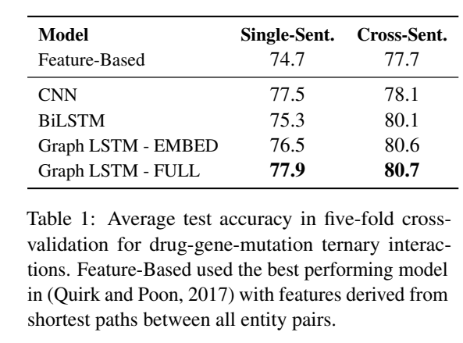
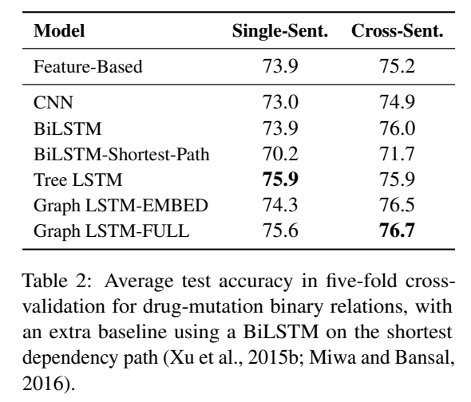
Experiments

Slide 13
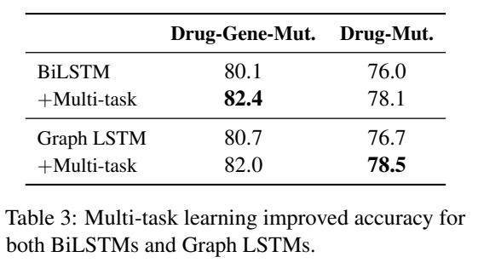
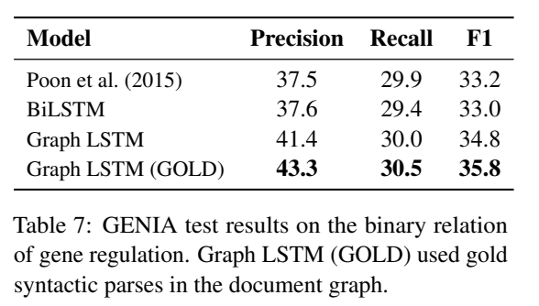
Experiments

Slide 14
Conclusion
Graph-LSTM subsumes linear-chain and tree LSTMs.
Graph-LSTM makes it easy to incorporate rich linguistic analysis.
Edge-Type parametrization and the partition of the Graph are further work.
Reduce the dependence on the quality of parsing is a further work.

